Slide 1
Indian Geography

Slide 2
Seasons of India
Winter
Summer
Monsoon

Slide 3
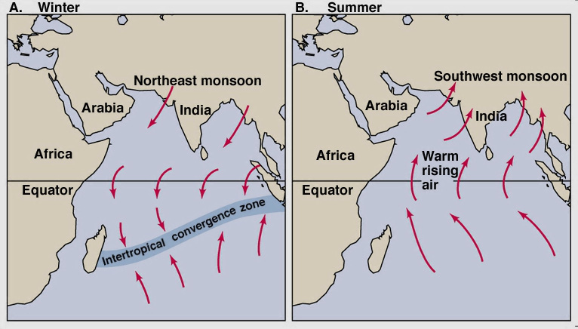
Monsoon
Unique weather phenomenon
“Mausam”= Seasonal reversal of winds
ITCZ

Slide 4
India Monsoon: unique features
Sudden Onset
Gradual retreat
Variation – regional and temporal
Gradual Advance

Slide 5
Indian Monsoon: mechanism
Tropical Easterly Jet
2nd equatorial trough
STWJ
El-Nino- IOD
Somali Jet

Slide 6
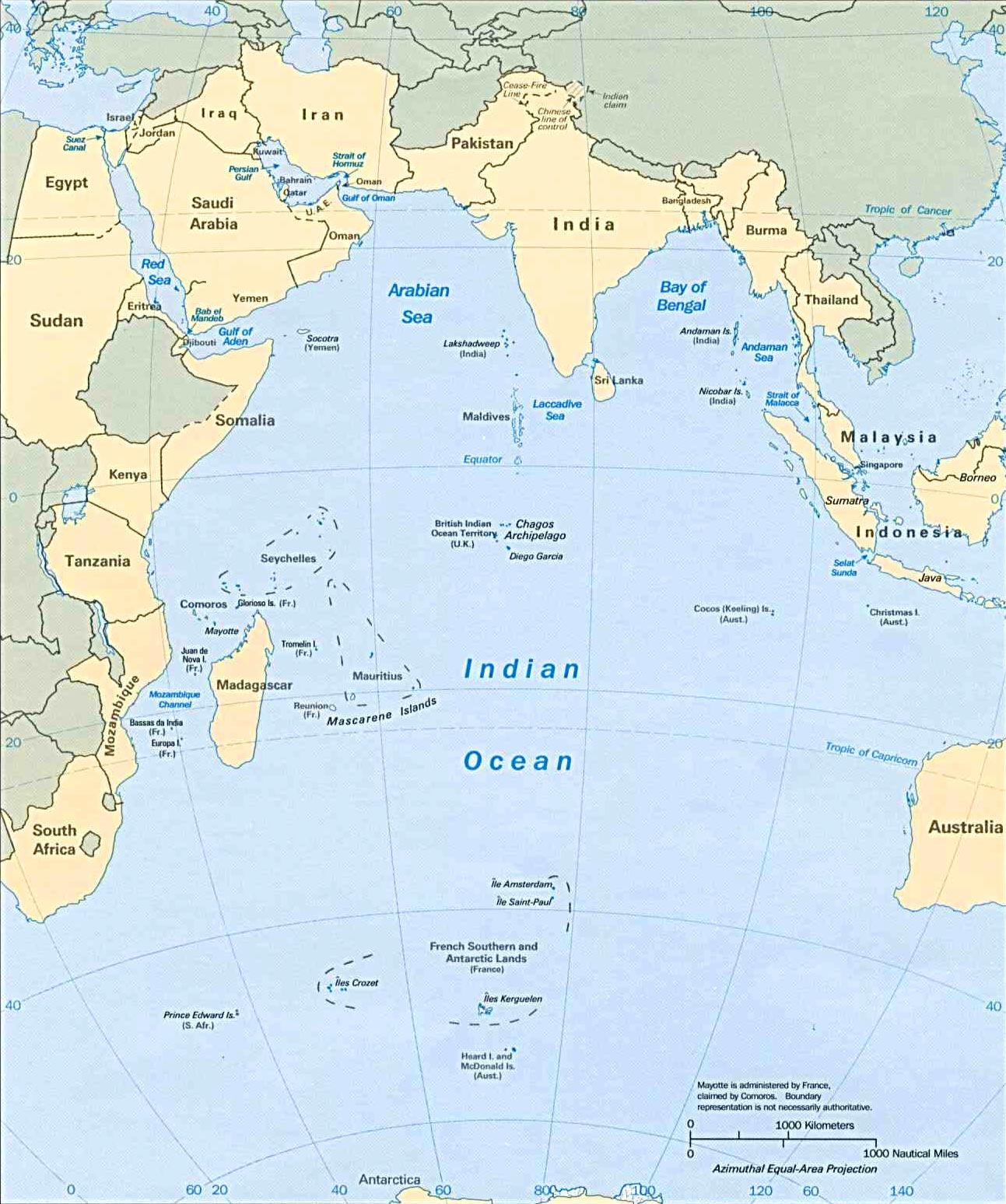
Tropical Easterly Jet (TEJ)
Northward movement of the sun in summer
Heating of Tibetan plt –LP
Rising of the air
Create TEJ above Tibet – move towards Mascarene High
Strengthen Mascarene High pressure cell
Tropical Easterly Jet
Tibet plt. LP
Mascerene High

Slide 7
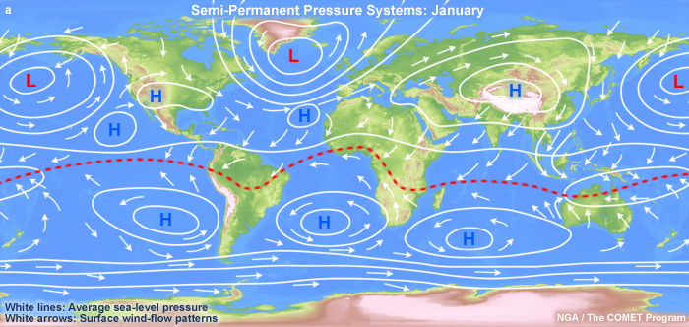
Pressure system on earth

Slide 8
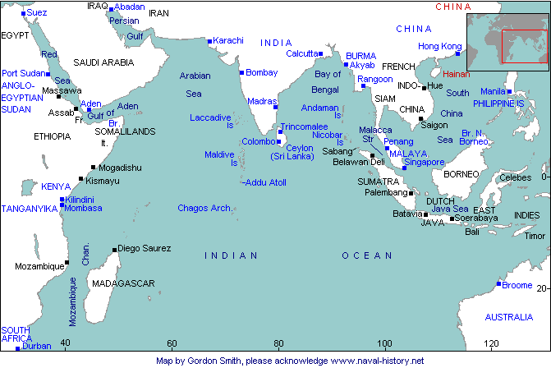
Second equatorial trough
Summer: northward movement of sun, northward movement of ITCZ
Sometimes, LP cells of ITCZ do not merge with ITCZ on movement of ITCZ
ITCZ
LP cell
LP cell

Slide 9
Second equatorial trough
When 2nd equatorial trough (LP cell of ITCZ) merges with main ITCZ – strengthen the LP of ITCZ
Attract more monsoon winds towards India
If not, then weak LP system over Tibet
ITCZ
LP cell
LP cell

Slide 10
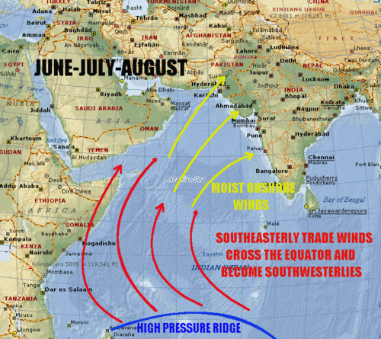
Somali current and Somali Jet stream
Somali jet stream – low level, appear only in summer
Intensify Somali ocean current
Somali jet stream pushes monsoon winds towards India
Stronger the Somali current, better d monsoon
Somali ocean current
Somali Jet stream/Findlater

Slide 11
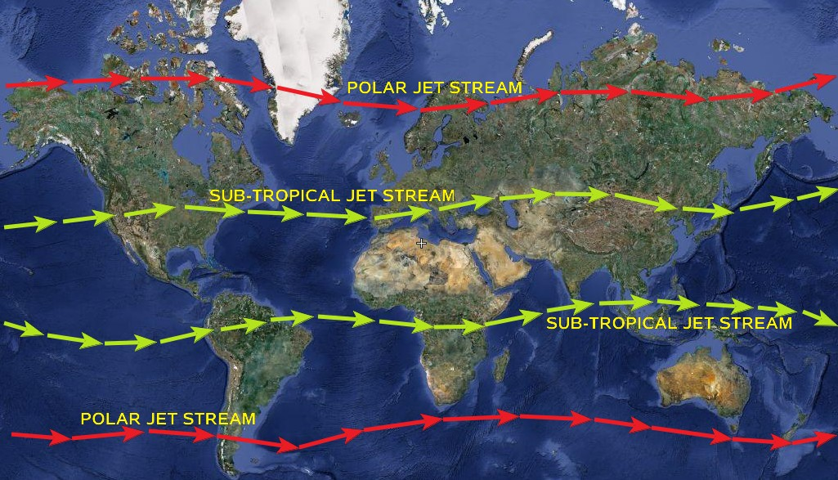
Permanent Jet stream in the world

Slide 12
Sub-Tropical Westerly Jet
Himalayas
Winter – entirely south of Himalayas – over north India
STWJ maintain the High pressure over north India
STWJ
HP
Himalayas
STWJ
HP
ITCZ
ITCZ

Slide 13
Sub-Tropical Westerly Jet
STWJ
Early summer – northward movement – bifurcation – southern branch still over northern India
HP conditions
STWJ
HP
STWJ

Slide 14
Sub-Tropical Westerly Jet
It resist monsoon winds towards India though land is warm enough
Even after development of ITCZ over Tibet, and merging of 2nd equatorial trough, monsoon winds can’t attract toward India
LP cell
HP
STWJ
LP cell

Slide 15
Sub-Tropical Westerly Jet
LP cell
Summer: STWJ entirely northward
Allow Onset of monsoon (sudden burst)
If southern branch re-establish- monsoon break
Himalayas
STWJ

Slide 16
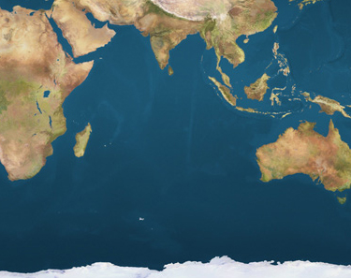
Indian Ocean Dipole
LP
Association of Western Pacific Pool with Mascarene High
Strong WPP- strong Mascarene High
LP
HP
Western pacific Pool
Mascarene High

Slide 17
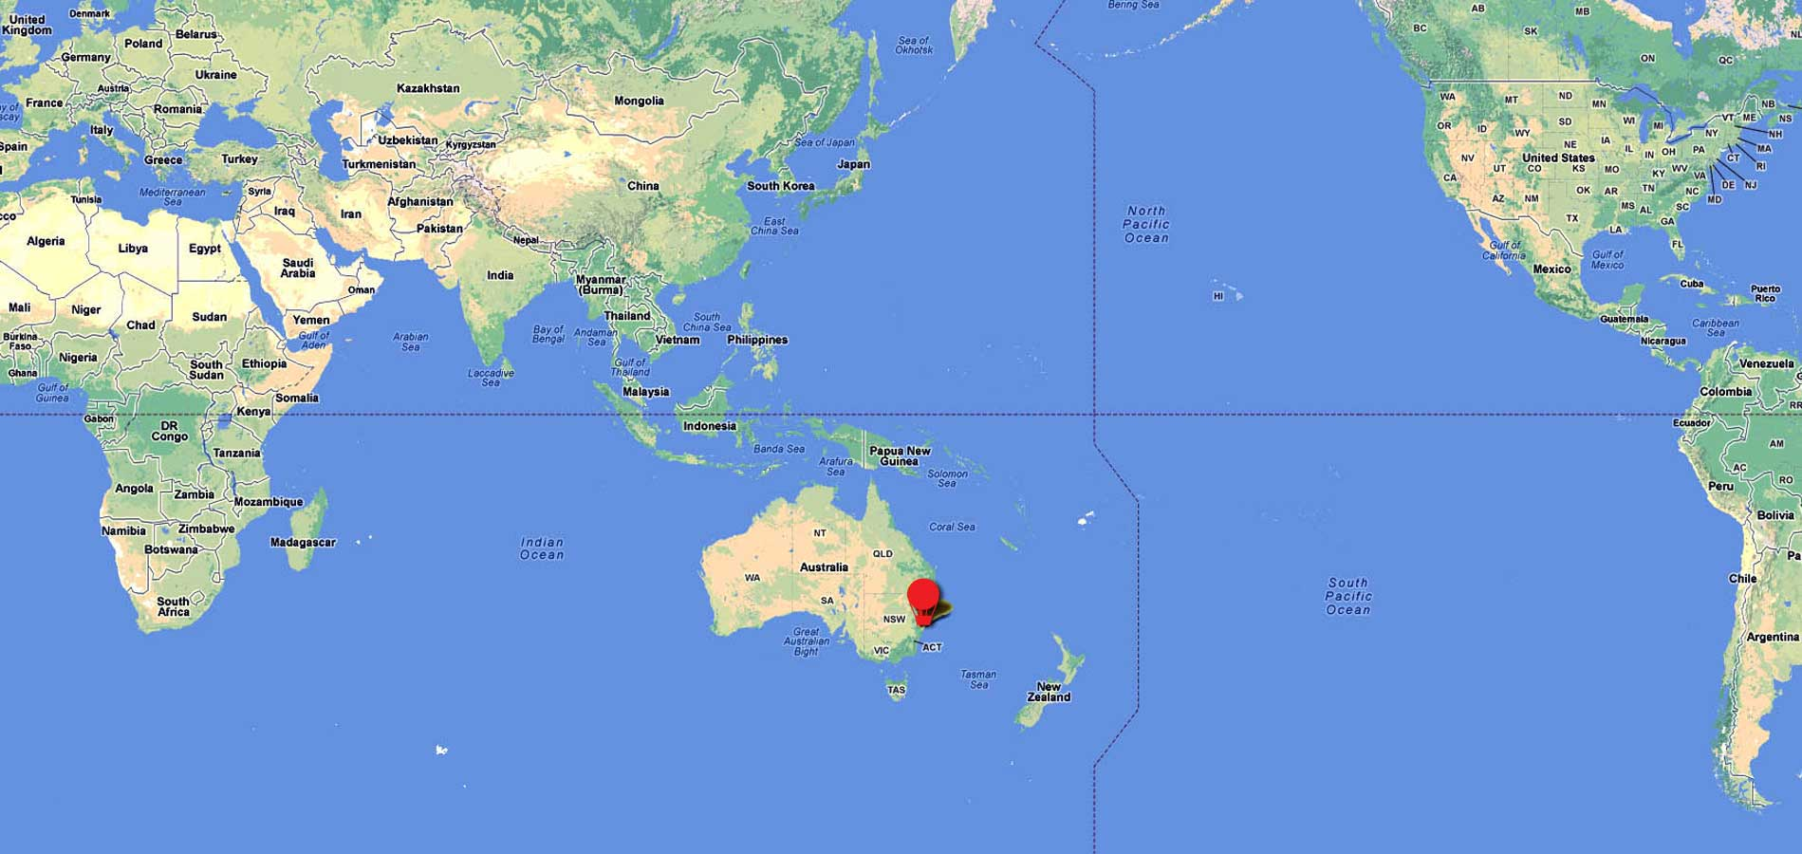
Indian Ocean Dipole
El-Nino year:
Weak WPP – weak Mascarene High
Low push to SW monsoon winds to move towards India
HP
HP
Western Pacific pool
LP
Mascarene High

Slide 18
Fluctuation in Monsoon
1) If ITCZ does not develop properly over Tibet
ITCZ

Slide 19
Fluctuation in Monsoon
ITCZ
2) If 2nd equatorial trough does not merge with ITCZ
LP cell
LP cell

Slide 20
Fluctuation in Monsoon
3) Southern branch of STWJ re-establish over north India
STWJ
HP
STWJ

Slide 21
Fluctuation in Monsoon
4) Inadequate heating of Tibetan plateau

Slide 22
Fluctuation in Monsoon
LP
5) Weak Mascarene High pressure cell
HP
Mascarene High

Slide 23
Fluctuation in Monsoon
6) Intensification of Indian ocean dipole/ El-Nino event
- If IOD intense= IOD negative – weak monsoon in India
HP
HP
LP

Slide 24
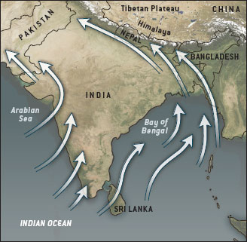
Monsoon
Burst of monsoon first on Malabar coast
2 branches:
Arabian branch
Bay of Bengal branch
Arabian branch
Bay of Bengal branch

Slide 25
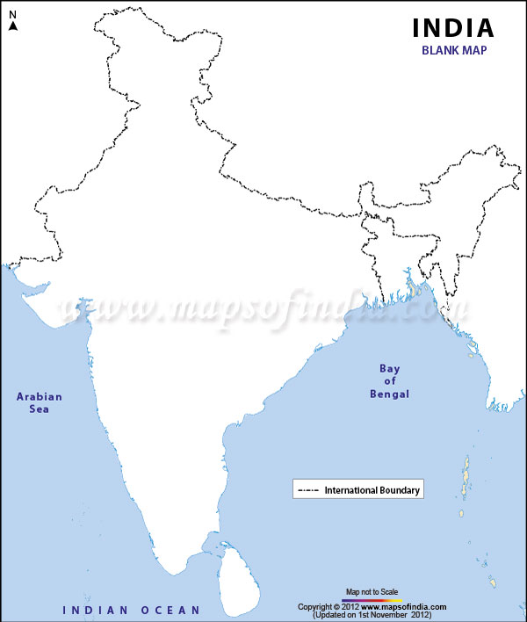
Monsoon: Arabian branch
Western Ghats blocks
Rainfall in windward side
South KN plateau, Rayalseema of AP remain dry
Western Ghats

Slide 26
Monsoon : Arabian branch
No effective barrier in Gujarat or Rajasthan
Aravalli parallel to the winds
Low rainfall in GJ-RJ
Rainfall along Kathiawar upland, south Aravalli
Aravalli

Slide 27
Monsoon : Arabian branch
Gaps between Western Ghats, river valleys – winds enter interior of India
Wind reach up to Himachal Pradesh-Punjab
Aravalli
Vindhyan
Satpura
Western Ghats

Slide 28
Monsoon: Bay of Bengal branch
Eastern Ghats – low, discontinued –cannot block
Large gaps, large river deltas – more winds can enter inland
Eastern Ghats

Slide 29
Monsoon: Bay of Bengal branch
Rainfall along chhotanagpur plateau, Vindhyan and Satpura range
Chhota nagpur plt
Vindhyan
Satpura
Eastern Ghats

Slide 30
Monsoon: Bay of Bengal branch
Purvanchal – Meghalaya plateau –
Funneling effect
high rainfall
Rainfall decrease from east to west
Most of the rain from eastern branch

Slide 31
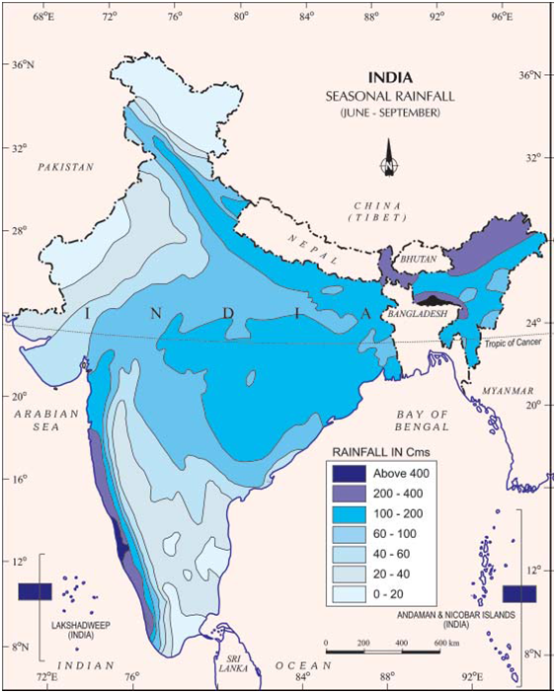
Rainfall pattern
India –avg rainfall = 120-180 cm = wetter
But rainfall variation is across regions and seasons
100 cm

Slide 32
Rainfall pattern
60 cm
Highest rainfall: western Ghats, North-east
Then East India
Then GJ-RJ and J&K
Then south KN- Rayalseema region
Thar and Kutchh deserts
60 cm
60 cm
100 cm
20 cm
200 cm
200 cm
100 cm
60 cm
200 cm

Slide 33
Retreating Monsoon
Northern Trade winds
Southward movement of ITCZ
SW monsoon winds and NE winds co-exist
Gradual withdrawal of SW monsoon winds – first eastern then western branch
Northern Trade winds
ITCZ
ITCZ
Southern Trade winds
Southern Trade winds

Slide 34
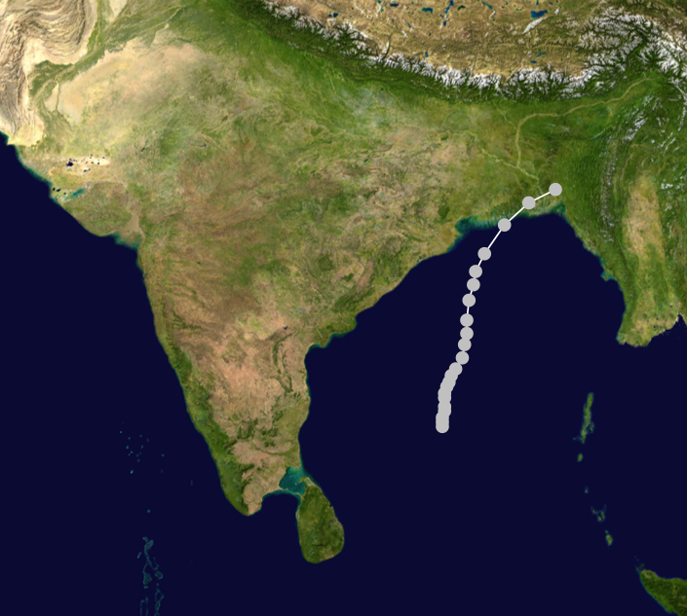
Retreating Monsoon: tropical cyclone
Increase in SST of Bay of Bengal and Arabian sea
Possibility of Tropical cyclone
Retreating SW monsoon branch drag them towards Eastern coast
ITCZ

Slide 35
Winter
NE winds – coming from land – dry winds
But passing through Bay of Bengal- become moist
Coastline of TN
Rainfall in TN
NE winds
North East Trade winds

Slide 36
Winter
STWJ from Mediterranean sea
Brings disturbances to north India
Winter rainfall – western disturbances
Himalayas
STWJ
ITCZ

Slide 37
Summer
Northward apparent movement of Sun
Temperature increases
LP but resisted by STWJ
Local heating convectional rainfall
Pre-monsoon thunder storm
Kalbaishakhi (WB), Mango shower, Blossom shower
STWJ
HP
ITCZ

Slide 38
Geological history of India
Soils of India
Physiography of India
Climatic regions of India
Indian weather: seasons

Slide 39
Physiography of India:
Plateaus and coastal plains of India
Indian rivers: Himalayan and peninsular rivers
Indian seasons:
Monsoon
Winter
summer

