Slide 2
Geological history of India
Soils of India
Physiography of India
Climatic regions of India
Indian weather: seasons

Slide 3
Soil
Soil Formation
Soil Profile
Soil Erosion - conservation
Soil-Salinity & conservation

Slide 4
Soil
Desertification & Prevention
Soils of India
Land Use-Pattern in India

Slide 5
Soil- forming factors
Rock
Climate
Relief
Biota
Time

Slide 6
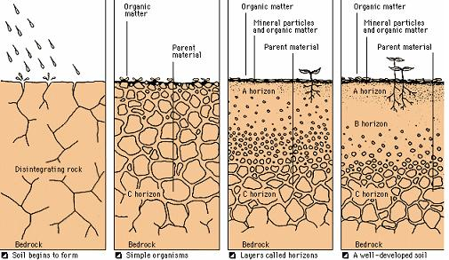
Soil- forming factors: rocks
Soil made up of erosion of parent rock
It provides soil minerals, texture, structure, pH value, porosity
Soft rocks – better soil formation than hard rocks

Slide 7
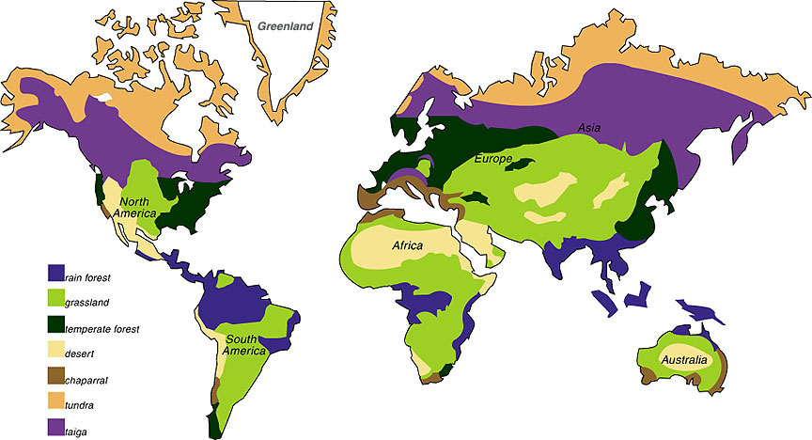
Soil- forming factors: Climate
Climate: temp + rainfall
Agent of erosion
Dry region – wind
Wet region –water
Cold region – glacier
Climate affect the type of erosion + intensity of erosion

Slide 8
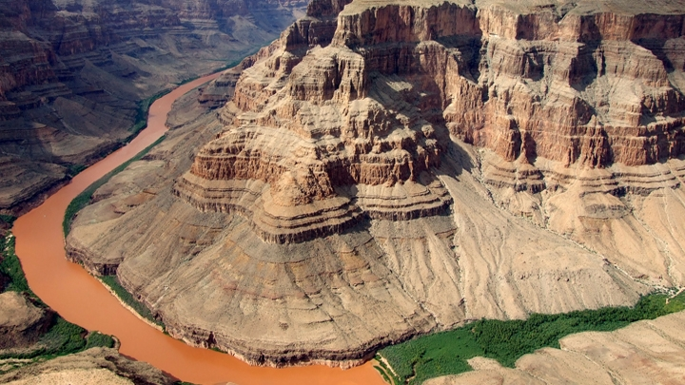
Soil- forming factors: Relief
Relief control the climate and type of forest
Steep gradient = thin, under developed soil
Plain (low gradient) = thick, well developed soil

Slide 9
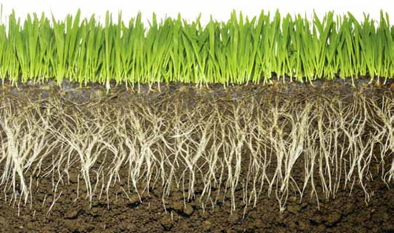
Soil- forming factors: Biota
Micro-organism help in enrichment of soil
Roots of vegetation – agent of weathering
Humus content from vegetation provide nutrients to soil

Slide 10

Soil- forming factors: Time
Soil-formation long-term process
All the factors need time to form the soil
After weathering – time decides maturity of soil

Slide 11
Transportation in soil
Capillary
Upward movement of minerals
leaching
Downward movement of minerals
Hot and dry climate
Humid condition

Slide 12
Chemical Processes within soil
Leaching
(Humid)
Hot-humid
Latosol
Cold-humid
Podzol

Slide 13
Chemical Processes within soil
Capillary
Gleying
Leaching
Latosol
Podzol
Soil processes

Slide 14
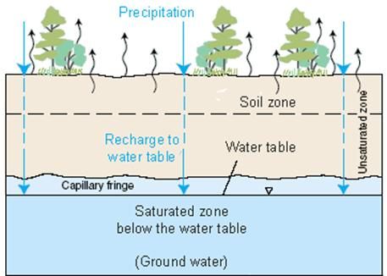
Chemical Processes of soil: capillary
In hot and dry climate
Evaporation is faster
Salts within the soil come at the upper layer
Calcium salts
Soil salinity

Slide 15
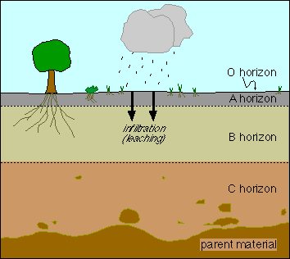
Chemical Processes of soil: Leaching
In hot and humid climate
Heavy rainfall
Silica within soil move downward – but Iron and aluminum remain at upper layer
Acidic and reddish soil
Lateritic soil
Iron + Al
Silica

Slide 16
Chemical Processes of soil: Leaching
In cold and humid climate
Iron and Aluminum move downward and silica remain at upper layer
Gray in colour
Podzoilic soil
Low fertility
Silica
Iron + Al

Slide 17
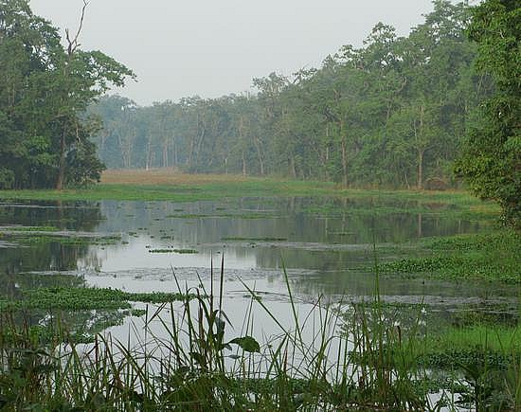
Chemical Processes of soil: Gleying
In swampy – peat soils
Terai, Mangrove region
Bluish in colour
Excessive Potassium salts

Slide 18
Soil
Soil Formation
Soil Profile
Soil Erosion - conservation
Soil-Salination & conservation

Slide 19
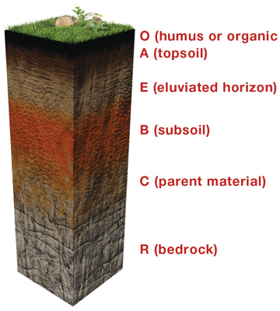
Soil Profile
Soil have different layers with different physical and chemical properties
Management of soil horizons important for soil conservation

Slide 20
Soil Profile
Horizons of soil:
O = organic dust, leaves, litter
A= top soil with nutrients
E = transition zone
B = sub-soil
C = weathered rock material

Slide 21
Soil Profile
C = parent rock
O and R not part of functional soil
Soil erosion = loss of top soil (A and E)
B cannot support plant life
Extreme soil erosion = loss of B also

Slide 22
Leaching
capillary
A layer is leached
B layer enriched
Latosol A (Al, iron), B (Silica)
Podzol A (silica), B (Al, iron)
A layer is enriched
A layer will have Calcium, or Sodium salts

