Slide 2
Indian Geography
Economic geography of India

Slide 3
Agriculture
Mines and minerals

Slide 4
Mines and Minerals
Mines
Industries

Slide 5
Metallic & Non-metallic minerals
Iron
Manganese
Copper
Mica
Chromite

Slide 6
energy minerals
Coal
Petroleum
Thorium
Uranium

Slide 7
Minerals and Physiography of India
Shield regions
Chhotanagpur plt
Dharwad
Rift valley- Gondwana time
Damodar valley
Mahanadi valley
Marine Transgression
G. Of Khambhat
G. Of Kutchh

Slide 8
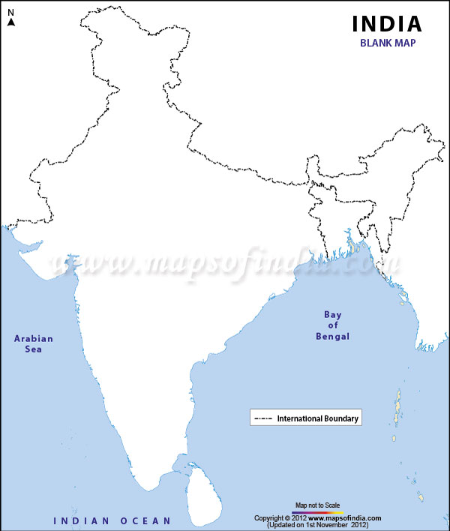
Shield regions
Metallic minerals
Aravalli
Chhota Nagpur plateau
Singhbhum
Dhrawad
Dharwad plateau

Slide 9
Rift valley: Gondwana time
Coal reserve
Son
Narmada
Damodar
Mahanadi
Godavari

Slide 10
Tertiary time: Marine Transgression
Brahmaputra-shilling shelf
Bengal-Bangladesh shelf
KG basin
Saurashtra Shelf

Slide 11

Marine Transgression
Petroleum reserve

Slide 12
Mineral regions
Peninsular uplands
Bauxite
Himalayan region
Anthracite coal
limestone
Coastal areas
salt
Thorium

Slide 13
Minerals in Himalayan region
Himalayan region
Assam
HP
Ladakh
Lignite coal
Rock salt
Geo-thermal energy

Slide 14
5 mineral rich regions
Northern belt
Central belt
Southern region
SW region
NW region
5
1
2
3
4

Slide 15
Northern Belt
1) Chhotanagpur plateau
Kynite (100%), Iron (90%), Chromium (90%), Mica (75%), coal (70%)
Manganese, copper, limestone
2) Assam petroleum reserve
Lignite coal

Slide 16
Central Belt
Chhattisgarh region -Extension of Chhota nagpur plateau
Iron, limestone in Chhattisgarh
Godavari- Wardha valley –coal field

Slide 17
South- East region
East KN: Bellary-hospet region- iron
AP: Cuddapah, Kurnool
Nellore (AP) – mica, Manganese, lignite coal
Telangana: Bauxite
TN: Neyveli – lignite coal

Slide 18
South- West region
KN: Dharwad
Shimoga, chitradurg, Tumkur, Chikmaglur
Iron, Manganese, limestone
Goa: iron
MH: Ratnagiri - iron

Slide 19
NW region
GJ and RJ
Petroleum
Salt from kutchh and pyala lake of RJ
Lake Sambhar, Lake Didwana – Gypsum, Borax

Slide 20
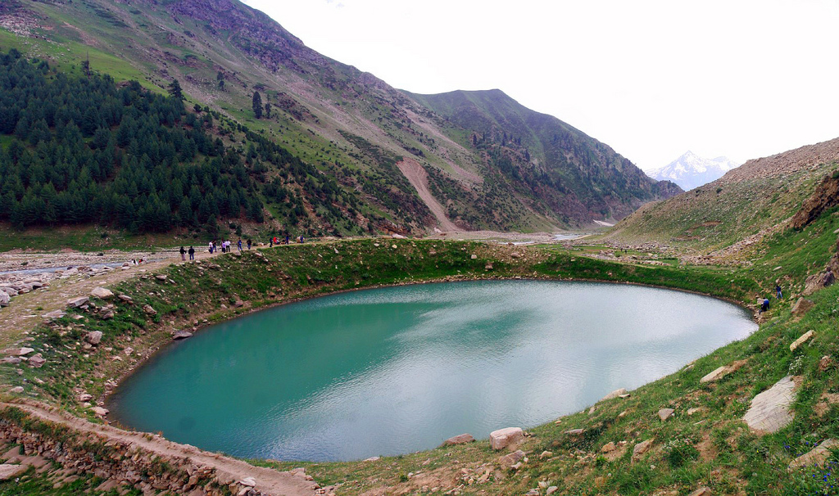
Pyala lake
Depression in deserts –filed with water occasionally
Water evaporate – salts remain
Deposition of salts and minerals

Slide 21
Metallic & Non-metallic minerals
Iron
Manganese
Copper
Mica
Chromite

Slide 22
Types of Iron ore
Hematite
iron & steel industries
Limonite
Pigment for manufacturer of paints
Siderite
Source of Manganese and Magnesium
Magnetite
Electronic industries

Slide 23
Iron-ore
India’s iron ore mostly – Hematite
India -2nd largest producer of hematite after Russia
Magnetite – Russia largest producer
China – Hematite, Limonite

Slide 24
Iron Reserve
State | Mineral rich regions / mines
Jharkhand | Hazaribaug (Lohardaga) Singhbhum [Noamundi, Kariburi, Mahaburi, Gua] Daltongunj
Odisha | Bonai Sukinda, Badampahar, Gurumahisani
KN | Shimoga, Chitradurg, Chikmaglur, Tumkur Kemangundi and Kudremukh mines
Chhatisgarh | Dalli rajhara (to Bhilai steel plant) Bailadila (to Vishakhapatnam steel industries)
MH | Ratnagiri
AP | Kurnool, Anantpur

Slide 25
Manganese Reserve
State | Mineral rich region
Jharkhand | All the iron region Biggest mine: Chaibasa
MP | Balaghat

Slide 26
Copper
State | Mineral rich regions
Jharkhand | Raka mines Mosabani mines
AP | Kurnool, Guntur, Nellore
HP | Kangra valley, Kullu valley
WB | Jalpaiguri, Darjeeling

Slide 27
Bauxite
State | Mineral rich regions
Jharkhand | Garhjat hills
Odisha | Panchampatmali hills, Niyam giri, Gandhmardhan hills
MP | Balaghat, Amarkantak
MH | Ratnagiri
GJ | Kheda, Amreli

Slide 28
Mica
states | Mineral rich regions
Odisha | Kodarma (largest in the world)
AP | Nellore
Bihar | Munger
KR | Alleppey

Slide 29
Limestone
states | Mineral rich regions
MP | Birmitrapur, Amarkantak
KN | Shimoga
MH | Satara

Slide 30
Chromite
states | Mineral rich regions
Odisha | Sukinda Largest reserve
KN | Shimoga
MH | Ratnagiri

