Slide 1
Indian Geography

Slide 2
Energy Resources
Coal
Petroleum
Thorium
Uranium

Slide 3
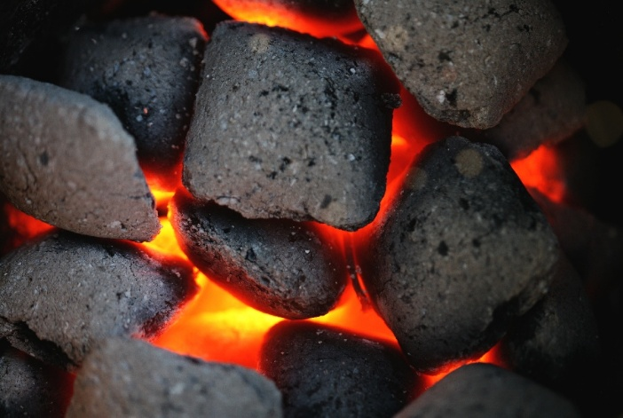
Indian coal
Minerals
Gondwana formation (later than Carboniferous time)
Inferior
Cocking coal… X
Metallurgical coal…X
Important for electricity generation
Volatile, Sulphur + moisture is high
Calorific value is low

Slide 4
Coal: Bituminous
States | Mineral rich regions
Jharkhand | Damodar valley [Bokaro, Jharia, Dhanbad, Giridih, Daltonganj]
WB | Extension of Damodar valley (raniganj and Barakar formation) Birbhum, Darjeeling (Pankhwali coal field, Darlin coalfield) Burdwan, Bankura
Odisha | Mahanadi basin Talcher valley (Talcher thermal plant)
Chhatisgarh | Narmada, Son rift valley
MP | Chindwara Jhilmil (cocking coal to Bhilai steel plant)
AP | Singreni coal field (Ramadugam Thermal plant) Kotagudam coal field
MH | Nagpur-kampti coal field

Slide 5
Coal: Lignite
states | Mineral rich regions
Assam | Makum
TN | Neyvelli
RJ | Palana
GJ | Umarsar (Kutchh)

Slide 6
Coal: Anthracite & Peat
states | Mineral rich regions
Anthracite
J&K | Kalakot
Peat
KR | Mangrove-Karee soil
WB | Gangetic Delta

Slide 7
Problems of Indian coal
Minerals
Not enough high grade cocking coal – depend on import
Good and low grade coal found together – selective mining = wasteful
Washing, dressing, blending, briquetting of inferior coal needed
Washing – lower down ash content – waste removed – low weight – transportation cost reduced

Slide 8
Problems of Indian coal
Minerals
Open-caste mining – smuggling, air pollution
Illegal mining – ecologically dangerous
Deep mining techniques primitive = high casualty
Coal field contains Coal Bed Methane
CBM policy for exploration and production in 1997

Slide 9
Problems of Indian coal
Minerals
Policy does not allow simultaneous exploration of coal and CBM
CBM exploration and production allowed only in pure seam gas bearing blocks
CBM blocks and coal blocks are separately auctioned by the govt.
Coal mines with Methane are dangerous for coal mining – allowed to escape= wasteful

Slide 10
Problems of Indian coal
Minerals
Poor connectivity from mines to consumer locations
Efficiency of Indian coal mining is very low – lack of tech + equipment
Output per man shift = India(3), world avg. (7)
Coal import is increasing despite large reserve

Slide 11
Underground coal- Gassification
Underground coal gasification is a method to extract gas from deep, unrecoverable coal reserves, where manual (labour) mining is impossible or costly.
They dig two wells
injection well: water+ oxygen+ gasification agent pumped from here
production well: synthetic gas (syngas) comes out from here

Slide 12
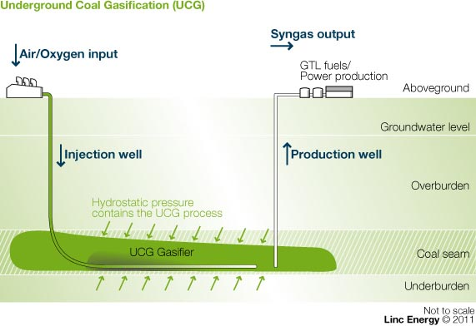
Syngas
Water, Oxygen
Gasification agent
Deep, unrecoverable coal reserve
Notes:
Technique- very deep and unrecoverable coal reserve
Exploration and gasification of coal simultaneously
similar technique = outside the mine
pressure at the depth = the surface gasification site
2 wells underground coal seam
one well- inject air/oxygen into coal seam
The oxygen synthesis with the gas => syngas
Second well extract the syngas

Slide 13
Underground coal- Gasification: Benefits
Syngas can be used in generating electricity, manufacturing of hydrogen & fertilizers.
Sulphur, mercury, arsenic, tar, ash etc. by-products remain underground = less pollution.
needs less water than conventional mining and hydraulic fracking

Slide 14
Energy minerals
Coal
Petroleum
Thorium
Uranium

Slide 15
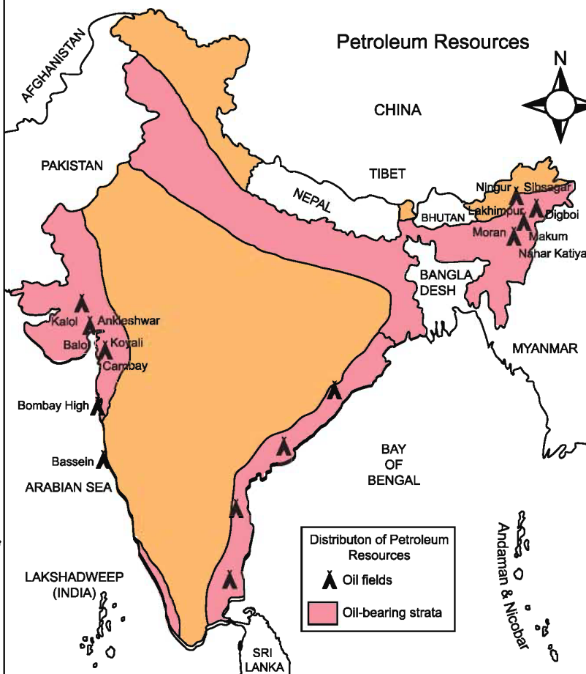
Petroleum Reserves
Saurashtra region (GJ, RJ, gulf of Khambhat, Off-shore Mumbai)
Upper Assam-Shillong shelf
Cuttak shelf
KG Basin

Slide 16
Petroleum
states | Mineral rich regions | Refineries
Assam | Digboi, Neharkatia, Sibsanagar, Dibrugarh | Digboi, Noonmati, Barauni, Bongaigaon
GJ | On-shore: Kheda, Mehsana Off-shore: Gandhar oil filed Aliya bet | Sanand refinery Hazira, Koyali refianries
RJ | Barmer (by Cairns)

Slide 17
Petroleum
States | Mineral rich regions
MH | Nilam oil field (Bombay High) – 60% of India’s production South Bassain (larger reserve than Nilam)
KG Basin | Rawa oil field (By Reliance and Niko) Off-shore Kaveri basin- Narimanam oil field

Slide 18
New Petroleum exploration
Cairn Energy, which bought a block in Rajasthan in 2002 and soon struck oil. The find in Barmer was far from the sea. The crude is waxy, and difficult to transport.
Now it is planning to lay a heated pipeline to Salaya and export the crude.
Reliance extracting oil in Krishna-Godavari basin offshore, found gas as well.

Slide 19
Petroleum refining industry
One of the 8 core industries of India
India import crude oil
1st refinery in India: Digboi in Assam
2nd Tarapur, in 1954
India exports refined petroleum products 10% of the production

Slide 20
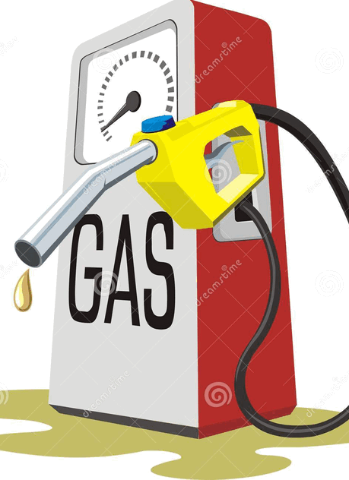
REFINARIES
Petroleum
Public sector | 17
Private | 3
JV | 2
Total | 22

Slide 21
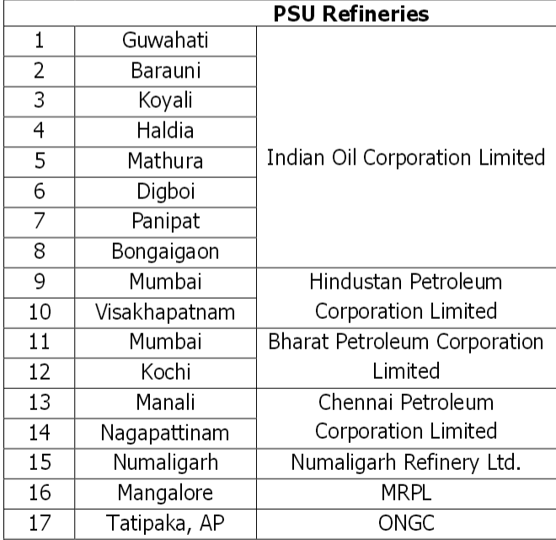
PSU (17)
Petroleum

Slide 22
Private (3)
Refinaries
Reliance
Jamnagar, GJ
Yanam, Puducherry
Essar
Vadinar, GJ
Cairn
Amalpuram, AP

Slide 23
JV (2)
Refinaries
Bina (MP): Bharat + Oman
Bathinda: HPCL + Mittal

Slide 24
Find correct statements
India's refining capacity exceeds demand.
India has only 3 private sector refineries
Both A and B
Neither A nor B
Ans. C Both correct

Slide 25
Oil Production
Challenges
Oil from ageing fields, except KG & RJ
Digboi refinery = 1st oil well of India. ~Lowest output in world.
Refinery -not upgraded, shortage of man, crude oil, finance
Challenges: environmental issues, bandhs/blockades
OVL get more assets abroad

Slide 26
Natural gas
Sedimentary rocks in which hydrocarbons are trapped often hold gas, sometimes in association with crude oil and sometimes alone.
It consists mostly of methane, which is lighter than air and toxic. It therefore requires airtight tanks for storage and similarly leak-proof pipes or trucks for transport, which raise its capital costs.
Natural gas occupies 4 times the space of a gasoline-equivalent energy

Slide 27
Natural Gas in India
In India natural gas found along with Oil reserve
India does not have exclusive natural gas reserve
Not enough natural gas reserve
Sometimes, Natural gas re-injected into the oilfield to maintain pressure which forces oil up to the surface

Slide 28
Sources of Natural gas for India
Production in India | Import from other countries
Bombay High | Qatar (>80%)
Gujarat | Egypt
Assam | Oman
KG basin | Australia
Kaveri Basin | Saudi Arabia

Slide 29
LNG Terminals
Natural gas is liquefied (LNG) then transported to long distances
Liquefaction plant at exporting country and re-gasification plant at importing country
India 5 existing such LNG terminals:
Dahej by Petronet
Hazira by Shell
Kochi by Petronet

Slide 30
LNG Terminals
4) Ratnagiri Gas and Power Pvt. Ltd., (Dabhol) MH by GAIL + NTPC
Terminals at Dabhol and Kochi – partially operational
Absence of pipeline- from source to consumers

Slide 31
5th LNG terminal at Kakinada, AP
2 major LNG terminals under process
By a consortium of Shell, Reliance and the KSPL (Kakinada Sea port ltd.)
By AP Gas Distribution Corporation Limited (a joint venture of Gail Gas and AP Gas Infrastructure Corporation) and KSPL

Slide 32
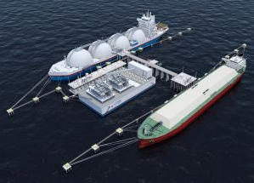
5th LNG terminal at Kakinada, AP
3) floating storage and Regasification unit (Shell, Andhra Pradesh Gas Distribution Corporation (APGDC), GDF Suez)
1st of such kind in India

Slide 33
Proposed new LNG terminals:
Mundra (GJ) by GSPC – gas from Australia and Egypt
Pipavav port (GJ)
Ennor (TN) by OIL
Manglore (KN) by ONGC-BPCL
Paradip (Odisha) GAIL dropped plan for floating terminal at Kakinada
Gangawaram, AP, Petronet

Slide 34
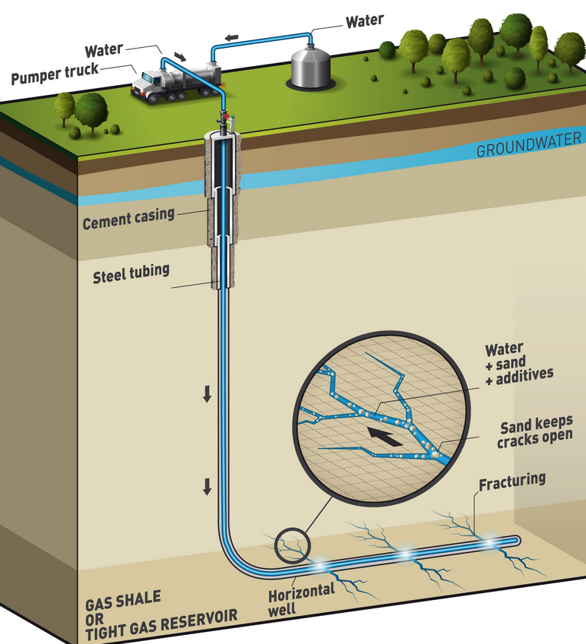
Basin centered Gas
one type of unconventional gas
also called “tight gas sands”
In the deeper parts of sedimentary basin.

Slide 35
Basin centered Gas
Their Reservoir has no Nature fractures, have to use hydraulic fracturing technique to extract gas.
technique employed to extract gas from reservoirs without natural fractures

Slide 36
Basin centered Gas
drilling=> special fluid pumped
fluid contains water + sand + chemicals
This pumping creates fractures in the basin.
Gas migrates into the well.

Slide 37
Basin centered Gas
15% of US Gas production via Hydraulic fracturing technique
India doing trials since 2010

Slide 38
Pipelines in India
Gas requires an expensive transport network in the form of pipelines
Self study: Domestic pipelines network: chap energy resources; D.R. Khullar

Slide 39
Cross-border Pipelines
TAPI
IPI
Russia-India

Slide 40
TAPI pipeline: detail
Pipeline project | Supply of oil | period | Operational from | distribution
TAPI | 90 ml std cm/day | for 30 years | 2018 | India= 38 Pakistan =38 Afghanistan = 14

Slide 41
Route of TAPI
Turkmenistan's Galkynysh field
Herat, Afg
Kandahar, Afg
Quetta, Pak
Multan, Pak
Fazilka, PN, India

Slide 42
TAPI pipeline: challenges
Passing from politically fragile region – Afghanistan and Pakistan -Security issues
TAPI nations have not been able to get an international firm to head a consortium, which will lay and operate the pipeline.
International firm to construct cross-border pipeline and operate in hostile condition of Afghan-pak region

Slide 43
TAPI pipeline : challenges
French co. Total SA had showed interest in leading a consortium of national oil companies of the 4 nations.
However, it backed off after Turkmenistan refused to accept its condition of a stake in the gas field that will feed the pipeline
Turkmenistan -law does not provide for giving foreign firms an equity stake in gas field, without which western energy giants will not be interested to take the risk.

Slide 44
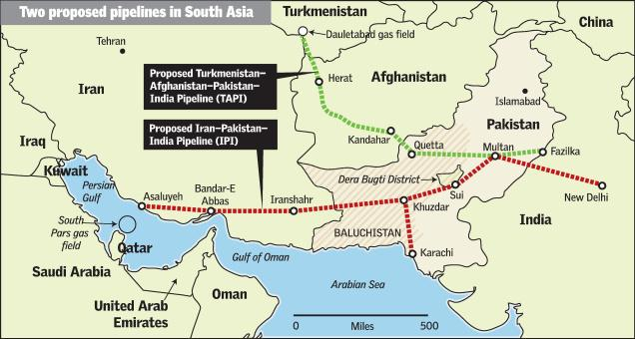
TAPI and IPI

Slide 45
IPI Pipeline: challenges
The pipeline faced setbacks due to sanctions put by USA on Iran
The agreement between Pak and Iran in 2009
Iran has constructed the pipeline on its part, while Pakistan could not due to lack of funds
Iran has given loan to Pakistan to build the pipeline on its part

Slide 46
IPI Pipeline: challenges
But in 2013, Iran cancelled the $500 bl loan to Pakistan –sanctions on Iran, due to which Iran itself facing resource crunch
Pakistan will have to pay penalty - $ 3 ml/day if pipeline not constructed on time
Saudi Arabia reservation against Iran-Pakistan pipeline

Slide 47
India and IPI
Pipeline passes through disturbed region of Pakistan- Baluchistan.
So, during hostile situation Pakistan can cut-off the supply to India, even Pakistan’s, militant forces can also disrupt the supply anytime.

Slide 48
Deep sea pipeline: Iran-India
India is planning of an under-sea gas pipeline from Iran to Indian coast
India have started talks with Iran and Oman for under-sea gas pipeline
The pipeline is technically and economically viable.
The construction of pipeline can be started only after sanctions against Iran are lifted
The pipeline expected to carry 31 million cubic meter of gas per day

Slide 49
Russia-India pipeline
Natural gas pipeline
2 proposed routes:
from Russia’s southern border to India via the Himalayas
from Russia - Astrakhan - Khazakstan — Uzbekistan and then along the Turkmenistan-Afghanistan-Pakistan route to India (TAPI gas pipeline).

Slide 50
Energy security
India = 2.4% of annual world energy production but consumes 3.4% of annual world energy production
Future concern:
Growing population, urbanization, Make in India campaign – energy security is necessary

Slide 51
Energy security: domestic challenges
Need Full exploration of India’s sedimentary basin
Need to Build Strategic reserve
Problem of high transmission and distribution losses
Untapped renewable resources (30% of its potential)

Slide 52
Energy security: global challenges
India relied on import for 75-80% of its demand
West Asia – political fragile region
Need diversification of sources
Need acquisition of foreign oil fields by state oil companies

Slide 53
Petroleum assets abroad
OVL
ONGC Videsh Ltd
from Sudan, Vietnam, Venezuela, Brazil, Russia, Syria, South Sudan, and Colombia
Geopolitical problem: S. Sudan, Syria = Lower production

Slide 54
Energy security: global challenges
Shale gas discovery in USA – slow down the research in renewable energy
Developed nations not willing to transfer green technology or advanced efficient technology to other nations

Slide 55
Kelkar panel on energy security (2013)
Enhance domestic oil and gas production
Lower down the import dependence by 2030
Devise roadmap for deregulation of retail oil and gas
Utilize oil industry development board cess

Slide 56
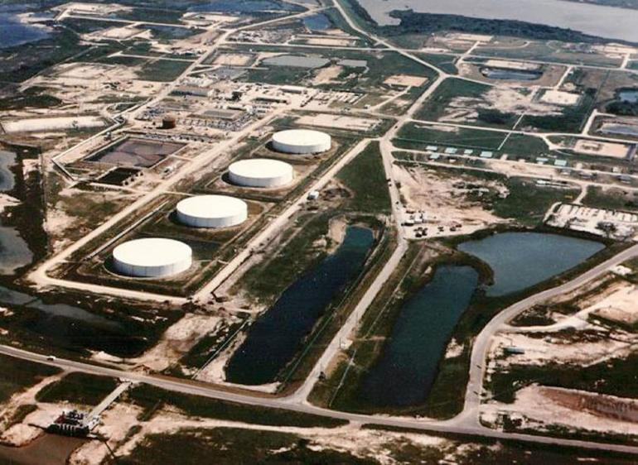
Strategic reserve of crude oil
2004 – Mangaluru and Padur in East coast and Vishakhapatnam in west coast
5 ml ton
To cover 2 weeks’ requirements
SPV- Indian Strategic Petroleum Reserve (ISPR) formed

Slide 57
Strategic Reserve of crude oil
2015:
Vishakhapatnam (AP)
Bikaner (RJ)
Rajkot (GJ)
Padur (KN)
Chandikhole (Odisha)
Total 12.5 ml ton
Cover 90 days requirement

Slide 58
Innovation in Strategic reserve of Crude oil
Iran – large crude carriers = floating storage (20-25 ml ton on tankers)
Storage capacity can be leased out to few of oil producing nations
Special cess or small import duty can be levied to fund the storage
US strategic reserve = 727 ml ton
China strategic reserve = 170 ml ton

Slide 59
UPSC
Question
Q. Consider the following statements
Natural gas occur in Gondwana beds
Mica occurs in abundance in Kodarma
Dharwad is famous for petroleum
Which of the above statements is/are correct?
Prelims
2013

Slide 60
UPSC
Question
1 and 2
2 only
2 and 3
None
Ans.
b)
Prelims
2013

