Slide 1
Indian Geography

Slide 2
energy minerals
Coal
Petroleum
Thorium
Uranium

Slide 3
Uranium
states | Mineral rich regions
Jharkhand | Jadughoda, Bhatin, Narwapahar, Turamdih
Meghalaya | Domiasiat, Wahkyn
AP | Tumallapalle (Nalgonda) Lambapur- peddagattu
KN | Gogi
RJ | Rohil

Slide 4
Uranium Processing
Uranium corp. of India ltd. (UCIL)– extract uranium and process Uranium -> yellow cake (Magnesium diurnate)
Yellow cake then sent to Nuclear Fuel Complex (Hyderabad) for fuel fabrication (make Uranium dioxide)
NFC sends fuel to all nuclear reactors of India

Slide 5
Nuclear Energy : mechanism
Fission
Fusion

Slide 6
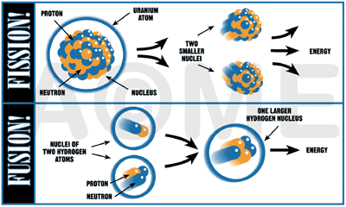
Fission and fusion process

Slide 7
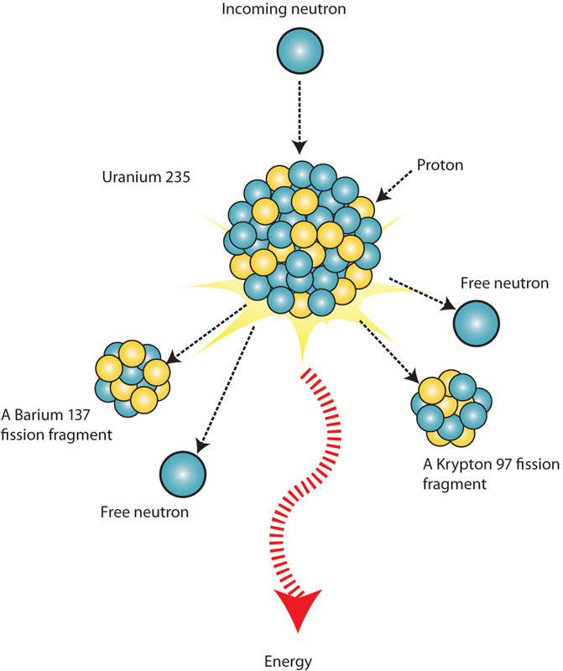
Fission reaction of Uranium
Free Neutron hits nucleus of Uranium atom and split it – release of 2 or 3 neutrons + energy
Chain reaction
Fission of 1 Ur atom = 200 Mev energy

Slide 8
Fissile Materials
The heavy elements which have ability to fission in an excited stage = fissile material
Ex. Uranium-233 (²³³U), Uranium -235 (²³⁵U), plutonium-239 (²³⁹Pu), and plutonium-241 (²⁴¹Pu)

Slide 9
Composition of Natural uranium
Natural Uranium
0.7%
99.3%
fissile isotope
Fertile
Ur 235
Ur 238

Slide 10
Composition of Natural uranium
Fertile
Ur 238
Have to absorb neutron = fissile
i.e. Plutonium
Fissile
Ur 235
Self-sustaining chain
need 3-4% enrichment
Natural Uranium

Slide 11
comparison
Heavy Water Reactor
Light Water Reactor
Fuel: natural Uranium
Coolant: deuterium oxide
By products: plutonium tritium (more amount)
Need frequent re-fuelling
Less heat generates
Fuel: enriched Uranium 235
Coolant: distilled water
By-products: plutonium, tritium
More energy per Uranium unit
But need expensive enrichment facilities

Slide 12
Moderator in nuclear reactor
Fission neutrons must be slowed down to enhance the chances of inducing further fissions.
Such reactors which use slow down neutrons by their repeated collision with moderator are called thermal reactors.
The pressurized heavy water reactor (PHWR), is a thermal reactor using heavy water as moderator and coolant.

Slide 13
Light water
Heavy water
Absorb more neutrons than needed
Enrichment of uranium fuel becomes necessary
Free neutron collide with hydrogen in the water – and slow down them
If water heated – expand – less dense – less collision – less slowing down
Thus, Heavy water heated with pressure in PHWR

Slide 14
Criticality of nuclear reactors
if more than one neutron is available for reaction, the rate of fission increases with time then reaction = 'super critical'.
If, exactly one neutron is available for fission reaction such that reaction rate is constant and then reaction = 'critical'.
If, less than one neutron is available for reaction and number of fission decreases with time or the reaction is 'sub critical'.

Slide 15
Criticality of nuclear reactors
In a nuclear reactor, an increase in the number of neutron is allowed initially to reach the required reactor power and then maintained at that level.
To reduce power level or to shut down the reactor - the reaction rate is lowered by decreasing the number of available neutrons e.g. by inserting a neutron absorbent like boron or cadmium.

Slide 16
Thorium reserve in India
Sources in India India has largest reserve | Sources in the world
Kerala beach sand: monazite | Brazil
Coastal areas of TN, Odisha, AP | Australia
 | USA
 | Egypt

Slide 17
Issue with Thorium- energy generation
India has the world’s highest thorium resource, it could be used for generating power for the next 600 years
Thorium not a fissile material – can’t produce energy through fissile process
Fuel breeding process slow and costly
Thorium need to be converted into Uranium 233 using other fissile material

Slide 18
India’s nuclear plan
Pressurized Heavy water reactors
Uranium + Deuterium oxide
Plutonium
Fast Breeder Reactors
Plutonium-Uranium mixed oxide
Uranium 233
Thorium based reactors
Thorium-uranium 233
energy

Slide 19
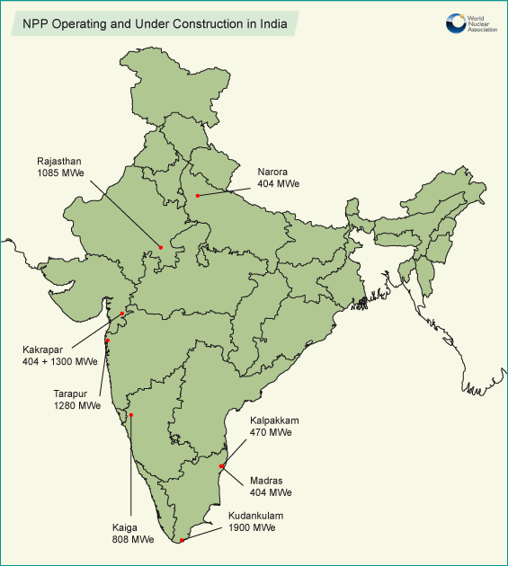
India’s Nuclear reactors: PHWR

Slide 20
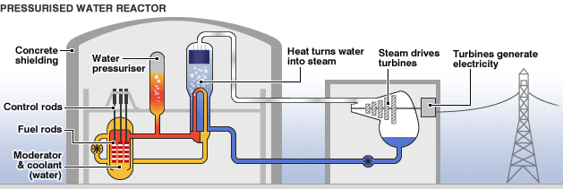
Pressurised Heavy Water Reactor

Slide 21
Nuclear energy generation: Zirconium
Uranium dioxide generate heat while undergoing fission + fission products.
The fission products are radioactive. Not allowed to mix with coolant water.
Hence the UO2 pellets are contained in Zirconium alloy tubes with both the ends sealed.

Slide 22
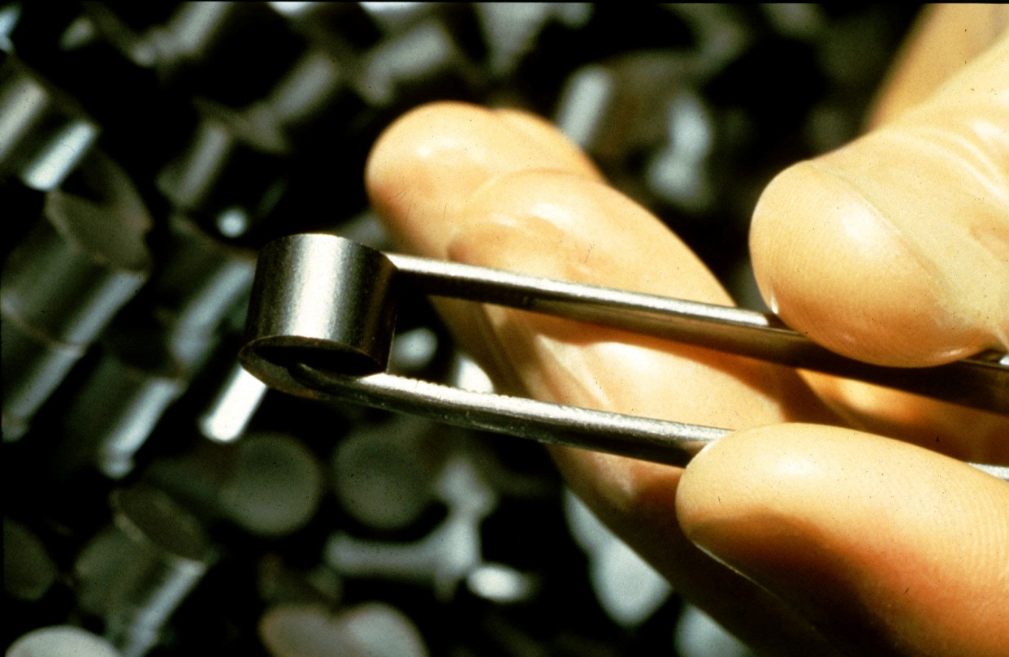
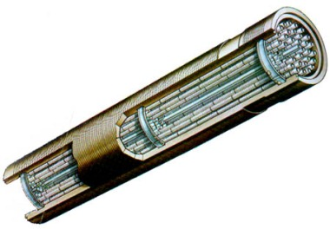
Uranium pallets
Fuel assembly

Slide 23
Sources of Zirconium
Sources in India | Sources in the world
Chavara, Kerala beach sand | Australia (largest)
Manavalakuruchi, TN | South Africa
 | China
 | Indonesia
 | Mozambique, India and Shri Lanka

Slide 24
Nuclear energy generation: Helium
Inside zirconium covering – Helium gas is added
Helium gas increase conduction heat from Uranium pallet to zirconium cover
Petroleum gas fields is source of Helium
USA, Canada, Algeria, Poland, Russia and China – produce Helium

Slide 25
Nuclear energy generation: Helium
In India- Helium reserve – not explored yet
Monazite sands – Helium as by-product
Water of hot spring contains Helium

Slide 26
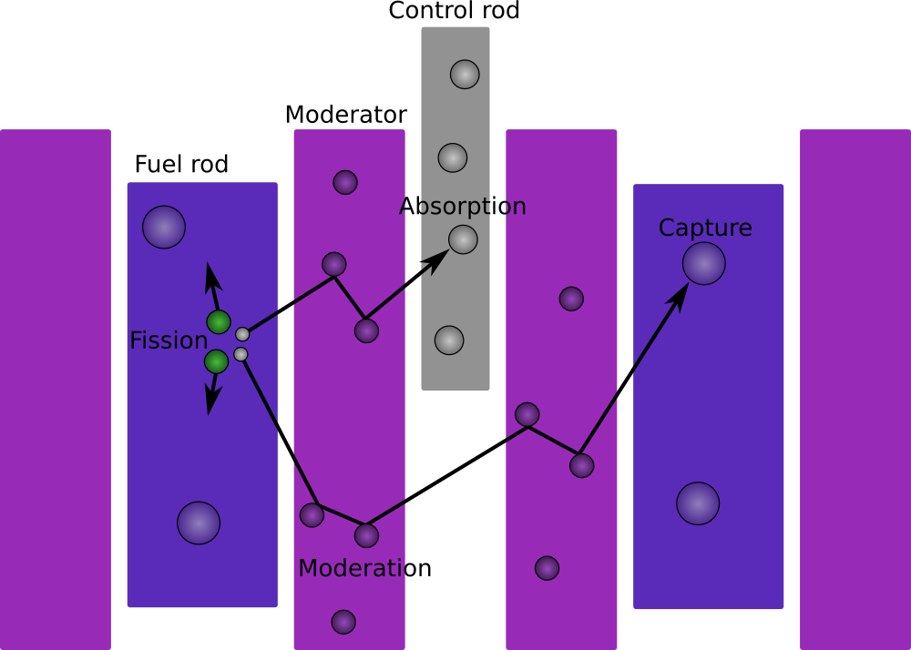
Work of Moderator and control rod
Control rod
Moderator
Moderator
Fuel Assembly
Fuel Assembly

Slide 27
Re-processing of fuels
Depleted Uranium (about 98%) recycled
Neutrons are absorbed in atoms of non-fissionable uranium- Plutonium (about 0.4%) formed
Bhabha Atomic Research Centre (BARC) reprocess the used fuel of PHWRs at Trombay, Tarapur and Kalpakkam to extract reactor-grade plutonium for use in the fast breeder reactors.

Slide 28
Prototype Fast breeder reactor
500 MW plant At Kalpakkam
Fuel – Plutonium-Uranium mixed oxide
Coolant – liquid Sodium
Control material -Boron carbide
Breeder reactor -> They breed more fuel than they consume. i.e more U233 or Th232
Plutonium will produce energy + Uranium additionally produce plutonium

Slide 29
Prototype Fast breeder reactor
Usual nuclear reactors uses 1% of uranium fuel to generate energy. Breeder reactor utilize 40-70% of the uranium fuel
The reactor is built by BHAVINI (Bharatiya Nabhikiya Vidhyut Nigam ltd), PSU under DAE
The technology is developed by IGCAR (Indira Gandhi Centre for Atomic Research)
Plan to build 5 FBR of 2500 MW

Slide 30
Thorium Reactors
Thorium based reactors can be constructed only after successful operation of FBR for 30-40 years

Slide 31
Indian Nuc-reactors and IAEA
India has 20 Nuclear power plants in operation:
Of which 10 are under IAEA safeguard
6 reactors of RJ, 2 of GJ and 2 of MH are under IAEA safeguard + Kundankulam nuclear plant is also under IAEA safeguard => that’s why they can import Uranium fuel
nuclear reactors of UP, KN, TN (kalpakkam) and MH are running on Indian Uranium reserve, which is not enough compared to demand

Slide 32
Kudankulam LWR
First nuclear reactor of India to generate 1000MWe
Beneficiary: TN, KR, KN, Puducherry
NPCIL will sell electricity to all them at a fixed price
All the unallocated electricity will belong to central govt.

Slide 33
India’s nuclear agreements with countries
countries | Civil nuclear agreements
USA | 2008
France | 2008
Kazakhstan (largest producer) | 2009 Uranium supply
Mongolia | 2009 Uranium supply
Namibia | 2009 Uranium supply
Argentina | 2009
Canada (2nd largest producer) | 2010 Uranium supply
UK | 2010
South Korea | 2011

Slide 34
India’s nuclear agreements with countries
countries | Civil nuclear agreements
Uzbekistan | 2014 Uranium supply (2014-18)
Australia (largest known reserve – 3th largest producer) | 2014 Uranium supply
India meets 40% of its uranium requirement through imports (2013)

Slide 35
Foreign Nuclear plants
USA | Mithi Vardi (GJ) and Kovadda (AP)
France | Jaitapur (MH)
Ruusia | Kundankulam (TN)

Slide 36
UPSC
Question
Q. With growing scarcity of fossil fuels, atomic energy is gaining more and more significance in India. Discuss the availability of new raw material required for the generation of atomic energy in India and the world. (10)
Mains
2014

Slide 37
Core Raw materials for nuclear energy
Uranium
Thorium
Heavy water
Zirconium
Helium

Slide 38
Problems associated with Nuc-energy
Expensive to construct – long gestation period for reactor to become critical
Risky “Not in my backyard” perception
Danger of radiation – health hazard
Issue of Nuclear waste
Possibility of proliferation –nuclear weapons - terrorism

Slide 39
Nuclear liability law in India
Required for US companies to get insurance in their country
But the act has provision – act permits operators (NPCIL) to make suppliers liable for damage for faulty reactor or parts

Slide 40
against
favour
India is signatory to International convention on supplementary compensation – which does not allow this.
The private companies do not have capacity to bear the burden of large scale damage of nuclear accident
tax-payers money will be spent in case of accident, due to faulty supply from suppliers

Slide 41
Nuclear liability law: breakthrough
A law will set aside nuclear insurance pool of Rs1500 crore
Government and state-owned insurers under GICI (General Insurance Corporation of India) will create the Pool. The suppliers will pay the premium to the insurance pool
One tier of the pool will cater operators
Tier2 and 3 will cater suppliers

Slide 42
Nuclear liability law: breakthrough
The pool will be used to pay damages to the victims – govt. will be liable for another Rs1100 crore, after which International Convention on Supplementary Compensation for Nuclear damage fund will bear the residual damages
India will be able to use the fund only after it ratifies the International Convention on Supplementary Compensation for Nuclear damage

