Slide 1
Indian Geography

Slide 2
Mines and Minerals
Mines
Industries

Slide 3
Industries in India
Iron and steel
cement

Slide 4
Making of steel
Iron mined (impure)
Heating of iron ore for purification – smelting
Oxygen furnace – oxygen blows through melted iron – lowers its impurities
Other metals are added to make various steel

Slide 5
History of Steel indu. In India
free India’s first Industrial Policy Resolution adopted by the Constituent Assembly in 1948.
Industries were divided into four categories.
In the first category were strategic industries which were made the monopoly of the Government.
In the second category were six industries which included, among others, coal, iron and steel.

Slide 6
History of Steel indu. In India
Government decided to start a chain of steel plants all over the country in the public sector.
The first such plant was set up at Rourkela in Orissa.

Slide 7
Location of steel industry
Raw material based
Port based
Market based

Slide 8
Raw material based steel industry
Steel sector – weight losing industry
Weight of raw material is higher than final product- steel
That’s why located near sources of raw materials

Slide 9
Raw material for Iron and Steel Industries
Iron
Coking coal
limestone
Manganese
Chromite

Slide 10
Raw material based steel industry
Old steel plants were located near coal fields – because old technique was coking coal intensive
Ex. Durgapur, Rourkela, Bokaro
New technique require less coking coal
Steel plant in south India and Bhilai use iron-ore intensive technique
Bhadravati, Bhilai

Slide 11
Major Iron and Steel indu. In India
Steel plants | state | Foreign assistance
Rourkela | Odisha | Germany
Bhilai | MP | Soviet Union
Durgapur | WB | UK
Bokaro | Bihar | Soviet Union
SAIL | Rourkela, Bhilai, Bokaro, Burnpur | ---
TISCO | Jamshedpur, gopalpur (Odisha) | ---

Slide 12
Major Iron and Steel indu. In India
Steel plant | state | resources
Vishweshwarya iron and steel ltd. | Bhadravati in shimoga (KN) | Sharawati Hydel power
Vijayanagar steel plant | Hospet in Bellary, KN | Coal from Chhattisgarh and Sigreni coal field of AP
Salem steel plant | TN | Rich iron ore and limestone

Slide 13
Major Iron and Steel indu. In India
Steel plants | state | Sources of raw material
Bhilai | MP | Iron – Dalli Rajhara Coking coal – Zaria Coal- korba Limstone –Akaltara Manganese – Balaghat
Bokaro | Bihar | Iron- Dalli Rajhara coal- Zaria Manganese- Badam pahar Limestone – Birmitrapur

Slide 14
Major Iron and Steel indu. In India
Steel plants | state | Sources of raw material
Bhadravati | KN | Iron – kemangundi, Kudremukh Coal- Neyvelli Limstone –Shimoga Energy- HEP form Jog fall and Krishnaraj sagar dam on Kaveri

Slide 15
Location of steel industry
Raw material based
Port based
Market based

Slide 16
Port based steel plant
Vishakhapatnam steel Plant, Andhra Pradesh
1st shore based steel plant
Iron – Bailadila, Chhattisgarh
Limestone- Chhattisgarh
Coal from Damodar valley, Jharkhand
Metallurgical coal from Australia
Energy- Balimela HEP on Godavari
Natural gas from KG Basin
Export to Japan

Slide 17
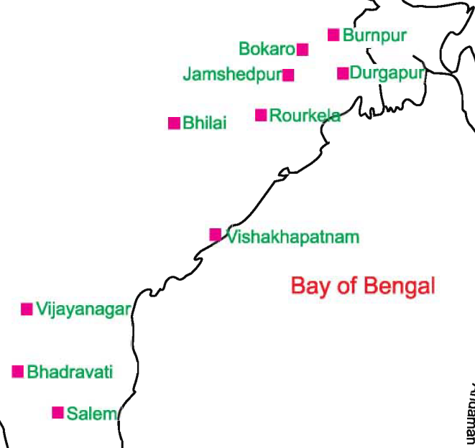
Major Iron and Steel indu. In India

Slide 18
Location of steel industry
Raw material based
Port based
Market based

Slide 19
Mini steel plants
<10,000 ton annually
Steel from steel scrap/ sponge iron sell further to mills
Gestation period is short
Large steel plants produce mild steel
Mini steel plants produce mild steel + alloy steel + stainless steel

Slide 20
Mini steel plants
Located near consumption market
Ex. Rathi steel (MP), Alang steel (GJ)
Mini steel plants account for 30% of steel production in the country

Slide 21
Status of Indian iron and steel industries
India is one of the largest crude steel producer in the world
China, Japan, USA and India
India annual production of steel = 71 ml ton (2014), China = 700 ml ton
Per capita finished steel consumption in India = 39 kg, world avg. =150 kg
India is the largest producer of sponge iron in the world

Slide 22
National Steel Policy 2005
100 ml ton of production by 2019-20
Need avg. yearly growth of 7%
Need $65 bl fund for tech upgradation

Slide 23
Challenges against Indian steel indu.
Non-availability of metallurgical coking coal – high ash content [relay on import]
Key ingredients: nickel, molybdenum- not available
Falling prices, stagnant demand – over-supply

Slide 24
Challenges against Indian steel indu.
High cost of power
High rate of interest
Low labour productivity
Poor infrastructure –transport
Less investment on R&D
Low quality, and less flexibility over lattest demands

Slide 25
Potential of Indian steel indu.
India has high quality iron reserve (hematite) [4th largest reserve]
3th Largest pool of technical man power
Cheap labour (but need skill deve)
Untapped rural market
Make in India, Housing for all by 2020, roads- railway -infra

Slide 26
Industries in India
Iron and steel
cement

Slide 27
Cement industries
One of the most advanced industries in India
Important for infra-development and housing in the country
Avg. per capita cement consumption in India = 110 kg (2003-04), world avg. (240 kg)

Slide 28
Raw material needed for cement industry
Limestone
(60-65%)
Sea-shells
Slag from steel plant
Slag from fertilizer plant
Silica (20-25%),
Alumina(5-12%)
Gypsum
Bauxite

Slide 29
Location factor in cement industries
Location based on source of limestone
1.5 ton of limestone require to produce 1 ton of cement
Coal is another important requirement
Energy intensive industry
Coal is need to burn the limestone. Ash of burnt coal is mixed with limestone to make clinker

Slide 30
State-wise cement production
State | regions | Cement plants
MP-Chhattisgarh | Largest limestone reserve Vindhyan rocks | Satna, Kymore, Katni
RJ | 2nd largest limestone reserve Aravalli | Sawai Madhopur, Lakheri, Udaipur
AP-Telangana | 3th largest limestone reserve Telangana plateau | Karimnagar -Telangana Krishna, Vijaywada - AP
GJ | Mostly Coastal areas | Sika, Porbandar, Sevolia,

Slide 31
Status of Indian cement industries
India-2nd largest producer of cement (after China)
137 large and 365 mini cement plants.
Rs 500 crore to add one million tonne capacity
Traget: ~ 40 million tonne per year

Slide 32
New opportunities for cement industries
Ministry of transport has decided to build concrete cement roads in place of traditional bitumen roads
cement roads are cost-effective and require less maintenance.
India has to import bitumen

Slide 33
Industries in India
Iron and steel
cement

