Slide 1
World Geography
Asia
Africa
Australia
Europe
North America
South America

Slide 2
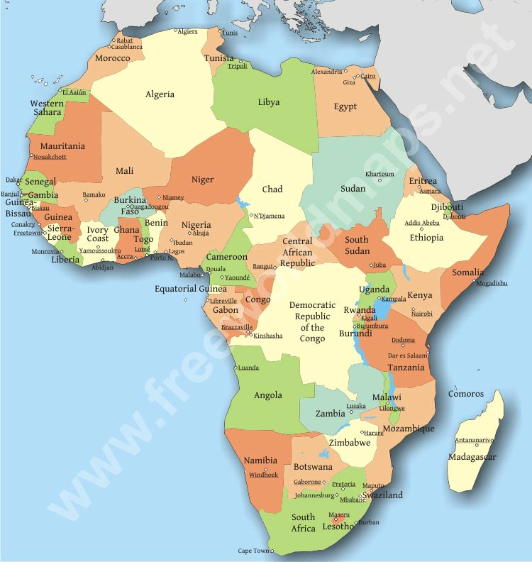
Africa

Slide 3
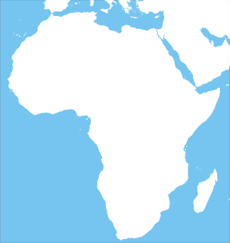
Physiography of Africa: Mt. and plateaus
Atlas Mt.
Ethiopian Highlands
Adamawa Highlands
Katanga Plateau
Bie plt.
Zambia Plt.
Zimbabwe Plt.
Grt Karoo

Slide 4
Plateaus of Africa
Plateaus | Facts
Katanga Plateau | Farming, ranching, resource rich – copper and Uranium deposits
Ethiopian Plateau | Lake Tana (Source of Blue Nile), cooler despite close to equator
Great Karoo | Semi-desert region
Bie Plateau | Important for copper, Agriculture and cattle rearing
Adamawa Plateau | Savannah vegetation, Bauxite deposits

Slide 5
Physiography of Africa: Deserts
Atlas Mt.
Libyan desert
Nubian desert
Sahara desert
Ethiopian Highlands
Adamawa Highlands
Katanga Plateau
Bie plt.
Zambia Plt.
Zimbabwe Plt.
Namib desert
Kalahari desert
Grt Karoo

Slide 6
Deserts of Africa & facts
Sahara Desert | Largest hot desert – subtropical HP zone Tuareg tribes
Namib desert | Off-shore trade wind + cold Benguella current, sandy desert Hottentots tribes
Kalahari Desert | Rain-shadow effect, stony-rocky desert. Bushmen tribe (oldest surviving tribal group of Africa)
Nubian desert | Separated by Libyan desert by Nile river rocky desert

Slide 7
Physiography of Africa: Basins
Atlas Mt.
Libyan desert
Nubian desert
Sahara desert
Chad Basin
Sudan Basin
Adamawa Highlands
Ethiopian Highlands
Congo Basin
Katanga Plateau
Bie plt.
Zambia Plt.
Zimbabwe Plt.
Namib desert
Kalahari desert
Grt Karoo

Slide 8
Physiography of Africa: Plains
Atlas Mt.
Nubian desert
Sahara desert
SAHEL
Adamawa Highlands
Ethiopian Highlands
Katanga Plateau
Bie plt.
Zambia Plt.
Zimbabwe Plt.
Namib desert
Kalahari desert
Veldt
Grt Karoo

Slide 9
Physiography of Africa: Rivers
Atlas Mt.
Nile
Sahara desert
Nubian desert
Senegal
Niger
Chari
Ethiopian Highlands
SAHEL
Volta
Adamawa Highlands
Congo
Katanga Plt.
Bie plt.
Zambia Plt.
Kalahari desert
Zambezi
Zimbabwe Plt.
Namib desert
Limpopo
Orange
Veldt
Grt Karoo

Slide 10
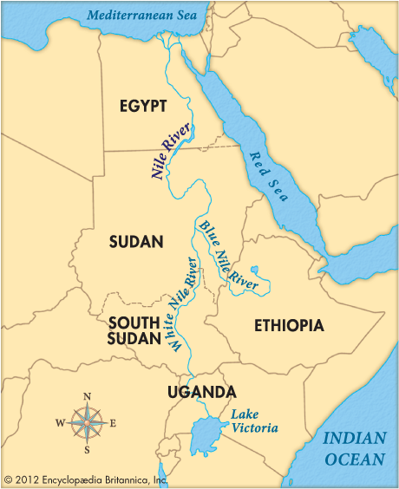
River Nile
Longest river
Cotton cultivation,
Petroleum at mouth, navigable, irrigation
Aswan dam, lake Naseer
Port Said and Alexandria at mouth
Cairo, Giza, Khartoum cities are on River Nile
Port Said
Alexandria
Cairo
Khartoum

Slide 11
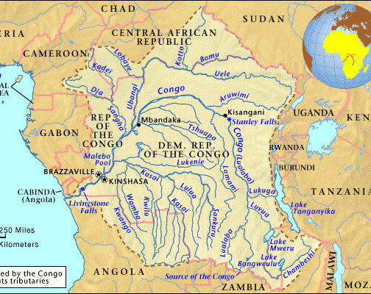
River Congo
Origin: Katanga Plateau
Northern Trib.- Urumqi,
Southern trib.- Kasai
Boyoma water fall
Pigmy tribes
Petroleum reserve at the mouth
Crosses equator twice

Slide 12
Other rives
River | Facts
River Zambezi | Origin: Katanga Plateau, famous Victoria fall
River Niger | Origin: Loma mountains Important river of west Africa
River Orange | Origin: Drakensberg, its tributary –Vaal is famous for gold deposits
River Limpopo | Origin: high Veldt, crosses tropic of Capricorn twice

Slide 13
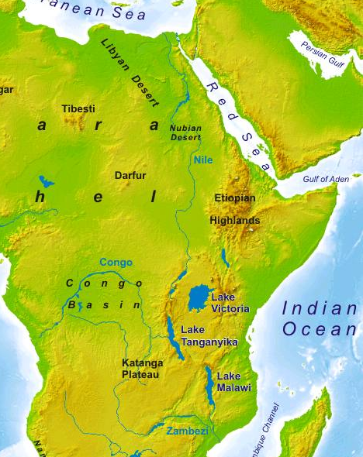
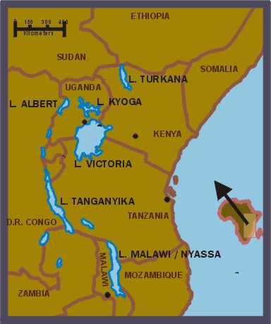
African rift valley & lakes

Slide 14
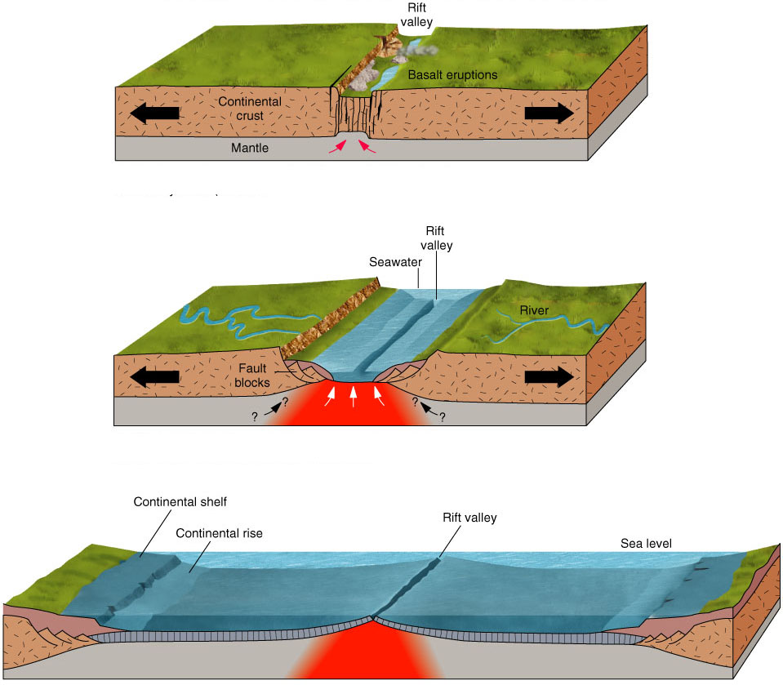
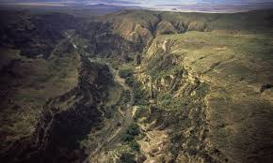
African Rift valley

Slide 15
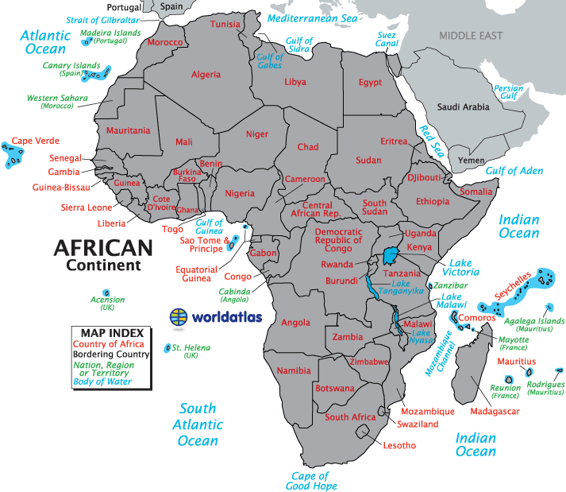
Islands of Africa
Madeira - Portugal
Canary - Spain
Cape Verde
Mauritius
Reunion - France
Comoros - France
Seychelles

Slide 16
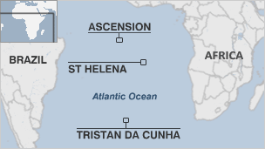
Islands between Africa and Latin America
All of them –British overseas territories
Ascension Islands– UK military base
St. Helena Islands – exile of Napoleon
Tristan De Cunha Island – most remote island of the world

Slide 17
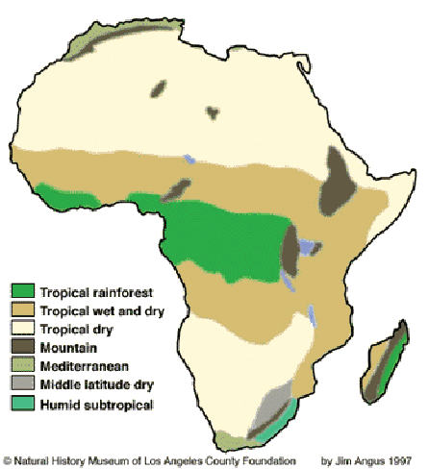
Climate of Africa
Mediterranean climate
Desert
Mountainous
Savannah climate
Equatorial Rainforest climate
Savannah climate
Desert
Temperate grasslands Veldt
Mediterranean climate

Slide 18
Agriculture in Africa
Mediterranean agriculture
cotton
Oil Palm, rubber, Cocoa
Coffee
Tobacco
Veldt - Wheat
Mediterranean agriculture

Slide 19
Status of Agriculture in Africa
Subsistence farming, small farms, family labour, little use of machinery
Low productivity (except Nile basin and Mediterranean region)
Only 6% of farmland in Africa is irrigated
Mostly in Egypt, South Africa, Madagascar, Morocco and Sudan
cultivable lands (excluding forest areas) in Africa are 3 times larger than the land currently cultivated

Slide 20
Status of Agriculture in Africa
Area suitable for agriculture – sparsely populated Ex. Sudan
Decreasing soil fertility due to deforestation, lack of investment and security of tenure of the agro-labourers
Low access to fertilizers, no awareness about soil fertility management
Major threat under climate change

Slide 21
Current status
Traditional African crops losing ground (cotton, palm oil, cocoa, coffee)
High fluctuation of price in global market
High taxation on exports of these crops – low competitiveness in global market
Boom in mining and oil products, quick and easy foreign money

Slide 22
Agro-exports from Africa
70% agro-export = cocoa
Then coffee, tea, cotton, sugar and fish
Low diversification in agro-export products
Only 25% of cocoa and 6% of cotton is processed in Africa- mostly processed in importing nations
Unprocessed = No value addition, industrial development and employment,

Slide 23
Problems of Africa
Around 60% of cultivable land is concentrated in seven countries in East and Central Africa
the central African region contains almost 50% of the continent’s water resources BUT less than 20% of its population.

Slide 24
Problems of Africa
Major political problems : the management of trans-boundary natural resources as well as by the inequitable distribution of these land resources.
EX. the management of the Nile waters, the conflict in eastern DRC, conflicts between pastoralists and farmers in the Sahel, the management of Lake Chad’s waters and land reforms in Southern Africa.

Slide 25
Problems of Africa
Land grabbing by foreign investors (inadequate legal contracts)
Foreign investors – technology and high productivity but expulsion of local people

Slide 26
Animal Husbandry in Africa
Primitive- confined to traditional pastoralist
Frequent drought in Sahel and east Africa
Limited development of food processing and cold storage infra
Poor govt. policy leads to sedentarisation of pastoral people

Slide 27
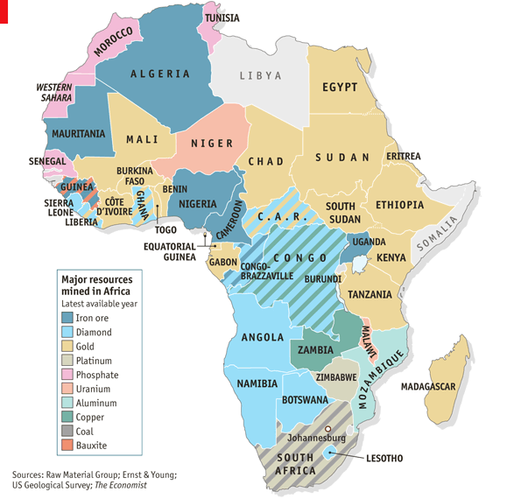
Mineral reserve of Africa
Petroleum
Coal
Iron
Diamonds
gold
Uranium, Platinum
Iron
Uranium
Gold
Diamond
Aluminum
coal, Platinum

Slide 28
Petroleum reserve of Africa

Slide 29
Indian oil companies in Africa
ONGC Videsh: Libya, Nigeria, Mozambique, Sudan and South Sudan
IOC: Libya, Gabon, South Africa, Nigeria
HPCL: Egypt
BPCL: Mozambique

Slide 30
Indian Private companies in Africa
Reliance (Gulf Africa Petroleum corp.): one of the largest petroleum marketing and trading Co. in Africa
primarily involved in petroleum product imports, retail and wholesale marketing, trading, storage, distribution, supply and transport of oil products to the countries in east and central Africa.
Airtel, Emami, Marico, Dabur, Essar, Tata Group, Godrej group, Bharti, Kirloskar, Mahindra & Mahindra, Escorts and Apollo.

Slide 31
coal
CIL of India

Slide 32
Iron

Slide 33
Gold

Slide 34
Diamonds reserve in Africa

Slide 35
China in Africa
China import cobalt, manganese from Gabon, South Africa and Ghana.
Timber from Gabon, Republic of Congo, and Cameroon
Chromium from South Africa, Madagascar, and Sudan
China invested in Zambia, Tanzania and Mozambique for copper, iron, gold and Manganese
Uranium from Niger

Slide 36
Indian Diaspora in Africa
British rule from 1896-1901 Indian were taken to Kenya to lay railway tracks
‘Passenger Indians’ – enterprising Indian from GJ coast to Africa
Today, Mostly concentrated in East Africa (Kenya, Uganda) south Africa and African Islands (Mauritius, Seychelles and Reunion)
Indian diaspora (especially Gujaratis) dominates economy of East African nations

