Slide 1
World Geography
Asia
Africa
Australia
Europe
North America
South America

Slide 2
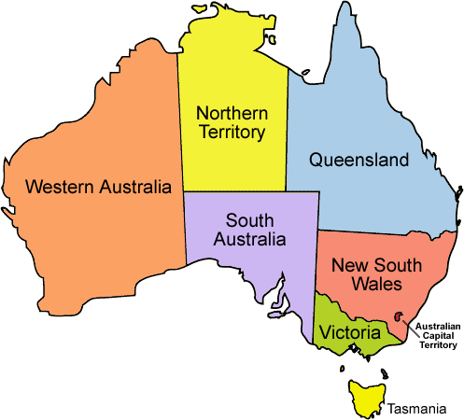
Australia

Slide 3

TO be noted down
Facts
In terms of settlement Australia = ‘New Island’
Smallest continent but largest Island
Discovered by Dutch people = ‘New Holland’
Matthew Flinders, British, circumnavigate Australia gave name ‘Australia’

Slide 4
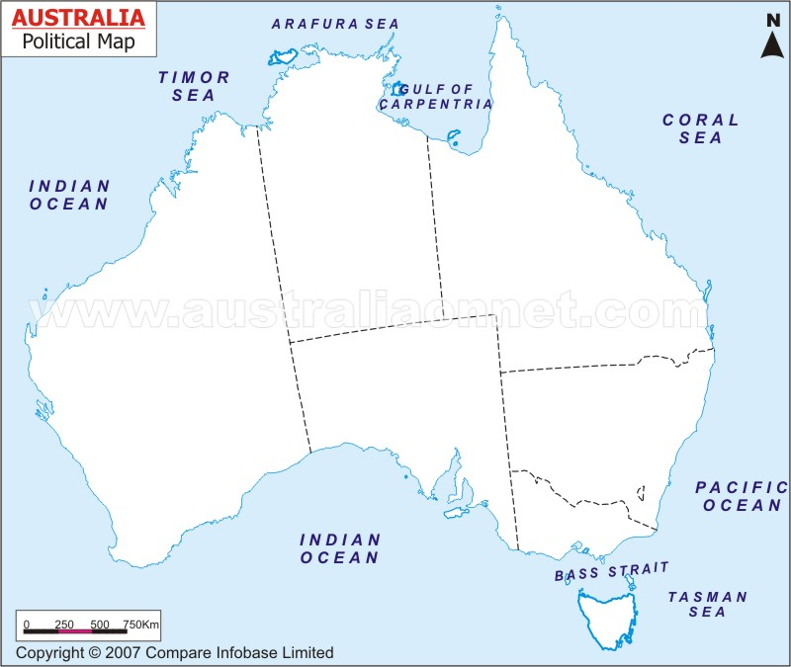
Physiography of Australia: Mountains
Great Dividing range
Reynold R.
McDonell R.
Grey Range
Masgrove R.
New England R.
Blue Mountain R.
Darling R.
Australian Alps

Slide 5
Physiography of Australia: Plateaus
Arnhem Land
Cape York Peninsula
Antrim plt.
Kimberly Plateau
Barkely Table land
Eyre Peninsula

Slide 6
Physiography of Australia: Deserts
Tanami
Grt Sandy
Simpson
Gibson
Grt Victoria

Slide 7
Physiography of Australia: Artesian Basin
Grt Artesian Basin

Slide 8
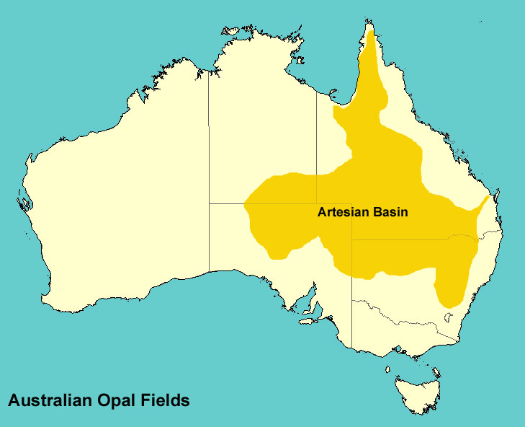
Artesian Basin of Australia
Artesian basin = confined groundwater aquifer (water stored in permeable sandstone)
Largest and deepest Artesian basin in the world
Biggest source of fresh water for central Australia

Slide 9
Physiography of Australia: Murray-Darling
Grt Artesian Basin
Murray-Darling basin

Slide 10
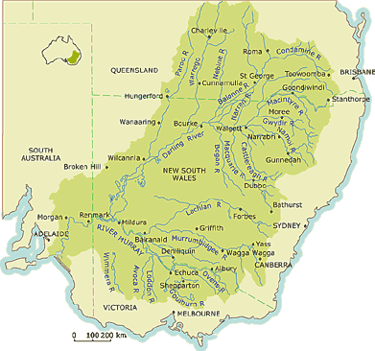
Murray-Darling Basin
Darling river originates from Great dividing range and Murray from Snowy mt.
Temperate grassland – ‘Downs’
Dairy farming and wheat production
Darling
Murray

Slide 11
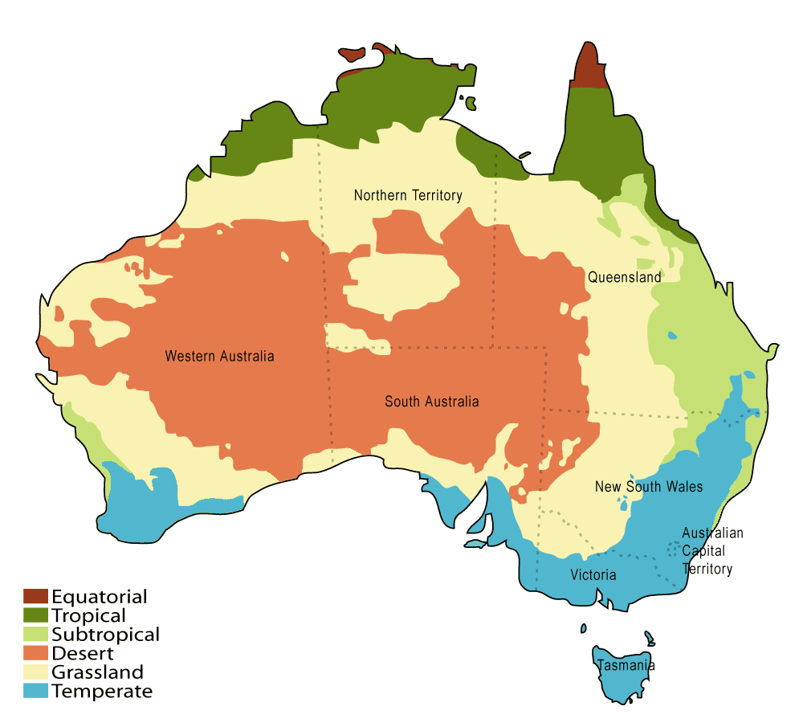
Climatic regions of Australia
Tropical Monsoon
Humid Sub-tropical
Tropical Grasslands
Hot desert
Mediterranean climate
Temperate Grassland

Slide 12
Economy of Australia
Main economic activities:
Agriculture – animal husbandry
Mining sector
Service industry
Tourism

Slide 13
Agriculture in Australia
Humid Sub-tropical
Tropical Monsoon = sugarcane, cotton, Tobacco, Maize
Wheat in Downs
Humid subtropical = Rice and wheat
Citrus fruits in Mediterranean climate
Tasmania – fruit cultivation
Tropical Monsoon
Desert
Mediterranean climate
Temperate Grassland

Slide 14
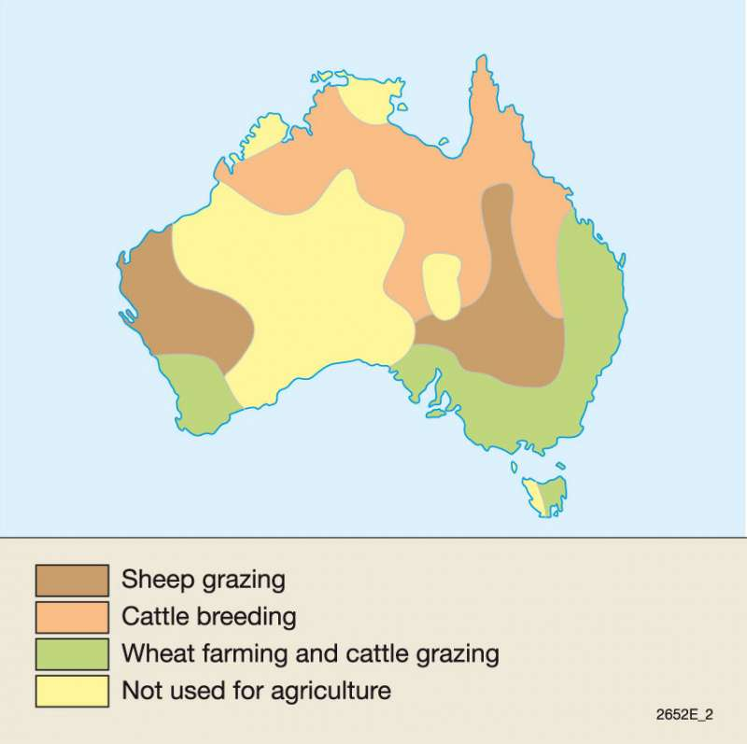
Animal husbandry in Australia
Sheep rearing = wool and lamb meat production
Cattle rearing = meat and dairy production
cattle
sheep
sheep
Cattle

Slide 15
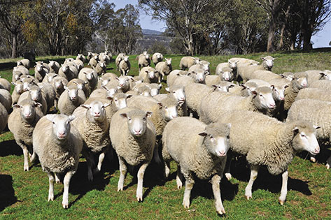
Sheep Rearing in Australia
Sheep rearing – merino sheep
High quality wool
Sheep farms = called Stations
Selective breeding of superior genetic line

Slide 16
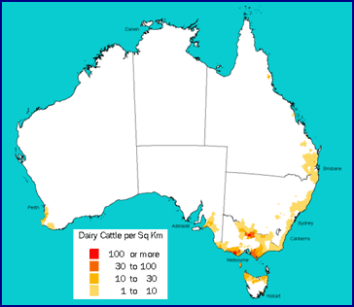
Dairying In Australia
Dairy cows were brought from England
Commercial Dairying with sophisticated technologies
Large pasturelands, herd management, large no. of cattle under a farm

Slide 17
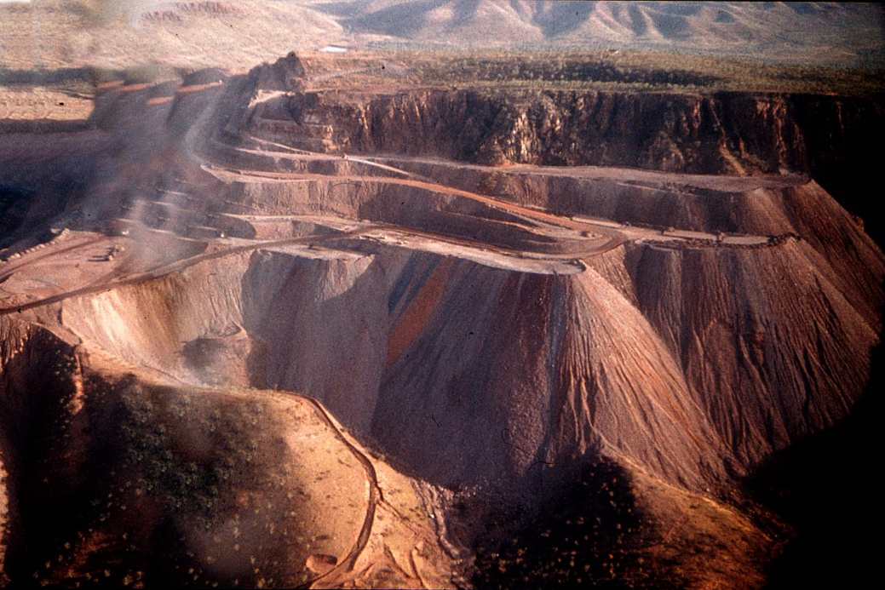
Mining in Australia
Coal
Iron
Bauxite
Copper
Gold
Uranium
Mainly Export to China, Japan, South Korea and India

Slide 18
How Australia is important for India?
Australia has world's largest known reserve of Uranium - important for our energy security using civil nuc-tech
India’s import from Australia is cocking coal, iron, copper, gold and natural gas
Growing number of Indian diaspora in the country

Slide 19
Region-wise mineral deposits
Bauxite
Cape York Peninsula
Bauxite
Bauxite and iron
Arnhem Land
Kimberly Plateau
Carpentaria basin
Uranium
Copper, Iron, coal
Uranium and copper
Great Dividing range
Grt Sandy
Gold and natural gas
Grt Victoria
Flinders Range
Iron

Slide 20
Coal reserves of Australia
Rock Hampton
Ipswich
Koolyanobbing
Gippsland
Wollongong

Slide 21
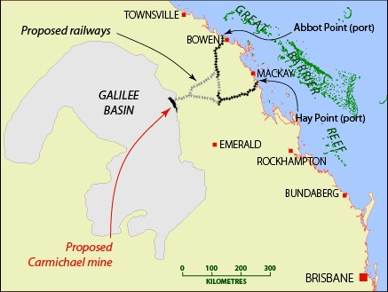
Adani coal mining in Australia
Carmichael coal mine of Galilee basin
Largest coal mine of Australia
Owned by Adani mining
Export from Hay point and Abbot point to India
Environmentalist protest – damage to great barrier reef

Slide 22
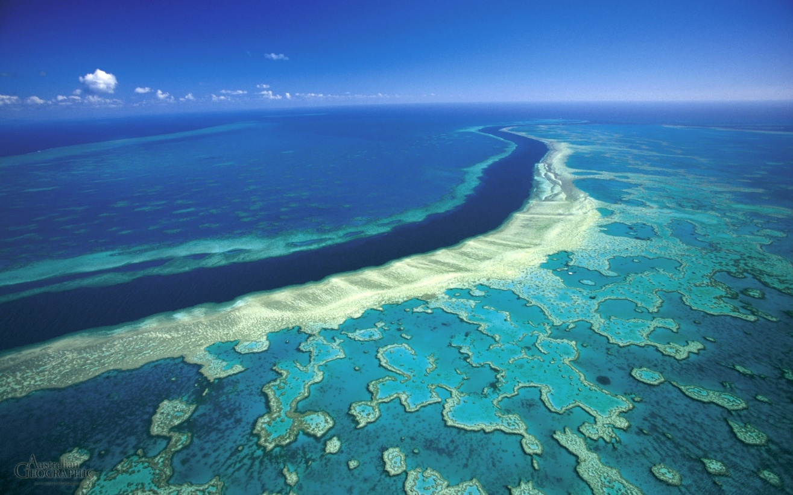
Great Barrier Reef
Largest coral reef system
Coral important part of marine ecology and diversity
World Heritage site
Cultural and spiritual importance to Australian Aboriginals

Slide 23
Troubles to India overseas acquisition
Acquisition of Petroleum fields
Political instability in foreign source
Natural environment for habitation
Loss in bidding process due to procedural delay in India
Difficulties in laying pipelines – But Pakistan in west and China in north

Slide 24
Troubles in overseas acquisition
Sudan- South Sudan
Vietnam
ONGC Videsh’s $2-3 billion investment in joint petroleum production companies & pipelines
Major oil fields in South Sudan but pipelines and export terminal in Sudan
Oil basins in South China sea
Chinese protest
ONGC videsh – Phu Kahn Basin
Oil could not be found

Slide 25
Troubles in overseas acquisition
Sakhalin Island, Russia
Loss in bidding
Sakhalin-I oil field & acquired co.- Imperial energy
Among the Most inhospitable spot on earth
ONGC interested in Arctic region and Siberian oil fields
2013 Kazakhstan, - Kashgan oil field lost to China
2010, Uganda oil field lost to China
2011 Angola oil field

Slide 26
Troubles in overseas acquisition
Venezuela
Infra development
Orinoco oil belt
ONGC-OIL-IOC consortium of 2010
60% stake under state owned co. – political tool
Delay in production due to red-tapism in Venezuela
China offers infra development in exchange of acquisition of mines
India cannot – poor track record
Long Delays

Slide 27
Iron reserves of Australia
Mt. Bundi
Yampi Sound
Fritzroy crossing
Pilbara
Jameson range
Mt. Tom price
Mt. Bruce
Mt. whale back
Iron knob
Port Pierre
Iron monarch

Slide 28
Uranium reserves of Australia
Nabarlek
Rum jungle
Mary Kathleen
Radium Hill
Mt. Fitton
Mt. Painter

Slide 29
Gold reserves of Australia
World’s 10% economic gold reserve
Cracow
Paddington
Coolgardie
Kalgoorlie
Norseman
Mt. Morgans
Boddington
Ballart

Slide 30
Copper reserves of Australia
Tennant Creek
Mt. Morgan
Kanmantoo
Mt. Lyell

Slide 31
Natural Gas reserves of Australia
Bonaparte Basin
Browse Basin
Carnarvon Basin
Gippsland Basin

Slide 32
Bauxite reserves of Australia
Gove
Weipa
Mitchell plateau
Boddington
Huntly
Willowdale

Slide 33
Diamond reserves of Australia
Argyle diamond mine
One of the largest diamond Mine – most valuable pink and red diamonds

Slide 34
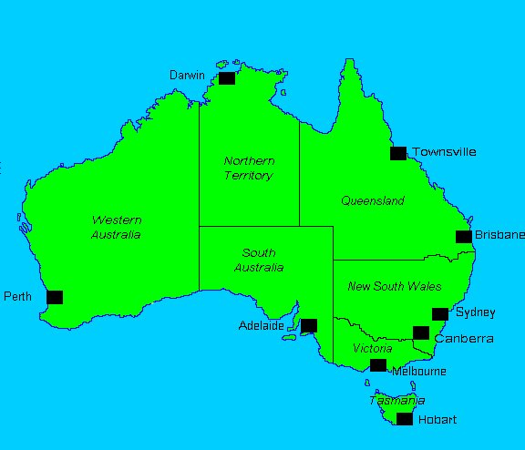
Settlement pattern in Australia

Slide 35
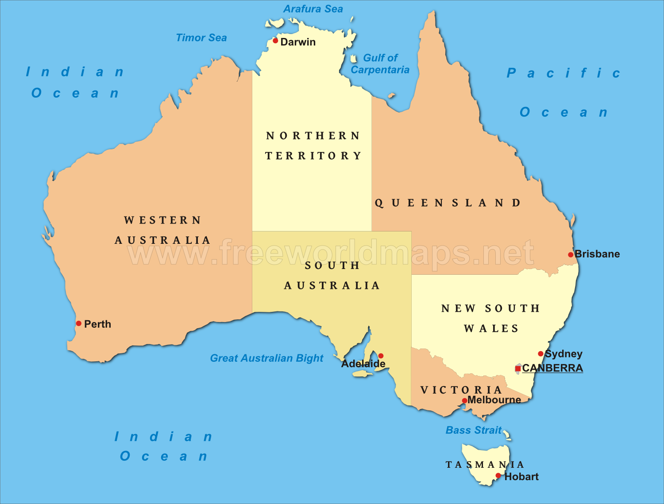
Industrial centers of Australia
Darwin
Bauxite mining
Brisbane
Textile, port
Perth
Plantation agriculture, gold mining
Adailade
Ship building, petro-refinery
Sydney textile
Melbourne
Manufacturing
Hobbart

