Slide 1
World Geography

Slide 2
World Geography
Asia
Africa
Australia
Europe
North America
South America

Slide 3
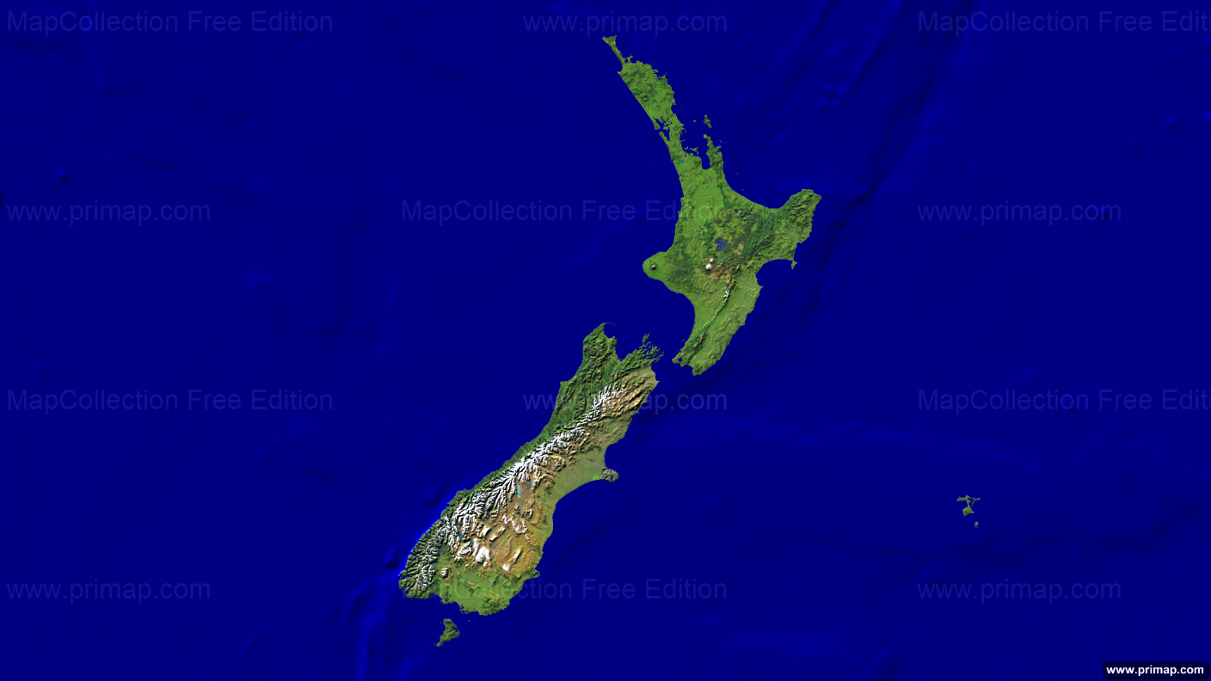
New Zealand
North Island
Tasman Sea
Cook’s straight
Pacific Ocean
South Island

Slide 4
New Zealand
NZ – Volcanic Islands
North Island
Tasman Sea
Lake Taupo
Cook’s straight
Southern Alps
Pacific Ocean
South Island

Slide 5
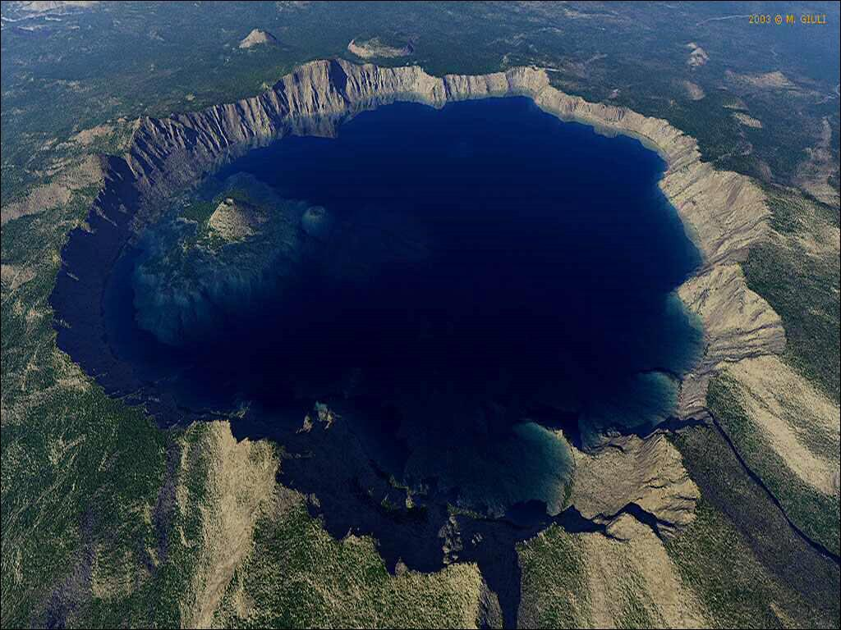
Lake Taupo
Caldera lake
Lake Taupo of mt. Tauhara- dormant volcano
An explosive eruption in volcano – empty magma chamber- fall of roof of magma chamber =caldera
Caldera later filled with water

Slide 6
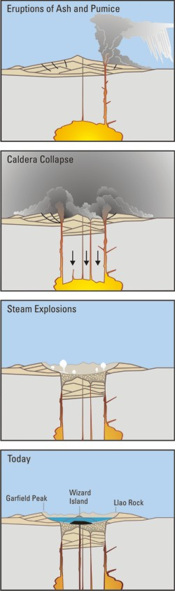
Caldera formation

Slide 7
Climate of New Zealand
China type
Laurentian type

Slide 8
Important regions of New Zealand
Taranaki Plain
Canterbury Plain

Slide 9
Taranaki Plain of New Zealand
Volcanic plain
Volcanic peak – Mt. Taranaki
More than 50% of region has rich pastureland
sheep and cattle rearing for Dairying, meat imp activities
Taranaki Plain
Canterbury Plain

Slide 10
Canterbury Plain of New Zealand
Pastoral farming
Predominantly sheep farming for lamb-wool
then cattle rearing for meat then dairying
Canterbury Plain

Slide 11
Important cities of New Zealand
Auckland
WELLINGTON
Christchurch
Dunedin

Slide 12
Cities of New Zealand
cities | Economic activities
Auckland | Major port, food processing and tourism
Wellington | Tourism, Entertainment (film-production) and ICT
Christchurch | Agriculture-allied industries, meat and wool processing, dairying, biotechnology
Dunedin | University education

