Slide 2
World Geography
Asia
Africa
Australia
Europe
North America
South America

Slide 3
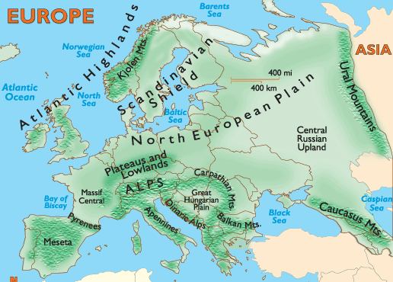
Physical Geography of Europe
Pennines
Cantabrian
Iberian Peninsula

Slide 4
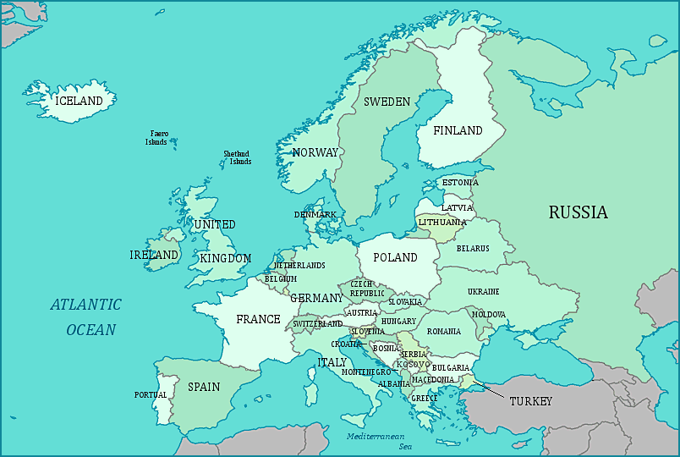
Water bodies around Europe
North
Sea
Baltic Sea
English Channel
Bay of Biscay

Slide 5
Water bodies around Europe
Gulf of Bothnia
Gulf of Finland
North Sea
Skagerrak
Kattegat
Baltic Sea

Slide 6
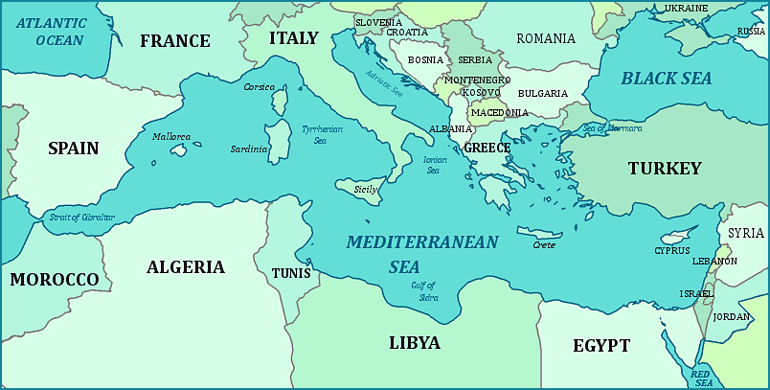
Islands within Mediterranean sea
Balearic Is.

Slide 7
Water-bodies within Mediterranean Sea
Marseille
Ligurian Sea
Gulf of Lions
Rome
Barcelona
Naples
Athens
Aegean Sea

Slide 8
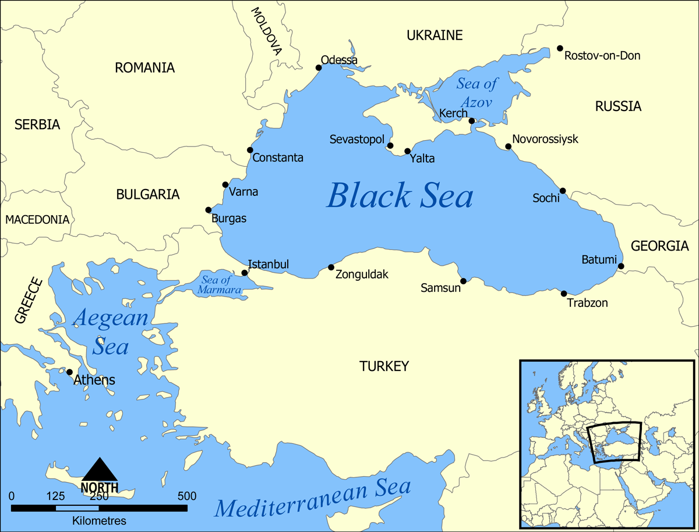
Black sea
Crimea

Slide 9
Water-bodies within Mediterranean Sea
Marseille
Ligurian Sea
Barcelona
Gulf of Lions
Rome
Naples
Athens
Aegean Sea
Izmir
Algiers
Tunis
Gulf of Gabes
Tripoli
Gulf of Sirte
Alexandria
Port Said

Slide 10
Rivers of Europe
Rivers flow to Mediterranean Sea
Rivers flow to Atlantic Ocean
Rivers flow to Black sea

Slide 11
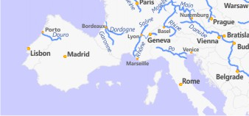
Rivers of Europe: Flow to Mediterranean
Ebro

Slide 12
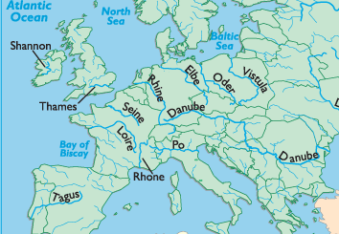
Rivers of Europe: flow to Atlantic Ocean
Rivers flow to Bay of Biscay, English Channel, North Sea and Baltic Sea?
English Channel
Garonne
Douro

Slide 13
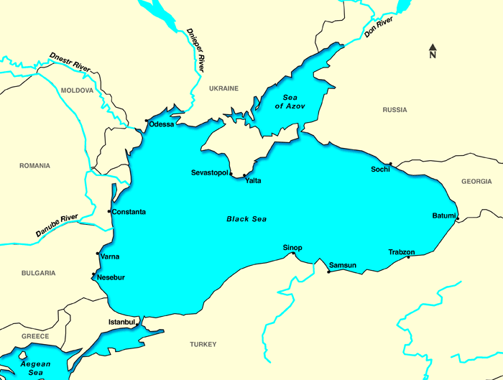
Rivers of Europe: flow to Black Sea
Ebro
Which rivers flow to Black sea?

Slide 14
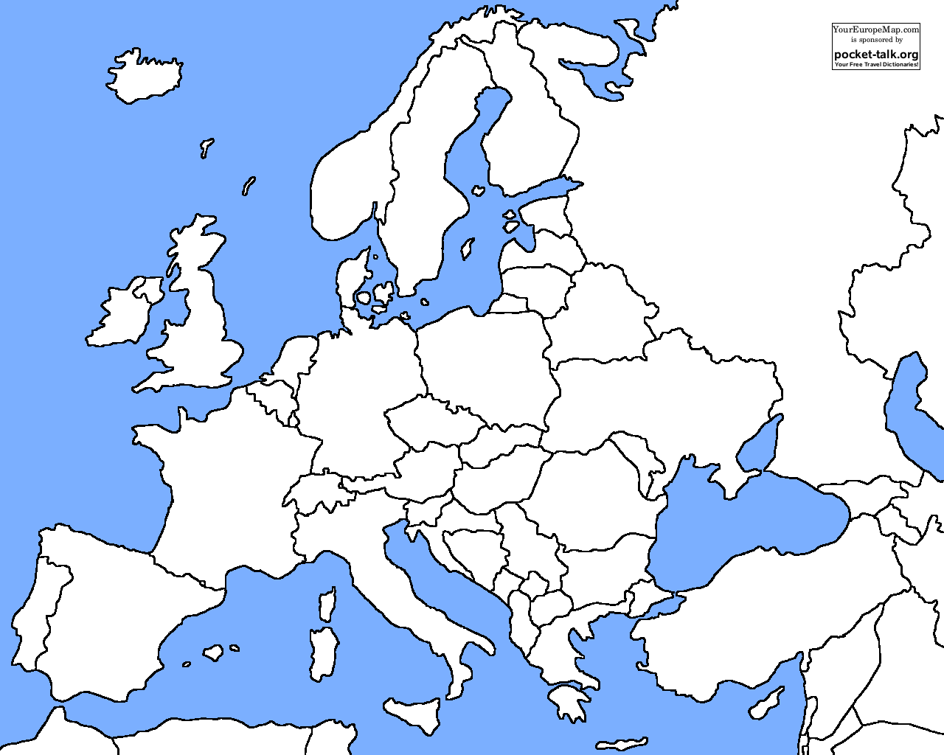
Rivers of Iberian Peninsula
Iberian Peninsula
Meseta - located between Cantabrian and Sierra Morena mountains
Cereal farming and Mediterranean agriculture
Portugal – port wine
Cantabrian
Pyrenees
Douro Riv.
Tagus Riv.
Ebro Riv.
Iberian Peninsula
Sierra Morena

Slide 15
Rivers of France
Rhone – irrigation, HEP, vineyard and fruit orchards – Burgundy wine
Garonne – Bordeaux wine
Loire – Champagne wine
Seine – port Le Havre, navigation to Paris
Le Havre
Seine
Loire
Paris
Garonne
Rhone

Slide 16
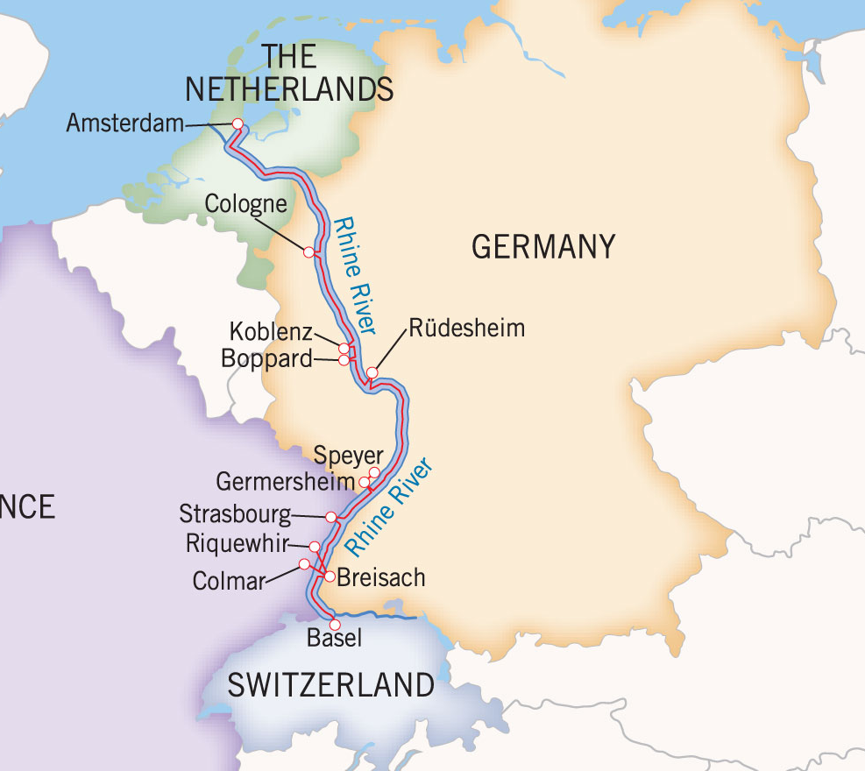
Rivers of Germany: Rhine
Rhine river
Important for navigation
Imp cities: Basel (Swiss), Strasbourg (France), Worms, Mainz and Cologne (Germany), Amsterdam (Netherlands)
New water canal: Europoort: out-port of Rotterdam (Netherlands)

Slide 17
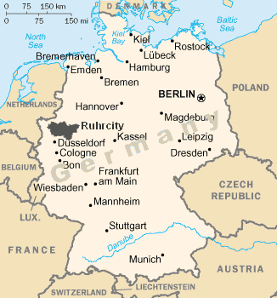
Rhine- Ruhr coal region
Tributary: Ruhr – one of the largest industrial region of the world
Ruhr coal field – Bituminous coal, steel industries, manufacturing and chemical industries
From Düsseldorf through Wuppertal to Hagen – most populated region of Germany

Slide 18
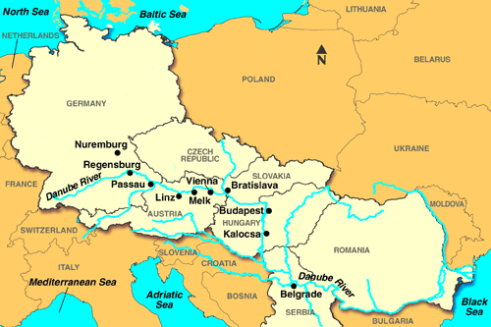
Important River: Danube
Passes through 10 countries
Germany, Austria, Slovakia, Hungary, Croatia, Serbia, Bulgaria, Romania, Moldova, Ukraine

Slide 19
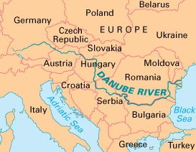
Important River: Danube
Origin: Black forest in Germany
Black forest – block mountain
Importance: for freight transport, HEP, Irrigation, fishing
Industrial use – polluted water: unfit for drinking and irrigation

Slide 20
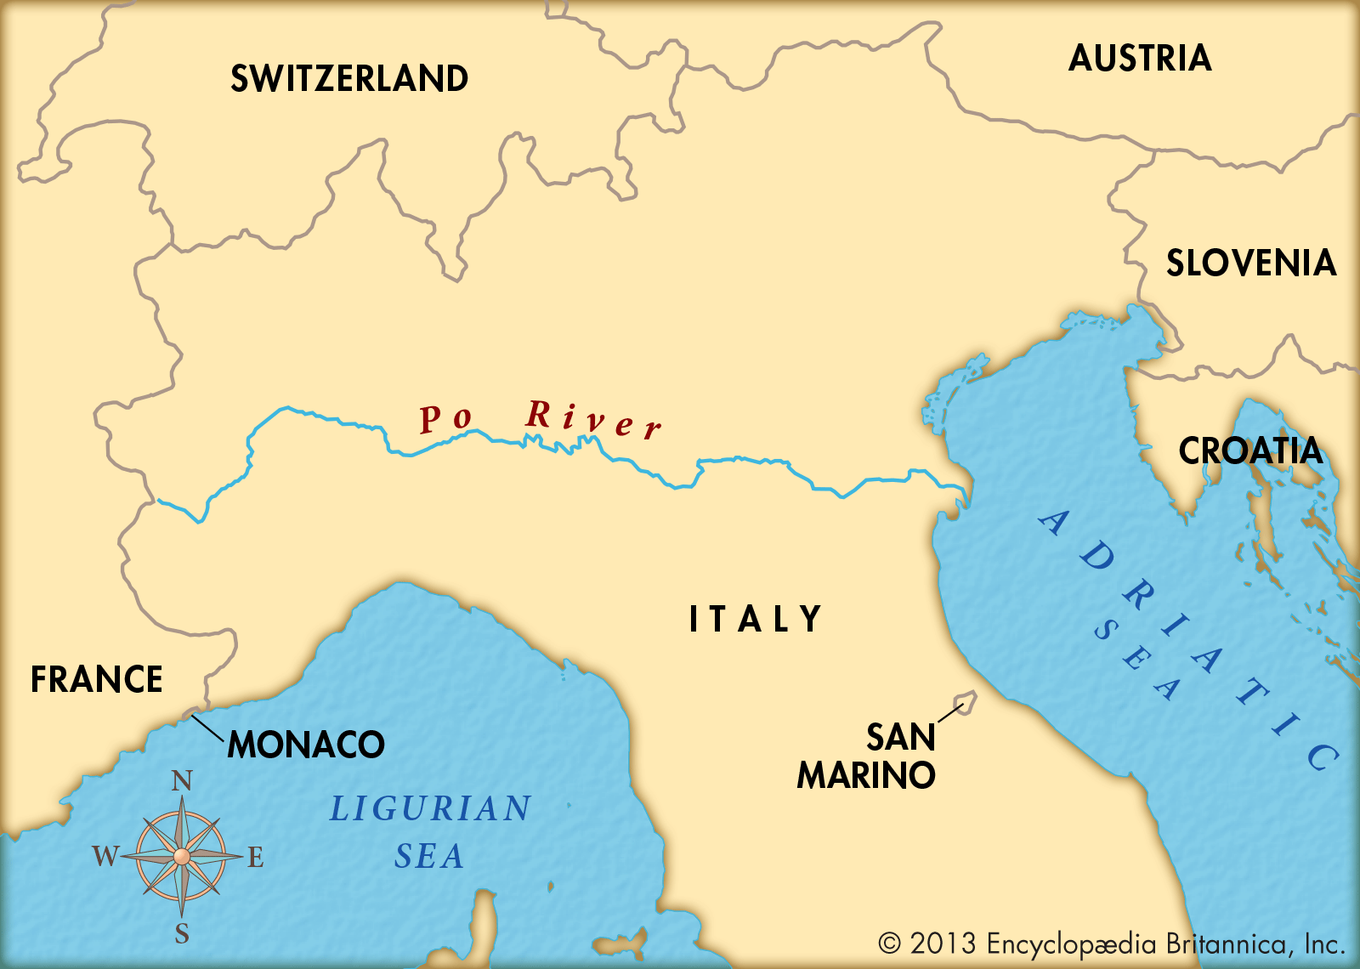
Important River: Po
Italy’s most widest and fertile plains
Partially navigable
Lombardy plain (Milan) and Piedmont plan (Turin) – fertile regions
Known for rice and maize cultivation and wine making
Piedmont: Asti wine
Piedmont region
Lombardy plains

Slide 21
Cities of Europe
City | River
Paris | Seine
Frankfurt | Rhine
Venice | Po
Vienna, Budapest, Belgrade | Danube
Kiev | Dniester
Berlin | Elbe

Slide 22
Climate of Europe
Taiga
British type
Steppe
Mediterranean type

Slide 23
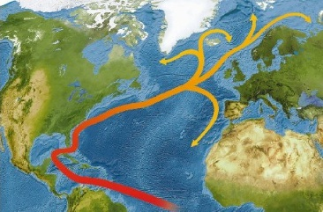
North Atlantic drift

Slide 24
Agriculture in Europe
Wheat, potato, sugar beet
Wheat, Barley, sugar beet, corn
Wheat, sunflower, nuts, corn
Wine, cheese, wheat
Rice, olives, citrus fruits
Barley, Orange, Olives, Almonds

Slide 25
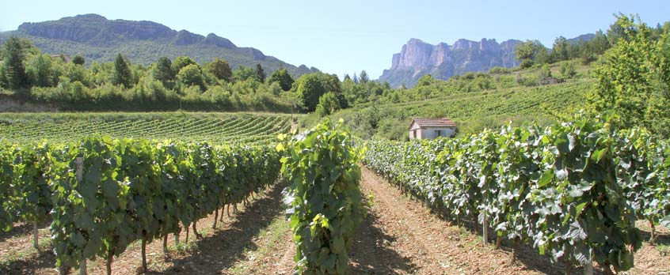
Viticulture
European countries largest producer of wine and largest consumers as well
Portugal, Spain, France, Italy
Port wine
Sherry wine
Bordeaux, champagne
Asti, Cincinnati wine

Slide 26
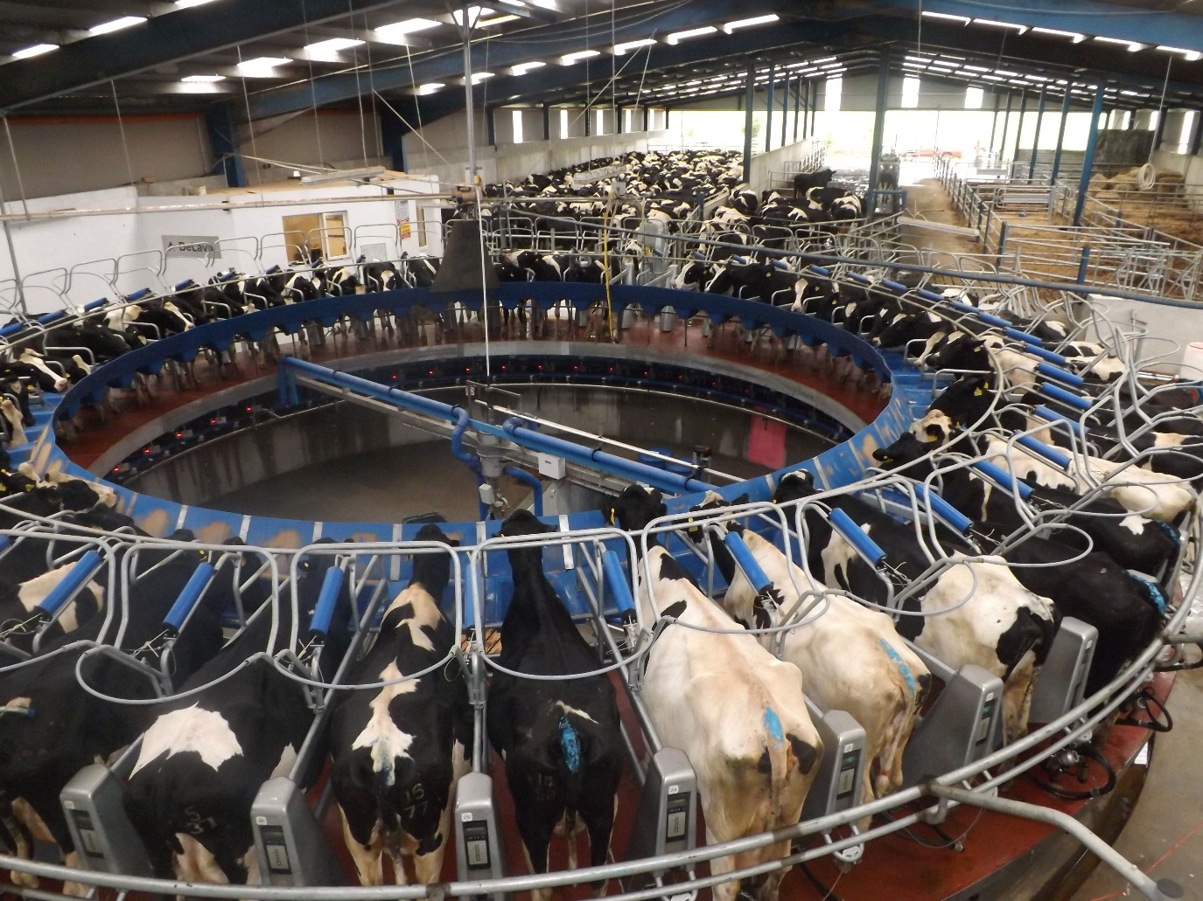
Dairy farming in Europe
Modern dairying
Cows wear electronic tag, machine scan it to know, whether cow is ready to be milked.
Tag holds info about quality and quantity of milk produced by every cow
Cows are milked by robotic milking machines

Slide 27
Dairy farming in Europe
Apart from cheese- whey powder, protein based products – protein sports drink, fortified meals
Netherlands, Denmark, Ireland, Germany
milk sent to dairy cooperatives
2/3th milk produce is exported

Slide 28
EU’s end of Milk Quota (2015)
The milk quota sys. Est in 1984
Domestic milk produce outstripped the consumer demands in European nations
So, every countries has quota to produce milk – quotas being raised periodically
Member state can be fined heavily if produce more than its quota
Producers were paid higher prices for milk compared to world market

Slide 29
EU’s end of Milk Quota (2015)
Quota system ended in March 2015
EU wants European dairies to compete global dairy market with growing demand in Asia and Africa
But protest by small farmers – benefit to only rich and large dairy farmers
Freedom of commercial decision making but problem of price fluctuation

Slide 30
EU’s end of Milk Quota: effects to India
EU’s dairy: organized, sophisticated, dairy giants (quality norms, brands)
Fall in Indian dairy exports
Drop in global prices (low cost producers- Ireland and Poland will increase the production)
If more competitors in Indian market – less remuneration to Indian farmers

Slide 31
Indian Dairying
India – world’s largest milk producer
Indian dairy products cannot get access in EU, USA, China, South Africa and Russia
Strict quality standards - TBT (Technical Barriers to Trade) of WTO
Ex. China – requires dairy import certification

Slide 32
Domestic Indian Dairy sector
Growing economy – disposable income – growing demand of milk and milk-produce in India
Amul has increased milk procurement price to its farmer-members by 75% in the last 5 years
Milk procurement in AMUL has witnessed an increase of 65%

Slide 33
Dairying at world level
Australia, New Zealand and EU nations – fall in farm-gate prices of milk
These countries used to export to China, but now Decrease in demand of dairy products in China + higher production in major exporting countries
Australia, NZ, EU pressurizing – access to Indian market for dairy products under FTA

Slide 34
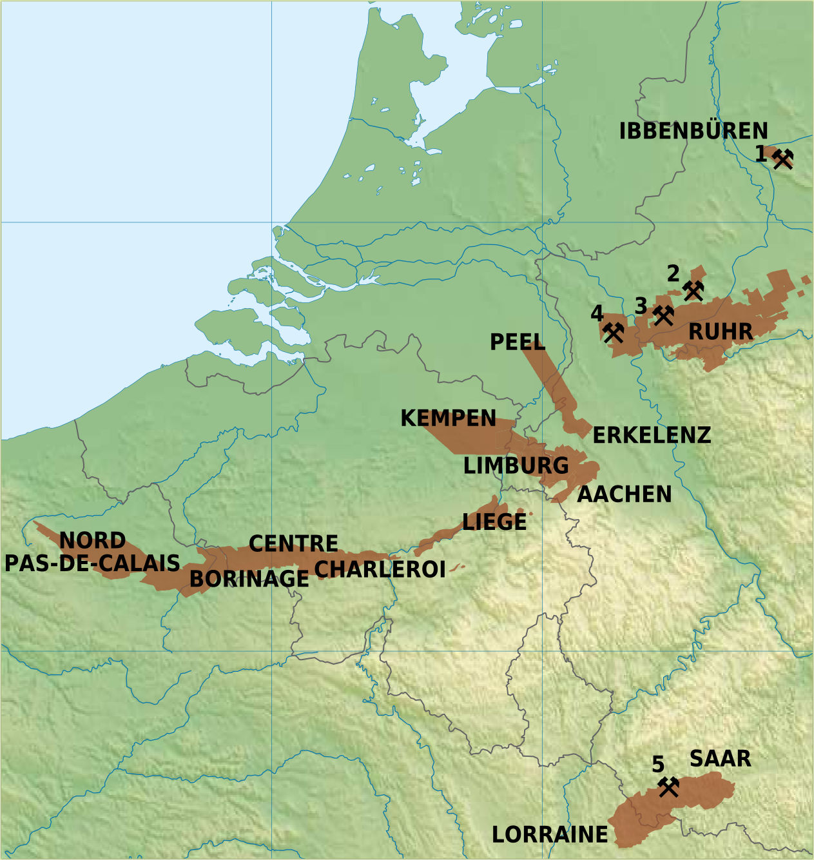
Coal in Germany region
Ruhr
Saar coal field
Minden coal field
Netherlands
Belgium
Germany
Luxemburg
France

Slide 35
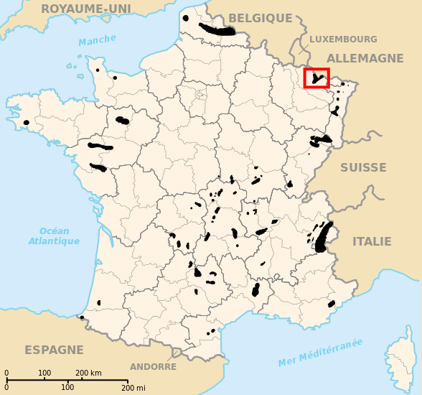
Coal in France
Lorraine region
Loire mining region
Vosges and Jura mountain region
Nord-pas-de-Calais region
Nord- Pas-de-Calais region
Lorraine mining region
Vosges and Jura region
Loire mining region

Slide 36
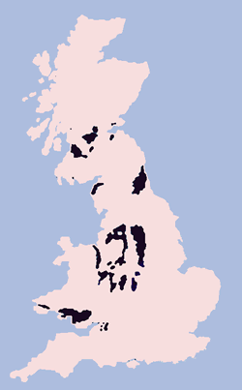
Coal reserve in UK
Most of them now exhausted
Currently, Kellingley, Thoresby , Hatfield
2014 – Kellingley and Thoresby closed

Slide 37
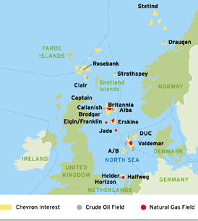
Petroleum reserve
North Sea
UK, Denmark, Norway, Netherlands
Norwegian sea (statfjord oil field) around Svalbard island
Norwegian sea

Slide 38
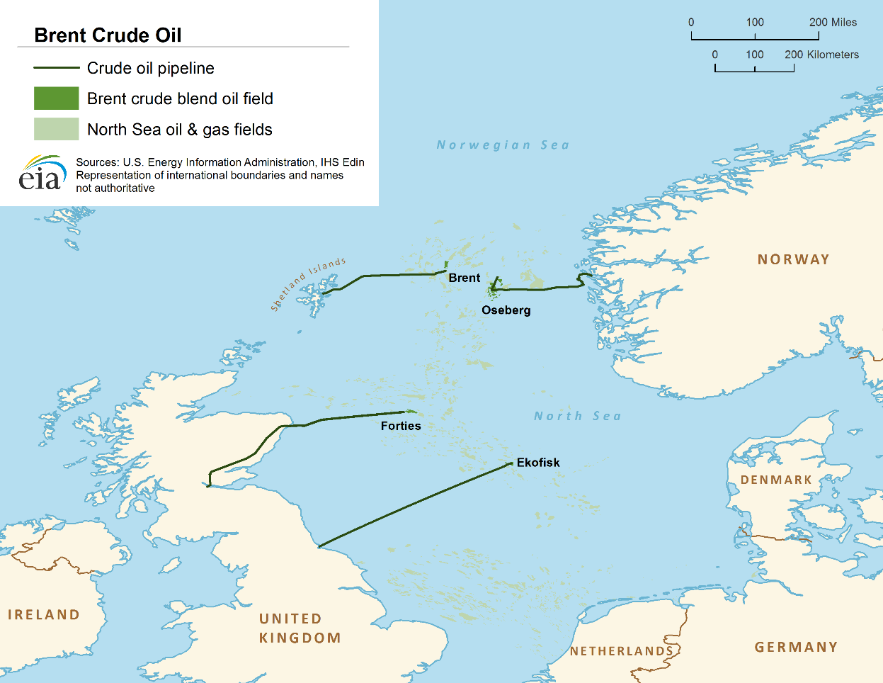
Brent crude oil
Sweet light crude oil
Sweet = low Sulphur (if high –sour crude oil)
Light = low density (produce higher amount of petrol and diesel after refining)
Brent
Oseburg
Forties
Ekofisk

Slide 39
Brent crude oil
Brent crude – major oil pricing benchmark for Atlantic basin crude oil- Other: OPEC, Urals oil, West Texas intermediate (WTI)
WTI – most sweet and light crude oil
Brent
Oseburg
Forties
Ekofisk

Slide 40
Diamond trading at Belgium
Antwerp diamond district (diamond quarter)
Historically – diamond cutting and polishing
Today only trading – 50% of world’s rough, polished and industrial diamonds traded
Diamonds from Botswana, Russia, S.Africa, Angola, Australia, Namibia and DRC
District dominated by Jewish and Indian dealers = diamantaires
Indians are increasingly dominating in Antwerp diamond trading
90% of diamond cutting in the world – in Surat

Slide 41
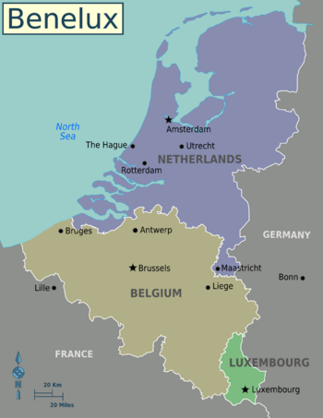
Benelux countries
Benelux = economic union of Belgium +Netherlands + Luxemburg
Est in 1958
Sec-gen –at Brussels (Belgium)
Later joined ECSC – EEC and = EU
Benelux Parliament, Benelux court of justice

Slide 42
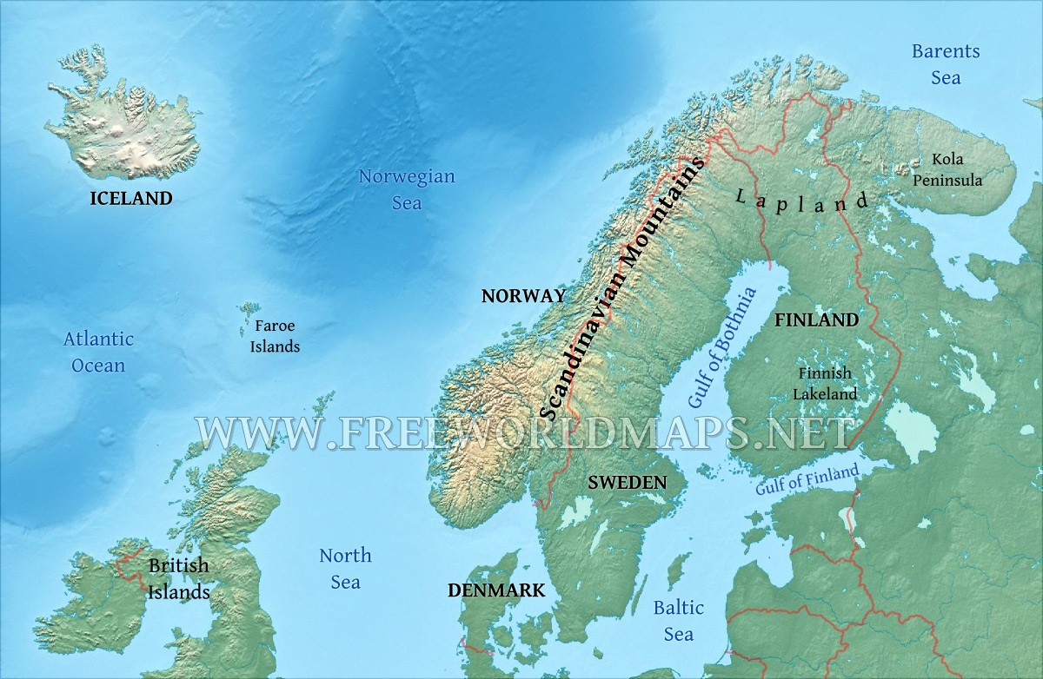
Northern Europe : physical geo
Scandinavia: cultural- linguistic region
Norway, Sweden and Denmark
Nordic countries: Norway, Sweden, Finland, Denmark and Iceland

Slide 43
Nordic countries: economy
Known for Very high HDI
Known for green technologies – HEP and wind energy for electricity
High latitude – Taiga Climate
Coniferous forest- softwood: lumbering and paper industries
Denmark: dairy industries

Slide 44
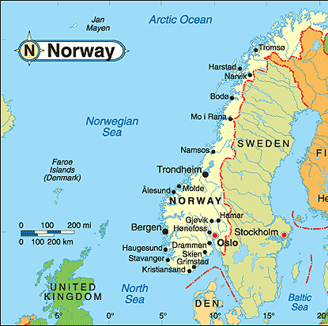
Norway
99% of electricity produced using HEP
Largest producer of solar grade silicon and solar cells

Slide 45
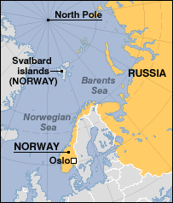
Norway
Svalbard- gold, coal
Northern Norway – gold and copper
Natural gas from North sea, Norwegian sea and Barents sea
Largest petroleum reserve in western Europe
Norwegian sea

Slide 46
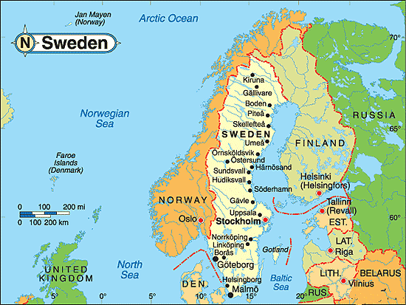
Sweden
~60% energy from HEP and wave power
~35% energy produced by nuclear
Plans for fossil fuel free vehicles by 2030 – vehicles running on bio-fuels (bio-methane)

Slide 47
Sweden
Kiruna mine of iron
Largest underground mine of Iron ore
Gold- Bjorkdal, Kristineberg
Iron
Gold

Slide 48
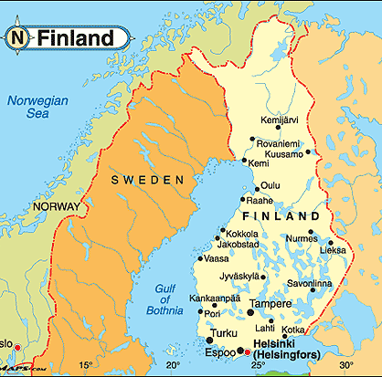
Finland
Energy from HEP, black liquor (by-product of paper industry, forestry), nuclear technology
Most of industrial wood residue is recycled into energy production
Pietarsaari – world’s largest biomass based power plant

Slide 49
Manufacturing centers of Europe
Lodz
Lille
Bilbao
Lyon
Turin
Valladolid
Naples

Slide 50
Manufacturing centers of Europe
city | Main economic activity
Bilbao (Spain) | Iron mining
Valladolid (Spain) | Copper mining
Lyon (France) | Silk –rayon textile, chemical industries
Lille (France) | Textile industries
Turin (Italy) | Automobile and chocolate industries
Naples (Italy) | Automobile, ship building and light aircraft manufacturing
Lodz (Poland) | Textile industries

Slide 51
Manufacturing centers of Germany
Hamburg
Hannover
Dortmund
Frankfurt
Stuttgart
Munich

Slide 52
Industrial centers of Germany
city | Main economic activity
Hamburg | Copper mining, nuclear plants
Hannover | Automobile (Valkswagen)
Dortmund-Essen | Ruhr region, iron and steel industries
Frankfurt | Important global financial center, seat of ECB, Deutsche bank
Stuttgart | Automobile (Mercedes, Porsche)
Munich | Automobile (BMW), electronics (Siemens), finance (Allianz)

Slide 53
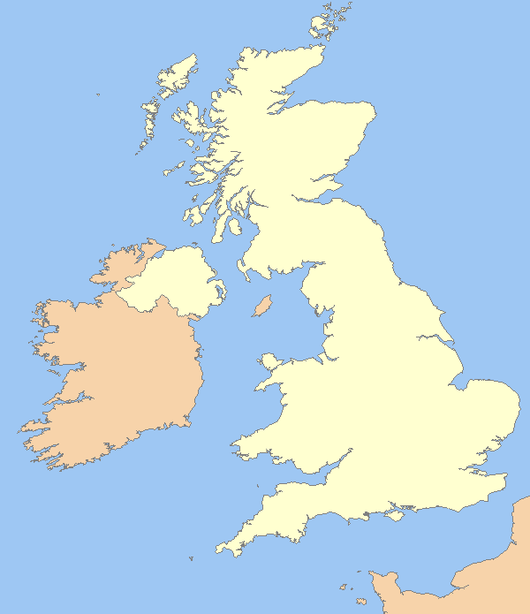
Industrial centers of UK
Glasgow
Edinburg
Birmingham
Coventry

Slide 54
Industrial centers of UK
city | Main economic activity
Coventry | Automobile (Jaguar Land Rover)
Glasgow | Shipbuilding industries
Edinburg (Cap. Scotland) | Steel, optoelectronics, defence manufacturing
Birmingham | Jewelry manufacturing, Cadbury chocolate

