Slide 1
Insolation –terrestrial radiation
Earth receive energy from the sun, so temperature should increase away from the earth surface.
But If we go to top of the mountain, it gets cooler
Earth gets heated not because of short wave solar radiation but long wave terrestrial radiation
Environmental lapse rate = 6.5 degree/km

Slide 2
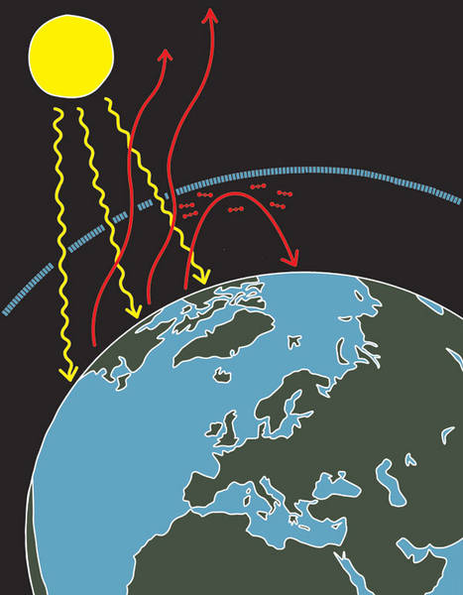
Heat budget
The average temperature of the earth 15 degree
Earth maintains influx and out-flux of the energy, but out-flux is not immediate, it has long time gap. That is why, the temperature is maintained.

Slide 3
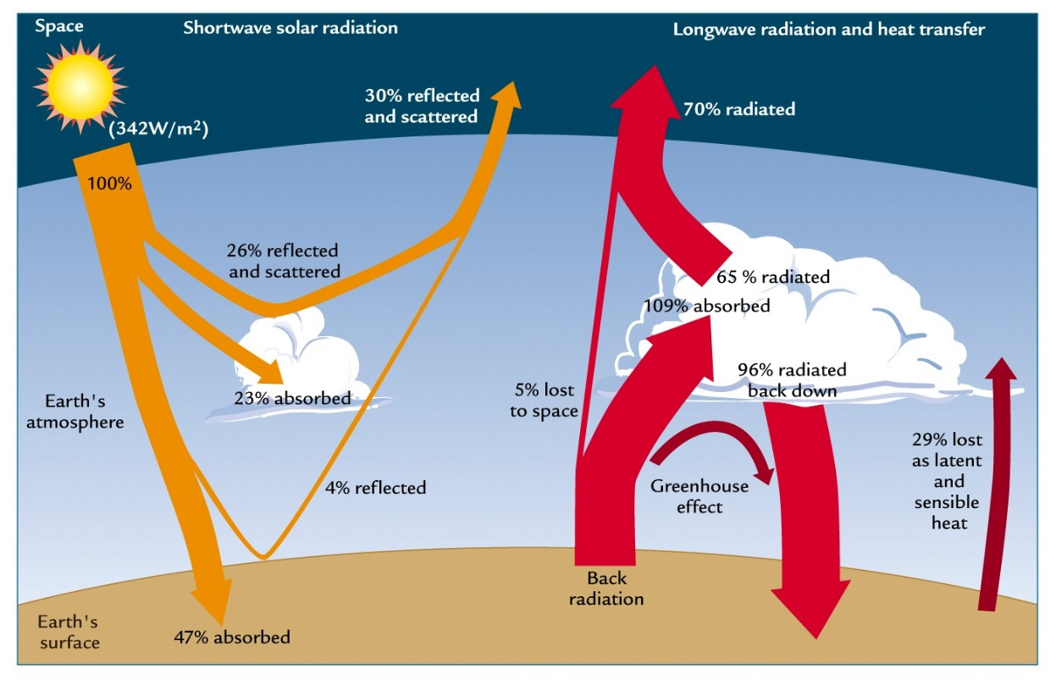
Heat budget - Incoming
First 35% absorbed by Ozone layer
Then 15% by cloud cover
Only 50% energy reached to the earth surface

Slide 4
Heat budget - outgoing
20% is lost in latent heat of evaporation 10% lost in sensible heat (temperature of the body)
15% absorbed by GHGs
Remaining 5% was released in the space

Slide 5
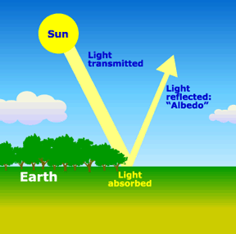
Albedo
Ratio between the total solar radiation falling upon a surface and the amount reflected
Represents as %
Earth’s avg. Albedo = 35%
Lowest- dark soil
highest - snowfall

Slide 6
Albedo - table
surface | Albedo
Fresh snow | 80%-90%
Desert | 35-45%
Grasses | 26%
Crops | 15%
Brick - concrete | 10-20%

Slide 7
UPSC
Question
Q. Which one of the following reflect back more sunlight as compared to other three?
sandy desert
Paddy crops
Land covered with fresh snow
Prairie land
Ans. A)
Prelims
2010

