Slide 1
Indian Geography
Physical geo of India

Slide 2
Geological history of India
Soils of India
Physiography of India
Climatic regions of India
Indian weather: seasons

Slide 3
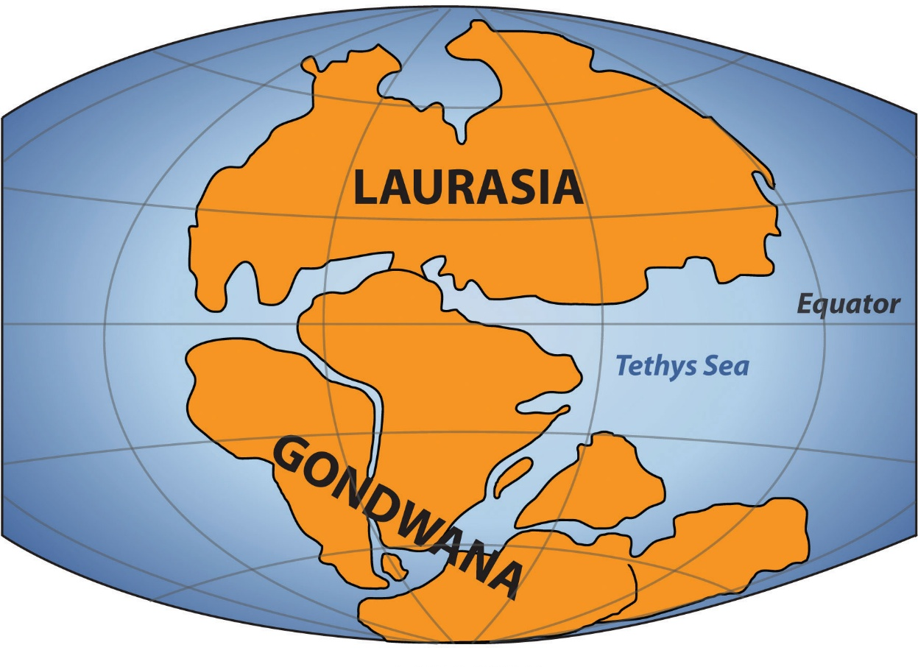
Geological history of India
Pre-Cambrian era
India part of Gondwana land

Slide 4
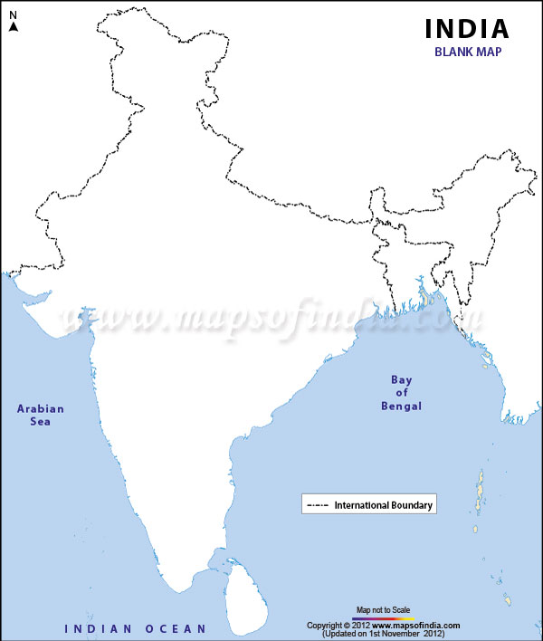
Pre-Cambrian era
Indian Peninsular plate =Oldest crustal block of India
Collision between 3 proto continents
Aravalli
Dharwad
Singhbhum
Aravalli
Singhbhum
Dhrawad

Slide 5
Pre-Cambrian era
3 lineaments
Narmada
Son
Godawari
Remmenants:
Aravalli R, Dharwad plt, Singhbhum plt
Son
Narmada
Godavari

Slide 6
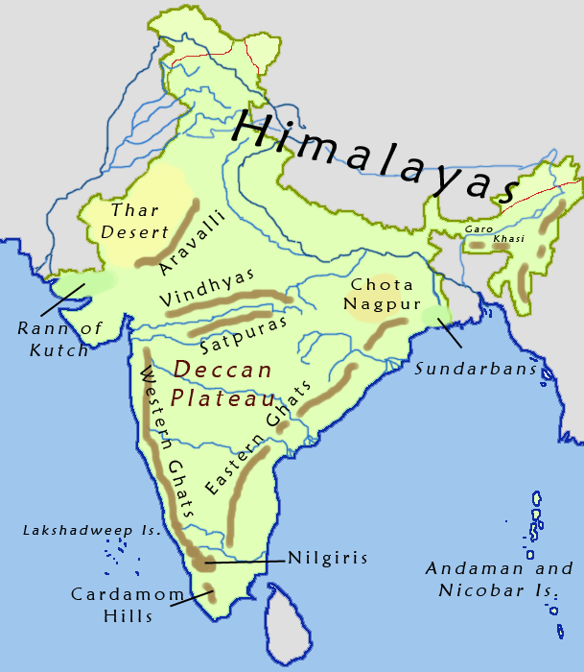
Pre-Cambrian era
Geosynclines at margins of Proto-continents:
Aravalli
Vindhyan
Satpura
Eastern Ghats
Bijawal

Slide 7
Gondwana times
Reactivation of Narmada – Son-Godawari lineament
Rifting of Mahanadi and Damodar valley
Submergence of forest-Development of coalfields
Son
Narmada
Damodar
Mahanadi
Godavari

Slide 8
Gondwana times
Faulting along western edge of peninsular plateau

Slide 9
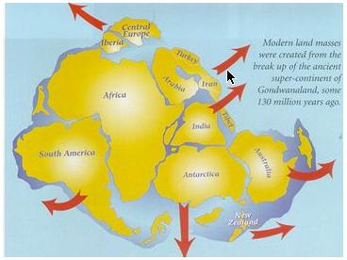
Mesozoic time
150 ml yrs ago Indian plate broke from Gondwana land
Started northward journey
15 ml yrs ago India broke from Madagascar

Slide 10
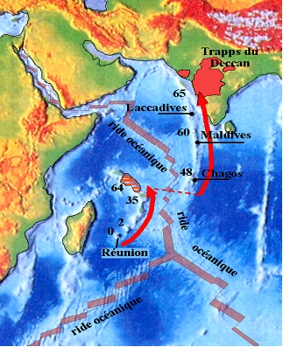
Late Cretaceous
India move over Reunion Islands
Hotspot volcanism
Deccan lava plateau
Narrowing of Tethys sea

Slide 11
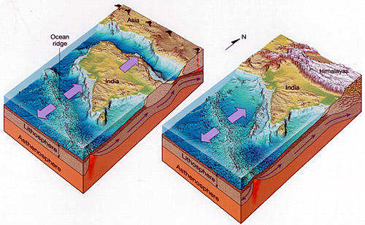
Tertiary time
Collision between Indian plate and Eurasian plate
Upliftment of Himalayas

Slide 12
Tertiary Time
The jerk – activation of crack created at western margin of peninsula
Breaking of western part – subsidence – peninsula raised at western side
Tilted on west-east direction
Western ghats = horst
Slope: South eastern

Slide 13
Tertiary time
1
3 phases of formation of Himalayas:
Great Himalayas (Oligo-Eocene)
Mid-Himalayas (Miocene)
Outer-Himalayas (Pleistocene)
2
3

Slide 14
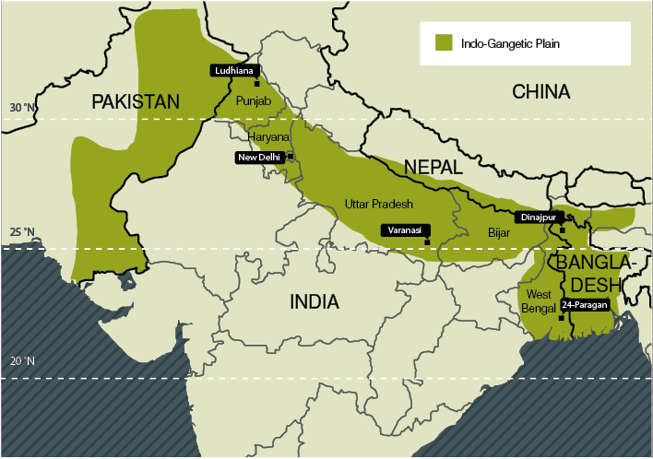
Tertiary time
Late Pleistocene – formation of Northern plains
Sediments from Himalayan rivers

