Slide 1
IBM University Engagement Project Submission
“Exploring the Power of Agentic AI with IBM Granite and IBM Bob”

Slide 2
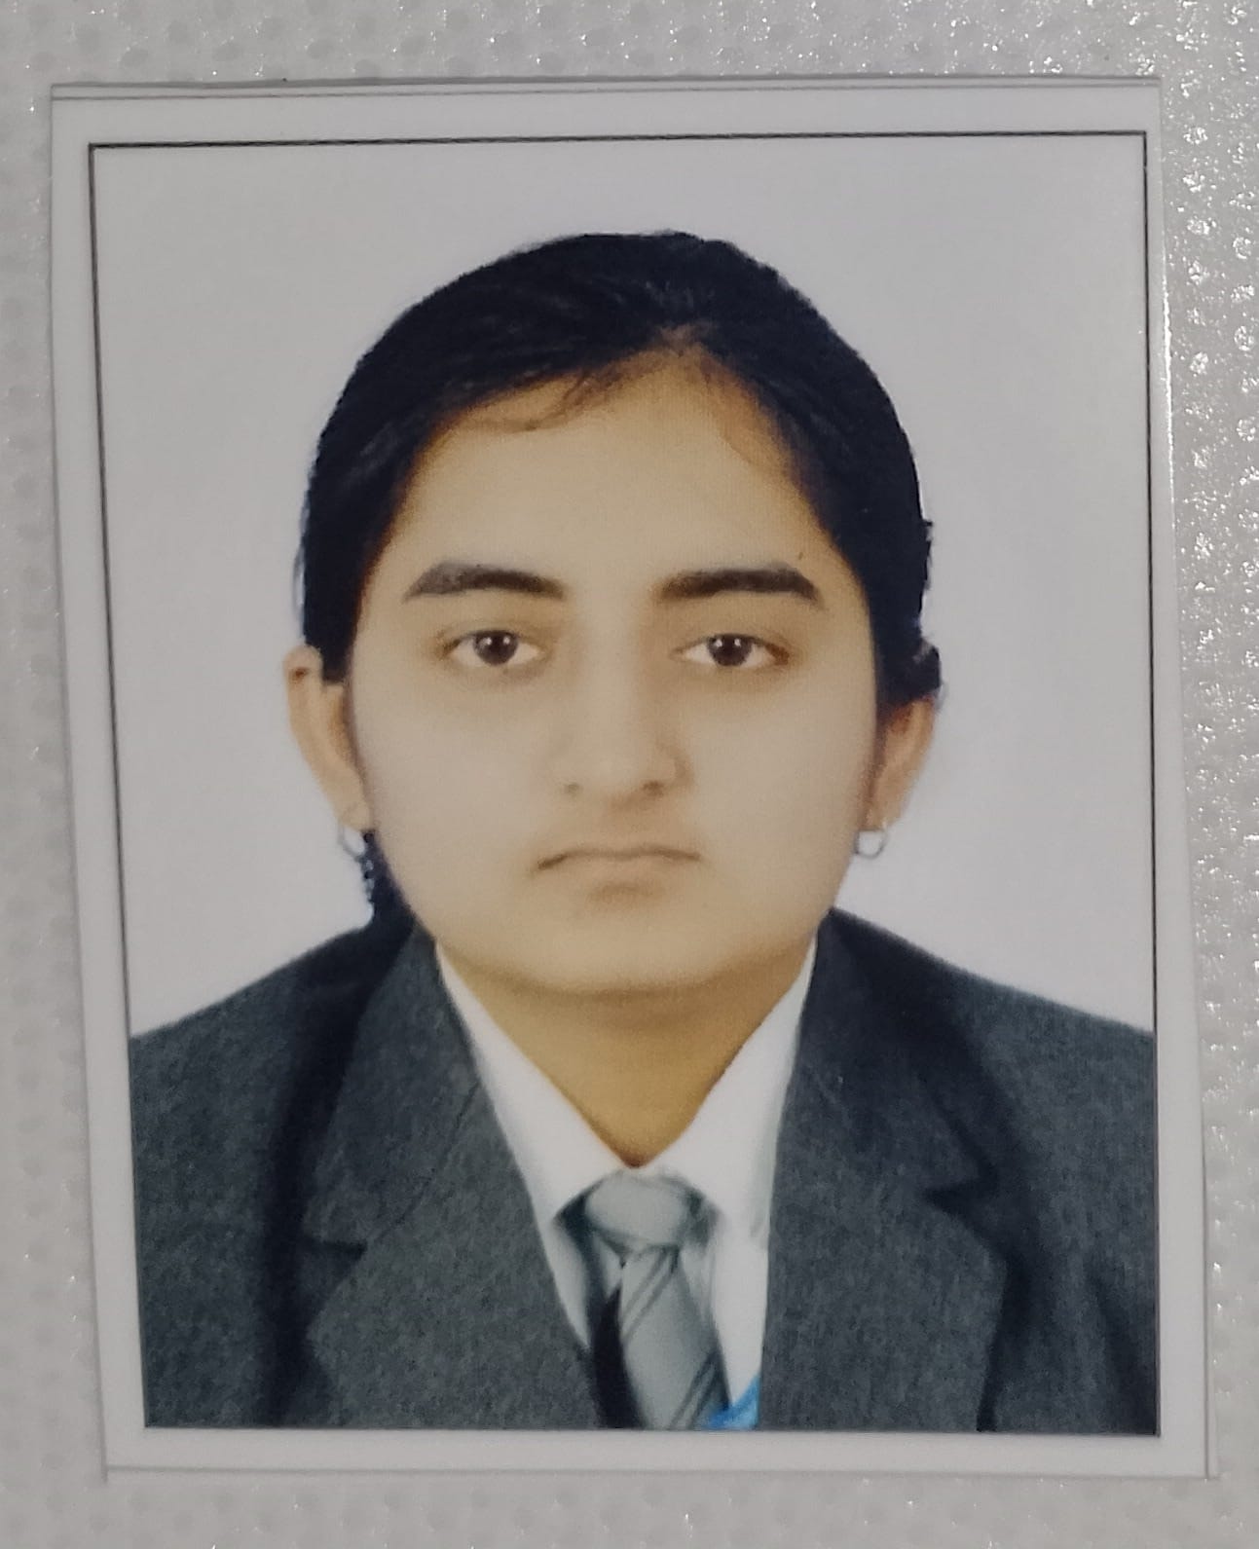
Project Tile – AI Agent for Smart Farming Advice
Domain of Project – Agriculture
Student Name | Recent Passport Photo | Email ID | Mobile number [WhatsApp]
Renuka Sahu |  | renukasahu1220@gmail.com | +91 6264880772

Slide 3
Problem Statement -
Problem Statement : AI Agent for Smart Farming Advice
The Challenge
Farmers often struggle with low crop yield, unpredictable weather, pest infestations, and limited access to timely expert advice. Traditional farming advisory services are fragmented, slow, and not personalized to the farmer’s specific land, crop, or climate conditions. With the rise of climate change, data-driven smart farming solutions are needed to empower farmers with actionable insights.
The Objective
Develop an AI-powered Smart Farming Agent that provides personalized, real-time, and sustainable agricultural advice. The solution should:
Agricultural Knowledge Retrieval (RAG) – Use Retrieval-Augmented Generation to fetch best practices, crop-specific guidelines, and government advisory updates.
Weather & Soil Insights – Integrate real-time weather forecasts, soil health data, and irrigation needs to optimize farm planning.
Pest & Disease Detection – Enable multimodal support where farmers upload crop images for early pest/disease identification and get instant recommendations.
Personalized Advisory Agent – Suggest seeds, fertilizers, irrigation schedules, and harvesting timelines based on farmer profile and land conditions.
Market & Cost Optimization – Forecast demand, suggest market prices, and recommend cost-efficient practices for better income.
Multi-Agent Collaboration –
  Crop Advisory Agent
  Weather & Irrigation Agent
  Pest/Disease Detection Agent
  Market Insights Agent

Slide 4
Proposed Solution -
Proposed Solution — FarmTwin AI
FarmTwin AI – AI-Powered Digital Twin for Smart Farming
FarmTwin AI is a multi-agent intelligent farming platform that creates a digital twin of the farmer's field by combining crop, soil, weather, pest/disease and market data. It uses IBM Granite, Langflow and watsonx Orchestrate to analyze farm conditions and provide personalized, real-time and actionable recommendations.
Key Solution Components
Crop Advisory Agent – Recommends suitable crops, seeds, fertilizers and harvesting schedules.
Weather & Irrigation Agent – Analyzes weather and soil moisture to optimize irrigation and reduce water wastage.
Pest & Disease Agent – Uses crop images and IBM Granite Vision to identify possible diseases/pests and suggest preventive actions.
Market Insights Agent – Analyzes market prices, yield and production costs to identify profitable selling opportunities.
FarmTwin Decision Engine – Combines insights from all agents to generate a single personalized Farm Action Plan.
RAG Knowledge System – Retrieves reliable agricultural guidelines and government advisories before generating recommendations.
What-If Simulator – Allows farmers to test decisions such as reducing irrigation, changing fertilizer or delaying harvest and see the expected impact on yield, cost, profit and sustainability.

Slide 5
Technology Used
IBM Bob Platform – For designing and orchestrating the multi-agent farming workflow.
IBM Granite Models – For AI reasoning, personalized recommendations, and crop-image analysis.
IBM Langflow – For building the RAG pipeline and retrieving reliable agricultural knowledge.
IBM watsonx Orchestrate – For coordinating Crop, Weather, Pest/Disease, and Market AI Agents.
IBM watsonx.ai – For IBM model deployment, embeddings, inference, and AI capabilities.
Python & FastAPI – For backend development, REST APIs, decision engine, and farm calculations.
SQLite + HTML/CSS/JavaScript – For data storage and building the interactive Smart Farming dashboard.

Slide 6
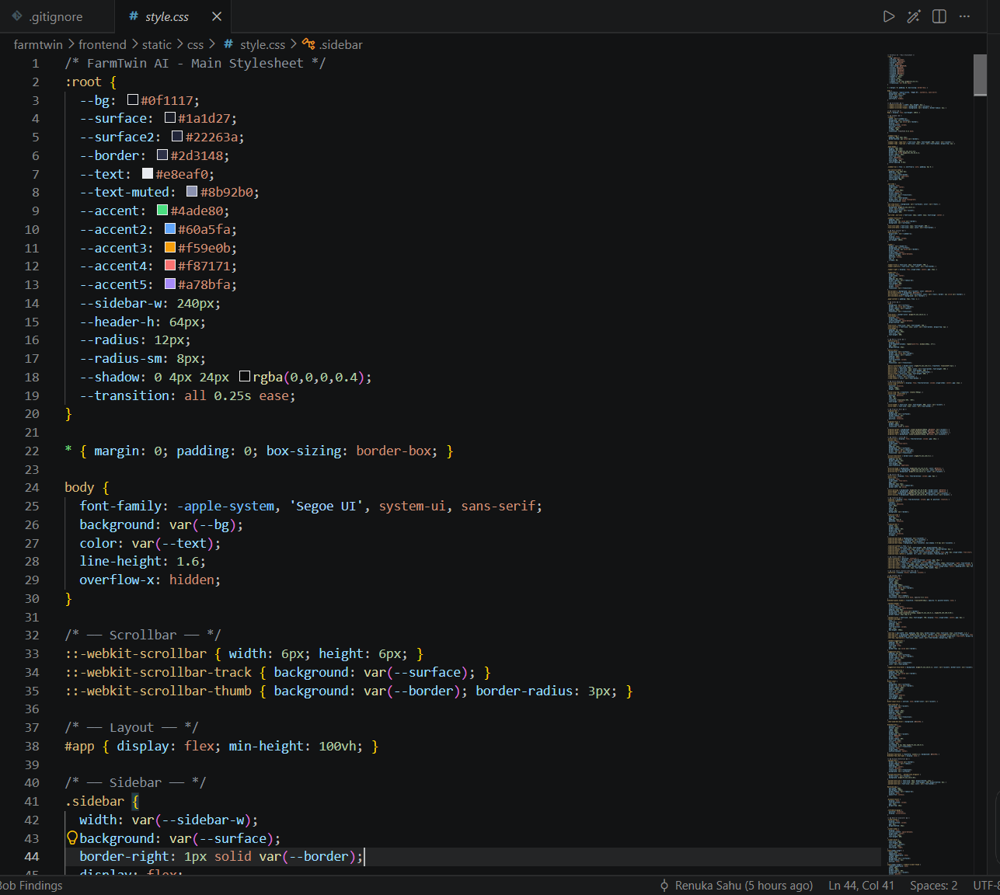
Required Files created using IBM bob -
Style.css

Slide 7
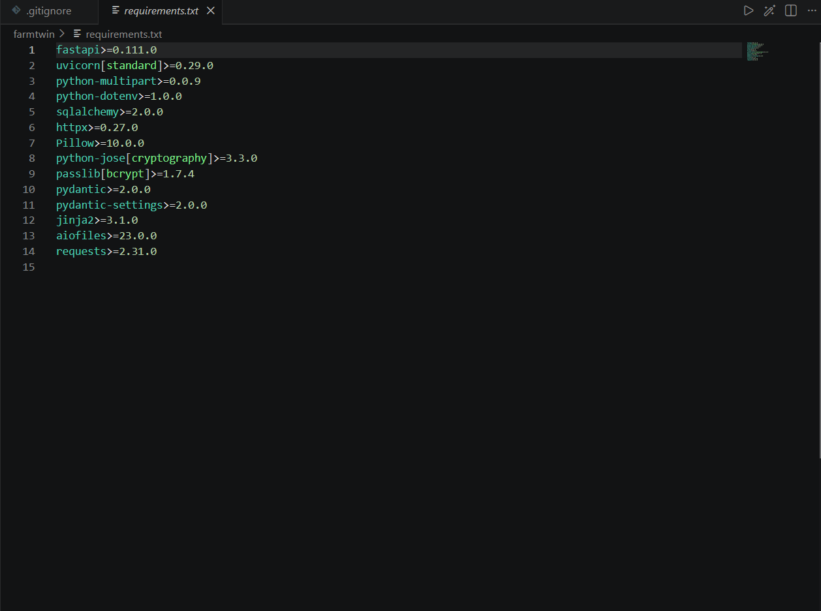
Requirements.txt

Slide 8
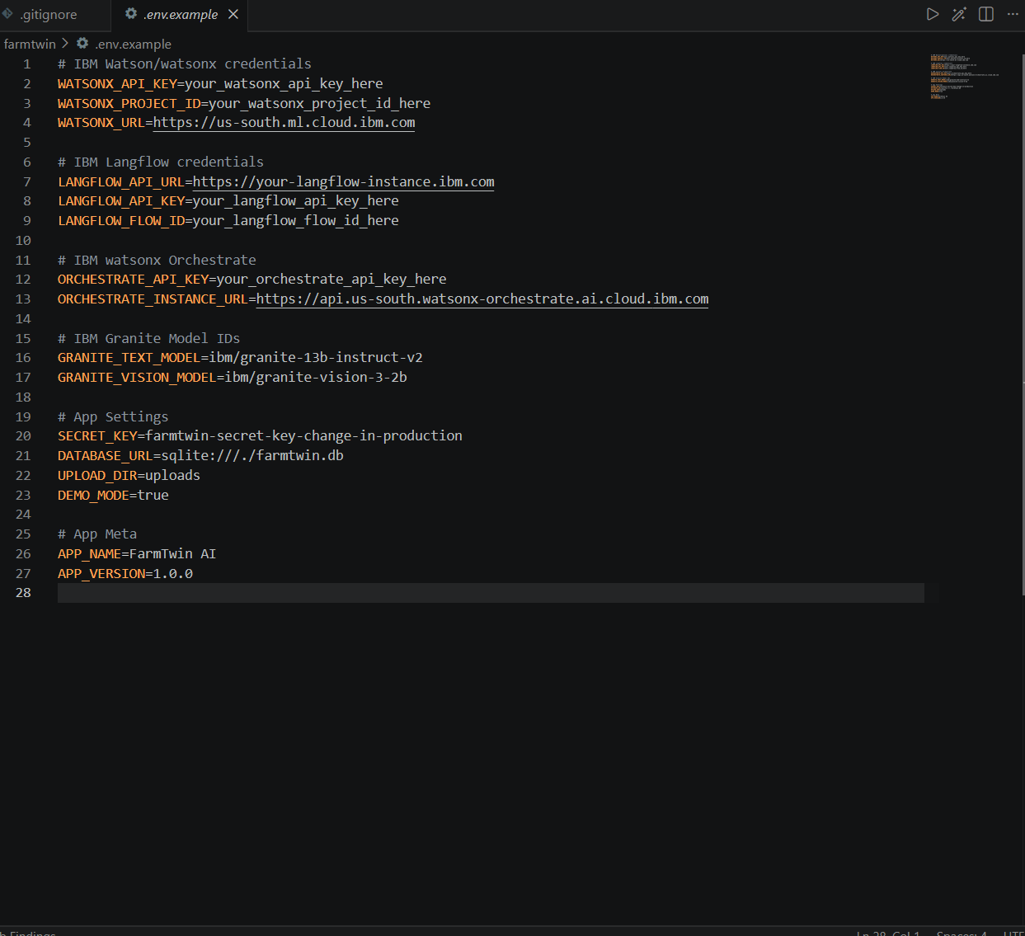
env.

Slide 9
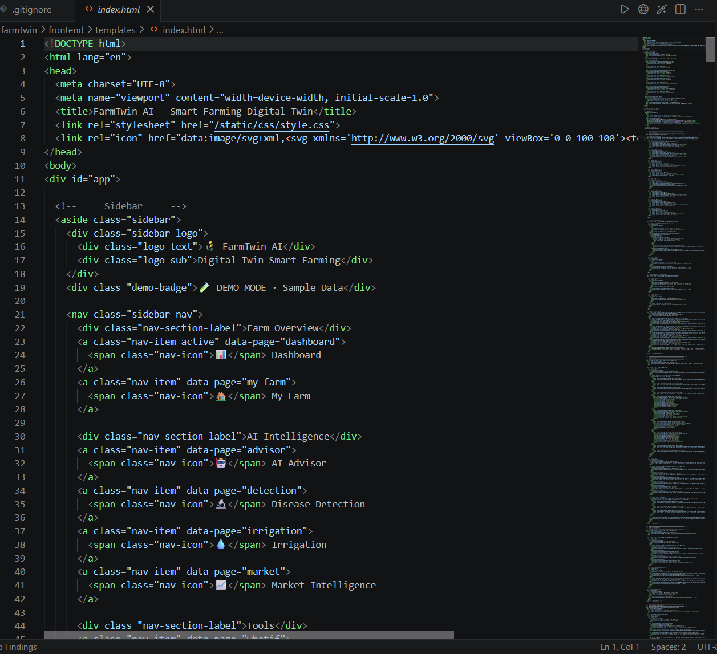
index.html

Slide 10

Role of Agentic AI in the solution
Role of Agentic AI in FarmTwin
Agentic AI acts as the intelligent decision-making layer of FarmTwin AI. Instead of providing generic farming advice, multiple specialized AI agents independently analyze crop, weather, soil, pest/disease, and market conditions, then collaborate through IBM watsonx Orchestrate to generate one personalized farm action plan. The agents continuously evaluate farm conditions, identify risks, recommend actions, and adapt decisions based on changing conditions. IBM Granite provides AI reasoning, while IBM Langflow enables RAG-based retrieval of reliable agricultural knowledge and advisories.
Key Roles
Crop Agent: Crop care, fertilizer, seeds and harvesting advice.
Weather & Irrigation Agent: Weather-based irrigation and water optimization.
Pest/Disease Agent: Crop-image analysis and early disease detection.
Market Agent: Price, yield, cost and profit analysis.
Decision Engine: Combines all agent outputs into a single actionable recommendation.
Agent Collaboration: Agents communicate and coordinate to make context-aware farming decisions.

Slide 11
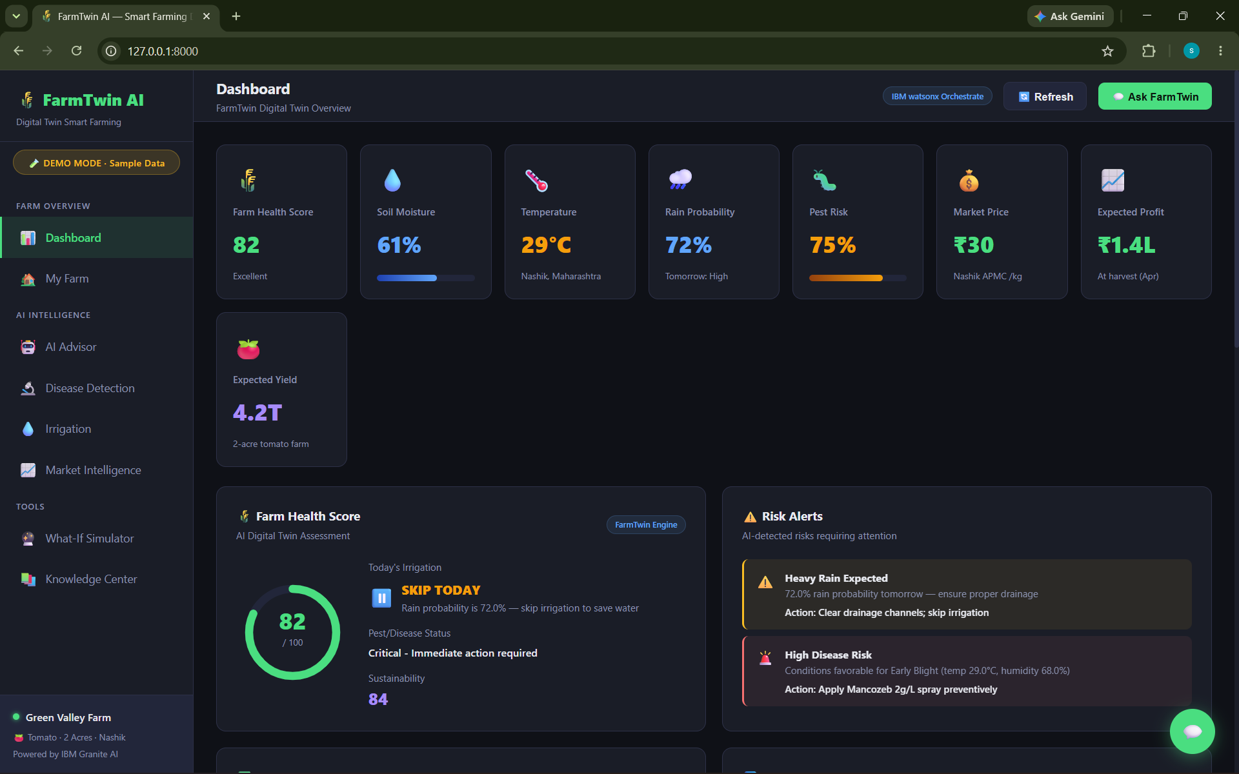
Project Output Screenshot
·
·
·

Slide 12
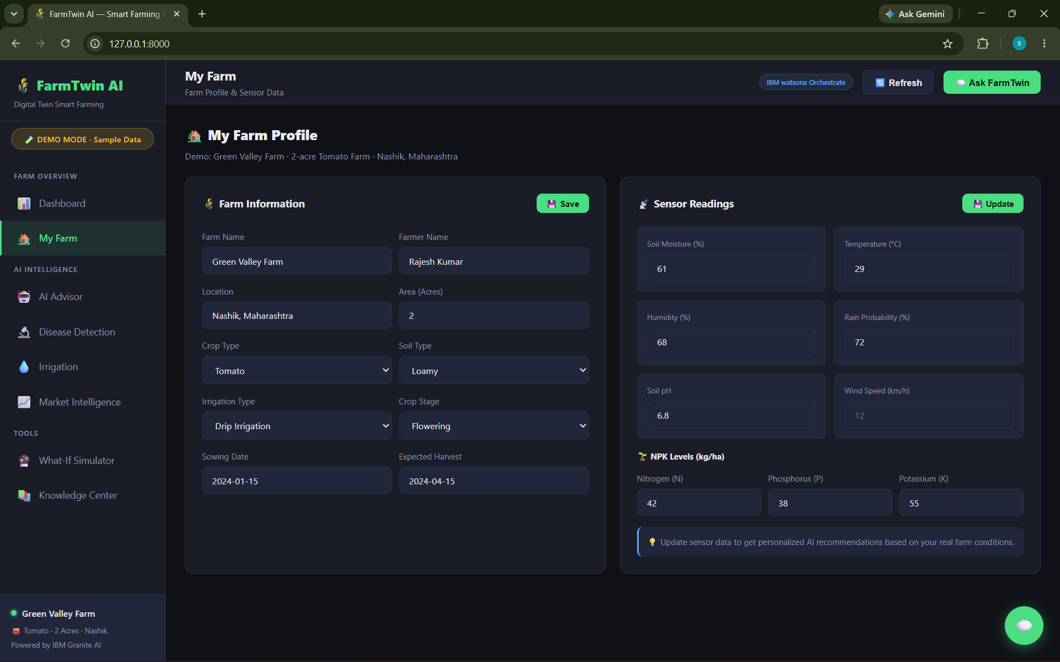
Project Output Screenshot
Please put IBM Bob output screenshots with 2-3 prompts.
You can take 2-3 more slides for each screenshot
·
·
·

Slide 13
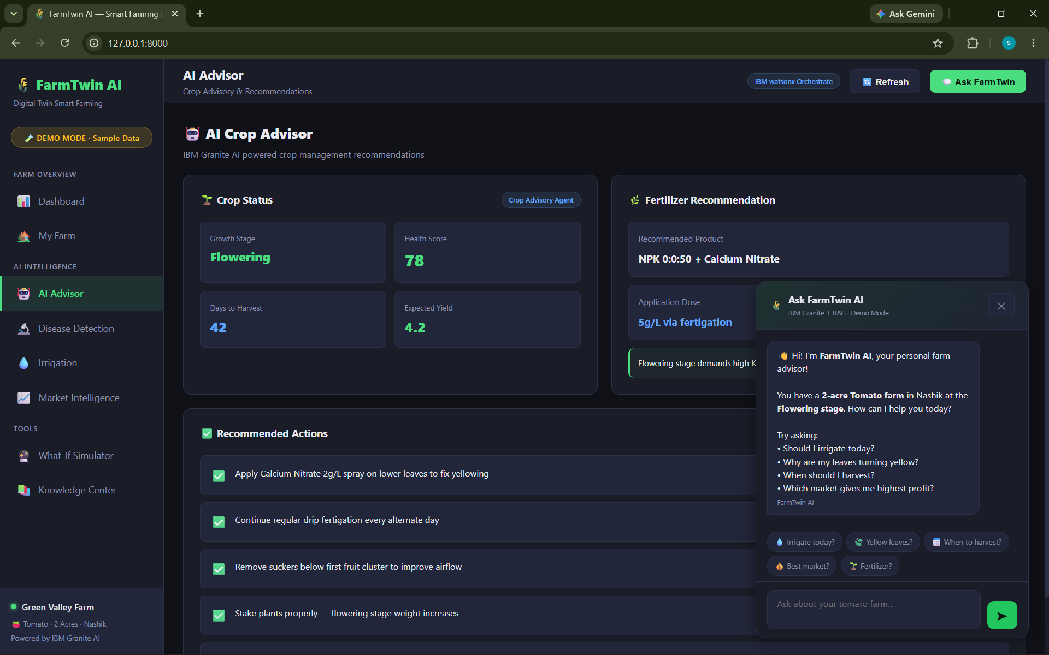
Project Output Screenshot
Please put IBM Bob output screenshots with 2-3 prompts.
You can take 2-3 more slides for each screenshot
·
·
·

Slide 14
Novelty and Uniqueness
FarmTwin AI – A Digital Twin for Smarter Farming
Digital Twin of the Farm – Creates a virtual representation of the farmer's field using crop, soil, weather, pest and market data.
Multi-Agent Collaboration – Four specialized AI agents work together instead of providing isolated recommendations.
One Unified Farm Action Plan – The Decision Engine combines all agent insights to provide a single, personalized recommendation for the farmer.
AI + RAG-Based Advisory – Uses IBM Granite with Langflow RAG to provide context-aware advice grounded in agricultural knowledge and advisories.
Vision-Based Early Detection – Farmers can upload crop images to detect possible pests and diseases and receive recommended actions.
What-If Decision Simulator – Farmers can test decisions such as “What if I reduce irrigation by 20%?” and see the estimated impact on water, yield, cost, profit and sustainability.
Profit + Sustainability Optimization – Goes beyond crop yield by balancing income, resource efficiency and environmental sustainability.

Slide 15
Git Hub Link
https://github.com/sahurenuka1220-a11y/FarmTwin-AI
·
·
·

Slide 16
Future Scope
IoT Sensor Integration – Connect real-time soil moisture, temperature, humidity and nutrient sensors for continuous field monitoring.
Drone & Satellite Monitoring – Use aerial imagery to monitor crop health, water stress and affected areas across large farms.
Advanced Yield Prediction – Improve yield forecasting using historical crop, weather, soil and satellite data.
Regional & Local Language Support – Provide voice-based farming advice in regional Indian languages for wider accessibility.
Real-Time Market Integration – Connect live mandi/market data to recommend the most profitable selling location and time.
Automated Irrigation – Integrate smart irrigation systems so recommendations can automatically control water usage.
Climate Risk Prediction – Predict droughts, floods, heat stress and other climate-related risks and provide preventive actions.
Scalable Multi-Farm Digital Twins – Extend FarmTwin AI from individual farms to villages, agricultural communities and large-scale farming operations.
·
·
·

Slide 17

Certificates Earned:

Slide 18
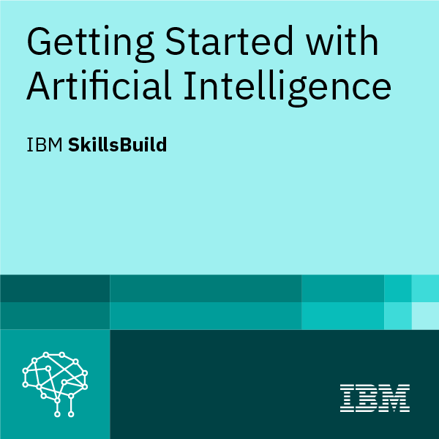
Certificates Earned:

Slide 19
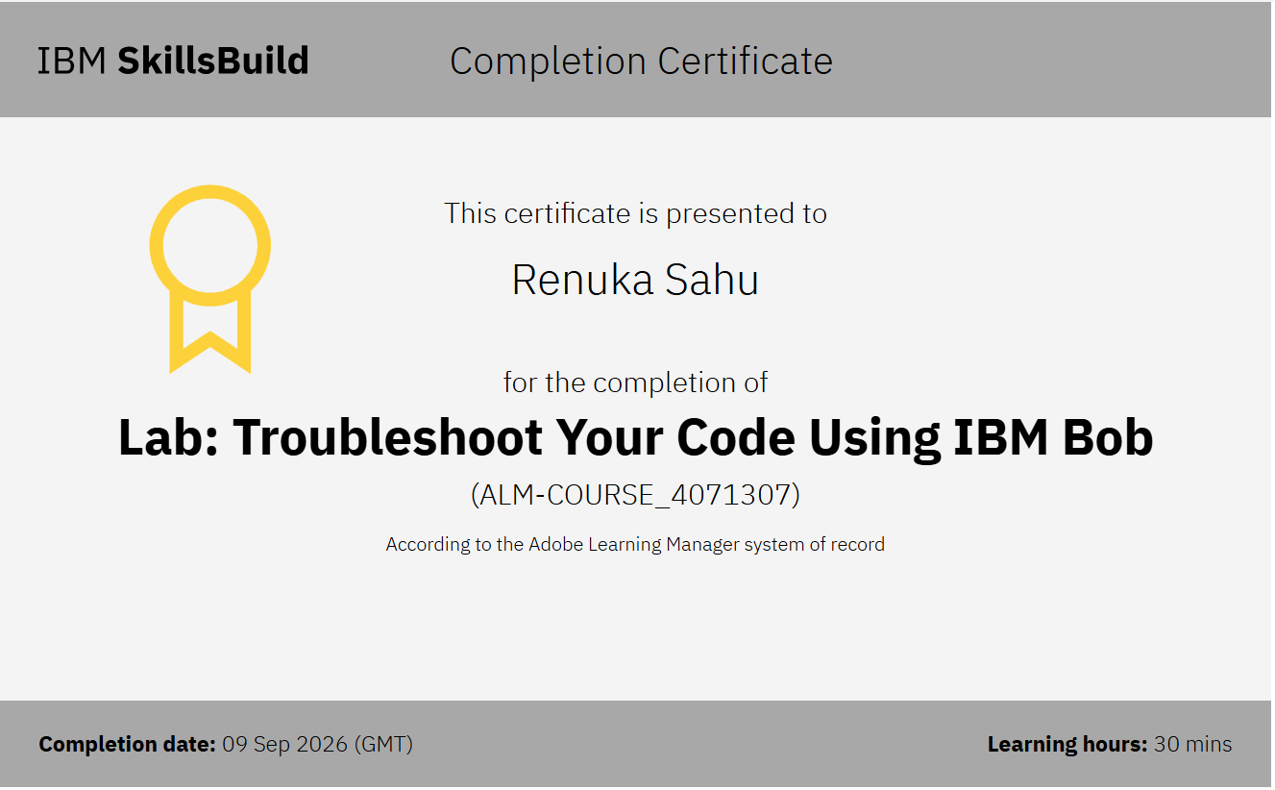
Certificates Earned:​
IBM BOB Certificate

Slide 20


