Slide 1
HACKSHIFT 2026
HACKSHIFT 2026
Theme – Building a Network, Not a Directory.
Team Name – ARROWS
Team Member Names :
UNITRACKER
Smart Student Event Hub
Mridul Bharadwaj (Backend, Core Logic & APIs);
Advit Goel (DB Management & Frontend);
Vidit Krishnatre (Backend, Core Logic & APIs);
Shreyansh Sahu (Presentation, Frontend Development) – (TEAM LEAD);
Aayush Acharjee (Figma & UI).
1. Gmail OAuth + Telegram Bot
2. Gemini 2.5 API + Poster OCR
3. Clarified Timeline
One-line Solution : An AI workflow that turns emails confirmations & WhatsApp opportunities updates into a live timeline.
@UniTracker (Team ARROWS)
1

Slide 2
PROBLEM
HACKSHIFT 2026
Problem-Statement :
Students register for multiple events, competitions, workshops, hackathons, and conferences, but their registrations, deadlines, venues, and schedules are scattered across different platforms.
Target – Users :
  Students & Hackathon Teams: Never miss a submission window, shortlist announcement, or campus departure time.
  College Societies & Organizers: Higher verified participant turnout at offline rounds and fewer deadline queries.
  Working Professional : Manage their meetings ,events and tasks at a single platform with zero-manual clicks.
Existing Gaps :
Medium
  Manual data entry, tracking multi-round states manually and pining PPT/Discord links to notes apps for being updated about different events.
  Different platforms for different events make the task management more complex as registration happens on different platform.
@UniTracker (Team ARROWS)
2

Slide 3
Proposed Solution
HACKSHIFT 2026
UniTracker : An AI workflow that turns emails & WhatsApp posters into a live timeline cards
UNITRACKER — PREVIEW
1. Forward WhatsApp poster to Telegram or auto-sync Gmail
Detailed explanation :
  Auto-Syncing Email Pipeline: Read-only Gmail OAuth filter captures Unstop/Devfolio confirmations and shortlist emails automatically.
  Forward-to-Bot WhatsApp Ingestor: Students forward any fest message or poster image to our bot for instant LLM + Vision OCR extraction.
  Multi-Stage Event Timeline: Merges Round 1 PPT, Shortlist, and Offline Finale updates into one progressive competition card.
Innovation and uniqueness of the solution :
  Deliverable & Asset Vault: Pins PPT templates, Discord links, and QR passes directly inside the timeline card.
  Smart Clash & Travel Guard: Flags exam overlaps and calculates 'Leave Campus By' buffer time.
“HackShift 2026! PPT due Oct 15, Finale @ IIITD Oct 17”
Submit
2. Three-stage pipeline extracts & merges rounds
GEMINI 2.5
JSON + Poster OCR
REVIEW
Gmail + Telegram Bot
MERGE
Merges rounds
Confirmation emails & updates merge into one parent card
3. Event Card & Buffer time
CURRENT STAGE
SHORTLISTED
LEAVE CAMPUS BY
07:15 AM
Resources: [PPT Template] [Discord Link] [QR Pass] • Route: Gr. Noida → IIITD
@UniTracker (Team ARROWS)
3

Slide 4
TECHNOLOGY
HACKSHIFT 2026
Technology Stack and Methodology
Gmail Confirmation or WhatsApp Poster
Technology stack :
  Frontend & UI: HTML5, CSS3, Bootstrap CSS, React.js (Timeline + Kanban views) , Next.js and Figma.
  Backend & Logic: JavaScript, Python.
  AI & OCR Engine: Gemini 2.5 Flash API and Vision OCR.
  Database & APIs: MySQL, Gmail API (OAuth2), Twilio WhatsApp / Telegram Bot, Google Maps API.
Methodology :
  Dual-Channel Ingestion: Confirmation emails and forwarded WhatsApp posters enter the Fast API sanitizer queue.
  Schema & Entity Resolution: Gemini extracts event name, rounds, deadlines, venue, and links, Nested-Dictionaries merges rounds.
  Proactive Action Sync: Calculates travel-time buffers and syncs blocks to Google Calendar.
FASTAPI & OAUTH
Filters event senders & preprocesses poster images
GEMINI 2.5 FLASH
Extracts structured JSON & Vision OCR for poster.
Preventing Duplication & MERGING
Links Round 1, Shortlist & Finale into 1 card
SMART COMMUTE ENGINE
Flags exam overlaps + calculates travel-time buffer
UNIFIED TIMELINE & TASK PRIORITY
MySQL DB + Google Calendar Sync
@UniTracker (Team ARROWS)
4

Slide 5
INNOVATION & IMPACT
HACKSHIFT 2026
Impact and Value Created
Benefits & Scalability :
  Operational: Zero manual calendar typing and instant access to resources before a deadline.
  Zero Training Overhead: Uses Gemini 2.5 API and MySQL Database.
  Travel Time: Live Buffer time calculator for travelling.
  Scalability: Uses Telegram Bot API, match event tokens and date to merge multi-round updates into one card via Python Deduplication.
How UniTracker Beats Existing Trackers :
  Google Calendar / Notion: Eliminates manual data entry, tracks multi-round states, and pins PPT/Discord links inside the card.
  Unstop / Devfolio / Luma: Works across every registration portal(by fetching the registration confirmation email) plus informal college WhatsApp/Telegram forwards.
Potential Impact :
  Students & Hackathon Teams: Auto-managing the tasks at single dashboard makes the workflow efficient & social links and commute buffers in one card prevents missed rounds and late arrivals.
  Working Professionals: Merging scattered invites and meeting links with zero manual clicks which eliminates app-switching and double-booked meetings.
0
< 3s
3-in-1
manual clicks to log events from Gmail or WhatsApp
end-to-end extraction from poster to live timeline
rounds, resources vault & commute buffer time in one card
Who benefits and How
Students
Zero missed rounds, pinned PPT/Discord links & commute alerts
Working Professionals
Manage their meetings ,events and tasks at a single platform with zero-manual clicks.
BUILT FOR
Hackathon Teams • Working Professionals • Student Individuals
@UniTracker (Team ARROWS)
5

Slide 6
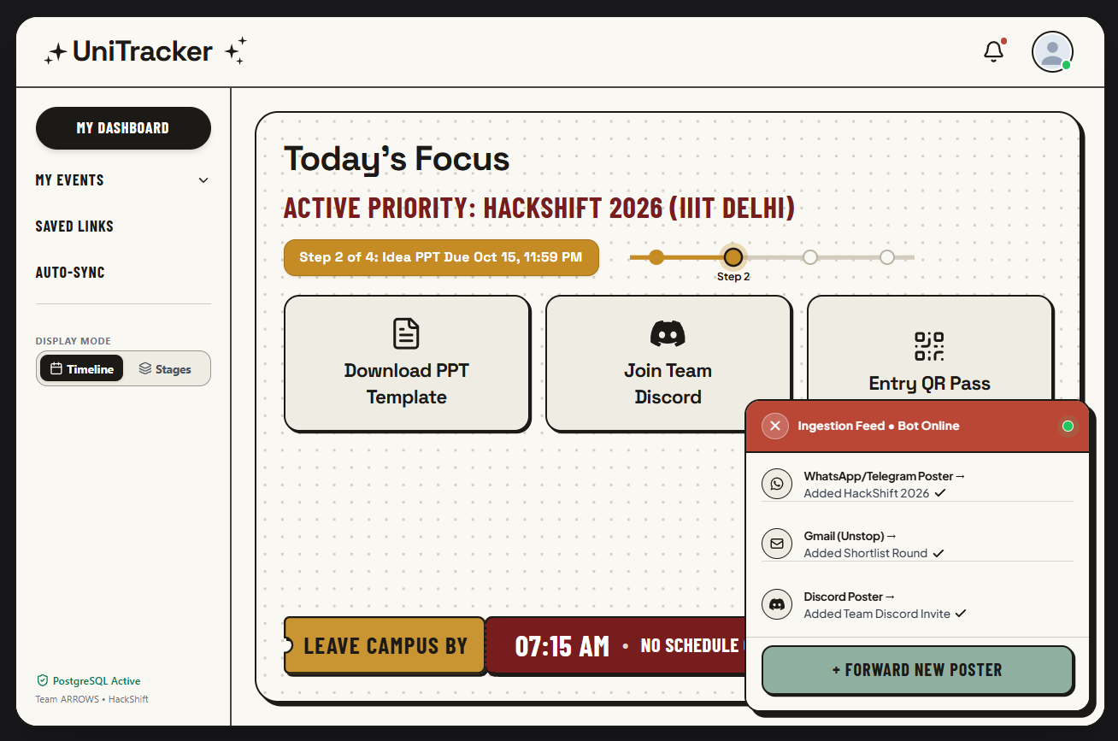
PROTOTYPE & EXECUTION
HACKSHIFT 2026
Prototype Snaps and Team-Execution Plan
24 Hours Hackathon Build Plan
Gmail OAuth read-only filter, WhatsApp Bot integration, UI/UX Designing
PHASE 1
PHASE 2
MySQL Database and Python Integration
PHASE 3
Google Maps API and buffer time calculation
Google Calendar export, live forward testing & presentation preparation
PHASE 4
@UniTracker (Team ARROWS)
6

