Slide 1


FOODZZ INFINITY
SHAH & ANCHOR KUTTCHI ENGINEERING COLLEGE
GROUP NO 9
__________________________________
MEMBERS
SE3_48 -> VARUN SAMPAT
SE3_10 -> KRISHI DAVE
SE3_46 -> KSHITIJ ROTE
SE3_47 -> SURAJ SAHU
MENTOR
MS. MEGHA MANDAVKAR

Slide 2
Overall Aim Of The Project :
1.It allows customers to order food easily , as it has varying kinds and options.
2.No installation required , Web-Based.
3.Contain Low Storage Compared To Apps.
4.Easy To Order Anytime , Anywhere.

Slide 3
WHY THIS
PROJECT?

Slide 4






Survey :
We had visited the following Websites for getting an idea about this project and gathering the details about their products.

Slide 5
ADVANTAGES :
This project will help to organize data of different apps.
This app would make the ordering process easy and access to a lot of brands.
Buyers don’t have to install all apps rather they can order through a single app,also the food will be delivered at their doorstep.

Slide 6
DISADVANTAGES :
Lack of restaurant experience.
No query resolution.
Time taking.
Slightly more expensive than individual apps.
Wouldn’t work for long distances.

Slide 7
FUNCTIONS :
1.Easy app management.
2.Easy menu management.
3.Easy access to more restaurants.
4.Easy user settings.
5.Payment tracking.

Slide 8
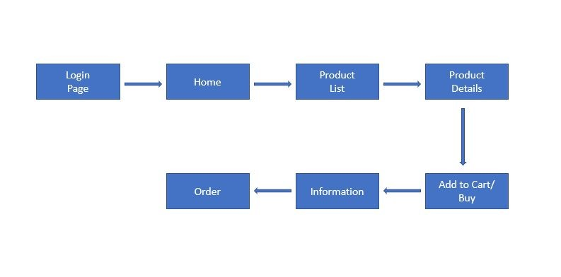
Block Diagram:

Slide 9
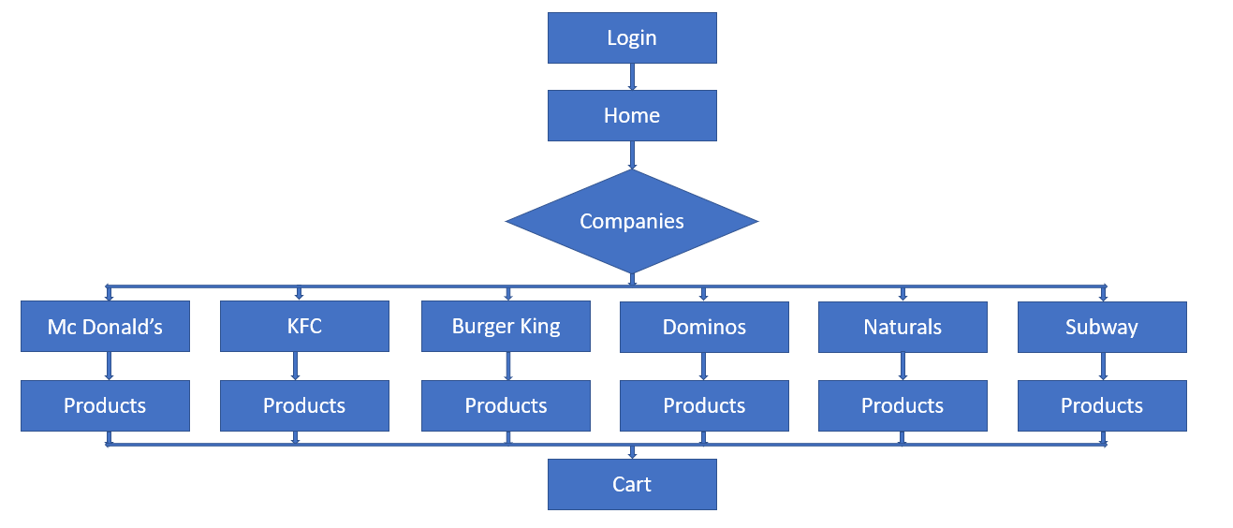
Flow Chart:

Slide 10
SKILLS REQUIRED :
<?php>
HTML - For making the layout of Website.
CSS - For Designing the Website and for adding Animations.
JAVASCRIPT - For making the Website Dynamic.
PHP - For Server-Side Scripting.
MYSQL - For Database Management
<style>
<html>

Slide 11
FEASIBILITY :
No investment/extra fees needed is required.
It is created by using web development skills/tools such as html, css , javascript , php , SQL.
It is a user friendly website.
The project would be feasible in a time span of 4 months.

Slide 12
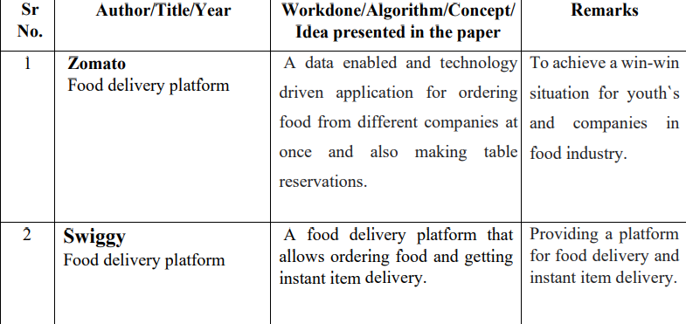
Literature Survey

Slide 13
Limitation
Earlier Customer have to stand in queue for ordering the food. After using this feature it is simple and convenient for customer to order food. But there is lack of user interaction with Server (Waiter).
Queries resolution is difficult for customer and also time consuming.
Ordering food online customers have limited options that are present at site only.
Customer have to wait on table until their order get processed. Sometimes there is a glitch while Ordering the food.
There might be payment related issues while doing transition. People who want to pay cash are unable to use this Features.

Slide 14

Motivation
Technology makes everything easier in our life.Then why not ordering our favorite food at sitting at one place.We all have visited mall once or we visit frequently and after everything is done we do visit food courts.But firstly we have to visit every store for “What to eat ?”.
Ever wondered what if we could get our food by sitting at one place that to without visiting any store could make it easy for everyone. This has motivated us to create a food ordering website where we can order our favorite food while visiting food courts that too sitting at one place.

Slide 15
Problem Statement :
• The labor rates are increasing steadily year on year thus making it difficult to find employees
• The food industry is highly labor intensive and the biggest expense in the food industry is the cost of employing the right kind of people to do the work
• One of the ways to reduce this expense is to use modern technology to replace some of the jobs done by human beings and make machines do the work
• Here we propose an “Online Food Ordering System – Foodzz Infinity” that has been designed for Fast Food restaurant, Take-Out or College Cafeterias. The system can also be used in any food delivery industry. This simplifies the process of food ordering for both the customer and the restaurant, as the entire process of taking orders is automated.

Slide 16
Software requirements
Code Editors like Visual Studios Codes.
Computer languages like HTML, CSS, JAVASCRIPT.
Software for code exchanging platform like GitHub using Git

Slide 17
REFERENCES :
https://www.w3schools.com/html/default.asp
https://www.coursera.org/learn/web-applications-php/home/welcome
https://www.youtube.com/watch?v=7S_tz1z_5bA
https://youtube.com/playlist?list=PLDyQo7g0_nsX8_gZAB8KD1lL4j4halQBJ
https://www.youtube.com/watch?v=yfoY53QXEnI
https://www.w3schools.com/css/

Slide 18
THANK YOU

