Slide 1
Customer Shopping Analysis (2021–2023)
Name: Yogyata Sahu
Batch: 19th January (DCA)
Institute: DataMites

Slide 2
Project Objective
Objective
Analyze customer shopping behavior based on:
Gender
Age Group
Product Category
Payment Method
Goal
Identify customer trends, purchasing patterns, and business opportunities.

Slide 3
Objectives
Analyze shopping distribution by gender
Analyze shopping distribution by age category
Study revenue generation patterns
Understand payment method usage
Identify customer purchasing behavior
Generate business recommendations

Slide 4
Dataset Description
Dataset Overview
Shopping data collected from 10 shopping malls between 2021–2023.
Dataset Attributes
Invoice Number
Customer ID
Gender
Age
Category
Quantity
Price
Payment Method
Invoice Date
Shopping Mall

Slide 5
Tools Used
SQL
Data Cleaning
Data Transformation
Revenue Analysis
Customer Segmentation
Power BI
Dashboard Development
Data Visualization
WPS Office
Documentation and Report Preparation

Slide 6
SQL Analysis Performed
Analysis Conducted
Gender-wise Revenue Analysis
Age Group Segmentation
Product Category Analysis
Payment Method Analysis
Revenue Analysis
Shopping Mall Analysis
Cross-analysis of Customer Demographics

Slide 7
Data Cleaning
Data Cleaning Process
Removed null values
Corrected data types
Removed duplicate records
Standardized column names
Created Revenue Column
Revenue Formula
Revenue = Quantity × Price

Slide 8
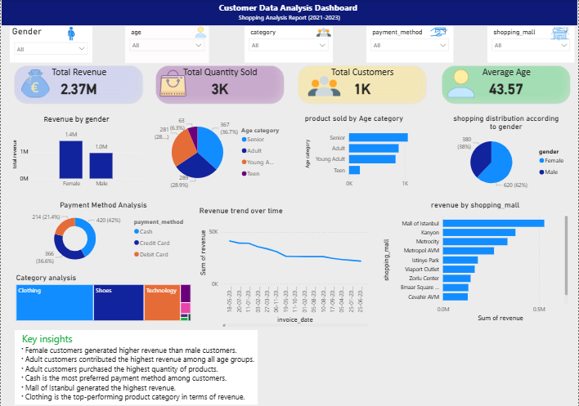
Dashboard Analysis

Slide 9
The dashboard provides insights into:
Revenue Distribution
Gender Analysis
Age Group Analysis
Product Category Analysis
Payment Method Analysis

Slide 10
Gender Analysis
Insights
Female customers contributed a larger share of purchases.
Female customers generated higher revenue.
Female customers contributed approximately 58% of total revenue.

Slide 11
Age Analysis
Insights
Customers aged 26–35 years were the most active shoppers.
This age group generated the highest revenue.
Young adults formed the largest customer segment.

Slide 12
Category & Payment Analysis
Category Insights
Clothing was the highest-selling category.
Shoes were among the top-performing categories.
Payment Method Insights
Credit Card was the most preferred payment method.
Digital payment methods showed strong adoption.

Slide 13
Key Findings
Female customers purchased more products.
Female customers contributed 58% of total revenue.
Customers aged 26–35 years were the most active shoppers.
Clothing was the highest-selling category.
Credit Card was the most preferred payment method.

Slide 14
Recommendations
Business Recommendations
Target Female Customers with personalized campaigns.
Introduce Loyalty Programs for repeat purchases.
Promote Clothing and Shoes categories.
Encourage Digital Payments through offers and rewards.
Implement Cross-Selling Strategies.
Use Customer Segmentation for focused marketing.

Slide 15
Conclusion
Female customers and customers aged 26–35 years emerged as the most valuable customer segments.
Clothing and Shoes were the top-performing categories, while Credit Card remained the preferred payment method.
These insights can help businesses improve customer engagement, marketing effectiveness, and revenue growth.

