Slide 1
In-Situ Sampler For Oceanography
PISTON ACTION OF AN
UNDERWATER SAMPLER
An NIO-KMIT Project

Slide 2
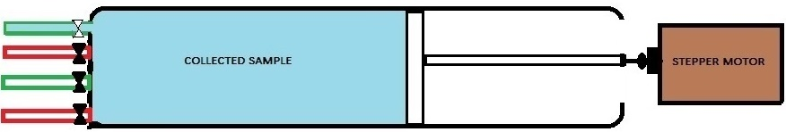
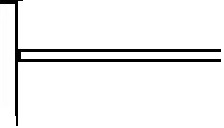

In-Situ Sampler For Oceanography
Sea water sample is collected through Inlet 1 and the other three valves are closed.
Inlet 1
An NIO-KMIT Project

Slide 3
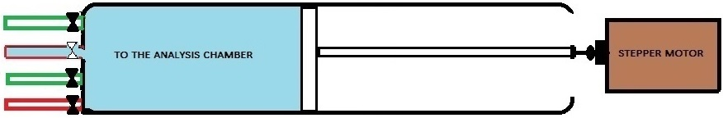
In-Situ Sampler For Oceanography
Measured quantity of collected sea water sample is then sent to the analysis chamber through outlet 1.
Outlet 1
An NIO-KMIT Project

Slide 4
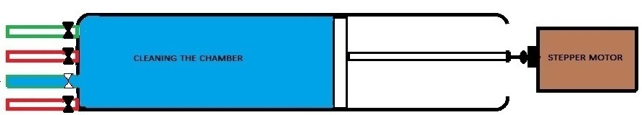
In-Situ Sampler For Oceanography
Distilled water is taken into the syringe to clean the syringe from the distilled water tank
through inlet 2.
Inlet 2
An NIO-KMIT Project

Slide 5
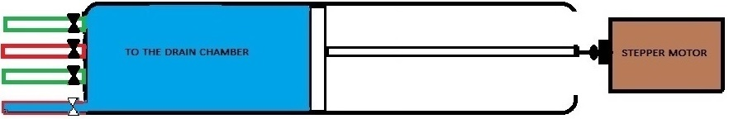
In-Situ Sampler For Oceanography
On cleaning the syringe the distilled water in the syringe is sent to the drain chamber through outlet 2.
Outlet 2
The piston and the valves are controlled with the help of a stepper motor.
Note: The analysis chamber is also cleaned using distilled water after the analysis of sea
Water is carried out. For this the analysis chamber also need a syringe type arrangement.
An NIO-KMIT Project

Slide 6
In-Situ Sampler For Oceanography
THANK YOU !!!
An NIO-KMIT Project

