Slide 1
40
1
20
50
2
10
30
45
60
3
Search Key = 35 => Fail
Time Taken depend on the Height of Binary Search Tree

Slide 2
Problem of Binary Search Tree
Even with the same key, the heights change.
It depends on how the keys are sorted.
Same keys, Sorted By Different Orders
Orders Possible => (number of Keys)!
Keys => 30, 20, 10 / Order Possible => 3! => 6
30, 20, 10 | h = 3
30, 10, 20 | h = 3
20, 10, 30
20, 30, 10
| h = 2
10, 30, 20 | h = 3
10, 20, 30 | h = 3
30
30
10
10
20
20
10
30
20
10
30
10
20
20
30

Slide 3
A set of keys can be represented by either
a long height or a short height.
Binary Search Tree Can improve with Rotations
Rotation 4 Types
Left Left => Right Rotation
Right Right => Left Rotation
Left Right => LR Rotation
Right Left => RL Rotation
Similar
Base on 3 Nodes
Similar
2 steps or Double Rotation

Slide 4
Balance Factor = Height of Left Subtree – Height of Right Subtree
{ -1, 0, 1 }
If the result is greater than one, the Left is heavy!
If the result is less than minus one, the Right is heavy!
The most important thing is to take the longest path or edges when calculating
the height of the root node to calculate the balance factor.

Slide 5
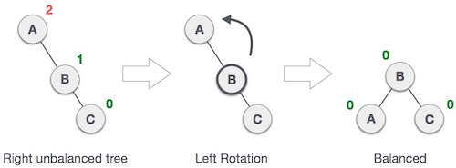
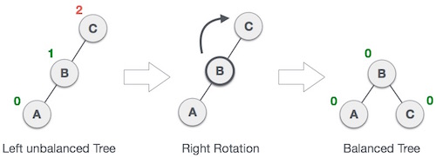
RR - Left Rotation
LL - Right Rotation

Slide 6

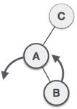
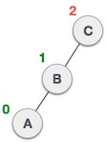
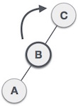
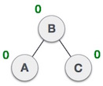
Left Right Rotation

Slide 7

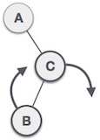
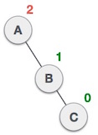
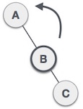
Right Left Rotation

