Slide 1
Reinforcement Learning
Project Review – 0 Batch – B Group - 3

Slide 2
Team Members
Jaidev CB.EN.U4AIE21117
Chandana CB.EN.U4AIE21118
Pranish CB.EN.U4AIE21137
Charishma CB.EN.U4AIE21169

Slide 3
Problem Definition
Developing a two-wheeled self-balancing robot using a Raspberry Pi with a gy-521 module
Integrating ultrasonic sensors for obstacle avoidance and autonomous navigation.
The specific challenge involves implementing Q-learning algorithm for autonomous navigation to enable the robot to efficiently navigate its environment while maintaining balance and avoiding obstacles.

Slide 4
Literature Review:
The paper "Using Reinforcement Learning to Achieve Two Wheeled Self Balancing Control" by Shih-Yu Chang and Ching-Lung Chang from the Department of Computer Science and Information Engineering at National Yunlin University of Science & Technology serves as a significant reference.
It outlines the design of a two-wheeled self-balancing robot using reinforcement learning, particularly Q-learning, to return the robot to balance under various dip angles.
Existing research has explored methods such as PID controllers, fuzzy inference, and machine learning for balance control in two-wheeled robots.

Slide 5
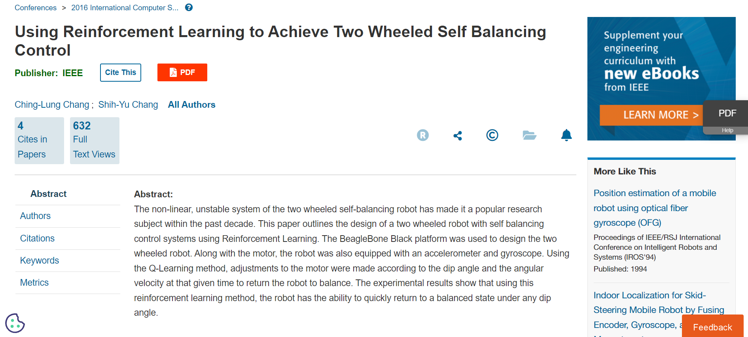

Slide 6
Novelty
The novelty in this project lies in the integration of Q-learning algorithm for autonomous navigation in addition to self-balancing control.
While the paper referenced focuses on self-balancing control using Q-learning, the proposed project extends this by implementing Q-learning for autonomous navigation, allowing the robot to make decisions and navigate in an environment with obstacles while maintaining balance.
This integration of Q-learning for both balance control and autonomous navigation presents a novel approach to the design of two-wheeled self-balancing robots.

Slide 7
Solution and Novelty
The proposed solution involves developing a two-wheeled self-balancing robot equipped with ultrasonic sensors for obstacle detection, Raspberry Pi for processing, gy-521 module for motion sensing, and integrating Q-learning algorithm for both self-balancing control and autonomous navigation.
The novelty lies in the utilization of Q-learning for autonomous navigation, enabling the robot to make intelligent decisions based on its environment to avoid obstacles while maintaining balance. This integration of Q-learning into the navigation system enhances the robot's adaptability and autonomy in real-world environments.

Slide 8
Progress
Assembling the base of the robot and testing the wheels with battery is done.
Should mount Raspberry pi on top of it and gy- 521 module along with it.
Should install Raspbian OS and required software in the monitor.
Should see alternate ways to implement autonomous navigation.

