Slide 1
Group No: 7
19AIE –102
DIGITAL MANUFACTURING
(GROUP PRESENTATION-2)
Batch : B

Slide 2

GROUP MEMBERS :
1) J.SAI CHANDANA-(aieb.1008660)
2) JAIDEV-(aieb1024213)
3)T.CHARISHMA CHOWDARY-(aieb.1018623
4) M.PRANISH KUMAR-(aieb.1025392)

Slide 3
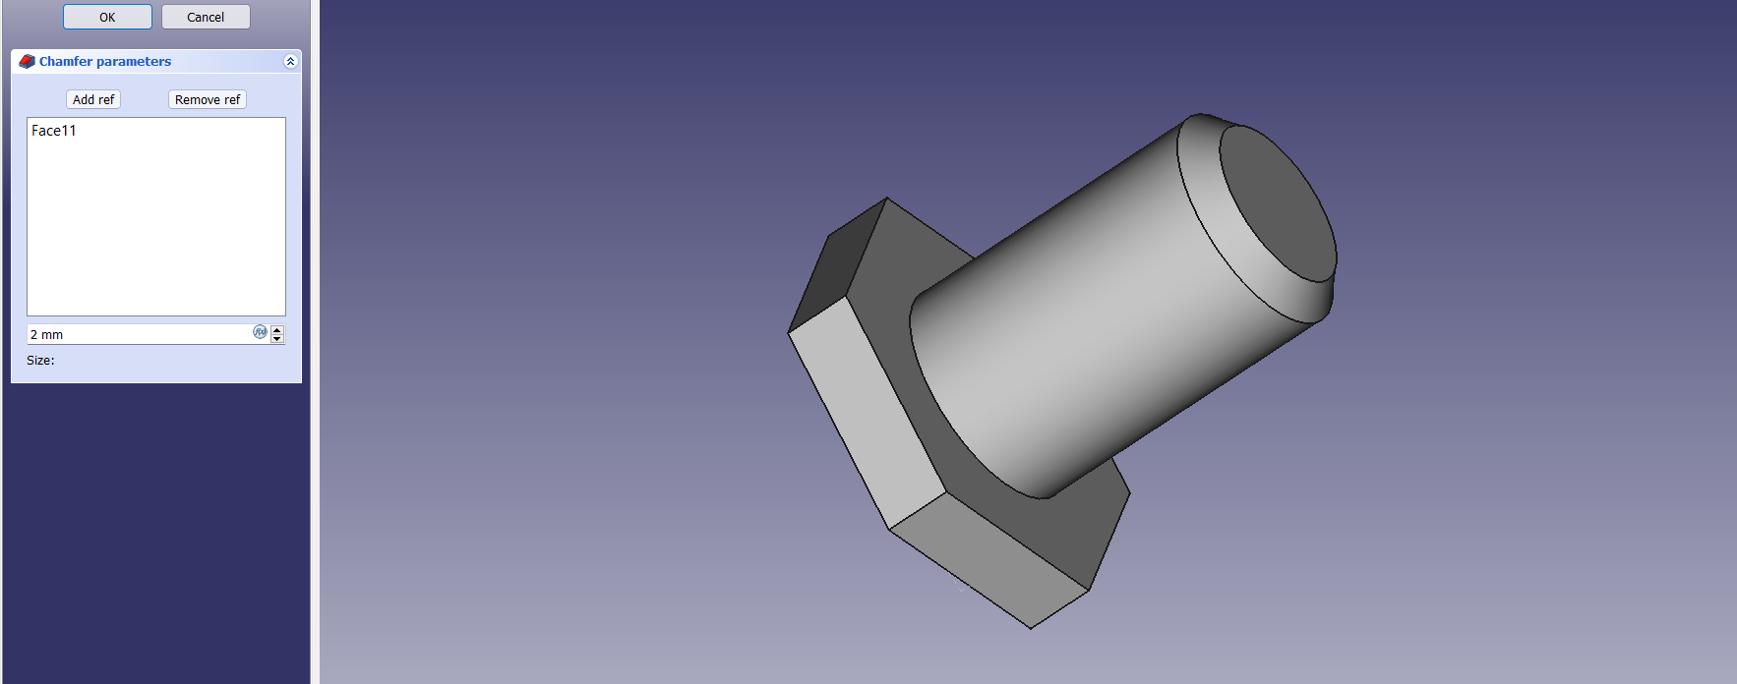
1. Model and Slice a nut bolt Combination together.

Slide 4
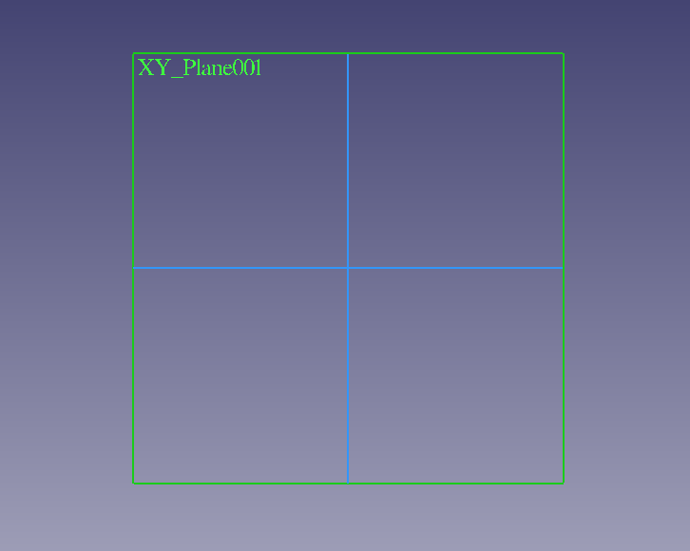
Firstly, we need to open a Part design in Free Cad and create and body.
We need to create a sketch to obtain this.

Slide 5
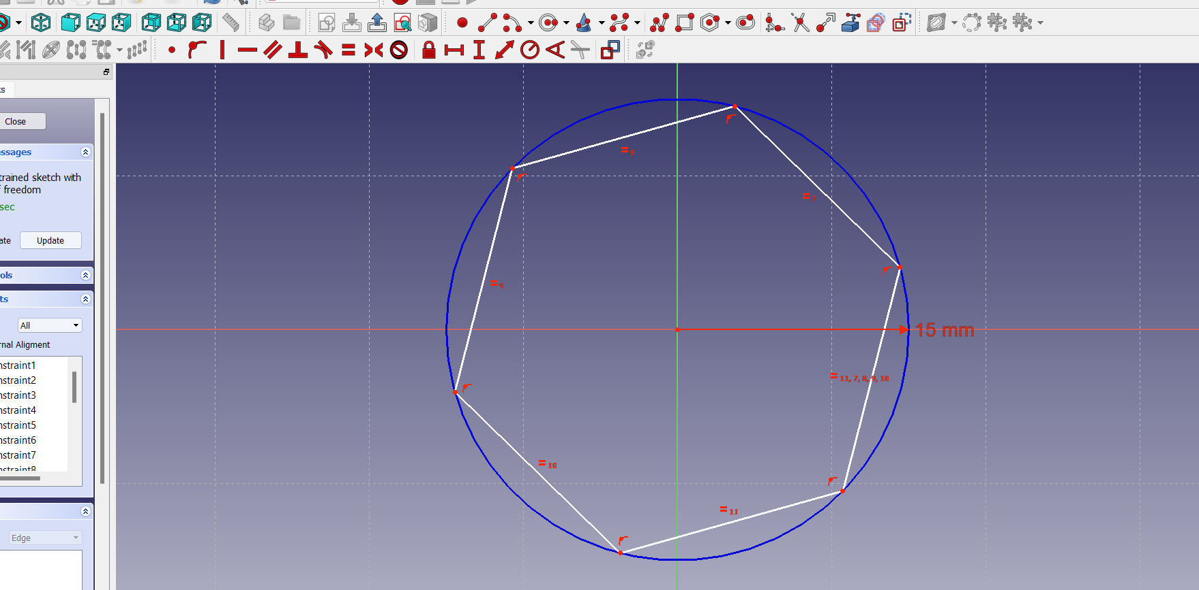
We must choose a plane to work and view in 2D, I have chosen XY plane and placed a Polygon and added constrains with Diameter of the polygon as 15mm

Slide 6
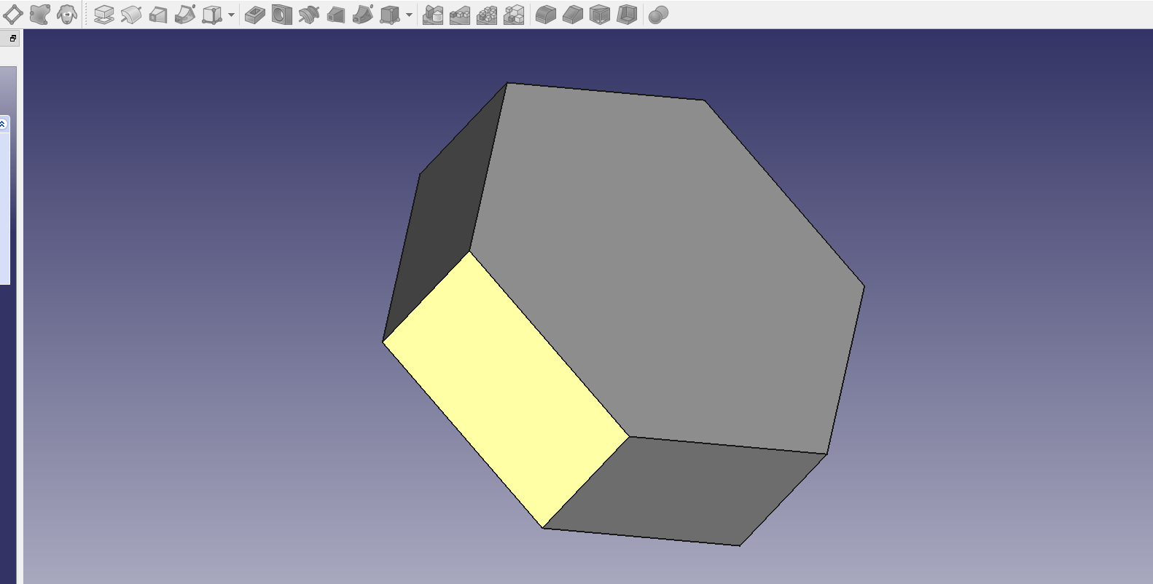
After Joining the two vertex we shall Pad the obtained body i.e Polygon,
We have given a length of 10mm for it.

Slide 7
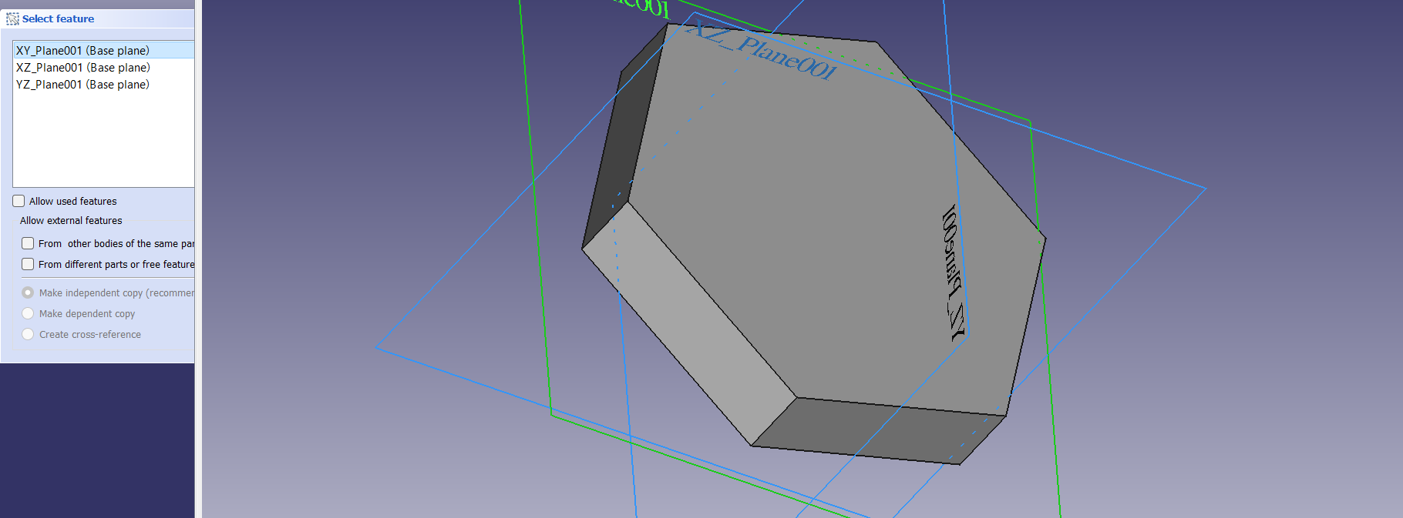
The base of the nut is ready , we must create a body for bolt , on doing so we must create a sketch again and we are choosing XY plane again to view it and work in 2D.

Slide 8
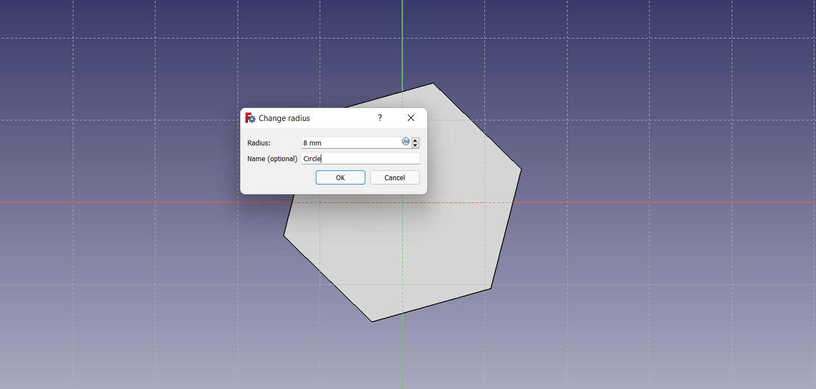
Now on fixing the constrains, We place a circle in the center of the polygon and give it a radius of 8mm.

Slide 9
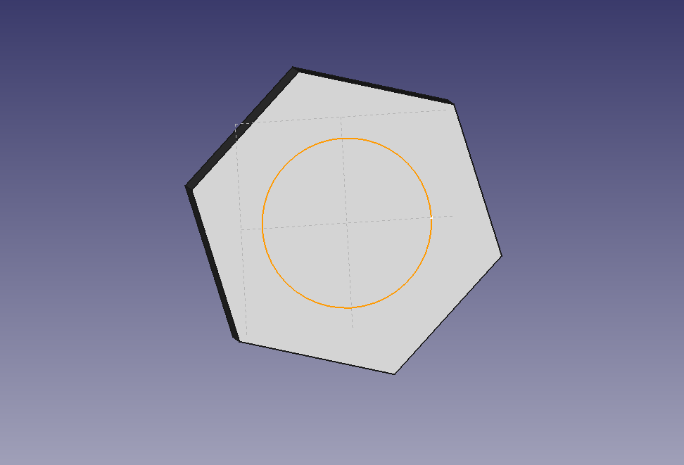
This is the way the circle is placed inside the polygon.

Slide 10
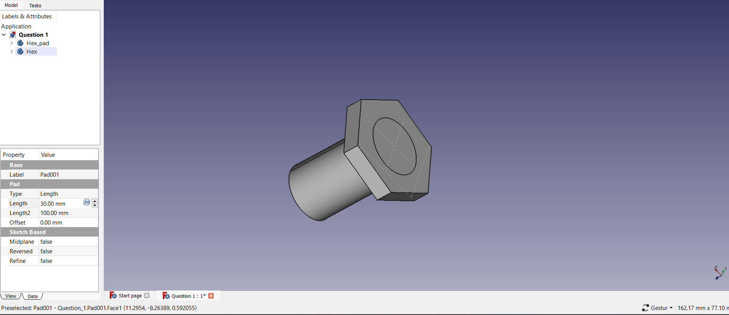
We must save the circle body and pad it. On padding we gave a length of 10mm for it, and this forms the bolt.

Slide 11
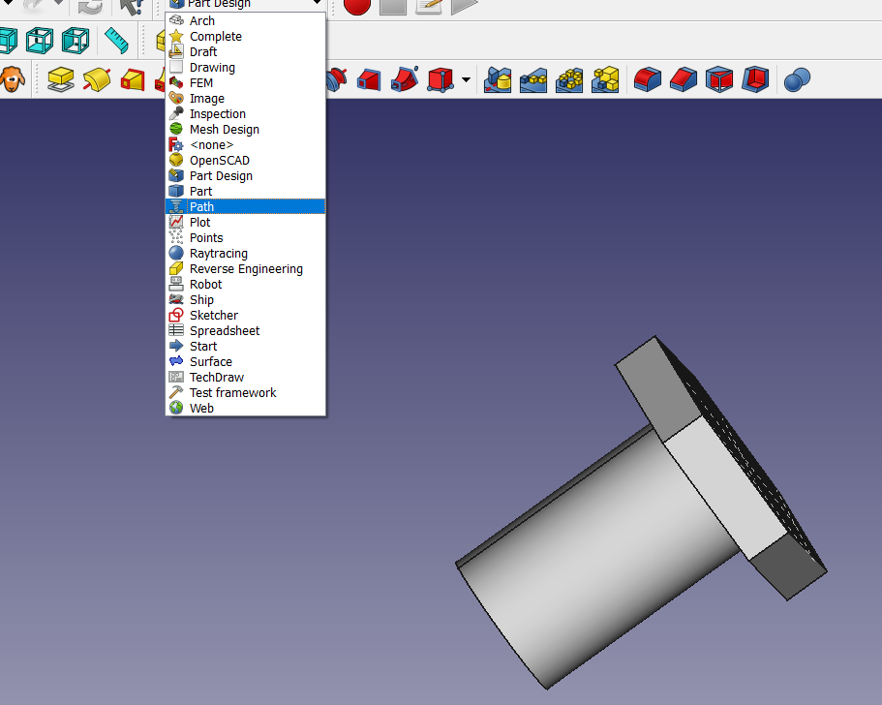
Now from Part Design we shall move to Part for threading the bolt using Helix.

Slide 12
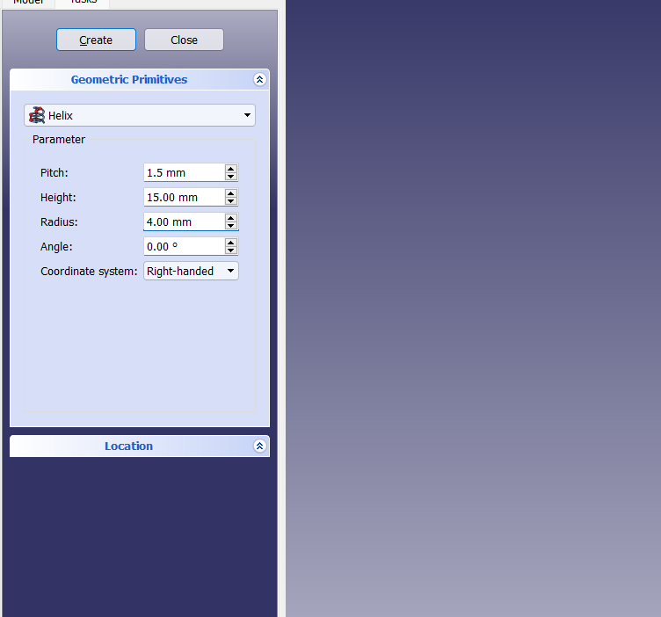
On choosing the Helix for threading , we gave the respective Length, height and Pitch as 4,15,1.5 mm.

Slide 13
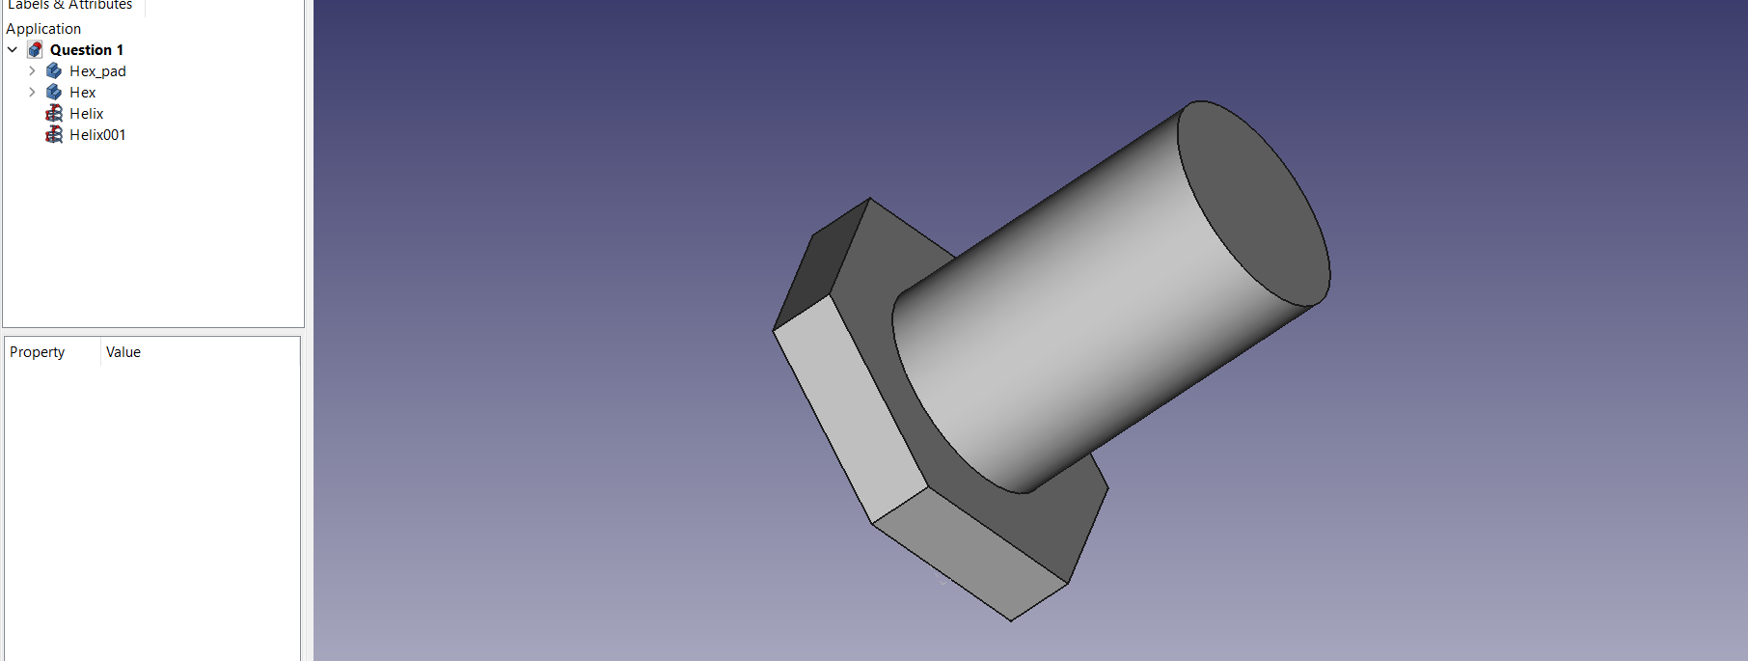
After Threading, this forms the Bolt and nut combination, the threads aren't visible of the colour but the body is formed in the layout.

Slide 14
We used the chamfer the edges option to cut out the edges , which brings us the final output of the Bolt and nut combination.
After exporting we shall Slice it and It takes 1 hr 20mins for slicing in Cura Ultimaker.

Slide 15
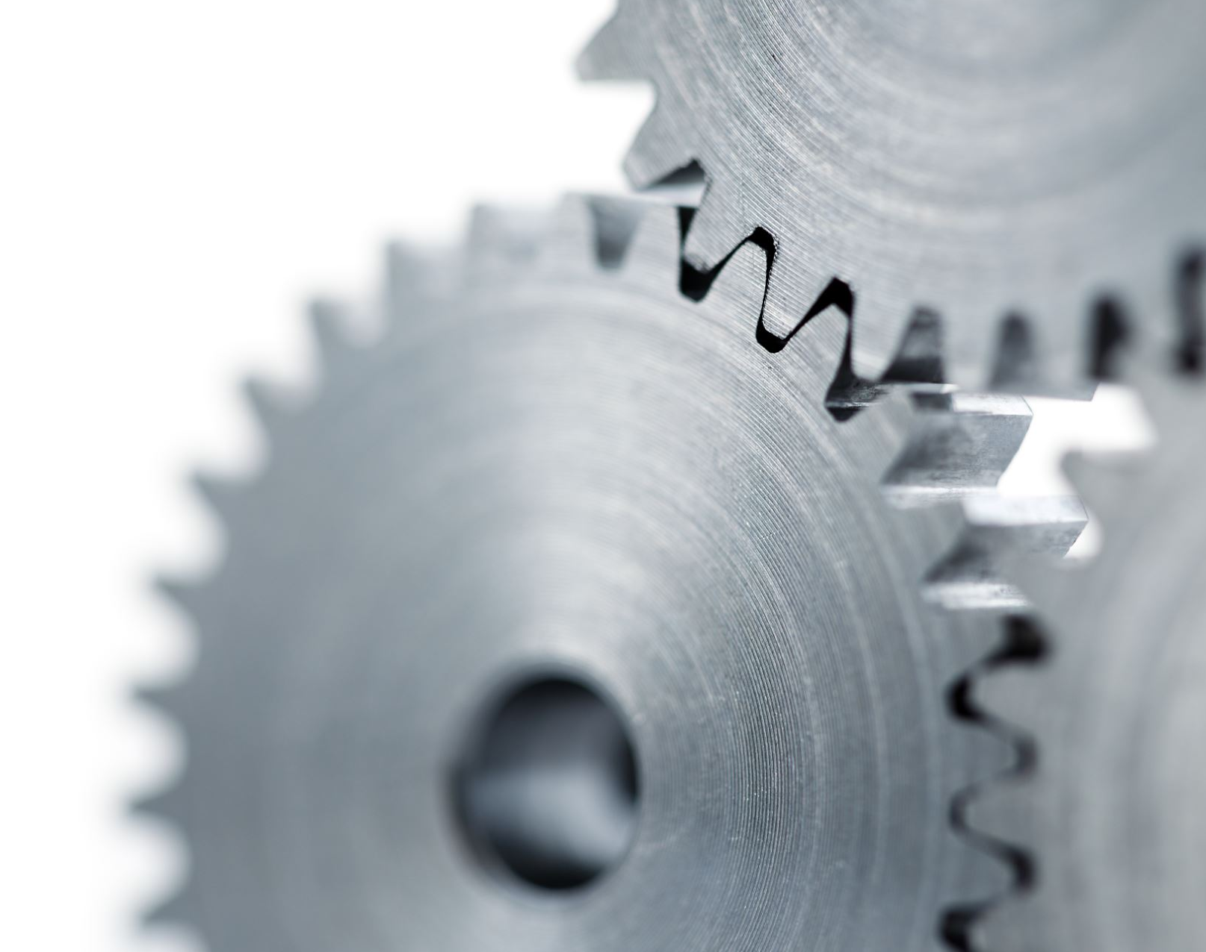
2. Model and slice two gears perfectly meshing with each other as given below. Further, Animate the motion of the two gears in mesh with each other.

Slide 16
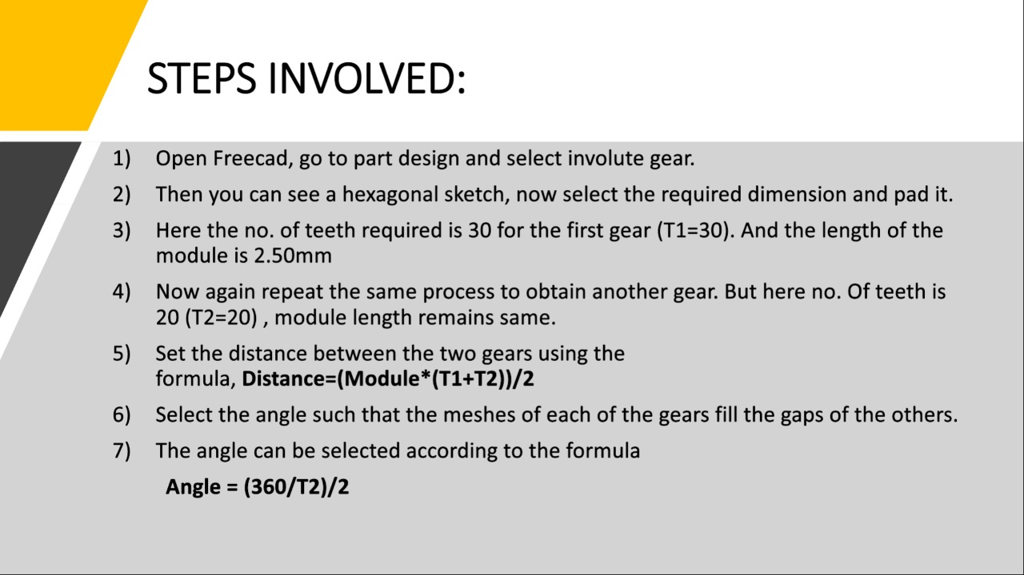

Slide 17
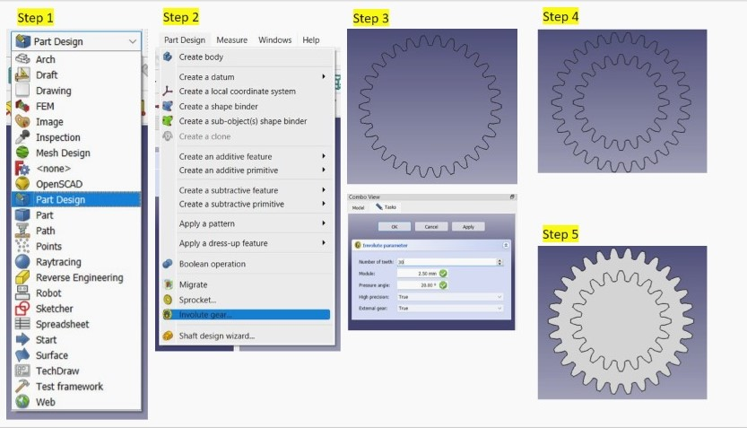

Slide 18
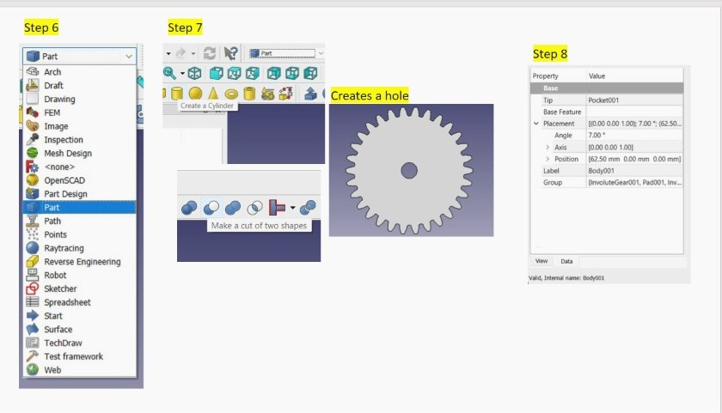

Slide 19
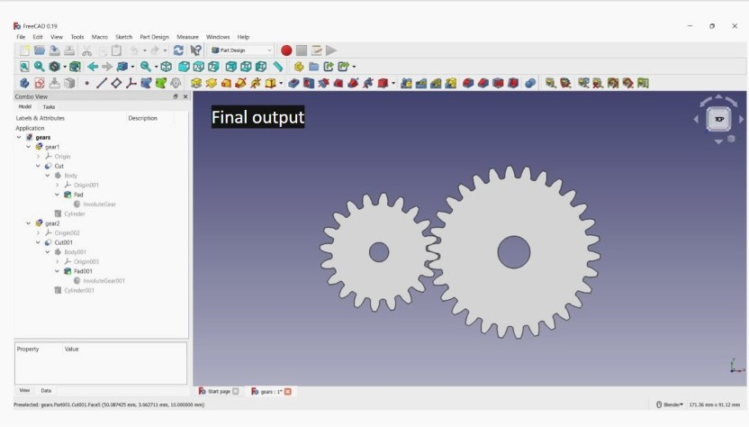

Slide 20
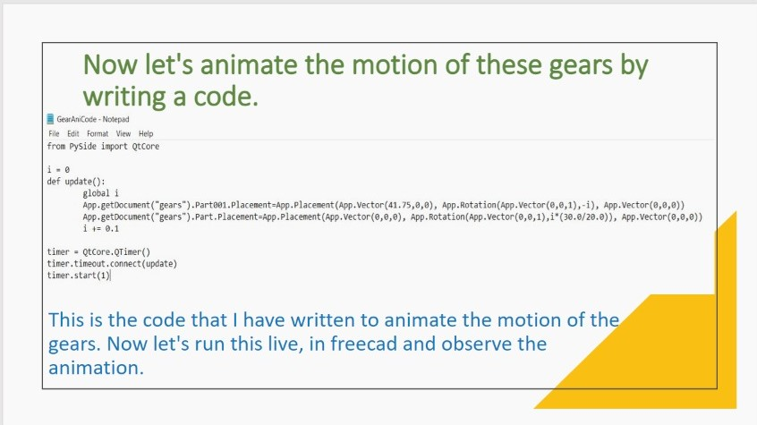

Slide 21
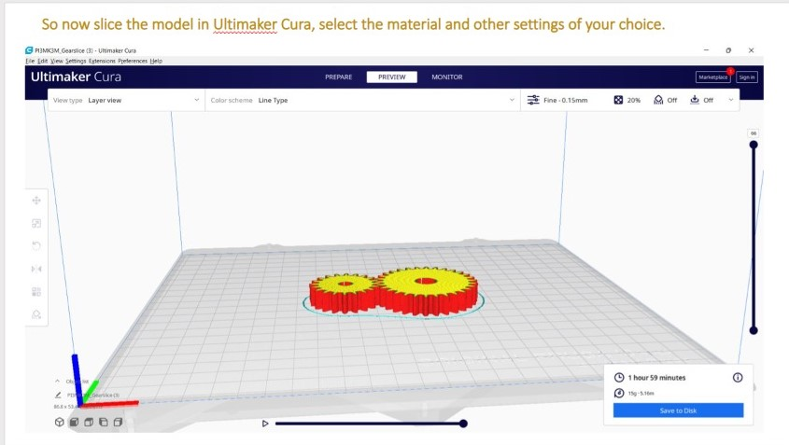

Slide 22

THANK YOU

