Slide 1

21MAT204
MATHEMATICS OF INTELLIGENT SYSTEMS – 3 End Semester Project Presentation
Date: 30th JAN, 2023

Slide 2

PROJECT TOPIC :
HEART DISEASE PREDICTION USING LOGISTIC REGRESSION
H

Slide 3
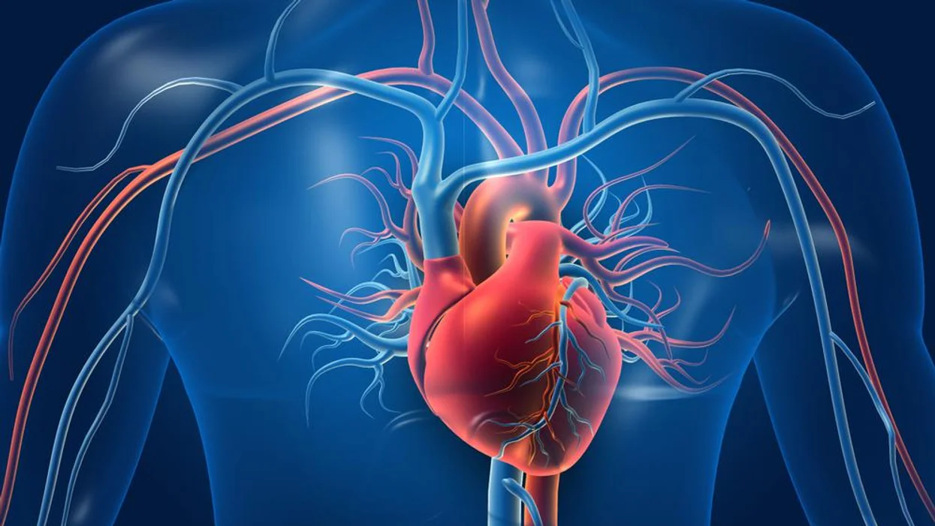
HEART DISEASE ?

Slide 4
A buildup of fatty plaques in the arteries (atherosclerosis) is the most common cause of coronary artery disease. Risk factors include a poor diet, lack of exercise, obesity and smoking. Healthy lifestyle choices can help lower the risk of atherosclerosis
Chest pain, chest tightness, chest pressure and chest discomfort (angina) Shortness of breath. Pain in the neck, jaw, throat, upper belly area or back. Pain, numbness, weakness or coldness in the legs or arms if the blood vessels in those body areas are narrowed.
Heart failure can be ongoing (chronic), or it may start suddenly (acute)

Slide 5
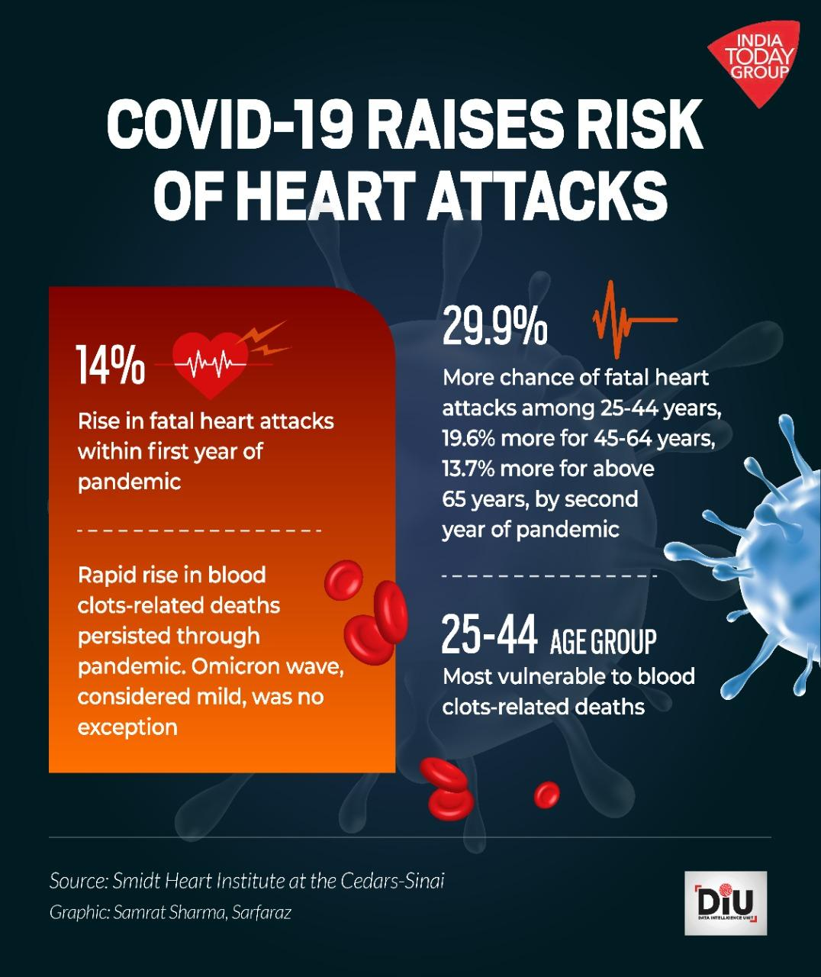
The number of deaths due to heart attacks in India has remained consistently over 25,000 in the last four years, and over 28,000 in the last three year.

Slide 6
PROJECT TASK :
BASED ON THE FEAUTURES WE NEED TO CHECK WETHER THE PERSON IS HAVING HEART DISEASE OR NOT
IT HELPS THE DOCTORS TO TREAT THE PATIENTS AND DIAGNOISE THEM .
FOR THIS WE USE THE MACHINE LEARNING ALGORITHM CALLED LOGISTIC REGRESSION

Slide 7

MACHINE LEARNING ?

Slide 8
LOGISTIC- REGRESSION

Slide 9
Logistic Regression in Machine Learning :
Logistic regression is one of the most popular Machine Learning algorithms, which comes under the Supervised Learning technique.
It is used for predicting the categorical dependent variable using a given set of independent variables.
In Logistic regression, instead of fitting a regression line, we fit an "S" shaped logistic function, which predicts two maximum values (0 or 1).

Slide 10
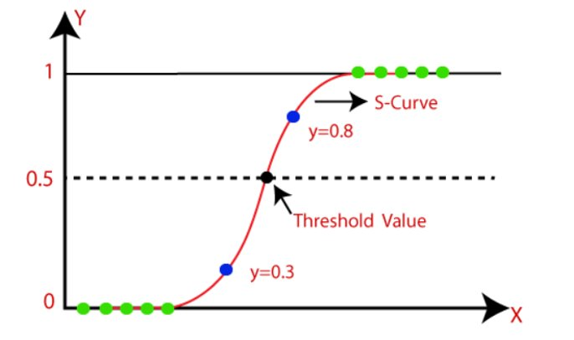

Slide 11
Logistic Function (Sigmoid Function):
​
The sigmoid function is a mathematical function used to map the predicted values to probabilities.​
It maps any real value into another value within a range of 0 and 1.​
The value of the logistic regression must be between 0 and 1, which cannot go beyond this limit, so it forms a curve like the "S" form.
The S-form curve is called the Sigmoid function or the logistic function.​
In logistic regression, we use the concept of the threshold value, which defines the probability of either 0 or 1. Such as values above the threshold value tends to 1, and a value below the threshold values tends to 0.​
​

Slide 12
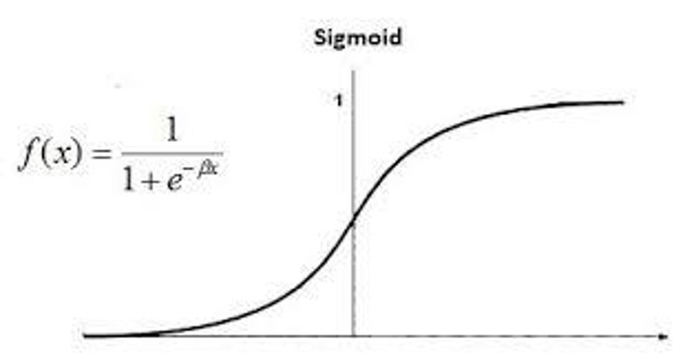

Slide 13
FEAUTURES INCLUDE : -
1.age: The person's age in years
2. sex: The person's sex (1 = male, 0 = female
3. cp: The chest pain experienced (Value 1: typical angina, Value 2: atypical angina, Value 3: non-anginal pain, Value 4: asymptomatic)
4. trestbps: The person's resting blood pressure (mm Hg on admission to the hospital)
5. chol: The person's cholesterol measurement in mg/dl
6. fbs: The person's fasting blood sugar (> 120 mg/dl, 1 = true; 0 = false)
7. restecg: Resting electrocardiographic measurement (0 = normal, 1 = having ST-T wave abnormality, 2 = showing probable or definite left ventricular hypertrophy by Estes' criteria)
8. thalach: The person's maximum heart rate achieved
9. exang: Exercise induced angina (1 = yes; 0 = no)
10. oldpeak: ST depression induced by exercise relative to rest ('ST' relates to positions on the ECG plot. See more here)
11. slope: the slope of the peak exercise ST segment (Value 1: upsloping, Value 2: flat, Value 3: downsloping)
12. ca: The number of major vessels (0-3)
13. thal: A blood disorder called thalassemia (3 = normal; 6 = fixed defect; 7 = reversable defect)
14. target: Heart disease (0 = no, 1 = yes)
Heart disease risk factors to the following: high cholesterol, high blood pressure, diabetes, weight, family history and smoking .
According to another source , the major factors that can't be changed are: increasing age, male gender and heredity.
Note that thalassemia, one of the variables in this dataset, is heredity.
Major factors that can be modified are: Smoking, high cholesterol, high blood pressure, physical inactivity, and being overweight and having diabetes. Other factors include stress, alcohol and poor diet/nutrition.

Slide 14
Conclusion : -
In this project , based on the features in the data set provided we have predicted whether a person is having heart disease or not

Slide 15

Thank You!
AUM NAMAH SHIVAYAH!

