Slide 1

21BIO201
INTELLIGENCE TO BIOLOGICAL SYSTEMS - 3 End Semester Project Presentation
Date: 25th JAN, 2023

Slide 2
Our Team Members
JAIDEV .K
PRANISH KUMAR . M
CB.EN.U4AIE21117
CB.EN.U4AIE21137
J
P
S
C
SAI CHANDANA . J
CHARISHMA CHOWDARY . T
CB.EN.U4AIE21118
CB.EN.U4AIE21169
Batch B
Group 2

Slide 3

PROJECT TASK
In this study, our task is to classify tumors into malignant (cancerous) or benign (non-cancerous) using features obtained from several cell images.
Features are computed from a digitized image of a fine needle aspirate (FNA) of a breast mass. They describe characteristics of the cell nuclei present in the image.

Slide 4
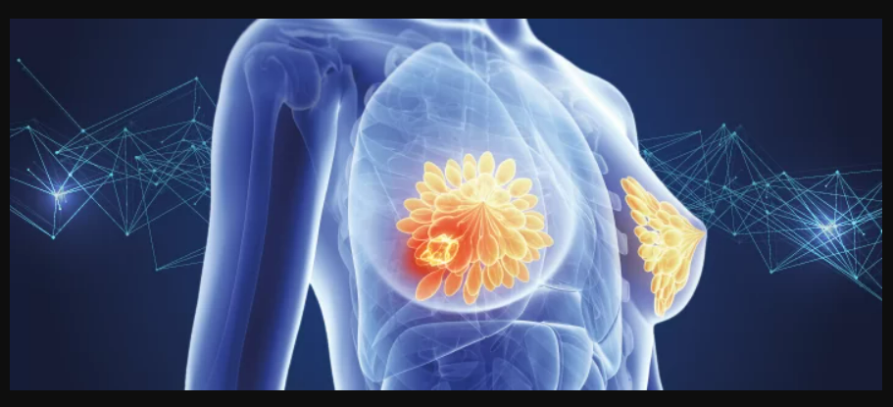
BREAST CANCER ?

Slide 5
Breast cancer is the most common cancer amongst women in the world. It accounts for 25% of all cancer cases, and affected over 2.1 Million people in 2015 alone.
It starts when cells in the breast begin to grow out of control. These cells usually form tumors that can be seen via X-ray or felt as lumps in the breast area.
Early diagnosis significantly increases the chances of survival.

Slide 6
The key challenges against it’s detection is how to classify tumors into malignant (cancerous) or benign(non cancerous).
A tumor is considered malignant if the cells can grow into surrounding tissues or spread to distant areas of the body.
A benign tumor does not invade nearby tissue nor spread to other parts of the body the way cancerous tumors can.
benign tumors can be serious if they press on vital structures such as blood vessels or nerves.

Slide 7

In the last few decades machine learning techniques have been developed for breast cancer detection and classification
which can be divided into three main stages: preprocessing, feature extraction, and classification.
Classification of cancer into Malignant and bengin using an efficient machine learning algorithm.

Slide 8
Our main task is to classify breast tumor into malignant and bengin , so that it makes easy for diganosis and also doctors can easily treat the patient according the type of tumor
For this task to be completed we will use a machine learning algorithm called “SVM”.we will use svm because it is very useful in linearly seperating data or classifiying data.
SVM is also useful for solving the multivariate problems in cancer diagnosis work.

Slide 9
Support Vector Machine

Slide 10
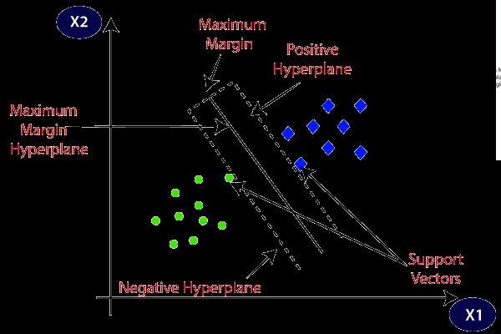
Support Vector Machine (SVM) is a binary linear classification whose decision boundary is explicitly constructed to minimize generalization error.
It is a very powerful and versatile Machine Learning model, capable of performing linear or nonlinear classification, regression and even outlier detection.
SVM construct a hyperplane that separates two classes (can be extended for multi class),
SVM tries to achieve the maximum separation between the classes.

Slide 11
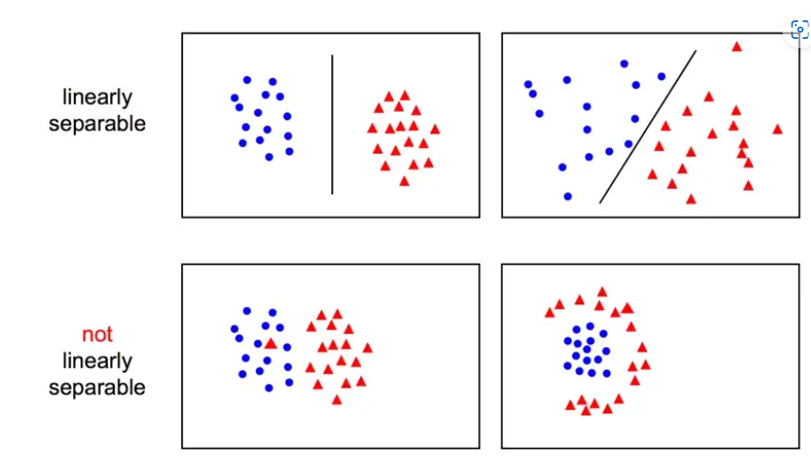
For our project we will use the concept of linear SVM (Hard Margin) ,as we have to classify the given samples linearly into two malignant and bengin.
When the data is linearly separable, and we don’t want to have any misclassifications, we use SVM with a hard margin.
the hyperplane separating our two classes is defined as w^T x + b = 0:
we can define the margin by two parallel hyperplanes:
w^T x + alpha = 0
w^T x + beta = 0

Slide 12
Advantages of Svm :
Effective in high dimensional spaces.
Still effective in cases where number of dimensions is greater than the number of samples.
Uses a subset of training points in the decision function (called support vectors), so it is also memory efficient.

Slide 13
Disadvantages of Svm :
If the number of features is much greater than the number of samples, avoid over-fitting in choosing Kernel functions and regularization term is crucial.
SVMs do not directly provide probability estimates, these are calculated using an expensive five-fold cross-validation (see Scores and probabilities).

Slide 14
Now , let us come to our implementation using svm
There are ten features in our dataset,
1) Radius (mean of distances from center to points on the perimeter)
2) Texture (standard deviation of gray-scale values)
3) Perimeter
4) Area
5) Smoothness (local variation in radius lengths)
6) Compactness (perimeter² / area — 1.0)
7) Concavity (severity of concave portions of the contour)
8) Concave points (number of concave portions of the contour)
10) Symmetry
11) Fractal dimension (“coastline approximation” — 1)
Attribute Information:
1) ID number
2) Diagnosis (M = malignant, B = benign)

Slide 15
Conclusion : -
In this project , we have classified tumors into malignant (cancerous) or benign (non-cancerous)

Slide 16

Thank You!
AUM NAMAH SHIVAYAH!

