Slide 1
Python for Machine Learning
Term Project
Batch: B
Group : 2

Slide 2
GROUP MEMBERS
JAIDEV CB.EN.U4AIE21117
CHANDANA CB.EN.U4AIE21118
CHARISHMA CB.EN.U4AIE21169
PRANISH CB.EN.U4AIE21137

Slide 3
INDIAN INDEX PREDICTION USING LSTM,KNN,LINEAR REGRESSION
Motivation:
Stock price prediction is a classic and important problem. With a successful model for stock prediction, we can gain insight about market behavior over time, spotting trends that would otherwise not have been noticed.
With the increasingly computational power of the computer, machine learning will be an efficient method to solve this problem. However, the public stock dataset is too limited for many machine learning algorithms to work with, while asking for more features may cost thousands of dollars everyday.
We will introduce a framework in which we integrate user predictions into the current machine learning algorithm using public historical data to improve our results. The motivated idea is that, if we know all information about todays stock trading (of all specific traders), the price is predictable. Thus, if we can obtain just a partial information, we can expect to improve the current prediction lot.

Slide 4
Long Term Short Memory
In sequence prediction challenges, Long Short-Term Memory (LSTM) networks are a type of Recurrent Neural Network that can learn order dependence. The output of the previous step is used as input in the current step in RNN. Hochreiter & Schmidhuber created the LSTM. It addressed the issue of RNN long-term dependency, in which the RNN is unable to predict words stored in long-term memory but can make more accurate predictions based on current data. RNN does not provide an efficient performance as the gap length rises. The LSTM may keep information for a long time by default. It is used for time-series data processing, prediction, and classification.

Slide 5
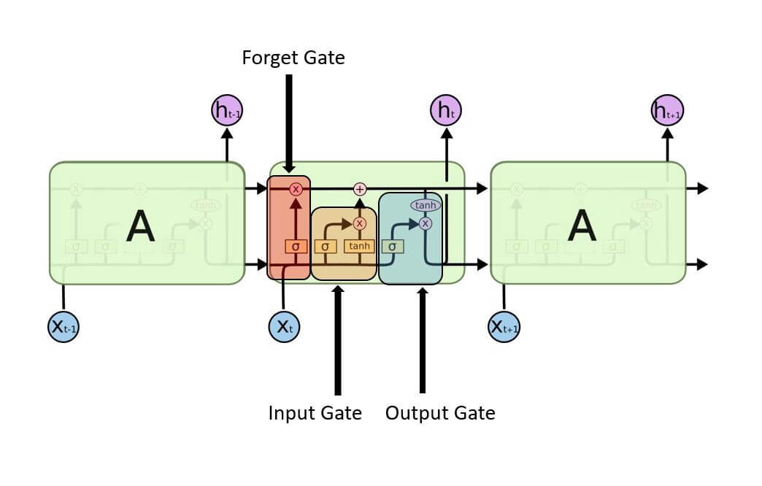
Structure of LSTM

Slide 6


Input Gate: It determines which of the input values should be used to change the memory. The sigmoid function determines whether to allow 0 or 1 values through. And the tanh function assigns weight to the data provided, determining their importance on a scale of -1 to 1.
Forget Gate: It finds the details that should be removed from the block. It is decided by a sigmoid function. For each number in the cell state Ct-1, it looks at the preceding state (ht-1) and the content input (Xt) and produces a number between 0 (omit this) and 1 (keep this).
Output Gate: The block’s input and memory are used to determine the output. The sigmoid function determines whether to allow 0 or 1 values through. And the tanh function determines which values are allowed to pass through 0, 1. And the tanh function assigns weight to the values provided, determining their relevance on a scale of -1 to 1 and multiplying it with the sigmoid output.

Slide 7

LSTM Networks
A sequence of repeating neural network modules makes up all recurrent neural networks. This repeating module in traditional RNNs will have a simple structure, such as a single tanh layer.
The output of the current time step becomes the input for the following time step, which is referred to as Recurrent. At each element of the sequence, the model examines not just the current input, but also what it knows about the prior ones.

Slide 8
K-Nearest Neighbor(KNN)

Slide 9
K-Nearest Neighbour is one of the simplest Machine Learning algorithms based on Supervised Learning technique.
K-NN algorithm assumes the similarity between the new case/data and available cases and put the new case into the category that is most similar to the available categories
K-NN is a non-parametric algorithm, which means it does not make any assumption on underlying data
It is also called a lazy learner algorithm because it does not learn from the training set immediately instead it stores the dataset and at the time of classification, it performs an action on the dataset.

Slide 10
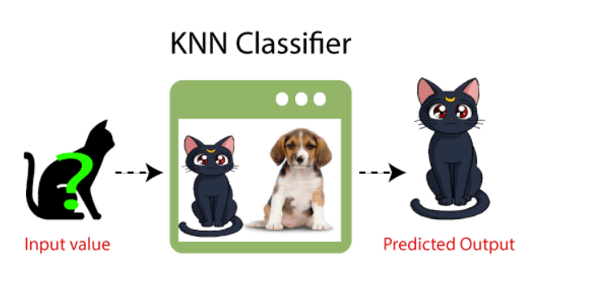
KNN algorithm at the training phase just stores the dataset and when it gets new data, then it classifies that data into a category that is much similar to the new data

Slide 11
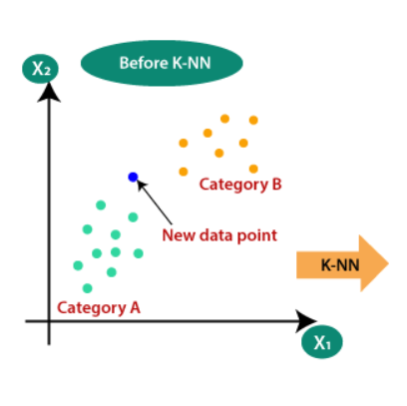
Why do we need a K-NN Algorithm?
Suppose there are two categories, i.e., Category A and Category B, and we have a new data point x1, so this data point will lie in which of these categories. To solve this type of problem, we need a K-NN algorithm. With the help of K-NN, we can easily identify the category
?

Slide 12
How does K-NN work?
The K-NN working can be explained on the basis of the below algorithm:
Step-1: Select the number K of the neighbors
Step-2: Calculate the Euclidean distance of K number of neighbors
Step-3: Take the K nearest neighbors as per the calculated Euclidean distance.
Step-4: Among these k neighbors, count the number of the data points in each category.
Step-5: Assign the new data points to that category for which the number of the neighbor is maximum.
Step-6: Our model is ready.

Slide 13
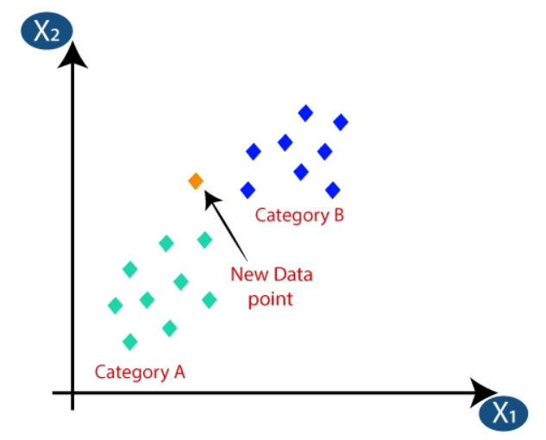
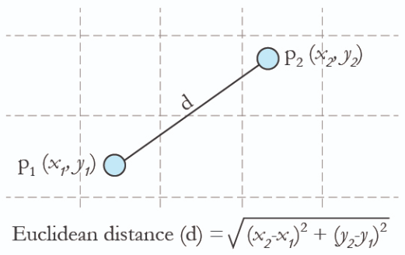
Suppose we have a new data point and we need to put it in the required category. Consider the below image:
Firstly, we will choose the number of neighbors, so we will choose the k=5
Next, we will calculate the Euclidean distance between the data points. The Euclidean distance is the distance between two points, which we have already studied in geometry. It can be calculated as:

Slide 14
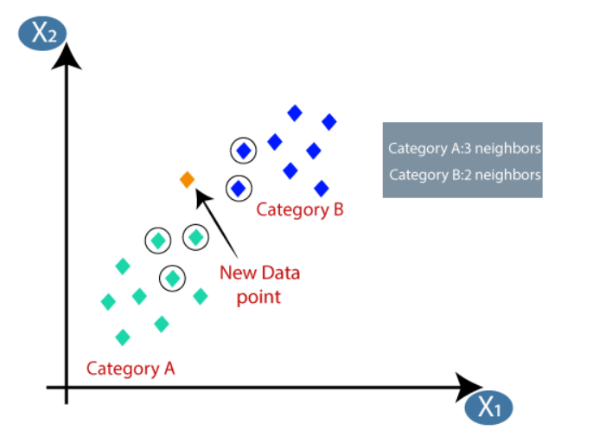
By calculating the Euclidean distance we got the nearest neighbors, as three nearest neighbors in category A and two nearest neighbors in category B. Consider the below image:
As we can see the 3 nearest neighbors are from category A, hence this new data point must belong to category A

Slide 15
How to select the value of K in the K-NN Algorithm?
There is no particular way to determine the best value for "K", so we need to try some values to find the best out of them.
The most preferred value for K is 5.
A very low value for K such as K=1 or K=2, can be noisy and lead to the effects of outliers in the model
Large values for K are good, but it may find some difficulties.

Slide 16
Advantages of KNN Algorithm:
It is simple to implement.
It is robust to the noisy training data
It can be more effective if the training data is large.
Disadvantages of KNN Algorithm:
Always needs to determine the value of K which may be complex some time.
The computation cost is high because of calculating the distance between the data points for all the training samples.

Slide 17
LINEAR REGRESSION :
Linear Regression is a machine learning algorithm based on supervised learning, It performs a regression task.
Regression models a target prediction value based on independent variables, It is mostly used for finding out the relationship between variables and forecasting.
Linear regression algorithm shows a linear relationship between a dependent (y) and one or more independent (y) variables, hence called as linear regression.
Linear regression is used in many different fields, including finance, economics, and psychology, to understand and predict the behavior of a particular variable.

Slide 18
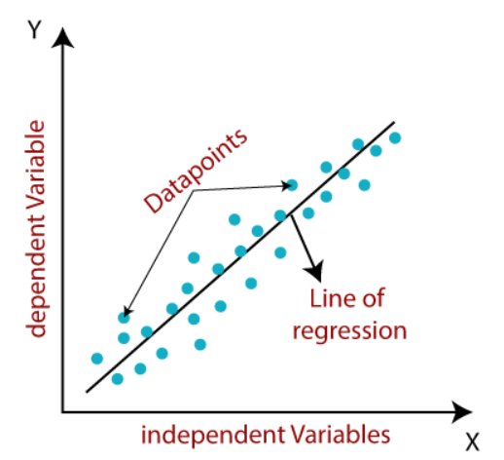
Mathematically, we can represent a linear regression as :
y= a0+a1x+ε
Here,
Y= Dependent Variable (Target Variable)
X= Independent Variable (predictor Variable)
a0= intercept of the line (Gives an additional degree of freedom)
a1 = Linear regression coefficient (scale factor to each input value).
ε = random error
The values for x and y variables are training datasets for Linear Regression model representation.
The linear line showing the relationship between the dependent and independent variables is called a regression line,The regression line is the best fit line for our model.

Slide 19
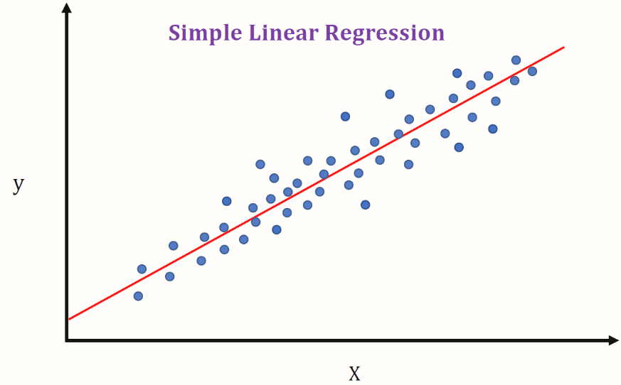
Types of Linear Regression
There are two types of linear regression ,
Simple Linear Regression : If a single independent variable is used to predict the value of a numerical dependent variable, then such a Linear Regression algorithm is called Simple Linear Regression.
Multiple Linear regression : If more than one independent variable is used to predict the value of a numerical dependent variable, then such a Linear Regression algorithm is called Multiple Linear Regression.

Slide 20
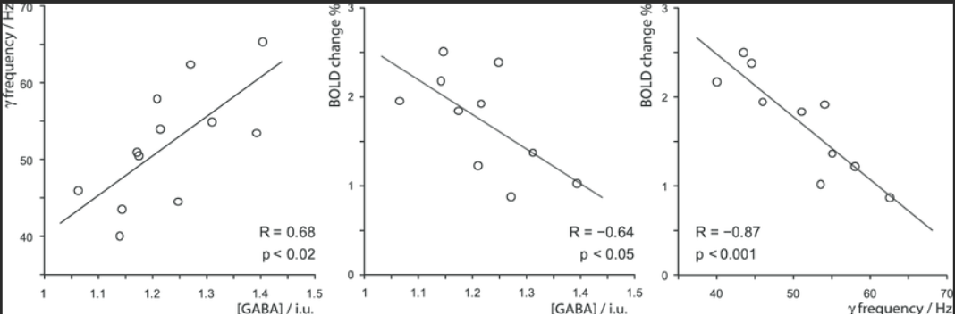
Finding the best fit line:
When working with linear regression, our main goal is to find the best fit line that means the error between predicted values and actual values should be minimized. The best fit line will have the least error.
The different values for weights or the coefficient of lines (a0, a1) gives a different line of regression, so we need to calculate the best values for a0 and a1 to find the best fit line, so to calculate this we use cost function.
The Goodness of fit determines how the line of regression fits the set of observations. The process of finding the best model out of various models is called optimization.
Some graphs with best fit lines

Slide 21
Linear regression is a powerful tool for understanding and predicting the behavior of a variable, but it has some limitations.
One limitation is that it assumes a linear relationship between the independent variables and the dependent variable, which may not always be the case.
In addition, linear regression is sensitive to outliers, or data points that are significantly different from the rest of the data.
These outliers can have a disproportionate effect on the fitted line, leading to inaccurate predictions.
Multicollinearity means high-correlation between the independent variables. Due to multicollinearity, it may difficult to find the true relationship between the predictors and target variables.
There can be a situation when the error term is the same for all the values of independent variables,so there can be no clear pattern distribution of data in the scatter plot.

Slide 22
THANK YOU

