Slide 1
Dialysis healthcare center

Slide 2
Fellow collaborator’s
Mrs. Ankita sirsi
Ms.Bhagya
Mrs.Deepthi yellisetty
Mr.Shubham kumbhar
Mr.Ratnakar
Ms. Rohitha nandgopal

Slide 3
KPI’s
Number Of Patients Across Various Summaries
Profit V/s Non-Profit Stats
TOP 5 Chain Organisations wrt Total Performance score as No Score
State Wise No.of Dialysis stations
# of Category Text - As Expected
Average Payment Reduction Percentage

Slide 4
Table of contents
01
02
03
04
Patient Outcomes Analysis
Treatment Modalities Comparison
Facility Performance Assessment
Resource Utilization Optimization

Slide 5
Introduction
This analysis delves into a comprehensive dataset focused on dialysis healthcare to extract valuable insights for enhancing patient care, improving outcomes, and optimizing resource allocation within the dialysis domain. By harnessing data analytics, we aim to uncover patterns, correlations, and key indicators that drive decision-making in dialysis care delivery.

Slide 6
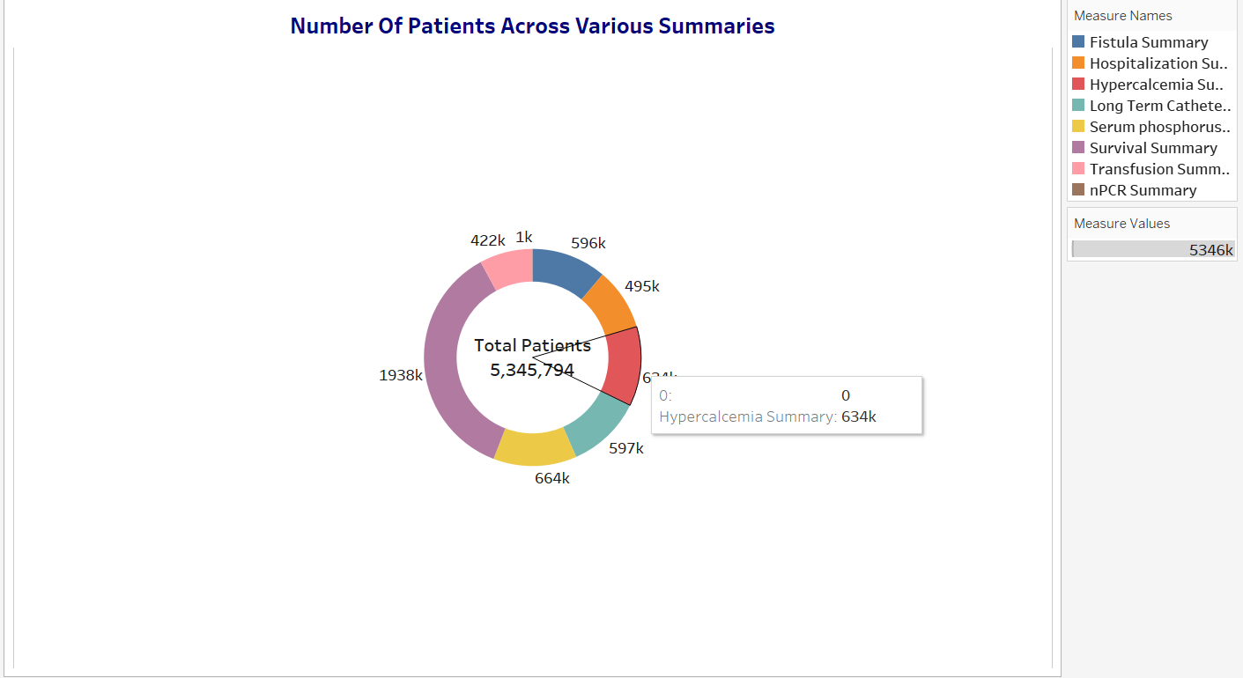
Number Of Patients Across Various Summaries
Approximately 5,345,794 patients are included in various summaries, indicating a significant demand for renal care services. specific patient counts are provided for different summary measures such as hypercalcemia, survival, transfusion, and long-term catheter summaries. These measures offer insights into the healthcare performance indicators and patient demographics within

Slide 7
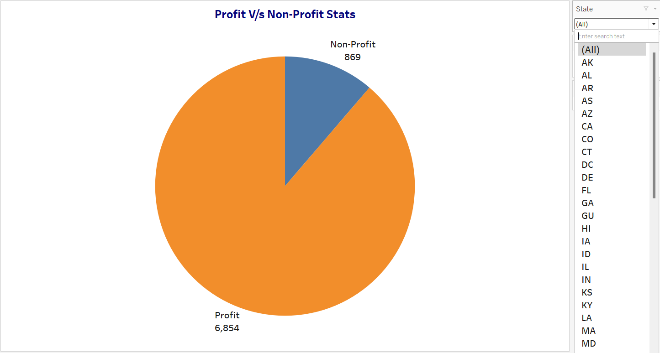
Profit V/s Non-profit stats
nalyze staff ratios and resource allocation.
nalyze staff ratios and resource allocation.
Financial Performance:
Service Delivery:
Compare revenue, costs, and profitability.
Assess services offered and patient accessibility.
Patient Outcomes:
Resource Efficiency:
Evaluate survival rates and quality of care.
Analyze staff ratios and resource allocation.

Slide 8
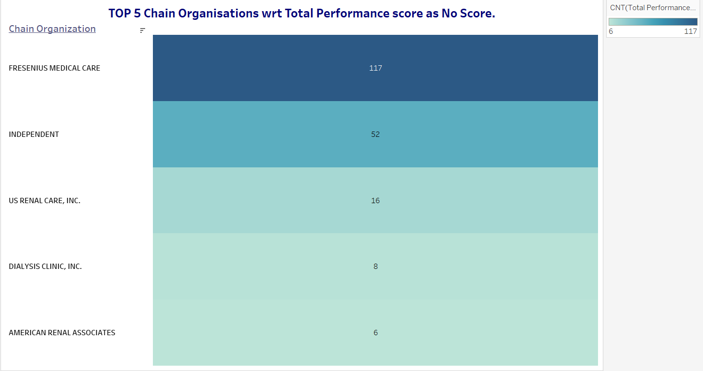
TOP 5 Chain Organisations wrt Total Performance score as No Score
Fresenius medical care
independent
US Renal care. INC
Dialysis Clinic .INC
117
52
16
8
American Renal associates
6

Slide 9
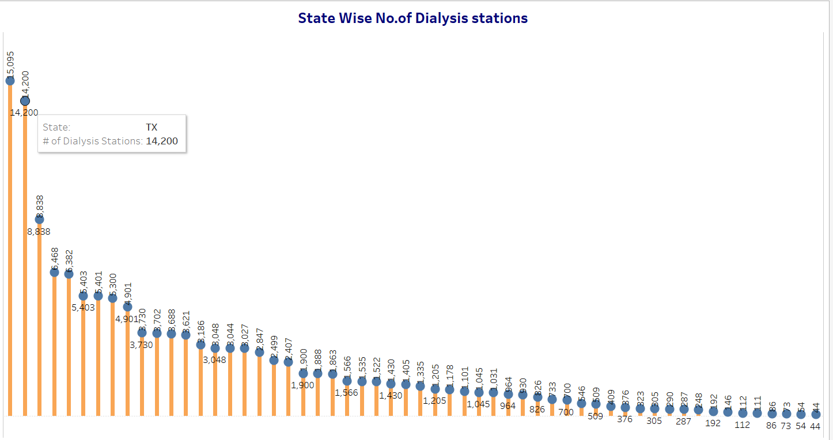
State wise No. of dialysis stations
There are 14,200 dialysis stations across different states, with a breakdown of the number of stations offering home hemodialysis training, in-center hemodialysis, and peritoneal dialysis.

Slide 10
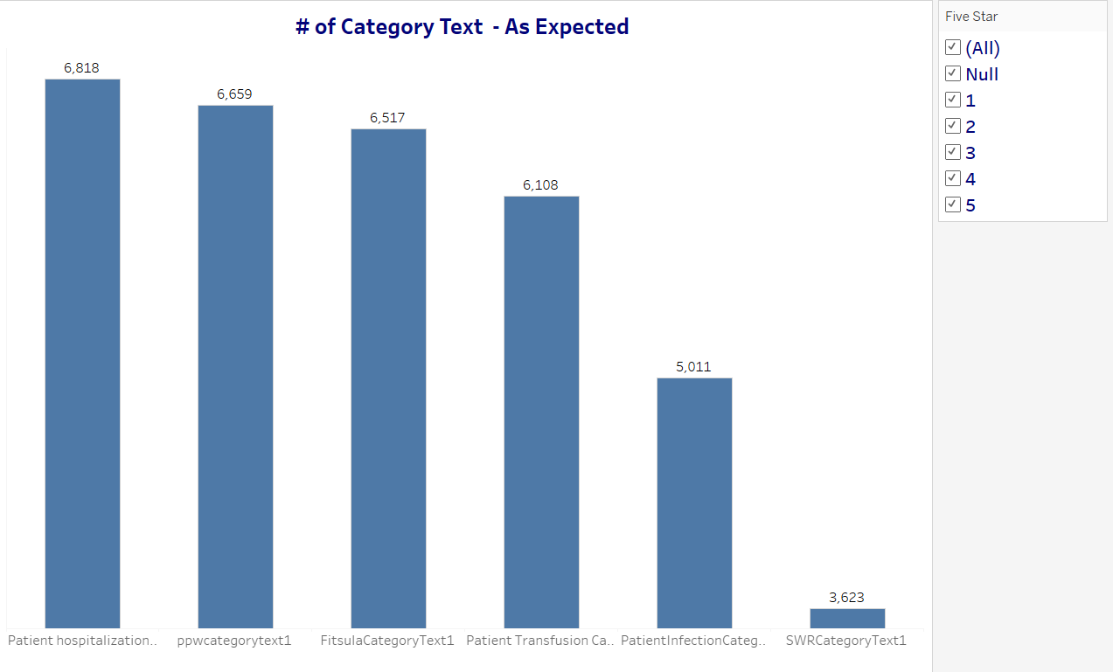
# of Category Text - As Expected
the availability of different types of dialysis treatments such as home hemodialysis training, in-center hemodialysis, and peritoneal dialysis, indicating the range of services offered.

Slide 11
Average payment reduction percentage
0.81%

Slide 12
Fistula rate
Mortality rate
Transfusion rate
Re-admission rate
62.77%
22.42%
20.18%
26.93%

Slide 13
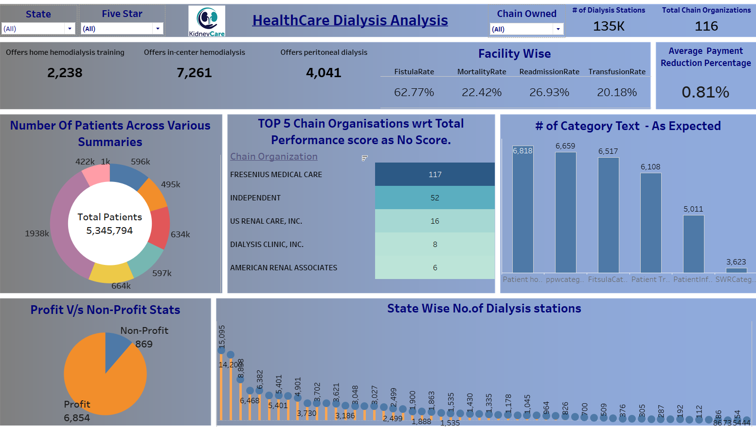

Slide 14
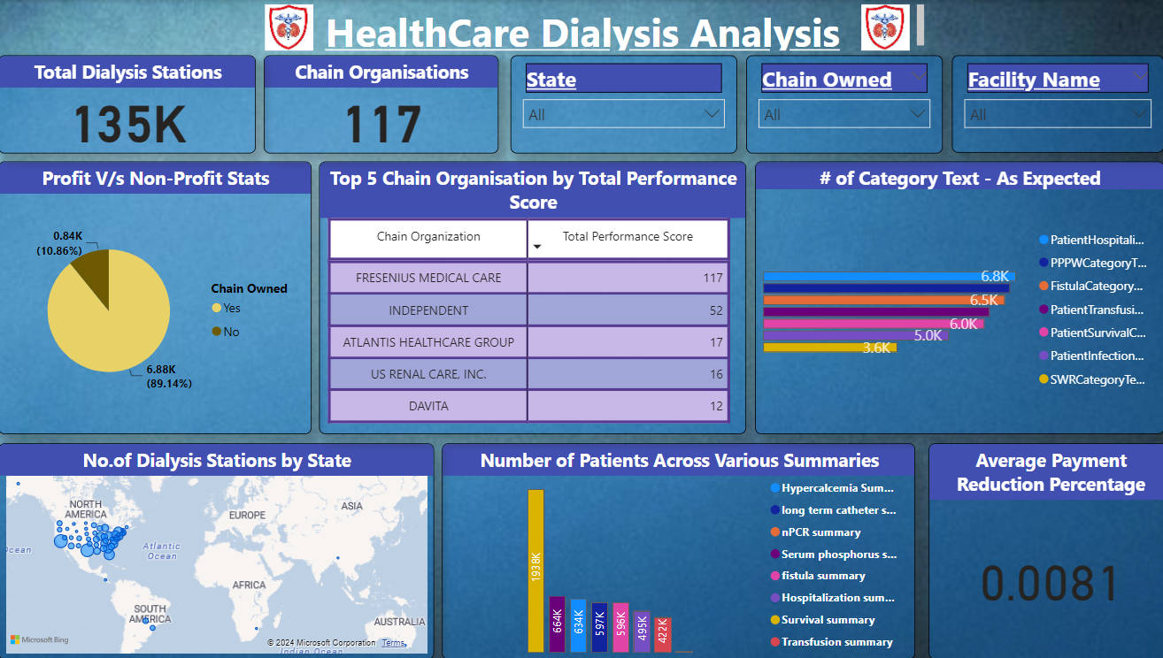

Slide 15
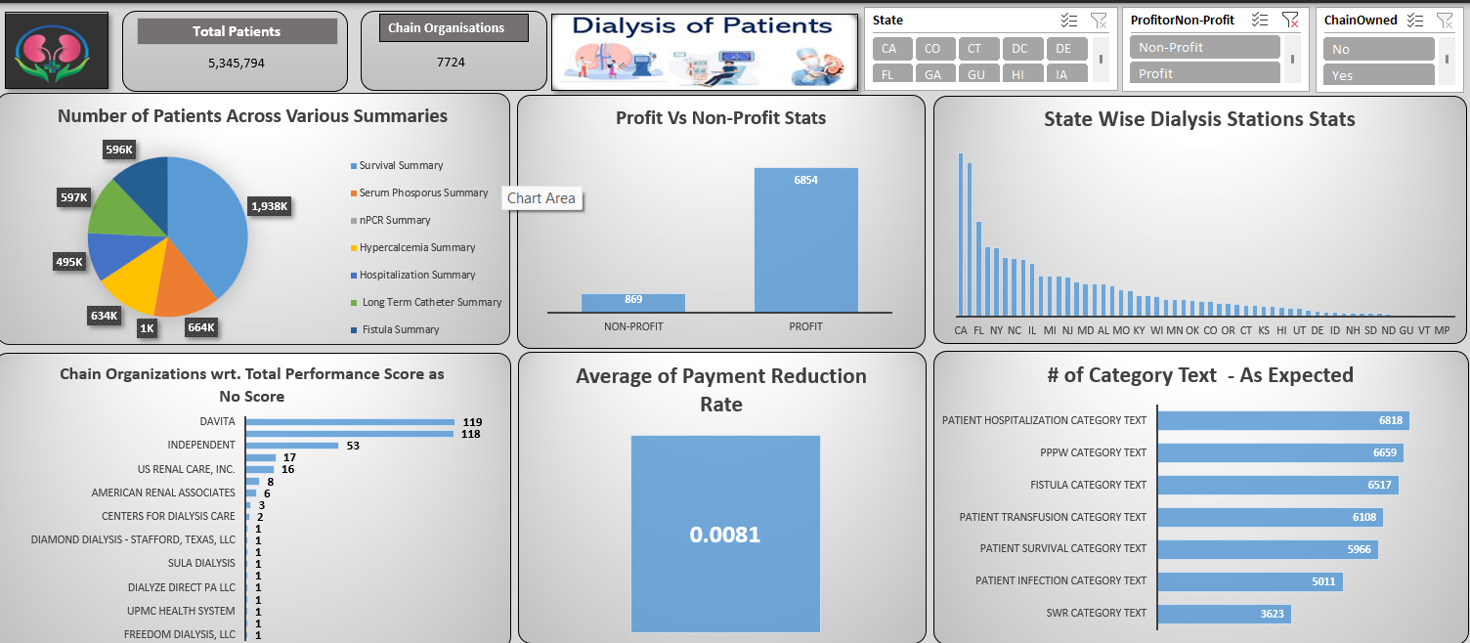

Slide 16
—Thomas Edison
"The doctor of the future will give no medicine, but will interest his patients in the care of the human frame, in diet, and in the cause and prevention of disease."

Slide 17
Thank you.⚕️

