Slide 1

Project Presentation
MedGuardAI
Intelligent Multi-Agent System for Medicine Authentication and Safety Verification
Group Members :
Sudip Konde - AI & ML Lead ( MITU22BTCS0859 )
Tanmmay Khedekar - Frontend Lead ( MITU22BTCS0906 )
Sai Jagdale - Backend Lead ( MITU22BTCS0692 )
Sujal Bafna - DB & DevOps Lead ( MITU22BTCS0864 )
Guide : Prof . Dr Rajendra Pawar
Department of Computer Science & Engineering, MITSOE, Loni Kalbhor

Slide 2
OUTLINE
Introduction & Problem Statement
Objectives
Concepts & Methods
Literature Review
Identification of Gaps
Process & Architecture
Tools & Technologies
Implementation
Result
Conclusion & Future Work
Reference
Department of Computer Science & Engineering, MITSOE, Loni Kalbhor

Slide 3
INTRODUCTION & PROBLEM STATEMENT
Growing issue of counterfeit, expired, and illegal medicines
Difficult for users to verify medicine authenticity in real-time
Existing systems lack multi-modal verification and accessibility
Need for an AI-based, user-friendly verification solution
Problem
Statement :
Counterfeit and expired medicines pose serious health risks, while existing barcode-based systems are unreliable due to damage, duplication, and lack of real-time verification. There is a need for a simple, integrated system using AI, OCR, and barcode technology to ensure accurate and accessible medicine authentication.
Department of Computer Science & Engineering, MITSOE, Loni Kalbhor

Slide 4
OBJECTIVES
Develop an AI-based medicine verification system
Enable verification using text, image (OCR), and barcode
Classify medicines as:
Authentic
Fake
Expired
Unverified
Implement similarity search using pgvector (RAG)
Provide safe symptom-based guidance using local LLM
Department of Computer Science & Engineering, MITSOE, Loni Kalbhor

Slide 5
CONCEPT & METHODS
Concept : MedGuard AI is an AI-powered medicine verification system that detects counterfeit, expired, or unsafe drugs. It analyzes images, text, and barcodes to provide real-time, reliable, and user-friendly authentication for consumers and healthcare professionals.
Methods :
Multi-Modal Input Processing – Handles text, image, and barcode inputs.
OCR (Google Cloud Vision API) – Extracts text from medicine packaging.
Barcode Decoding – Identifies product information.
Information Extraction & Validation – Processes and verifies data.
Semantic Search (RAG + pgvector/FAISS) – Retrieves relevant medicine data.
Verification Logic – Checks authenticity and expiry.
LLM-Based Summarization (AI Models) – Generates simple results.
Microservice Architecture – Ensures scalability and modular design
bit of body text
Department of Computer Science & Engineering, MITSOE, Loni Kalbhor

Slide 6
LITERATURE REVIEW
Ref | Outcome | Limitation | Contribution | Paper
[1] | Achieved ~90% accuracy inidentifying real vs fakepackaging. | Limited dataset size; lacksbarcode handling and real-world variability. | Used CNN-based imagerecognition and OCR forcounterfeit detection. | Motwani et al., 2022 -Counterfeit MedicineDetection using DeepLearning
[2] | Enabled quick verificationthrough QR scanning andserialization. | Fails if code is duplicatedor damaged. | Developed a QR/Barcode-based medicineauthentication system. | Renushe et al., 2024 - A QRCode Approach ToCounterfeit Drug Prevention
[3] | Improved drug labelrecognition accuracy to88%. | Computationally intensive;limited generalization forunseen data. | Proposed hybrid modelcombining image featuresand OCR text embeddings. | Liu et al., 2020 - DLI-IT:Drug Label Identificationthrough Image and TextEmbedding
[4] | Detected counterfeit andexpired drugs effectively inreal conditions. | Dependent on manualscanning and infrastructurequality. | Analyzed serialization-based authentication inhospital systems. | Naughton et al., 2016 -Effectiveness of MedicinesAuthentication Technology
Department of Computer Science & Engineering, MITSOE, Loni Kalbhor

Slide 7
IDENTIFICATION OF GAPS & SCOPE OF WORK
Gaps :
Existing systems rely on single-mode verification and lack a unified multi-modal approach (MedScan, Zydus Verify)
Many solutions require costly infrastructure (blockchain, IoT, lab setup), limiting real-world use (ITS Mobile, Blockchain Drug Trace Systems)
Current methods are not scalable or user-friendly for general consumers (PharmaSecure psVerify)
Lack of advanced AI integration and poor handling of real-world issues (damaged packaging, duplicate barcodes) (QR Code Verification Systems, MedScan)
Scope of Work :
Build a complete multi-modal verification system
Improve accuracy using AI + similarity search
Develop scalable backend using Django REST Framework
Enable real-time verification and user history tracking
Expand dataset and improve model performance
Department of Computer Science & Engineering, MITSOE, Loni Kalbhor

Slide 8
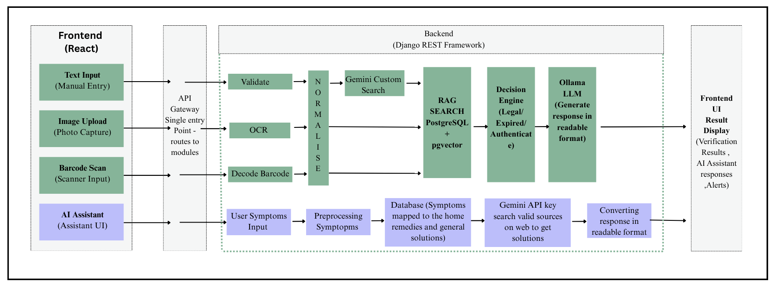
PROCESS AND ARCHITECTURE
Department of Computer Science & Engineering, MITSOE, Loni Kalbhor

Slide 9
TOOLS AND TECHNOLOGIES
Backend: Django REST Framework
Database: PostgreSQL
RAG: pgvector
OCR: PaddleOCR, Tesseract
LLM: Ollama (local)
Frontend: React, Flutter
Authentication: JWT
Deployment: Docker, Cloud
Department of Computer Science & Engineering, MITSOE, Loni Kalbhor

Slide 10
IMPLEMENTATION
Developed API services using Django REST Framework
Integrated OCR for image-based text extraction
Implemented barcode scanning and decoding
Built classification logic for medicine verification
Stored data and embeddings using PostgreSQL + pgvector
Connected frontend with backend APIs
Containerized services using Docker
Department of Computer Science & Engineering, MITSOE, Loni Kalbhor

Slide 11
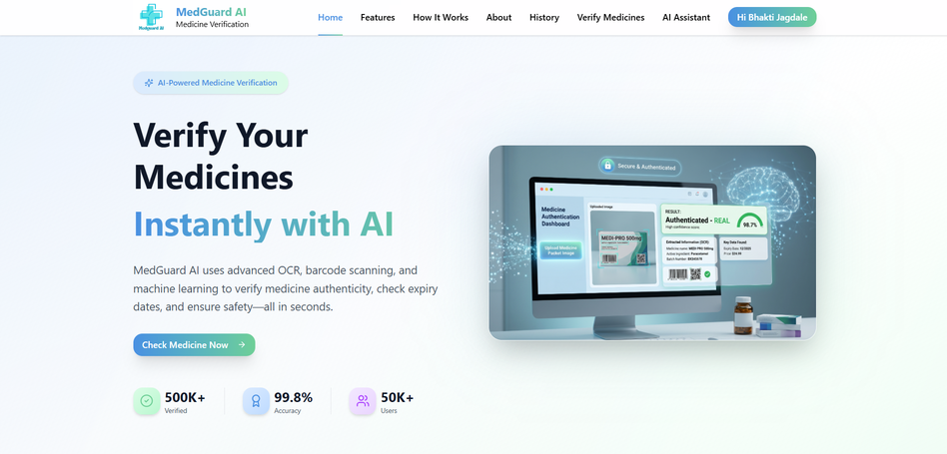
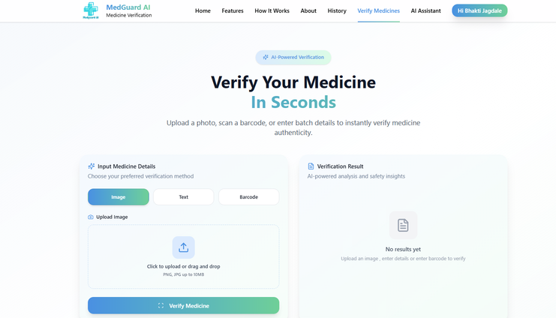
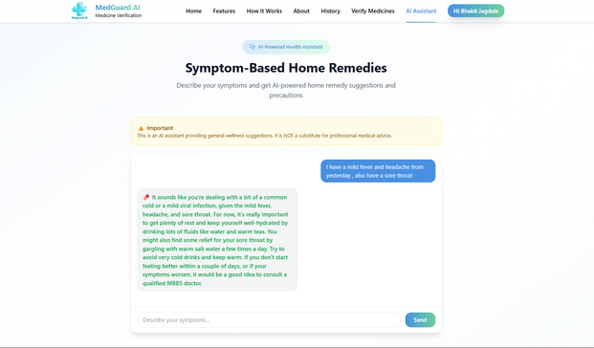
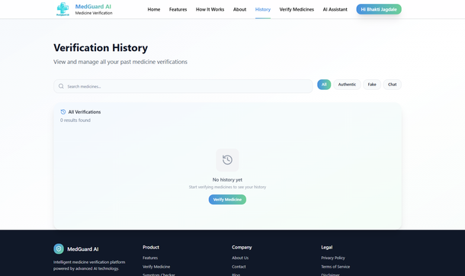
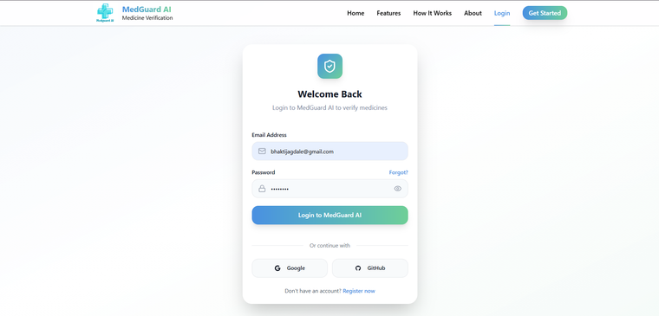
RESULTS
Home Page
Verification Page
AI Assistant
History
Login Page
Department of Computer Science & Engineering, MITSOE, Loni Kalbhor

Slide 12
CONCLUSION AND FUTURE WORK
Conclusion :
Successfully developed a multi-modal AI-based verification system
Improved reliability in medicine authentication
Provides accessible and practical solution for users
Future Work :
Expand dataset for higher accuracy
Improve AI model performance
Launch mobile application
Integrate real-time regulatory databases
Deploy fully on cloud for large-scale use
Department of Computer Science & Engineering, MITSOE, Loni Kalbhor

Slide 13
REFERENCES
[1] P. Motwani, R. Sharma, and S. Bansal, “CounterfeitMedicine Detection Using Deep Learning,”International Journal of Innovative Research inTechnology (IJIRT), vol. 3, no. 11, pp. 45–50,2022.https://ijirt.org/publishedpaper/IJIRT156491_PAPER.pdf2.
[2] A. Renushe, V. Shinde, and R. Patil, “A QR CodeApproach to Counterfeit Drug Prevention,” Journal ofNeonatal Surgery, vol. 13, no. 2, pp. 115–120, 2024.3.
[3] Y. Liu, M. Yang, and Q. Chen, “DLI-IT: A DeepLearning Approach to Drug Label Identificationthrough Image and Text Embedding,” BMC MedicalInformatics and Decision Making, vol. 20, no. 4, pp.87–96, 2020.https://doi.org/10.1186/s12911-020-1078-34.
[4] P. Naughton, R. Smith, and L. Morrison,“Effectiveness of Medicines AuthenticationTechnology to Detect Counterfeit, Recalled andExpired Medicines,” Journal of Public Health, vol. 38,no. 4, pp. 603–611,2016.https://bmjopen.bmj.com/content/6/12/e0138375.
Department of Computer Science & Engineering, MITSOE, Loni Kalbhor

