Slide 1

NATIONAL INSTITUTE OF TECHNOLOGY PUDUCHERRY
(An Institute of National Importance under MHRD, Govt. of India)
KARAIKAL – 609 609
Department of Computer Science and Engineering
Third Review
3-4 October 2023
SENTIMENTAL ANALYSIS BASED ON TWITTER DATA ON GENERAL ELECTIONS
Project by,
Ankita Bhowmik, CS21B1059
Sai Keerthiga Murugan, CS21B1062
Supervisor
Dr. V Vani
Assistant Professor
CSE
Dr. N. Karthik
Assistant Professor
CSE
1

Slide 2
OUTLINE
Title
Literature survey
Objectives
Existing System Limitations
Proposed System
System Architecture
Tool Findings
Data set Identification
Pre-processing
References
2

Slide 3
OBJECTIVES
Manual labeling is no longer feasible due to the massive volume of Twitter data.
Sentiment analysis covers both English and Tagalog, which introduces language diversity challenges.
Using Natural Language Processing techniques, these tweets were annotated, processed, and trained to classify both English and Tagalog tweets into three polarities: positive, neutral, and negative.
Using Self-Training with Multinomial Naïve Bayes and 30% unlabeled data achieved an accuracy of 84.83%, exceeding prior Twitter-based studies in the Philippines.
3

Slide 4
LITERATURE SURVEY
Related Work-1:
.
TITLE | AUTHOR | FINDING
A Semi-Supervised Approach to Sentiment Analysis of Tweets during the 2022 Philippine Presidential Election | Julio Jerison E. Macrohon, Charlyn Nayve Villavicencio, X. Alphonse Inbaraj and Jyh-Horng Jeng. | It does not explore how sentiment may have evolved or changed after the election. The research did not explicitly address external factors that may have influenced sentiment, such as news events, political developments, or the behavior of political candidates. Ignoring these factors can limit the study's explanatory power. It does not explore how sentiment may have evolved or changed after the election.
4

Slide 5
LITERATURE SURVEY
Related Work-2:
TITLE | AUTHOR | FINDING
Election Result Prediction Using Twitter sentiment Analysis | Apoorv Agarwal Boyi Xie Ilia Vovsha Owen Rambow Rebecca Passonneau | Twitter Data Collection,Data Preprocessing,Data Labelling Labeled Training Dataset,Sentiment Classification Results
Sentimental Analysis of before and after elections: U.S. election 2020 | Hassan Nazeer Chaudhry 1,, Yasir Javed 2 , Farzana Kulsoom 3 , Zahid Mehmood 4,, Zafar Iqbal Khan 2 , Umar Shoaib 5 and Sadaf Hussain Janjua | Pre-processing,Feature Extraction,Sentiment Analysis output:Classified Sentiments,Insights and Analysis
Prediction and analysis of Indonesia Presidential election from Twitter using sentiment analysis | Widodo Budiharto and Meiliana Meiliana | The experimental results showed that the method accurately predicted the election outcome, with Jokowi leading the prediction. The prediction was in line with results from reputable survey institutes. The authors highlighted the simplicity and reliability of their approach in using tweet counting and sentiment analysis for election prediction.
Sentiment Analysis of Twitter Data | Apoorv Agarwal Boyi Xie Ilia Vovsha Owen Rambow Rebecca Passonneau Department of Computer Science Columbia University New York, NY 10027 USA | 1. Unigram model (our baseline) 2. Tree kernel model 3. 100 Senti-features model 4. Kernel plus Senti-features 5. Unigram plus Senti-features
5

Slide 6
EXISITING SYSTEM LIMITATIONS
It does not explore how sentiment may have evolved or changed after the election.
The research did not explicitly address external factors that may have influenced sentiment, such as news events, political developments, or the behavior of political candidates. Ignoring these factors can limit the study's explanatory power.
It does not explore how sentiment may have evolved or changed after the election.
6

Slide 7
PROPOSED SYSTEM
Predicting the outcome of a general election based on Twitter data is a complex and challenging task, but it can be done using machine learning and data analytics techniques. Here's a proposed system for general election prediction in 2022 based on Twitter data:
1. Data Collection
2. Data Preprocessing
3. Sentiment Analysis
4. Social Network Analysis
5. Time Series Analysis
6. Machine Learning Models
7. Geographic Analysis
8. Visualization and Reporting
9. Model Evaluation and Validation
10. Ethical Considerations
7

Slide 8
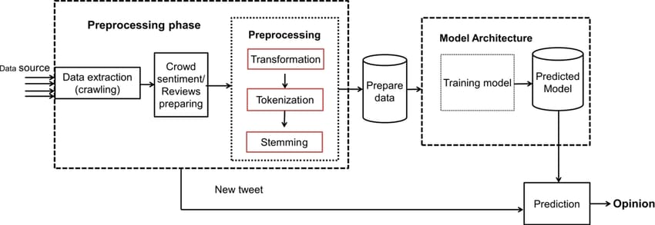
ARCHITECTURE DIAGRAM
Fig 1: Architecture Diagram
8

Slide 9
TOOL FINDINDS
Machine learning models: SK learn module
Sentiment analysis: The script utilizes NLTK’S VADER(valence aware dictionary for sentiment reasoning) sentiment analysis tools to assess the sentiment of input comments categorizing it as positive, negative .
Visualization : Matplotlib for pie charts plotting.
9

Slide 10
DATASET IDENTIFICATION
The dataset comprises Twitter data related to Indian political leaders Narendra Modi and Rahul Gandhi. Sourced from Kaggle, it includes tweets, user profiles, date and emotions . This dataset can be used for research and analysis, offering insights into public sentiment, political trends, and social media discussions. When using this data, it's important to follow the rules of Twitter and give credit to Kaggle as the source of the data.
10

Slide 11
PREPROCESSING
In preprocessing, firstly we removed duplicates and nulls value fields and then continued step by step as below:
Tokenize
Filter Tokens
Lemmatization
Stop Words Removal
Generate n-Grams
Finally, removed nulls value fields if any.
11

Slide 12
REFERENCES
1. Palatino, M. Why the Fight for the Philippines Vice Presidency Matters. The Diplomat, 3 December 2021. Available online: https://thediplomat.com/2021/12/why-the-fight-for-the-philippines-vice-presidency-matters/ (accessed on 10 June 2022).
2. Baclig, C.E. TIMELINE: The 4-Year Robredo-Marcos POLL case, INQUIRER.NET, 16 February 2021. Available online: https://newsinfo.inquirer.net/1396547/the-4-year-robredo-marcos-vice-presidential-case (accessed on 10 June 2022).
3. DW. Philippines: Marcos Jr. Wins Presidential Election Landslide, 9 May 2022. Available online: https://www.dw.com/en/philippines-marcos-jr-wins-presidential-election-landslide/a-61727645 (accessed on 10 June 2022).
4. Mendoza, D.J. Reflections on the Philippine Presidential Race, 9 May 2022. Available online: https://www.bworldonline.com/opinion/2022/05/09/447235/reflections-on-the-philippine-presidential-race/ (accessed on 10 June 2022).
5. StatCounter. Social Media Stats Philippines, June 2022. Available online: https://gs.statcounter.com/social-media-stats/all/philippines. (accessed on 23 July 2022).
6. Mateo, J. Philippines Still World’s Social Media Capital–sudy. The Philippine Star, 3 February 2018. Available online:
https://www.philstar.com/headlines/2018/02/03/1784052/philippines-still-worlds-social-media-capital-study/amp/ (accessed on23 July 2022).
7. Investopedia. Web 2.0 and Web 3.0, 21 May 2022. Available online: https://www.investopedia.com/web-20-web-30-5208698 (accessed on 10 June 2022).
8. Hubspot. What Is Twitter and How Does It Work? 29 January 2019. Available online: https://blog.hubspot.com/marketing/what-is-twitter (accessed on 10 June 2022).
9. Bansala, B.; Srivastava, S. On predicting elections with hybrid topic based sentiment analysis of tweets. Procedia Comput. Sci. 2018, 135, 346–353. [CrossRef]
12

Slide 13
THANK YOU
13

