Slide 1
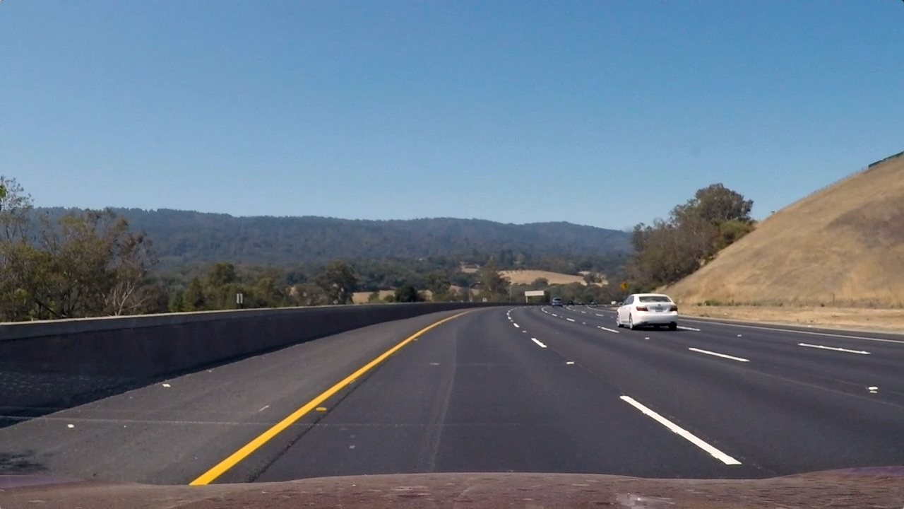
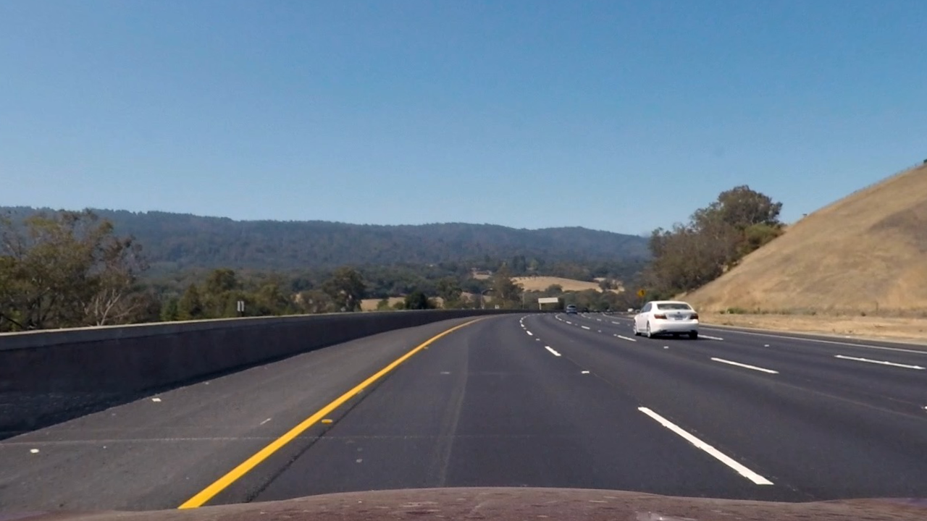

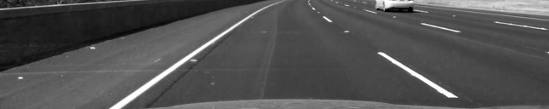


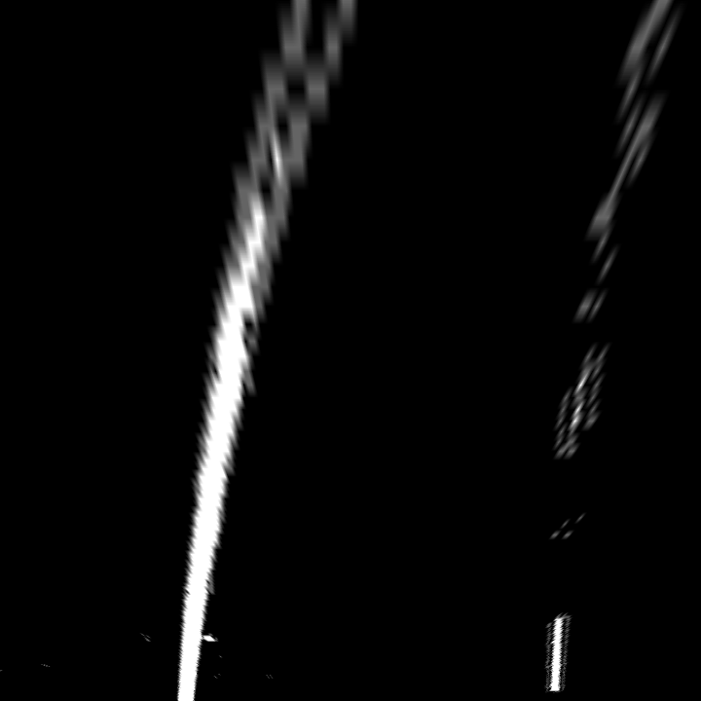
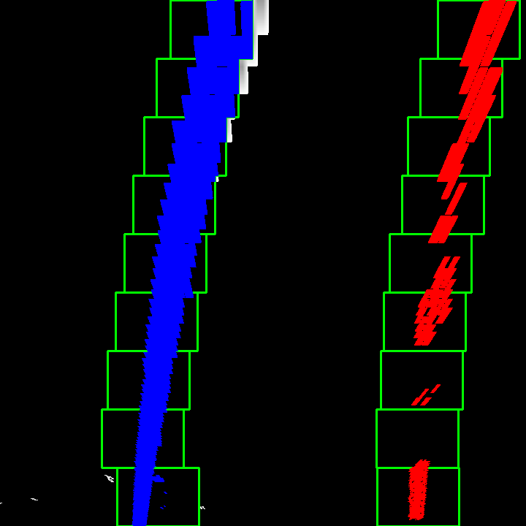


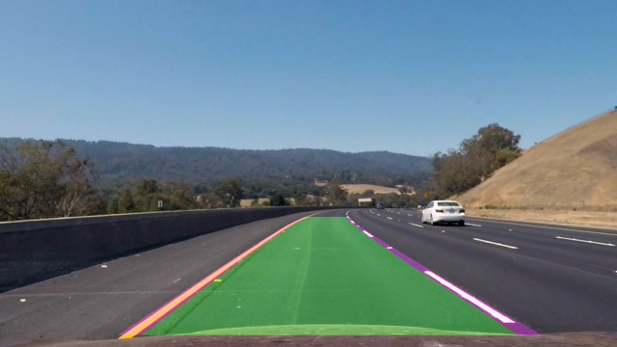
Sobel Thresholding
Image/Frame
Perspective
Correction
Cropped
Combined Thresholding
HLS Thresholding
Warped (Bird-Eye View)
Sliding Window Search
Illustrate Lane
Warped (Camera View)
Final Result

