Slide 1
XAI-TransMed
Explainable AI for Alzheimer’s Disease Detection
and Progression Prediction
1M1B AI for Sustainability Virtual Internship
SDG 3 • Good Health & Well-being
Voladri Sai Krishnareddy
CSE • Vardhaman College of Engineering

Slide 2
Problem Statement
02
“How might we use Explainable AI to support the early detection
and progression prediction of Alzheimer’s disease so that healthcare
professionals can make more informed and interpretable decisions?”
Challenge
AI Need
Goal
Complex MRI and clinical information must be interpreted together.
Models should capture global brain patterns and provide explanations.
Provide research-stage decision support, not autonomous diagnosis.
XAI-TransMed • AI for Sustainability • SDG 3

Slide 3
SDG 3 Alignment
03
SDG 3 — Good Health & Well-being
How it contributes
Sustainability angle
The project explores responsible AI for healthcare decision support, with a focus on Alzheimer’s disease stage classification and progression-related analysis.
• Supports analysis of MRI images
• Combines clinical information
• Provides progression-related predictions
• Adds visual explanations
Better-informed health decisions can support well-being and healthcare resource planning. The project remains a prototype and requires further validation.
XAI-TransMed • AI for Sustainability • SDG 3

Slide 4
Who Is Affected?
04
• People undergoing dementia assessment
• Healthcare professionals involved in assessment and monitoring
• Patients and caregivers who depend on informed care decisions
• Researchers developing interpretable medical AI
Existing challenge
Existing approaches may focus on local image features and can be difficult to interpret.
Data challenge
MRI information and clinical/demographic data provide different but complementary signals.
Trust challenge
Healthcare applications need transparency and human oversight.
XAI-TransMed • AI for Sustainability • SDG 3

Slide 5
Why AI Is Needed
05
MRI
Medical image input
ViT
Global feature extraction
XGBoost
Progression-related prediction
XAI
Attention maps / Grad-CAM
• Vision Transformer uses self-attention to model relationships across image patches.
• Multimodal inputs combine MRI information with clinical/demographic features.
• Explainability techniques produce visual evidence associated with the model output.
XAI-TransMed • AI for Sustainability • SDG 3

Slide 6
Proposed AI Solution & Workflow
06
1
MRI + Clinical Data
2
Preprocessing
3
Vision Transformer
4
Stage Classification
5
Progression Model
6
XAI Output
Outputs: dementia-stage prediction • class probabilities • progression-related prediction • attention heatmap
XAI-TransMed • AI for Sustainability • SDG 3

Slide 7
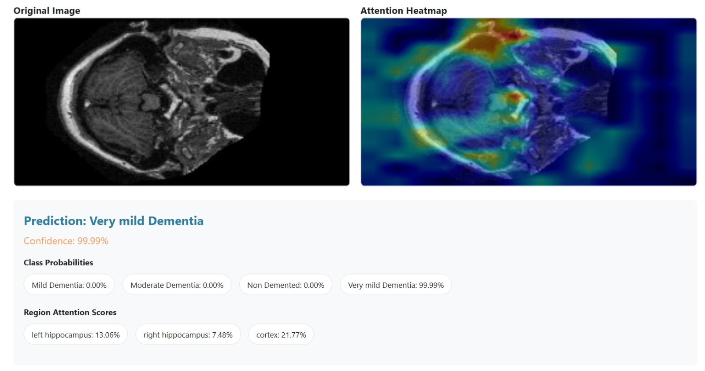
Prototype Demo — Stage Prediction
07
Prototype output: MRI + attention heatmap + predicted stage + class probabilities + region attention scores
XAI-TransMed • AI for Sustainability • SDG 3

Slide 8
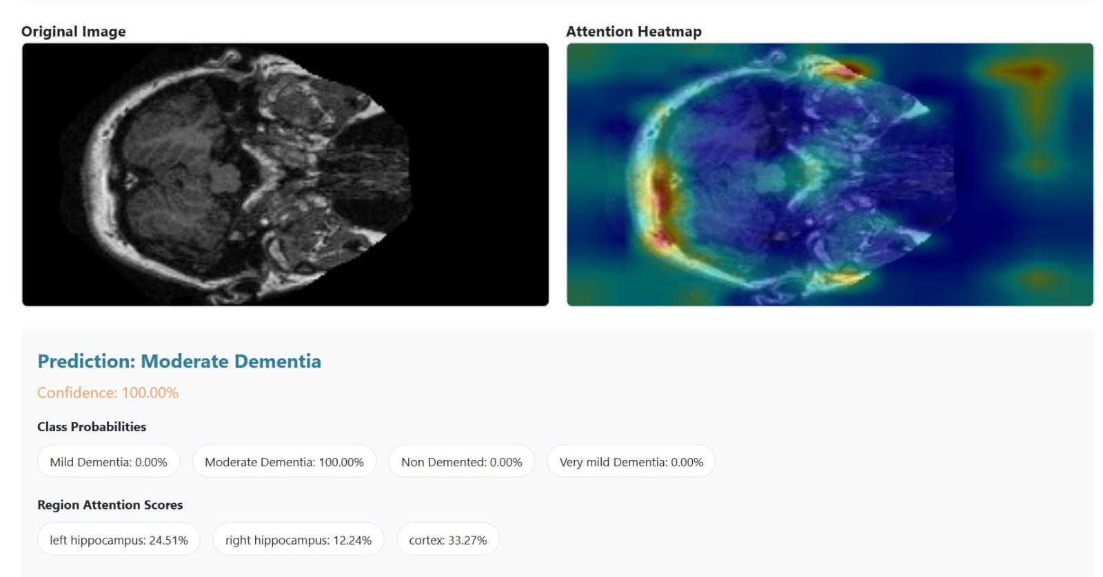
Prototype Demo — Explainability
08
Attention heatmap provides a visual explanation alongside the model’s predicted dementia stage.
XAI-TransMed • AI for Sustainability • SDG 3

Slide 9
How the AI Works
09
Vision Transformer (ViT)
Progression Prediction
Explainable AI
Extracts MRI features using patch embeddings and self-attention to capture global relationships.
XGBoost is used for MMSE/progression-related prediction; the research design also describes Cox proportional hazards analysis.
Attention Rollout / Grad-CAM generate heatmaps that visualize regions associated with model attention.
Four output classes
Technology
Non-Demented • Very Mild • Mild • Moderate
Python • PyTorch/TensorFlow • XGBoost • OpenCV/NumPy • Web interface
XAI-TransMed • AI for Sustainability • SDG 3

Slide 10
Responsible AI Considerations
10
Transparency
Fairness
Privacy
Human Oversight
Use visual explanations so users can inspect model attention rather than receiving only a black-box output.
Evaluate performance across demographic groups and investigate potential differences.
MRI scans and clinical information are sensitive; protect data and limit use to appropriate purposes.
Predictions should support qualified professionals and must not be treated as an autonomous diagnosis.
Key principle: explainable, privacy-aware, fairness-tested AI with clear limitations.
XAI-TransMed • AI for Sustainability • SDG 3

Slide 11
Expected Impact, Limitations & Future Scope
11
Expected Impact
Limitations
Future Scope
• Supports analysis of complex MRI information
• Provides stage classification
• Provides progression-related information
• Adds visual explanations
• Can support informed healthcare decisions
• Research/prototype stage
• Predictions can be wrong
• Performance depends on data quality
• Further external validation is needed
• Not a replacement for medical judgment
• Larger and more diverse datasets
• Additional clinical/imaging modalities
• Better generalization
• Fairness evaluation
• Real-world clinical validation
XAI-TransMed • AI for Sustainability • SDG 3

Slide 12
Conclusion
XAI-TransMed combines Vision Transformers, clinical data,
progression modelling and Explainable AI to explore
responsible AI-based decision support for Alzheimer’s disease.
SDG 3 • Good Health & Well-being
Thank You • Questions?

