Slide 1
LetsGame
Project Presentation
SWE6733 - Emerging Software Engineering Processes
Spring 2021
Team #1
Instructor: Dr. Xia Li

Slide 2
Agenda
Team Introduction
Problem statement and Project goals
Project motivation
Goals of the application and intended users
Process and technologies used in building and deploying the application
Scrum journey (planning, sprints, and retrospectives)
Azure DevOps
Technical Implementation and integration details
Project Implementation
Code base and Technical implementation
Development strategy
CICD
Azure cloud and pipelines
Auto deployment and releases
LIVE DEMO OF PROJECT

Slide 3
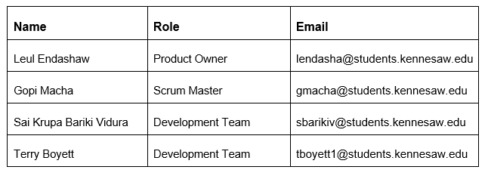
Team

Slide 4
Project Motivation
Playing games allows an escape from reality into another reality. The competition to win by itself gives gaming an addictive flavor to it. Mainly our system aims to solve the hustle Call of Duty gamers have to go through to find the perfect gaming partner.
In order to comprehend and completely immerse once self into this multi playing competitive environment perfectly selected complimentary skill set between teammates or partners is needed. Once that is achieved the likelihood of winning skyrockets than prior odds. Our mission is mainly to provide that for Call of Duty gamers so that they have the perfect team and partnerships and win every match they go in to.
In this application, we will be fetching gamers data, such as: levels, number of wins, number of kills, … from Call of Duty open-source API. Display it on the UI in a nice way for users to view and create their desired friend list.

Slide 5
Project Goals
Create a platform to help Call of Duty game players to find their desired teammates.
Export the desired friends list along with their relevant data for safe keeping offline.
Ensure the website is 100% responsive and compatible on mobile devices, such as: tablet, Apple & Android phone, etc.

Slide 6
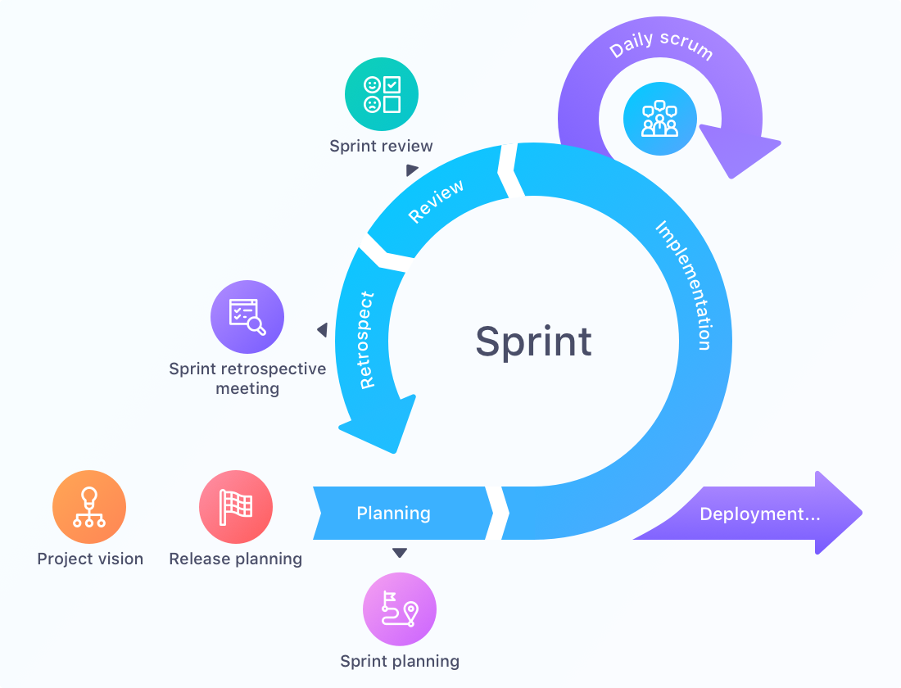
Agile Scrum

Slide 7
Scrum Journey
Product Backlog Items/ Stories
Identifying the stories and adding acceptance criteria
Story Assignment to Sprints
Based on rationale, priorities and dependencies
Sprint Planning and Story Pointing
Based on team capacity and story complexity
Sprint Reviews
Review completed stories at the end of the Sprint
Spring Retrospective
Identify any roadblocks and try to resolve them for improvement

Slide 8
Scrum Journey
Scrum Updates
Design Sessions
Brain Storming Sessions
Unit Testing
Mob Programming
Impediment Resolution

Slide 9
Project Inception
https://github.com/emergingsoftwar/documents
Product Vision
Near and far Vision
Product Backlog Items
Definition of Ready
Backlog Order

Slide 10
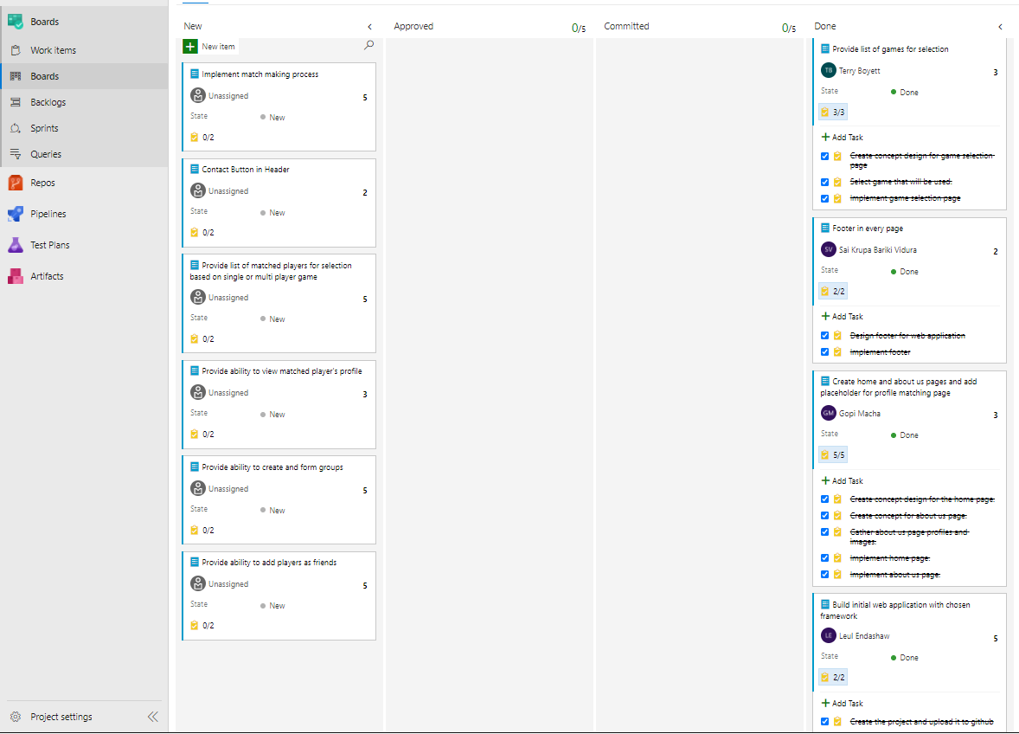
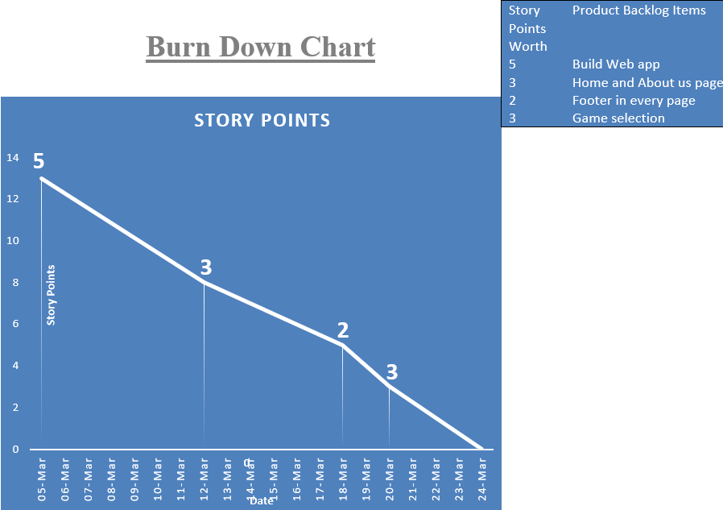
Sprint#1
https://github.com/emergingsoftwar/documents/tree/main/Sprint%201

Slide 11
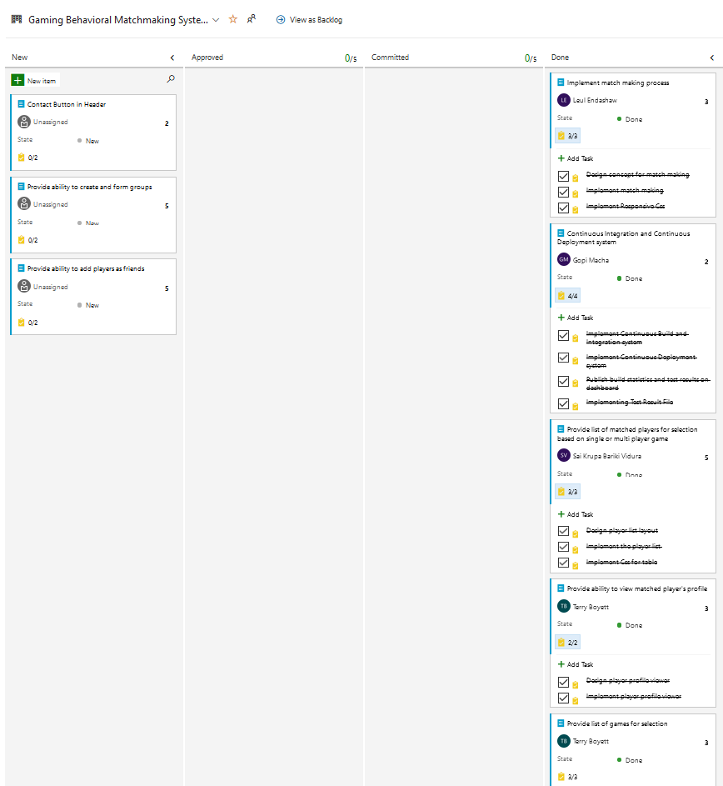
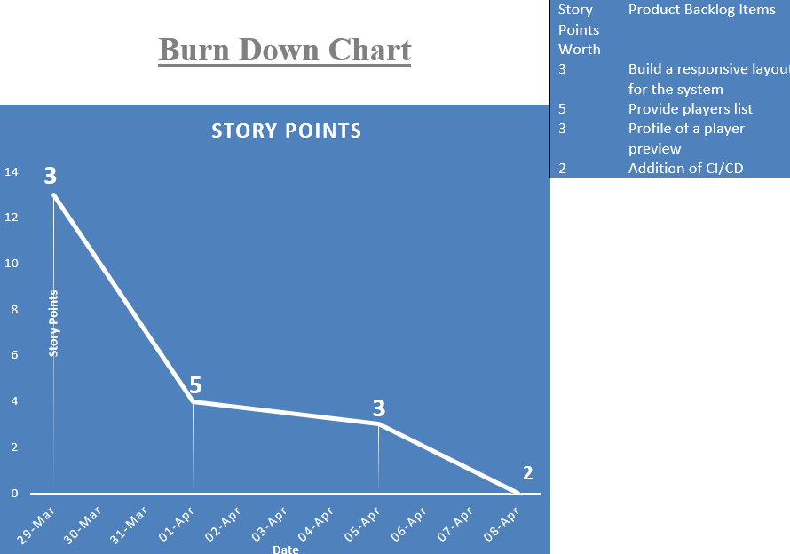
Sprint#2
https://github.com/emergingsoftwar/documents/tree/main/Sprint%202

Slide 12
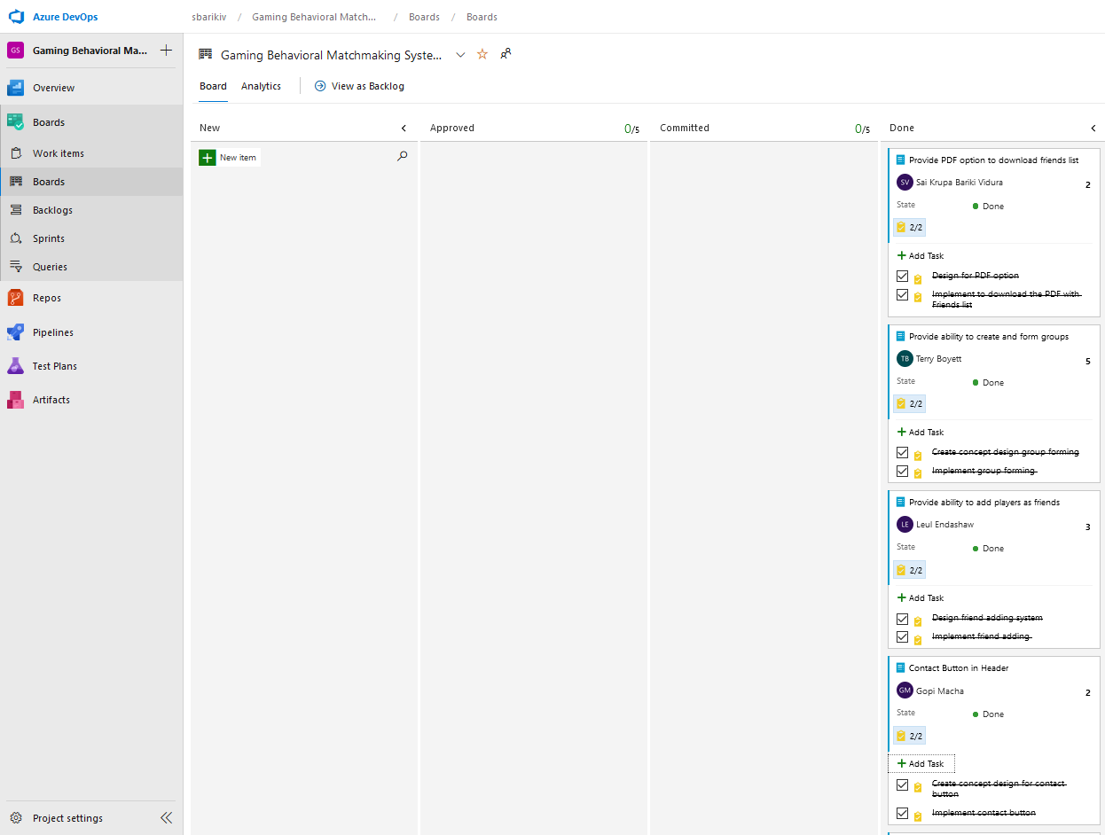
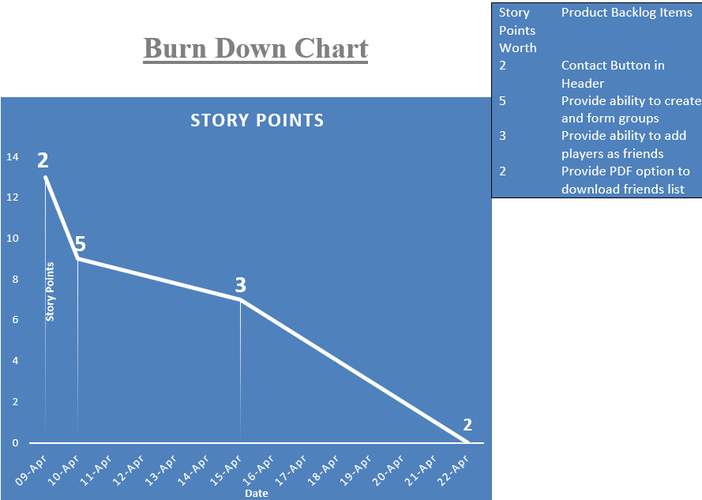
Sprint#3
https://github.com/emergingsoftwar/documents/tree/main/Sprint%203

Slide 13











Tools and Technology Stack

Slide 14
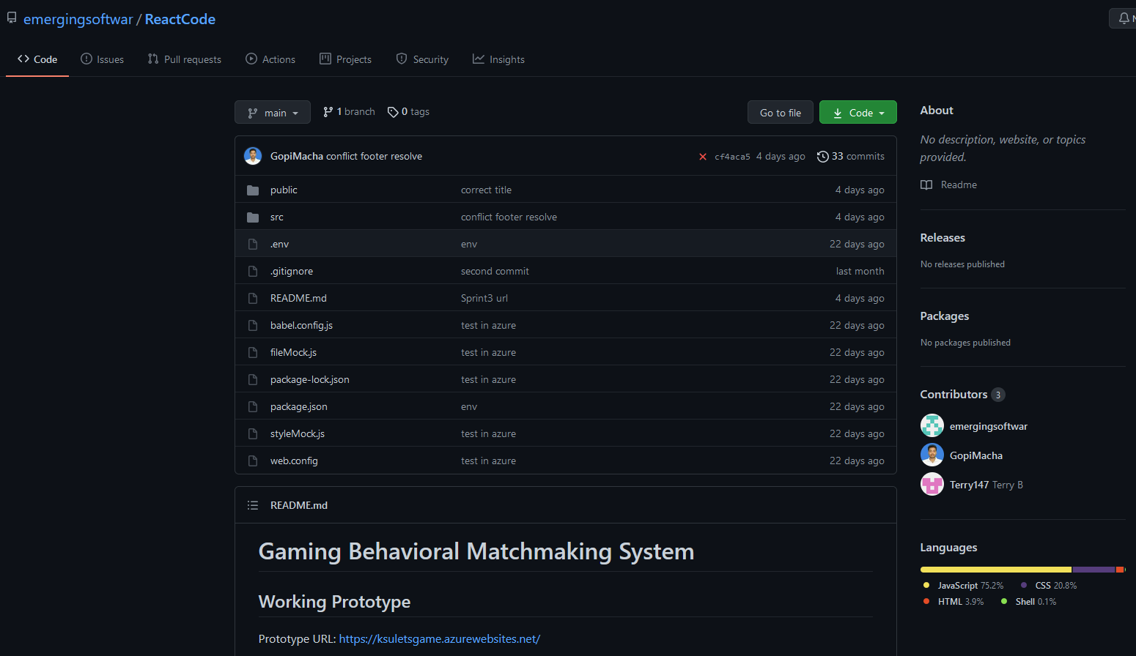
Code Base
https://github.com/emergingsoftwar/ReactCode

Slide 15
Continuous Integration Continuous Deployment
CI/CD is a method to frequently deliver apps to customers by introducing automation into the stages of app development.
The main concepts attributed to CI/CD are continuous integration, continuous delivery, and continuous deployment.
Continuous Integration and Deployment System https://dev.azure.com/sbarikiv/Gaming%20Behavioral%20Matchmaking%20System/_build?view=pipelines
https://dev.azure.com/sbarikiv/Gaming%20Behavioral%20Matchmaking%20System/_release?_a=releases&view=mine&definitionId=2
Test Runs: https://dev.azure.com/sbarikiv/Gaming%20Behavioral%20Matchmaking%20System/_testManagement/runs?_a=runQuery

Slide 16
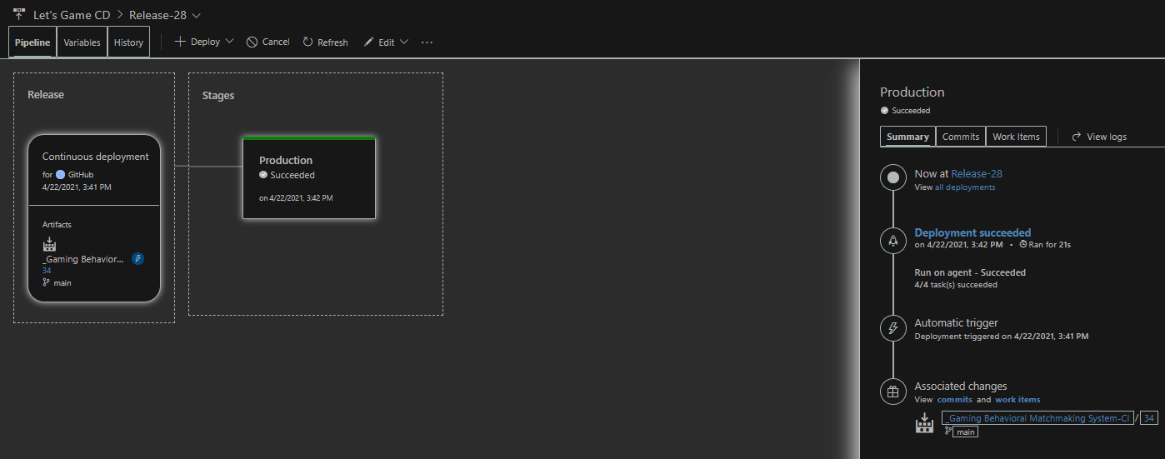
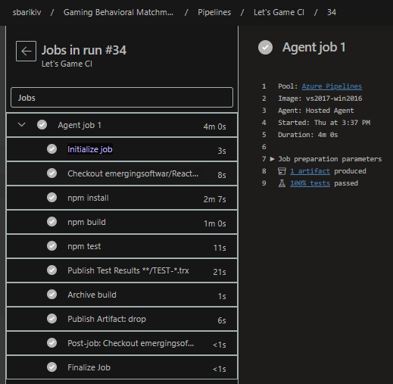
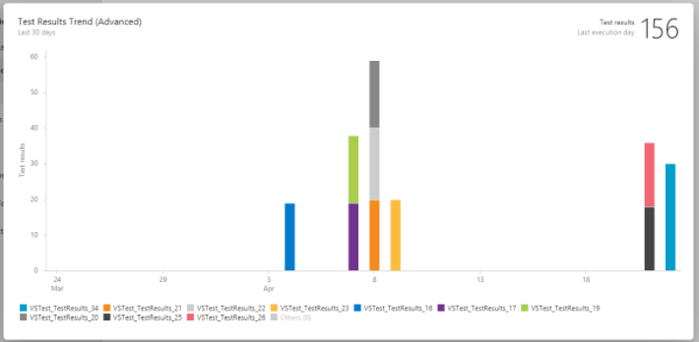
Continuous Integration Continuous Deployment

Slide 17
Not Recommended Technology
We recommend not to use Bootstrap in React JS. Instead, we used React-Bootstrap which provides a react components that have been built using CSS and JAVASCRIPT functionality of Bootstrap.

Slide 18
LIVE DEMO OF PROJECT
https://ksuletsgame.azurewebsites.net/

Slide 19
Thank you

