Slide 1
Predict Airline Passenger Satisfaction
Sai Geetha Manoharan

Slide 2
Predict Airline Passenger Satisfaction
Objective: Predict the passenger satisfaction from the airline travel information.

Slide 3
About Data
Dataset: https://www.kaggle.com/teejmahal20/classification-predicting-customer-satisfaction
Total Attributes: 25
Total ‘int’ attributes: 17
Total ‘float’ attributes: 1
Total ‘categorical’ attributes: 5
Irrelevant attributes(id, index): 2
ID
Index

Slide 4
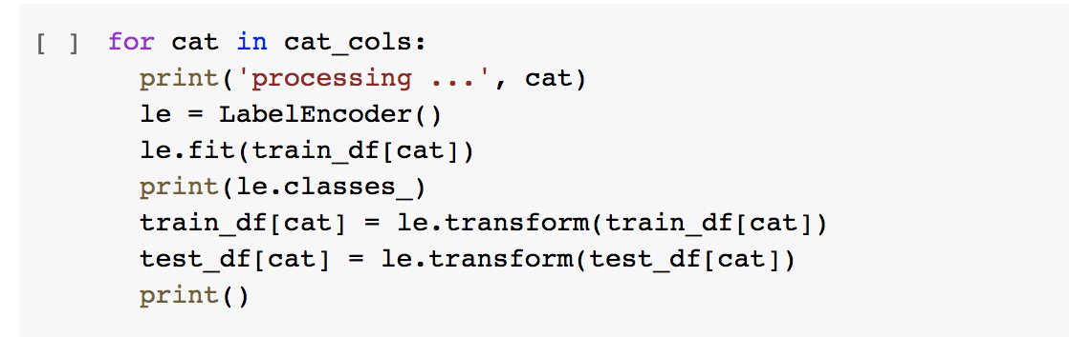
Handling Categorical attributes
Using scikit LabelEncoder

Slide 5
Data cleaning – null values
train_df.select_dtypes(include=['int64', ‘float64’]).isnull().sum()
Gender 0
Customer Type 0
Age 0
Type of Travel 0
Class 0
Flight Distance 0
Inflight wifi service 0
Departure/Arrival time convenient 0
Ease of Online booking 0
Gate location 0
Food and drink 0
Online boarding 0
Seat comfort 0
Inflight entertainment 0
On-board service 0
Leg room service 0
Baggage handling 0
Checkin service 0
Inflight service 0
Cleanliness 0
Departure Delay in Minutes 0
Arrival Delay in Minutes 310
satisfaction 0

Slide 6
Data Cleaning
Use median values for fill in empty values
train_df['Arrival Delay in Minutes’].fillna(
train_df['Arrival Delay in Minutes'].median(), inplace=True)
test_df['Arrival Delay in Minutes’].fillna(
test_df['Arrival Delay in Minutes'].median(), inplace=True)

Slide 7
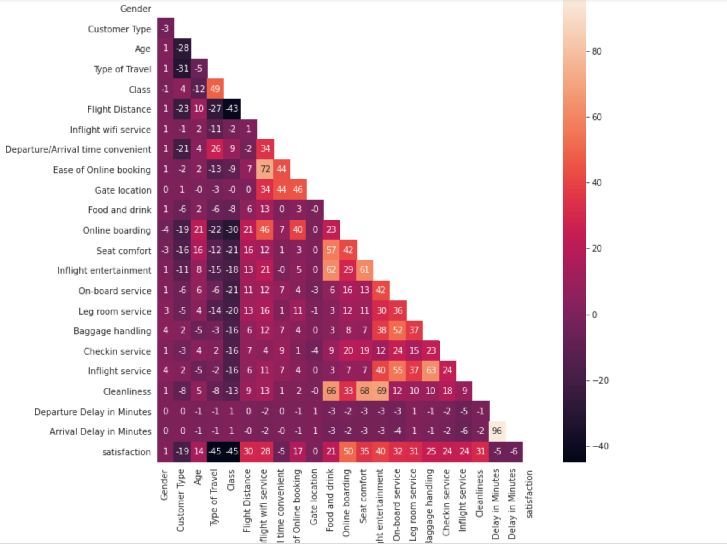
Correlation Info

Slide 8
Feature Relationship
Strongly correlated features
Online boarding
Type of Travel
Class
No correlation
Gate location
Gender
Departure/Arrival Time convenient

Slide 9
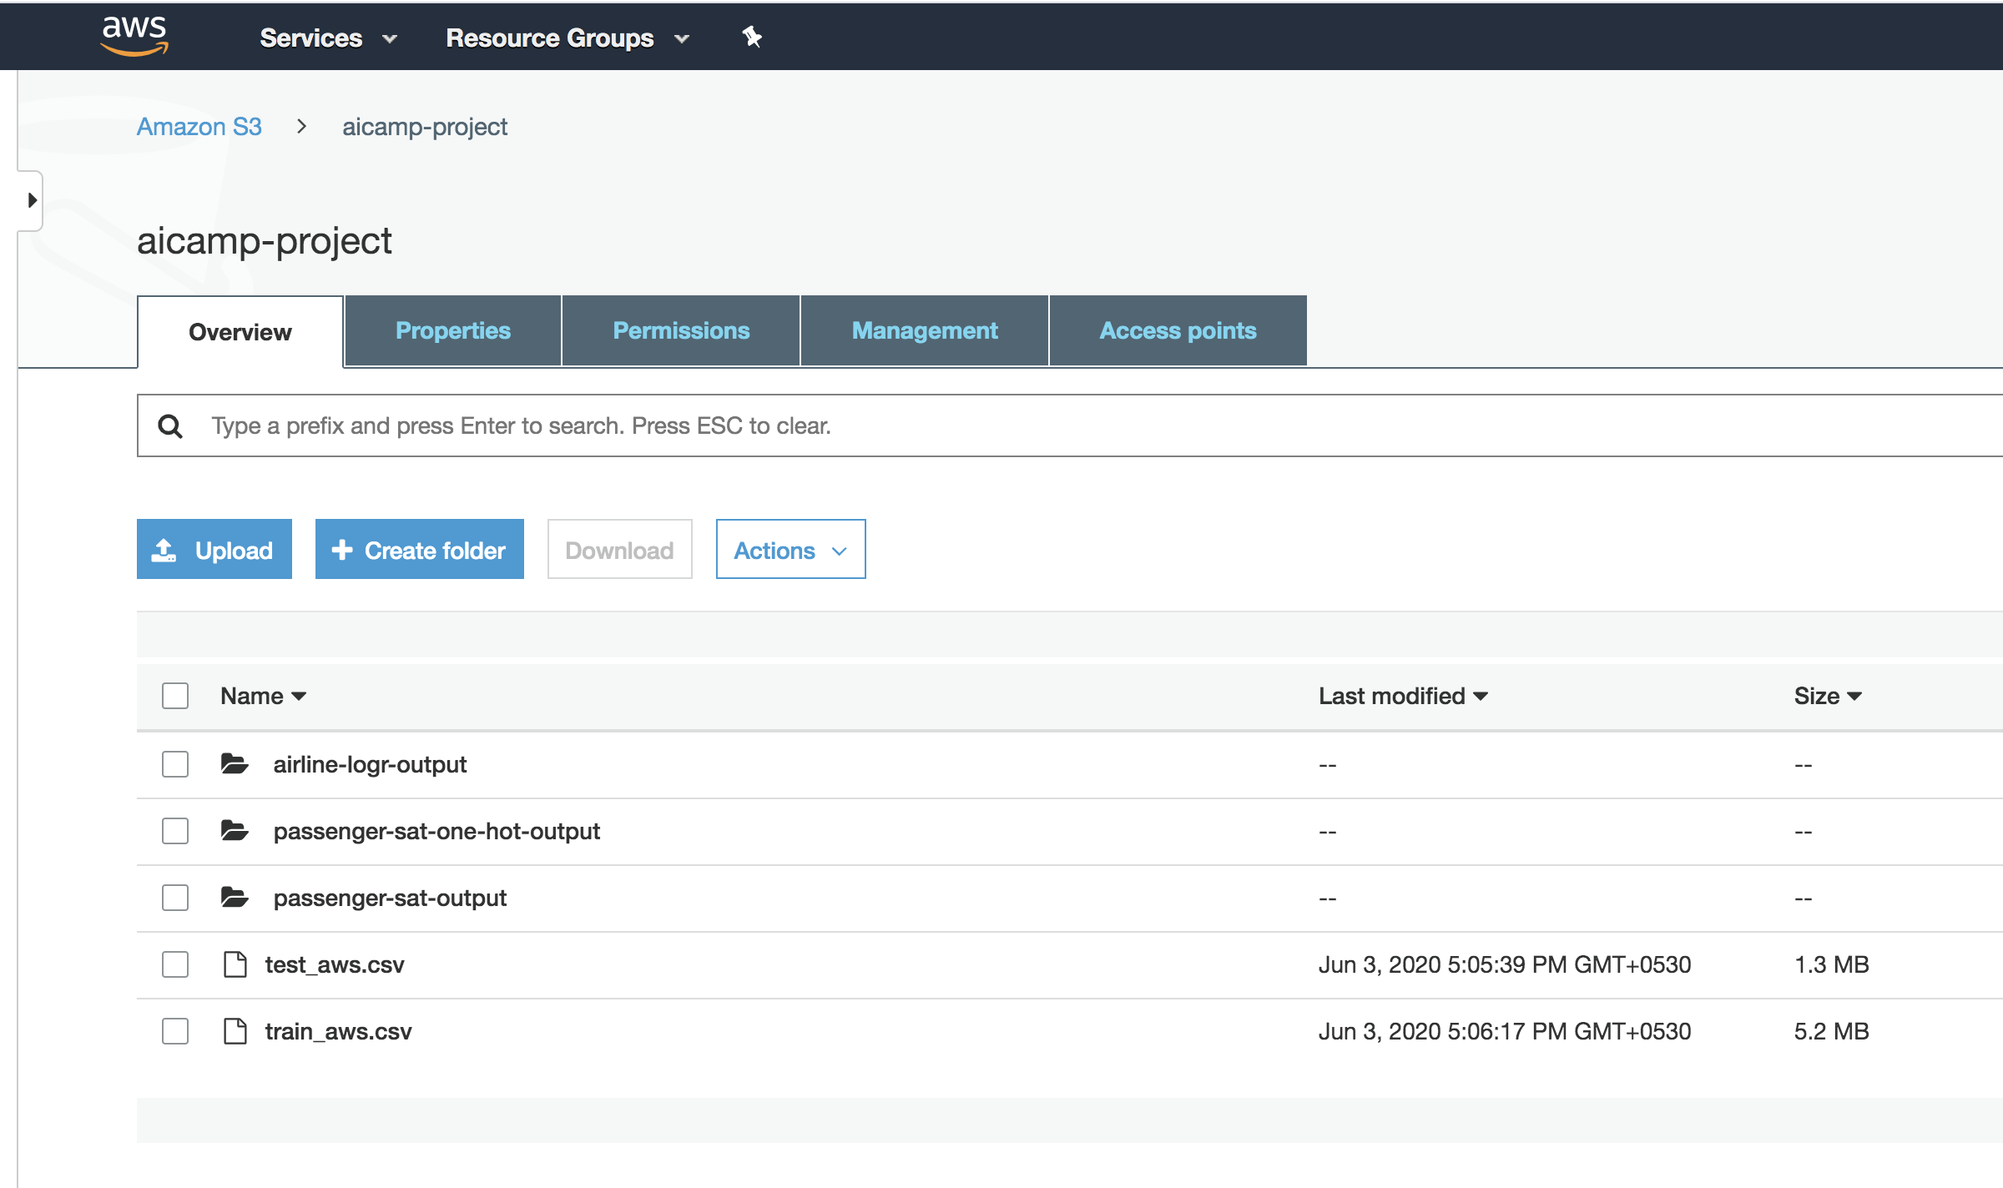
Upload to S3

Slide 10
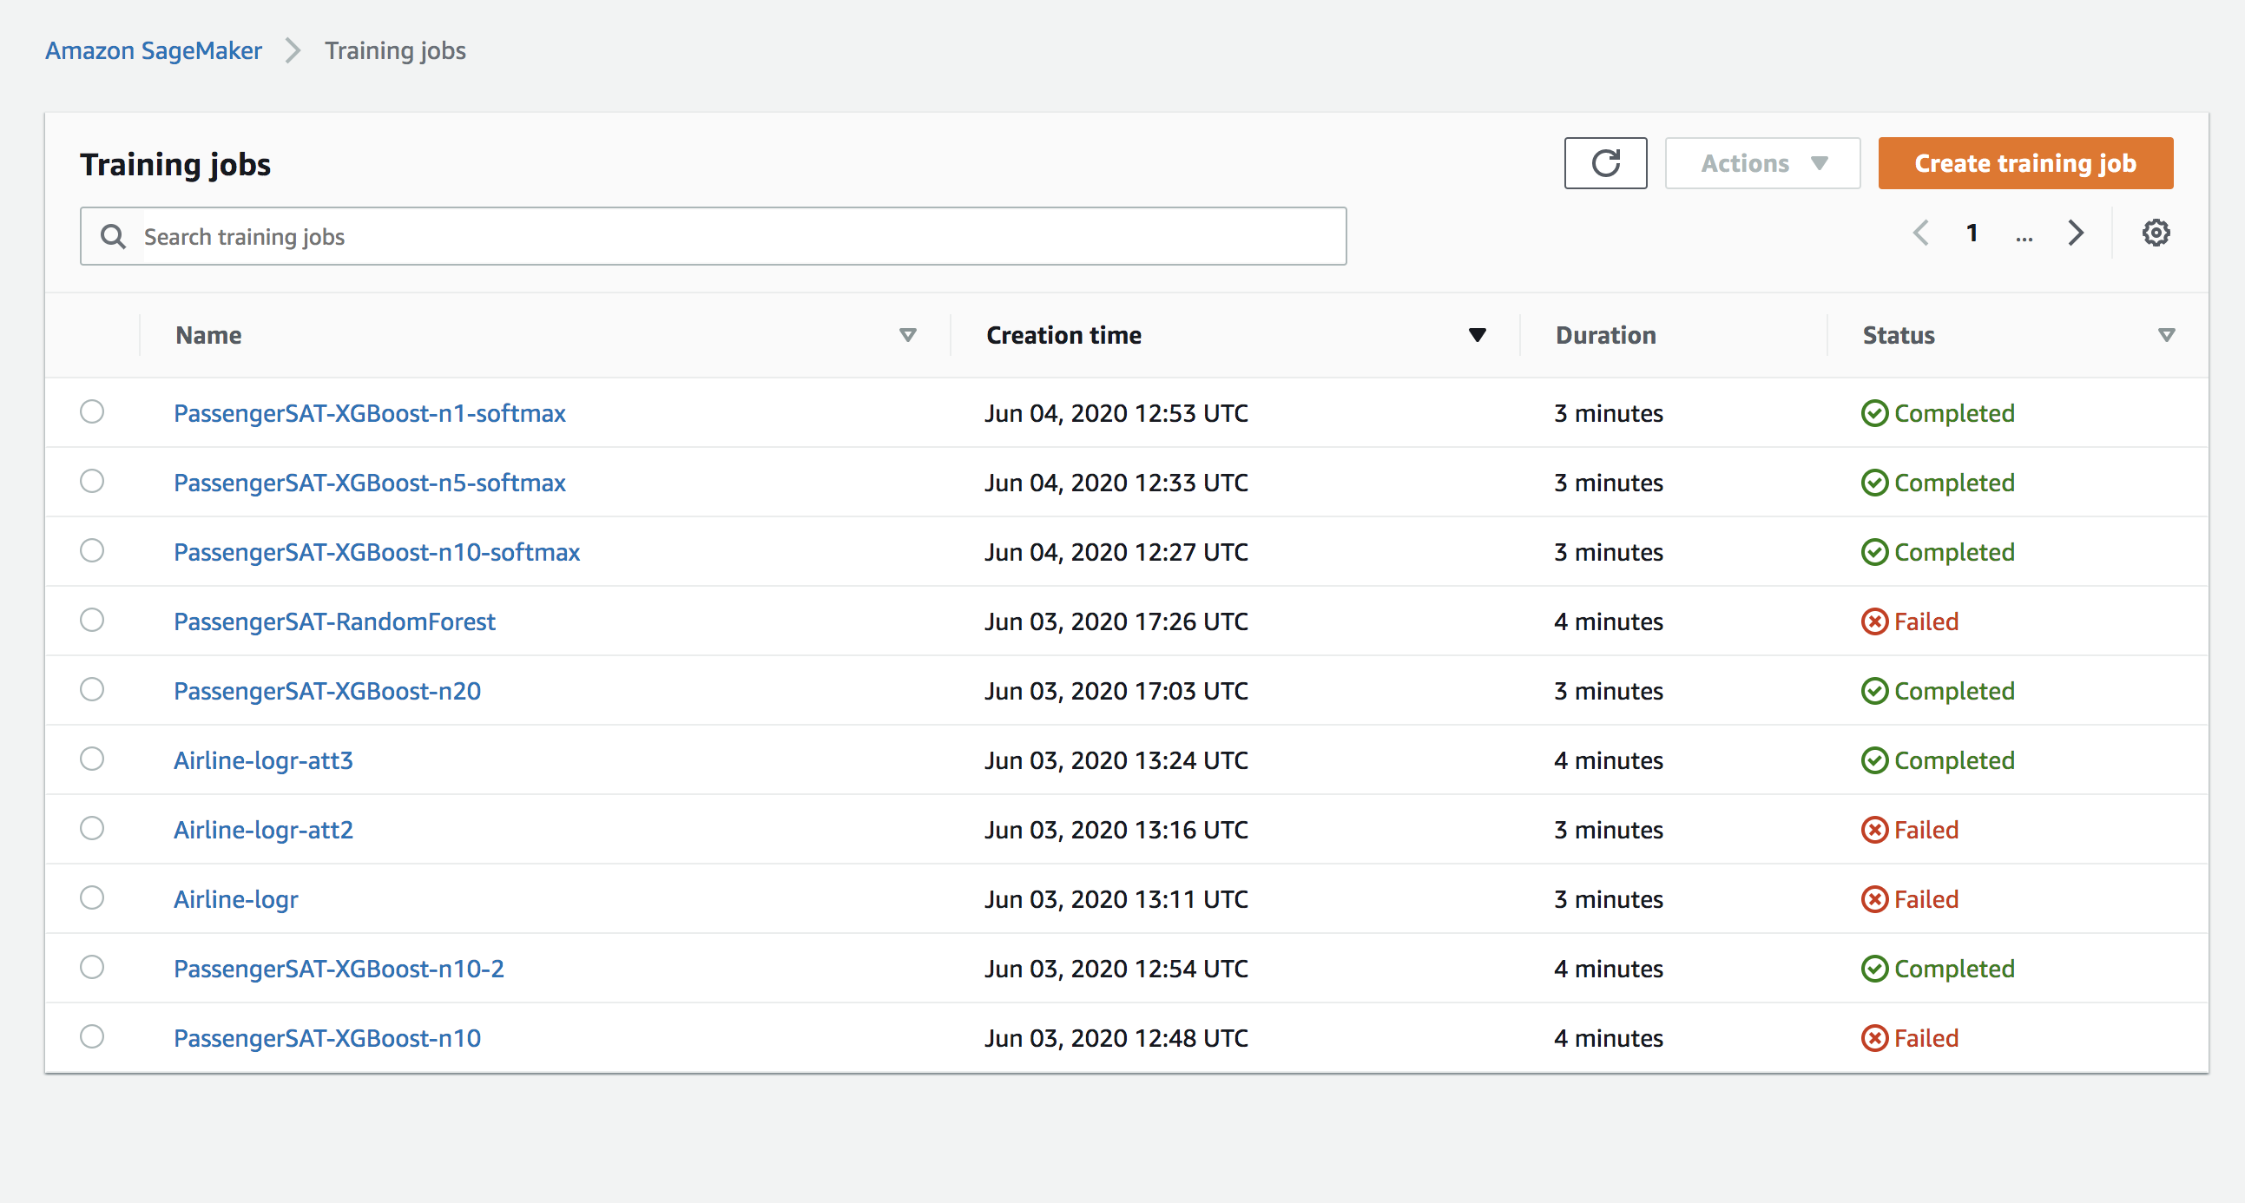
ML Algorithm and Training Jobs in Amazon Sagemaker
Linear Learner - Binary Classifier
XGBoost - default
XGBoost - hyperparameters

Slide 11
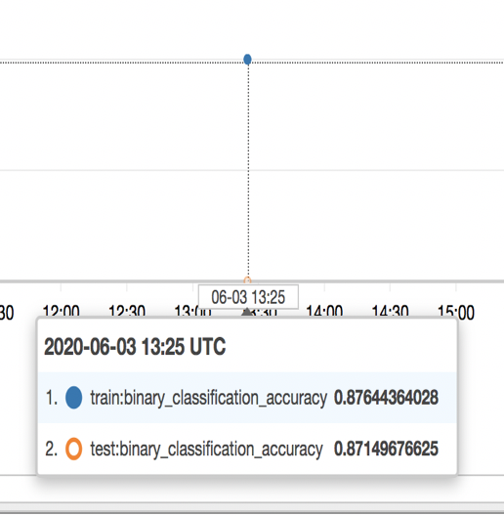
Linear Learner Results
Test Binary Classification Acc: 87%

Slide 12
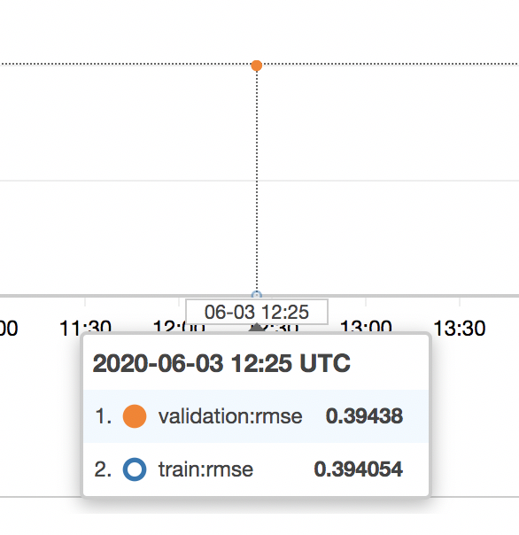
XGBoost with default parameters - Results
Validation Accuracy : 61%
Validation RMSE: 0.39

Slide 13
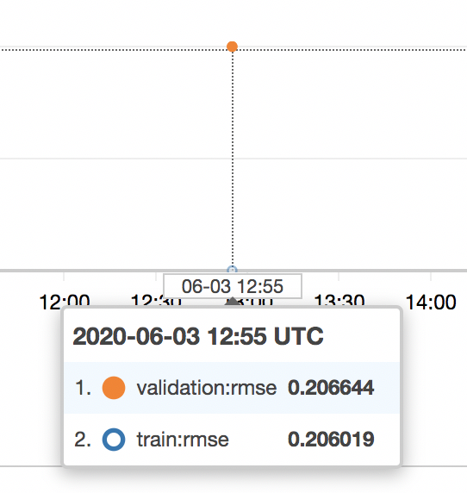
XGBoost with modified hyperparameters - Results
Hyper parameters ( num_rounds = 10 )
Validation Accuracy : 80%
Validateion RMSE: 0.20

Slide 14
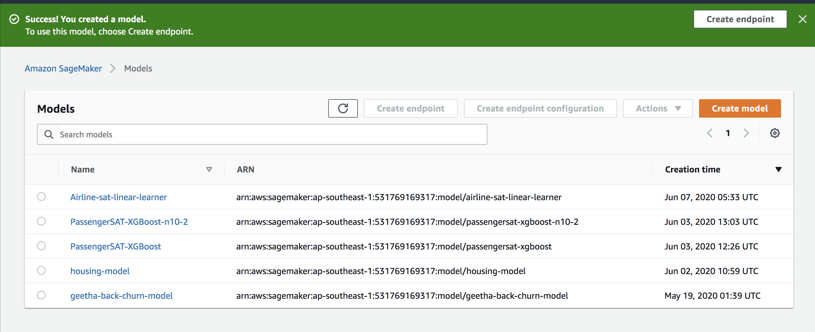
Models created for training job

Slide 15
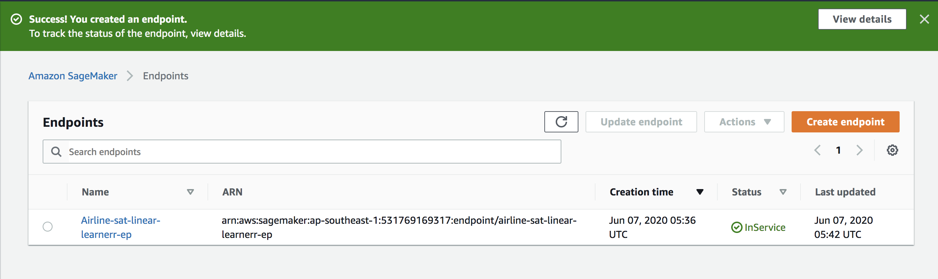
Endpoints created for the models
Picked the model of Linear learner as it gave the best accuracy

Slide 16
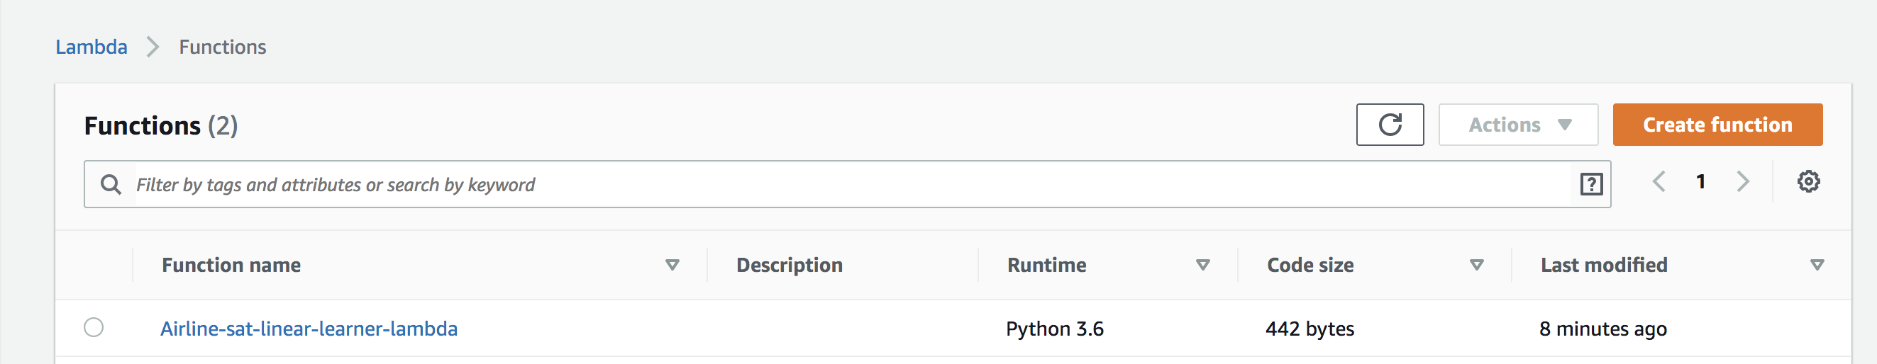
Lamba function to call the endpoint

Slide 17
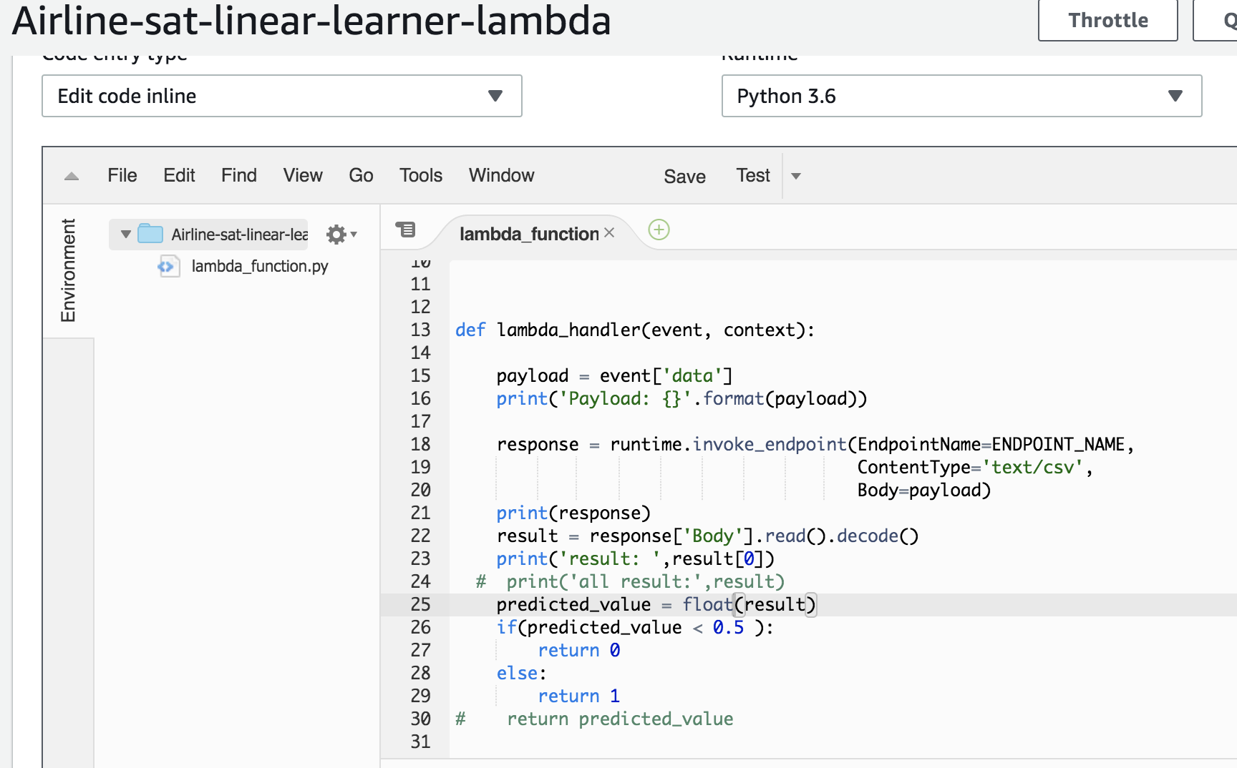
Lamba function code

Slide 18
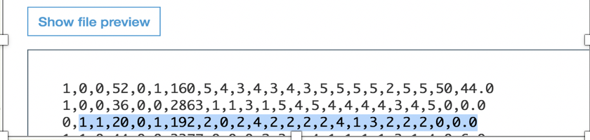
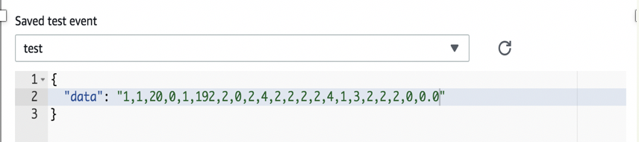
Test results of Lambda function (test1)
1. Choose data from file in S3
2. Update test configuration for Lambda function
3. Test results

Slide 19
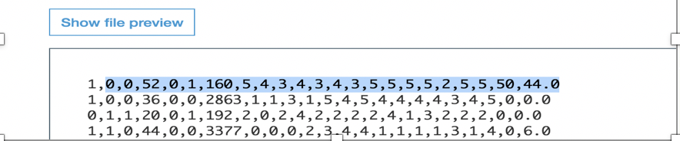
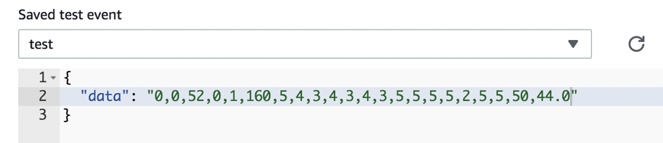
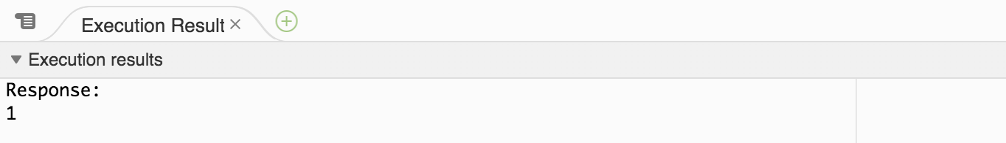
Test results of Lambda function ( test2)
1. Choose data from file in S3
2. Update test configuration for Lambda function
3. Test results

Slide 20
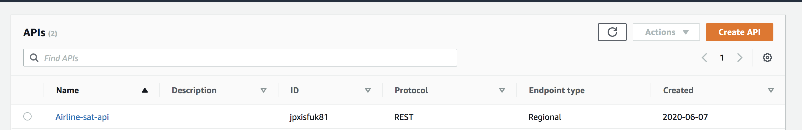
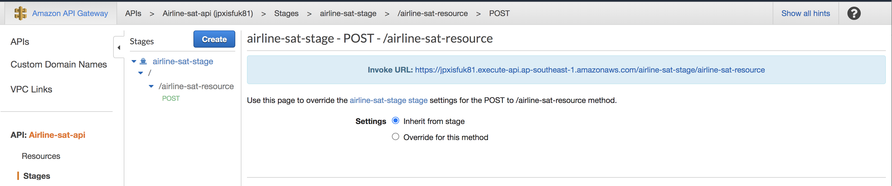
Create API Gateway

Slide 21
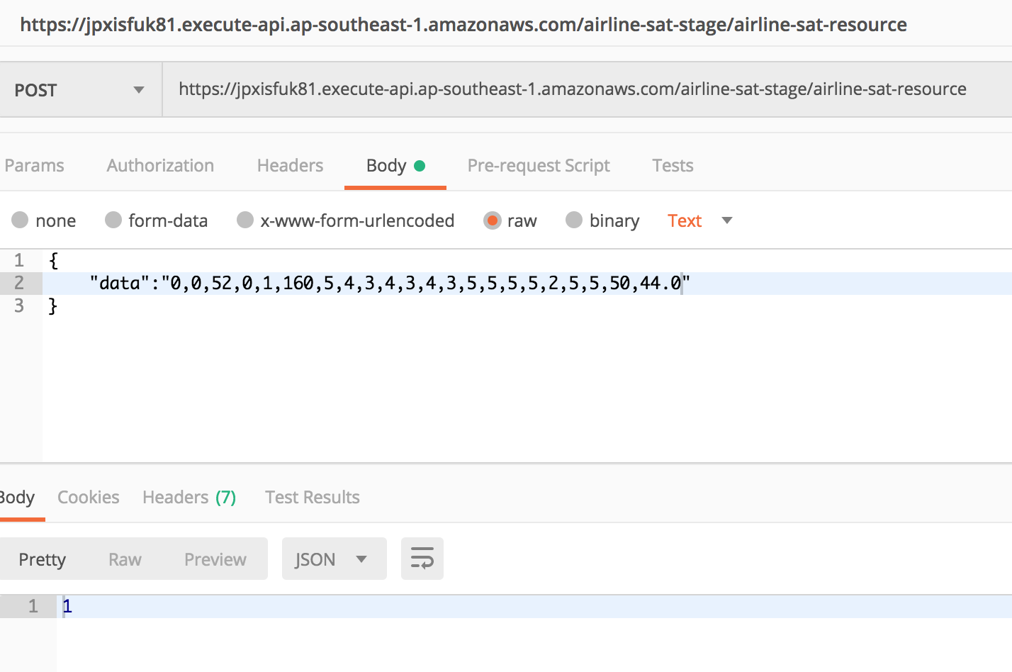
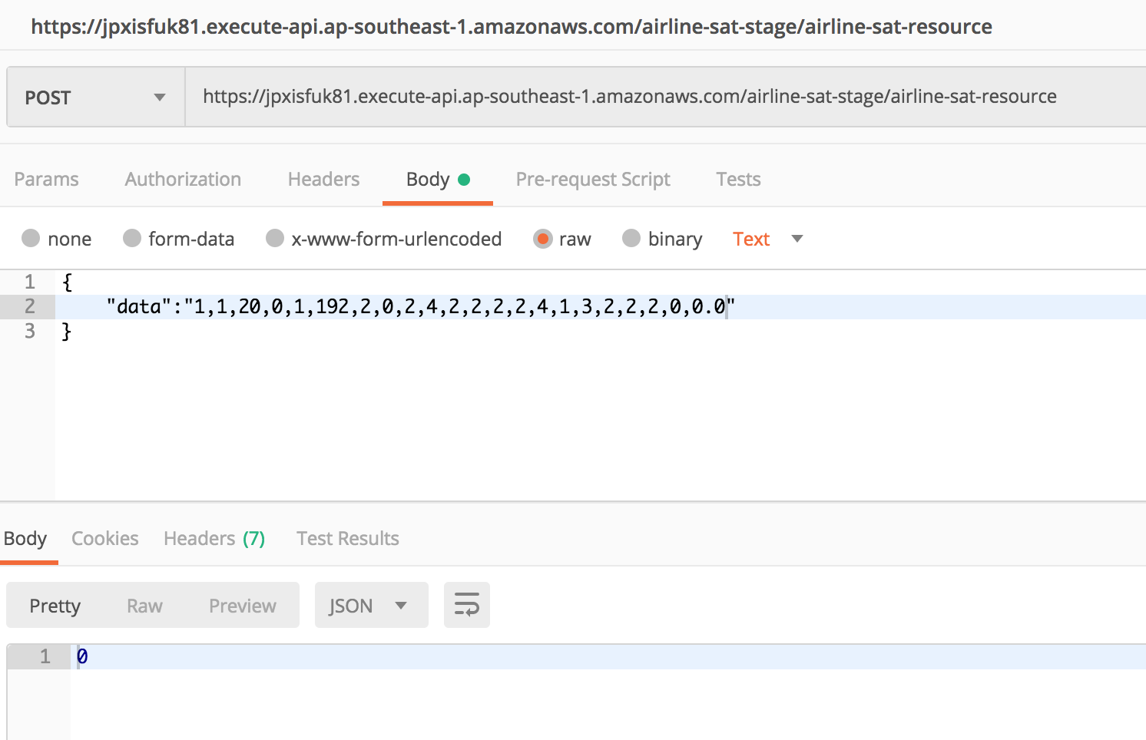
Invoke Rest API from Postman

