Slide 1
Real-Time Parking Finder for Campuses and Streets

Slide 2
AGENDA
High Level Pitch of Project
High Level Architecture Diagram
Tasks and it’s deliverables

Slide 3
High level Pitch
Smart Park is a real-time parking finder system that helps drivers quickly locate available parking spaces in large outdoor areas like university campuses and city streets. Using camera feeds and computer vision, it detects empty spots and displays them on a simple mobile or web app. Unlike costly sensor-based systems that only work in indoor garages, Smart Park is low-cost, scalable, and designed for outdoor use—making parking faster, reducing traffic, and saving time and fuel.

Slide 4
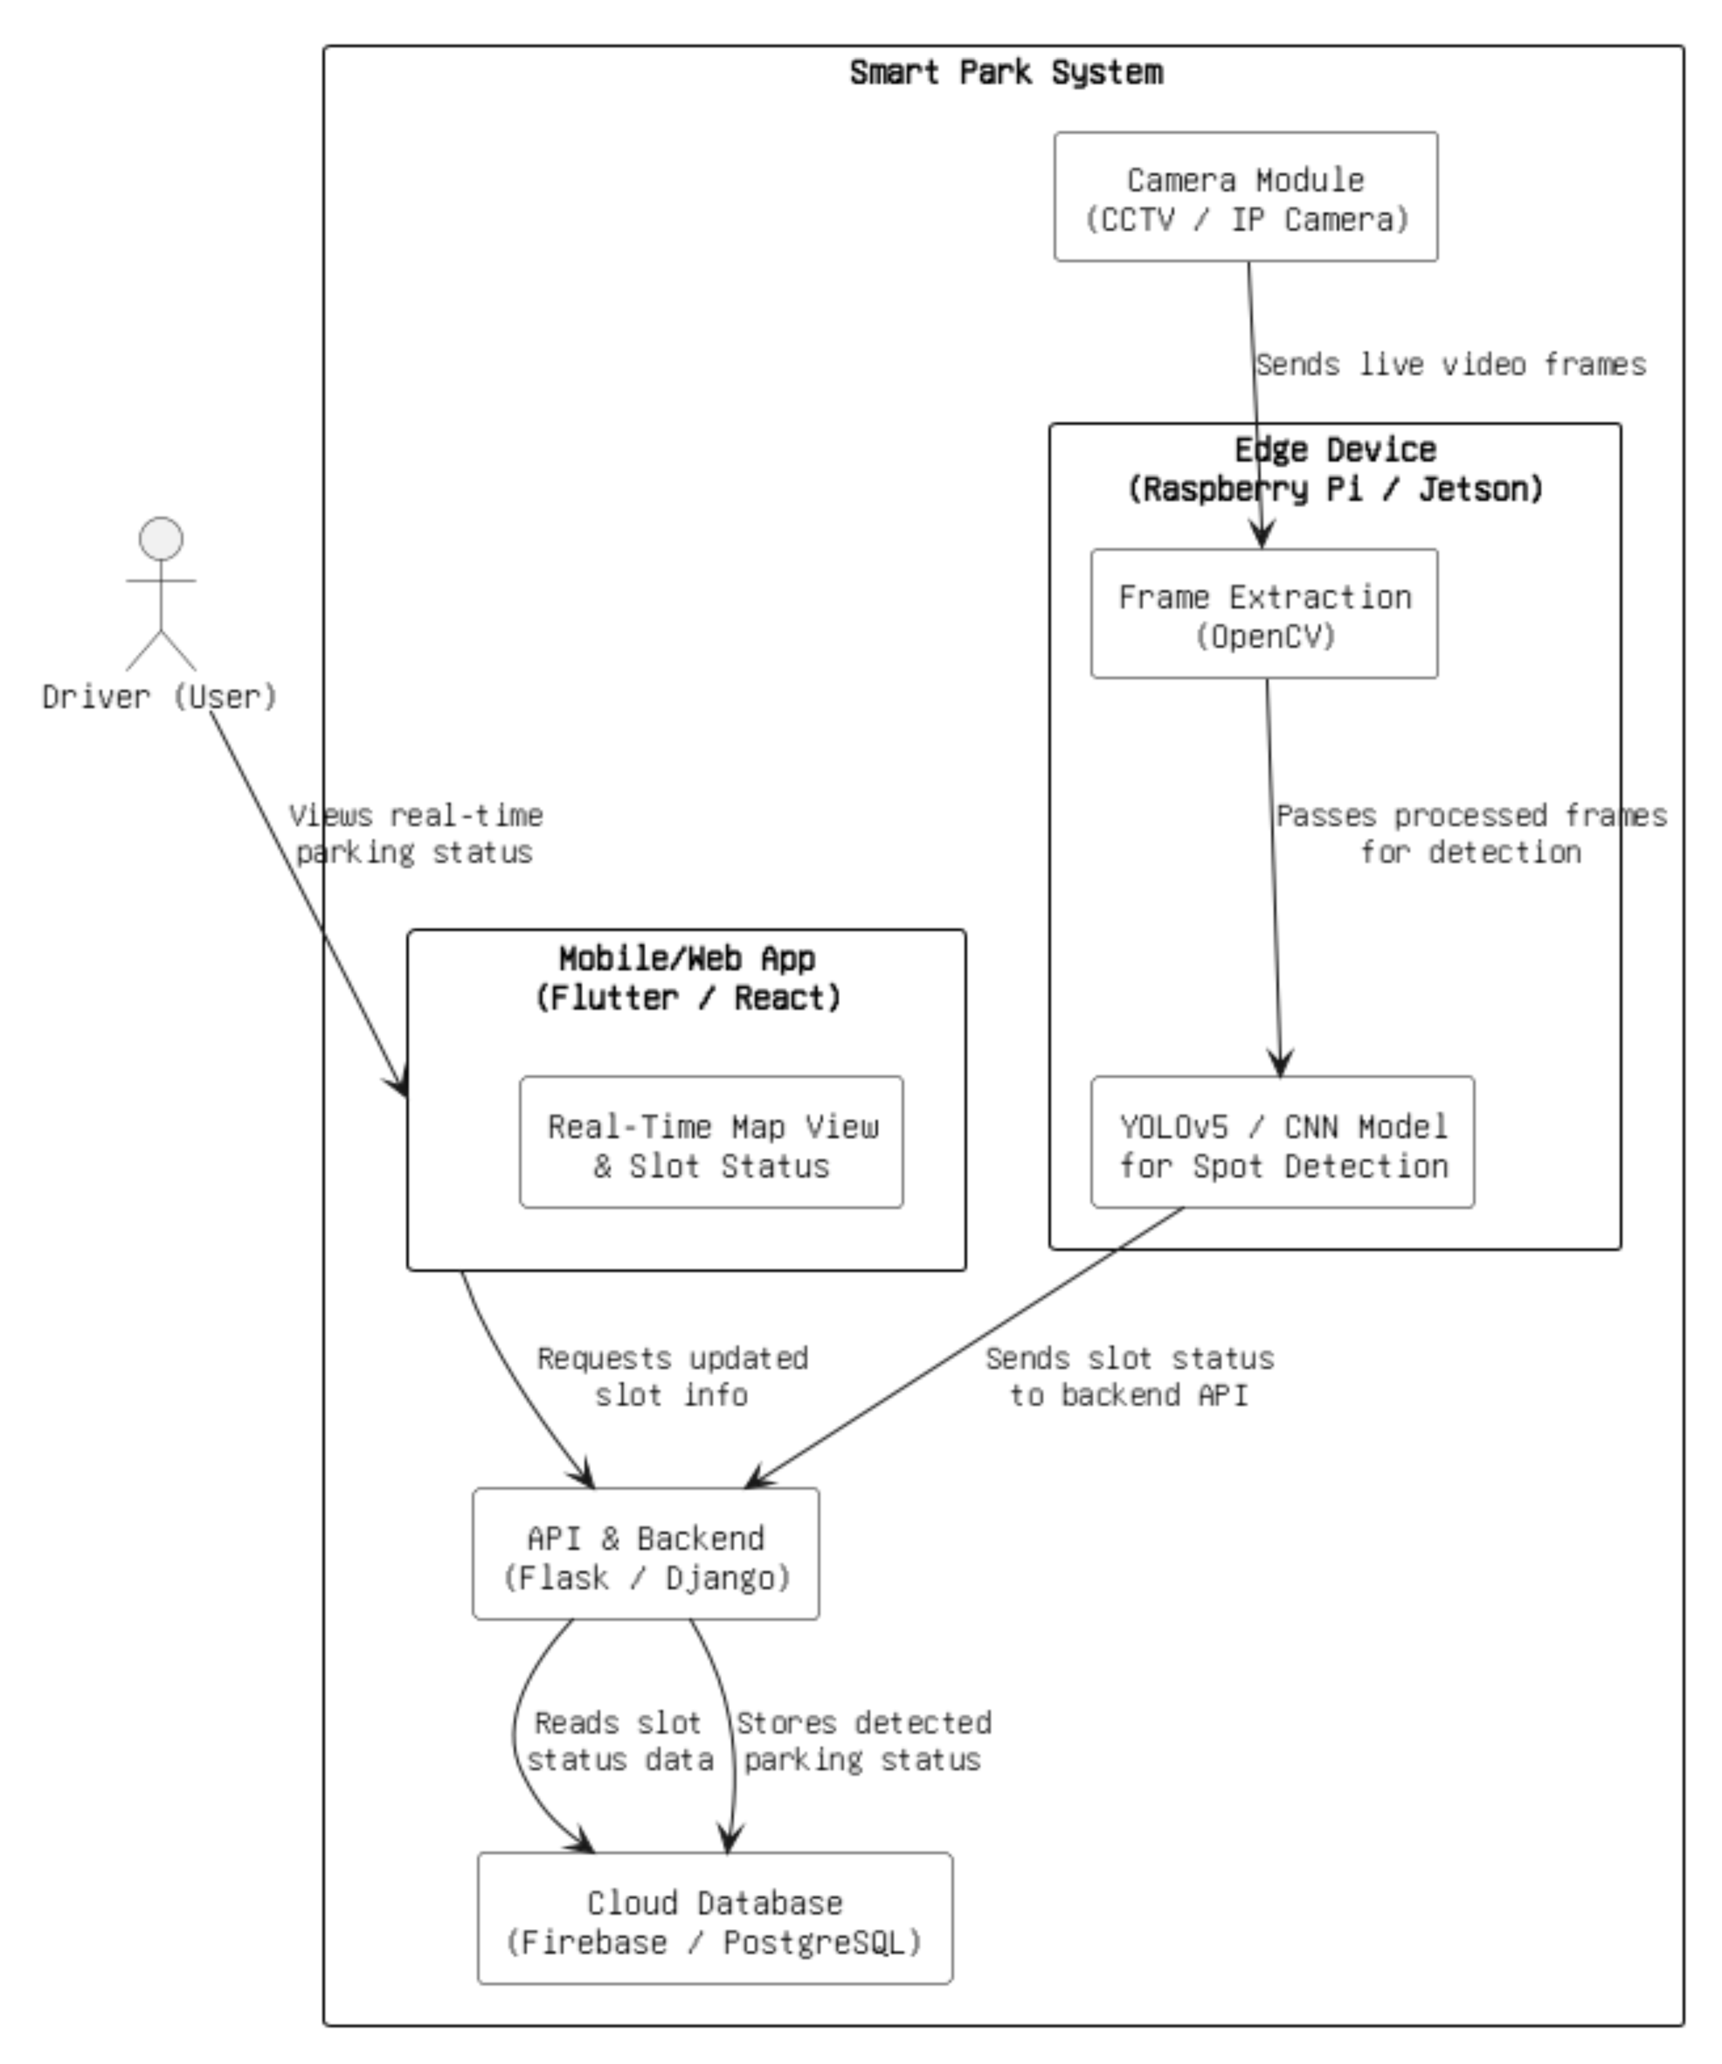
HIGH LEVEL ARCHITECTURE DIAGRAM

Slide 5





Tasks & its deliverables
Camera Feed Integration
Parking Slot Detection
API and Backend Logic
Real-Time Database Sync
User Interface Design

Slide 6
Camera Feed Integration
Parking Slot Detection
API and Backend Logic
Real-Time Database Sync
User Interface Design
Camera Interface script, Test frame output, Technical report.
YOLO Training Notebook,
Model files,
Result video
Endpoints (Postman), Swagger docs,
Working packaged backend.
Firebase schema,
Sync test logs,
Slot status sync demo,
Final system integration demo.
UI screenshots,
Live demo map,
Presentation with stakeholders,
Final report,

Slide 7
Thank you
SAI NIKHIL R̥EDDY KUNDURI
DARSHAN JIGALA CHANNA REDDY

