Slide 1
Synthetic Network Traffic Analysis
Key Insights and Visualizations

Slide 2
Synthetic Network Framework
The synthetic network framework is designed to generate network traffic data for simulating and analyzing network protocols, performance, and behavior. It provides customizable parameters for various network conditions and traffic patterns.

Slide 3
Decision Tree Regression
Decision Tree Regression is a non-linear model that splits data into regions based on feature values. It iteratively partitions data to minimize prediction error.
Flow:
1. Start with the entire dataset.
2. Split the dataset based on a feature that minimizes error.
3. Repeat the process for subsets (nodes).
4. Stop when a predefined criterion is met.

Slide 4
TCP, UDP, and HTTP
TCP (Transmission Control Protocol): Reliable, connection-oriented protocol used for data transmission (e.g., web browsing, file transfer).
UDP (User Datagram Protocol): Lightweight, connectionless protocol used for fast data transmission (e.g., video streaming, gaming).
HTTP (Hypertext Transfer Protocol): Application-layer protocol used for transferring web resources over TCP.

Slide 5
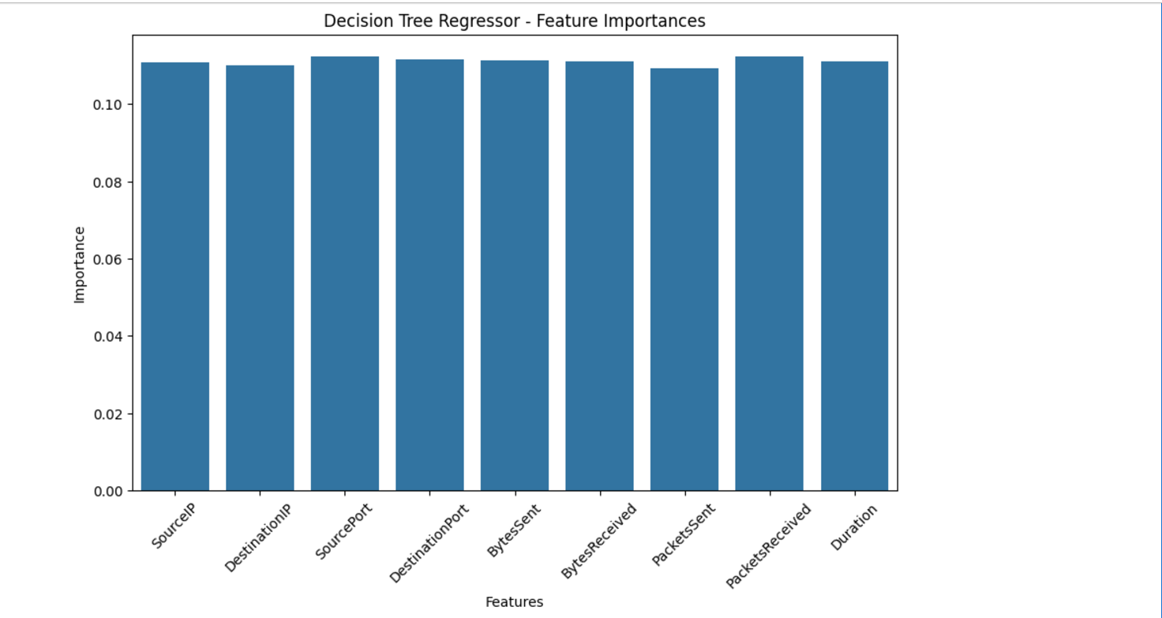
Feature Importance Graph

Slide 6
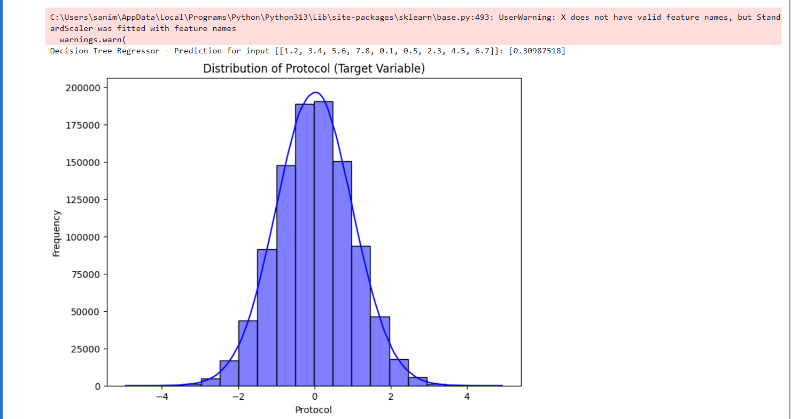
Distribution of Protocol

Slide 7
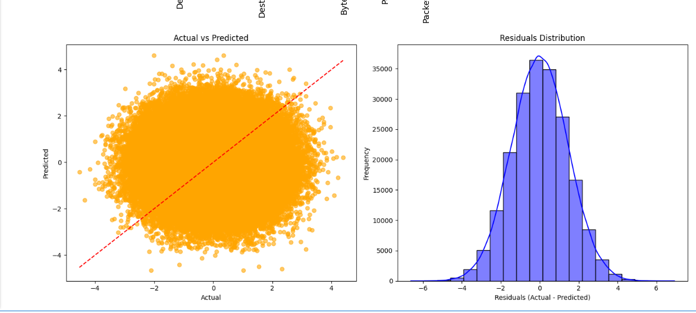
Prediction vs Actual

Slide 8
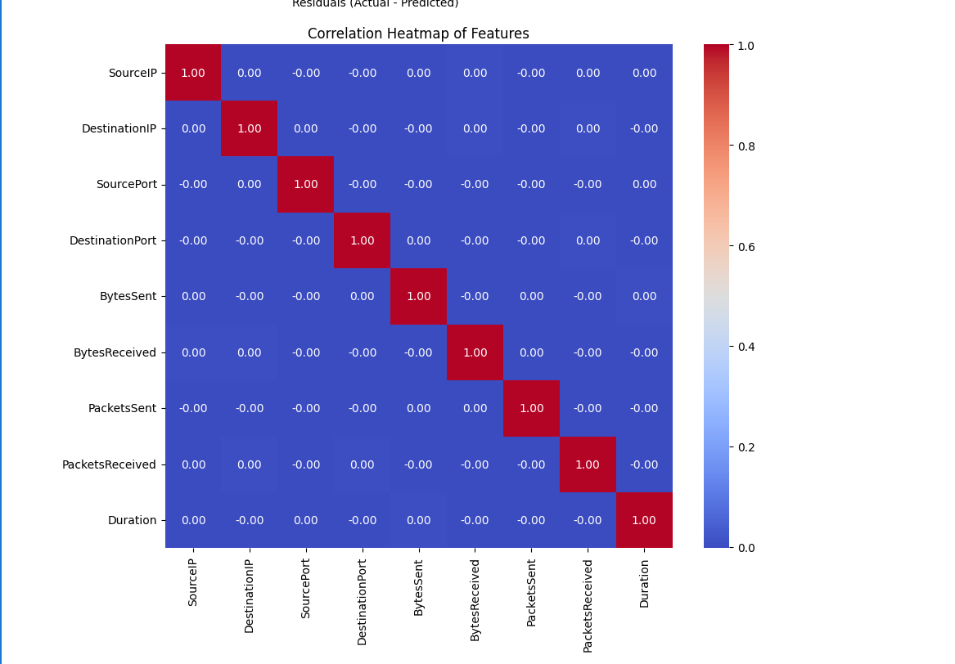
Heatmap Graph

