Slide 1
HematoVision
Blood Cell Classification Using Transfer Learning
BY
Subhan Basha G (22091A04K7, RGMCET- Nandyal)
Hemanth Yarra (S200406, RGUKT- Srikakulam)
Varshini Kapuluri (S200807, RGUKT- Srikakulam)
DATE
25th, June 2025

Slide 2
Problem Statement
Manual blood cell classification is time-consuming and error-prone.
Need for automated, fast, and accurate diagnostic tools.
Deep learning offers consistent and scalable solutions.

Slide 3
Objective
Classify four types of blood cells — eosinophils, lymphocytes, monocytes, and neutrophils — using deep learning and transfer learning techniques.
Build a real-time, web-based prediction app.
Ensure high accuracy and generalization.

Slide 4
Project Overview
Automated classification of white blood cells using deep learning.
Uses MobileNetV2 pretrained on ImageNet for transfer learning.
Achieved 85.52% accuracy on test data.
Deployed as a Flask web application for real-time predictions.

Slide 5
Dataset Overview
Sourced from Kaggle Blood Cell Images repository.
Train: ~12,500 images | Test: ~3,000 images.
Classes: Eosinophils, Lymphocytes, Monocytes, Neutrophils.
Internally split training into 80% train and 20% validation.

Slide 6
Data Preprocessing
Resized images to 128x128 pixels.
Normalized pixel values to [0, 1].
Applied augmentations:
- Rotation, Zoom, Flip, Shear, Shift
Used Keras ImageDataGenerator for pipeline setup.

Slide 7
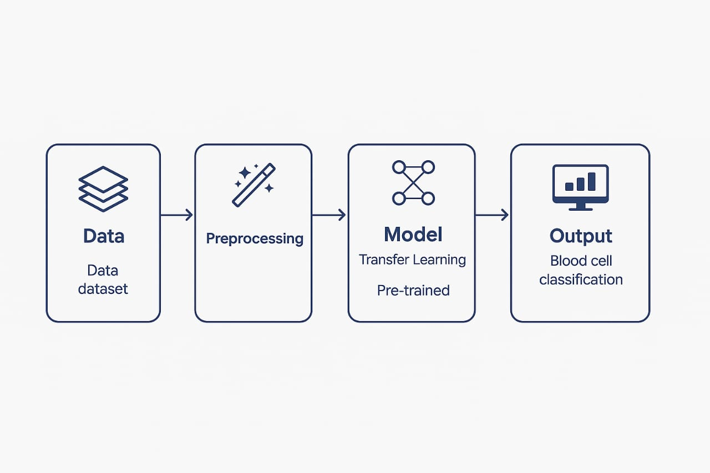
Training Pipeline
Data → Preprocessing (resize, normalize) → Transfer Learning Model (MobileNetV2) → Prediction (4 blood cell types)

Slide 8
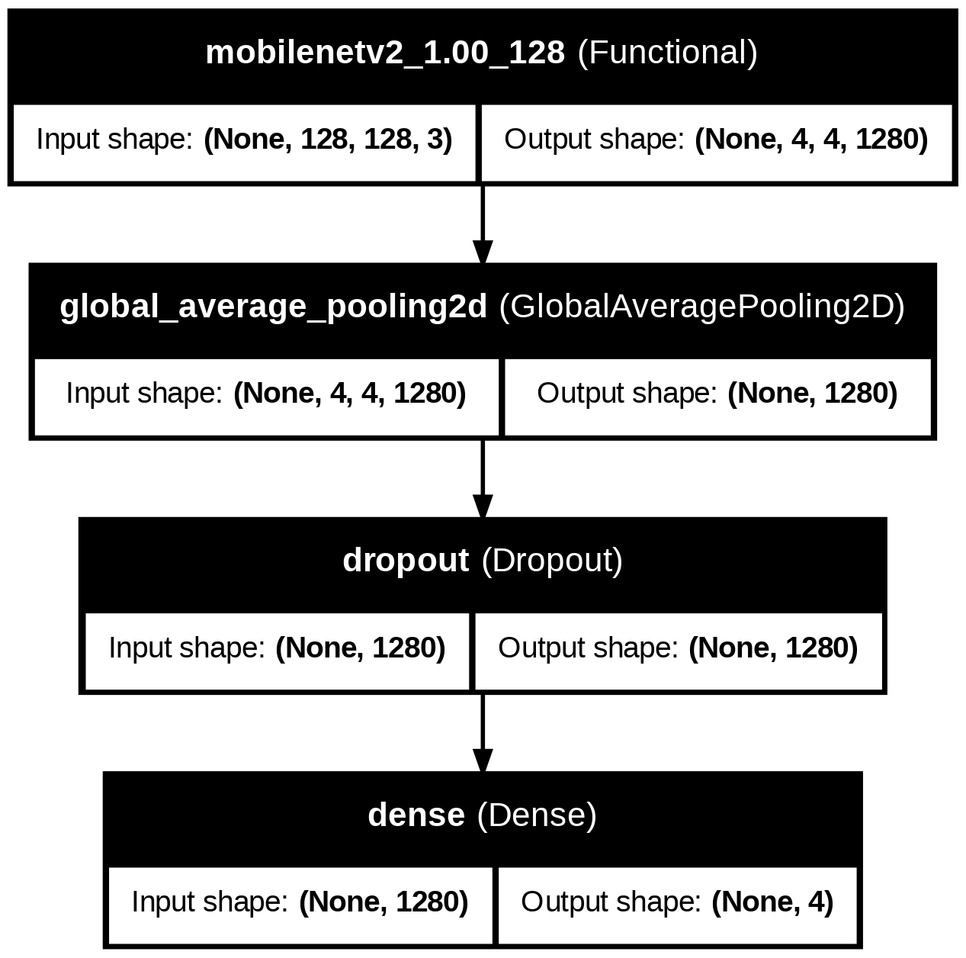
Model Architecture
Base: MobileNetV2 without top layer (include_top=False).
Custom head:
- GlobalAveragePooling2D → Dropout (0.5) → Dense(4, Softmax)
Loss: Categorical Crossentropy | Optimizer: Adam.
Input Shape: 128x128x3.

Slide 9
Training Strategy
Phase 1: Freeze base, train head for 10 epochs.
Phase 2: Unfreeze and fine-tune full model for 10 epochs.
Callbacks:
- ModelCheckpoint, EarlyStopping, ReduceLROnPlateau

Slide 10
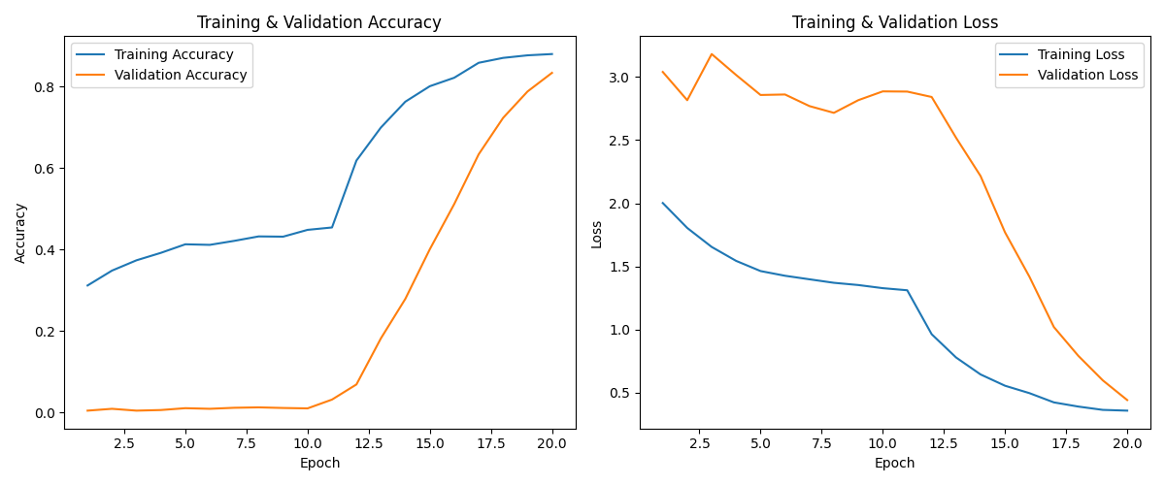
Model Training

Slide 11
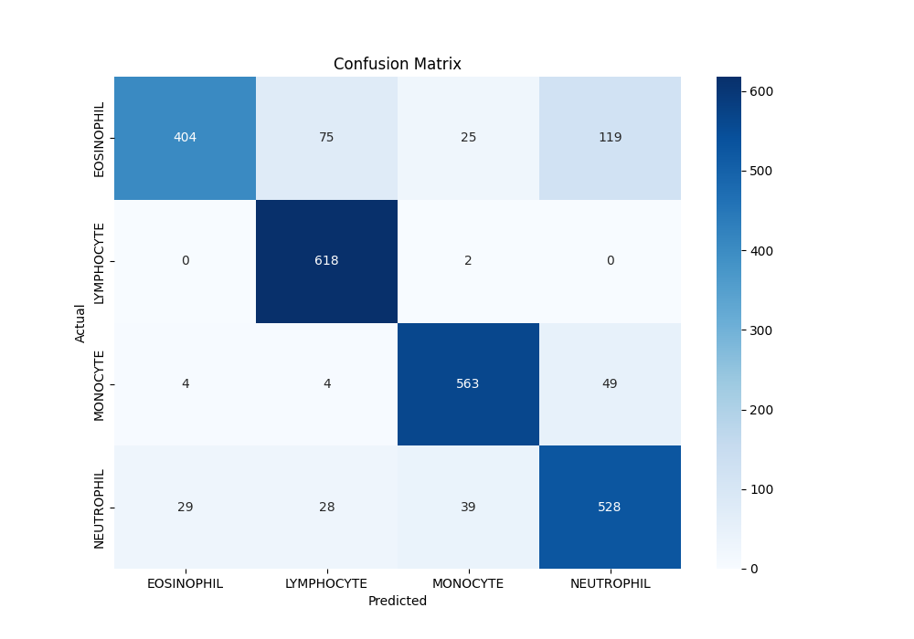
Model Evaluation
Test Accuracy: 85.52% | Test Loss: 0.4704
High F1-scores across all classes.
Best performance on Monocytes and Lymphocytes.
Well-generalized model (no overfitting).

Slide 12
Deployment – Flask Web App
Built using Flask, OpenCV, Keras.
Flow: Upload image → Process → Predict → Display result.
Frontend: HTML templates (home.html, result.html).
Model file: blood cell.h5

Slide 13
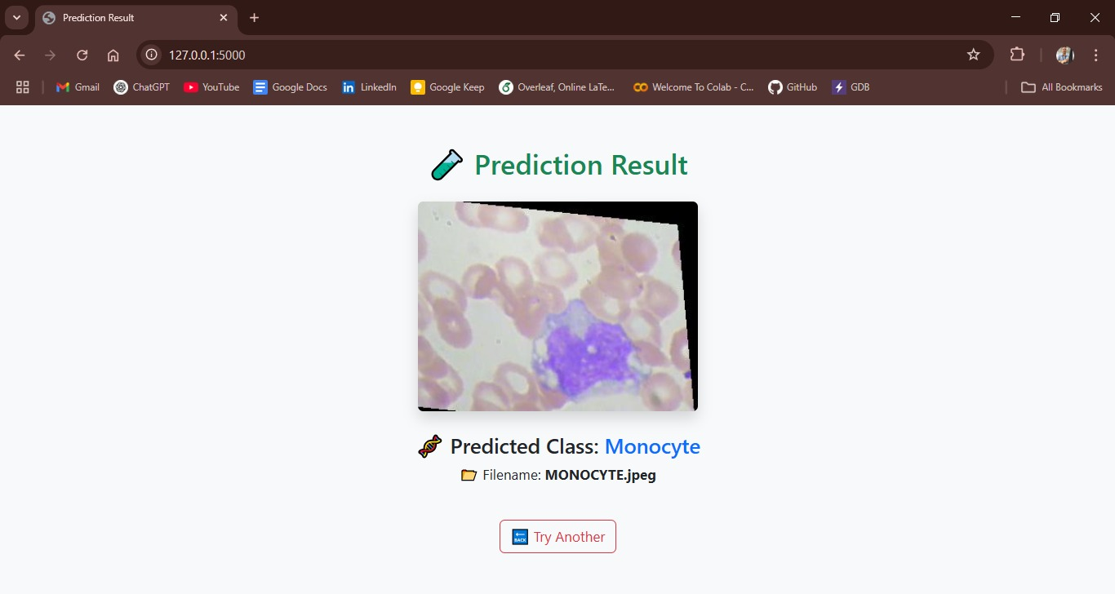
Web Output
Screenshot: Web app uploading a blood cell image.
Shows predicted type (e.g., ‘Monocyte') with model confidence.

Slide 14
Challenges & Solutions
• Class imbalance → Used data augmentation.
• Overfitting → Fine-tuned only top layers, early stopping.
• Limited dataset → Applied transfer learning with MobileNetV2.

Slide 15
Applications
HematoVision offers valuable use across multiple domains:
Clinical Diagnostics: Enables faster, automated pre-screening of blood samples,reducing manual workload.
Telemedicine: Supports remote diagnosis by processing uploaded microscope im-ages via mobile or web platforms.
Medical Education: Acts as a training tool with real-time feedback, helpingstudents learn blood cell classification effectively.

Slide 16
Conclusion
Demonstrated effective use of transfer learning for blood cell classification.
Developed a functional web app for live image upload and prediction.
Potential use in diagnostics, telemedicine, and education.
High accuracy with efficient architecture.
Practical, real-time, user-friendly web deployment.

Slide 17
Future Work
Add more blood cell types.
Build full-stack web deployment.
Integrate batch processing and hospital workflows.
Develop a mobile app version.
Deploy on cloud (Streamlit, GCP).
Add user authentication & clinical-grade security.

Slide 18
THANK YOU

