Slide 1
EvacOS2
Hierarchical agent evaluation for emergency evacuation
OpenEnv runtime | 3B floor specialists | 7B orchestrator canary
62.38% to 80.05%
34.47% to 1.10%
0% parse errors
held-out bounded score
invalid actions
7B canary
Sai Shashank Narang | June 2026

Slide 2
WHY THIS EXISTS
The gap: agents are still graded like solo text generators
Static evals miss the hard part
Coordination creates failure modes
Evacuation makes it concrete
Most benchmarks ask whether a model can answer. Real systems ask which agent should act, when it should defer, and whether the action is valid after the world changes.
Local success can hurt the team if exits bottleneck, hazards spread, or a floor acts without knowing the building-level state.
Emergency response turns model allocation into something measurable: fast local action, global prioritization, escalation, and invalid-action discipline.
EvacOS2 | 02

Slide 3
SYSTEM OVERVIEW
What EvacOS2 actually is
A live OpenEnv-compatible simulator where six agents coordinate under evolving fire, flood, and gas scenarios.
1 building-level orchestrator plus 5 floor agents
Role-specific observations and action schemas
Deterministic resets for reproducible evaluation
Programmatic rewards, invalid-action tracking, and route-target audits
LoRA training with public checkpoints and metrics artifacts
OpenEnv surface
/openenv/health, /metadata, /reset, /step, /state
Response lanes
openenv_fire_response, openenv_flood_response, openenv_gas_response
Artifact trail
README, notebook, plots, held-out CSVs, adapter repo, paper
EvacOS2 | 03

Slide 4
ARCHITECTURE
The core idea: split speed from judgment
Fast 3B specialists handle routine floor-level movement. A slower 7B coordinator is reserved for global priorities and outliers.
7B orchestrator
3B floor 1
3B floor 2
3B floor 3
3B floor 4
3B floor 5
Local
Global
Fallback
route, scout, prioritize rooms
directives, bottlenecks, overrides
mixed incidents and escalation
EvacOS2 | 04

Slide 5
EVIDENCE STACK
We separate proof from ambition
1
Live runtime
Public HF Space responds to OpenEnv health, reset, metadata, and step calls.
2
3B held-out proof
Same seeds, same evaluator, base Qwen2.5-3B versus trained LoRA specialists.
3
Training signal
50-step canaries and H200 continuations show checkpoints, metrics, and reward traces.
4
7B canary
The orchestrator path resumes, checkpoints, emits role metrics, and keeps parser failures at zero.
EvacOS2 | 05

Slide 6
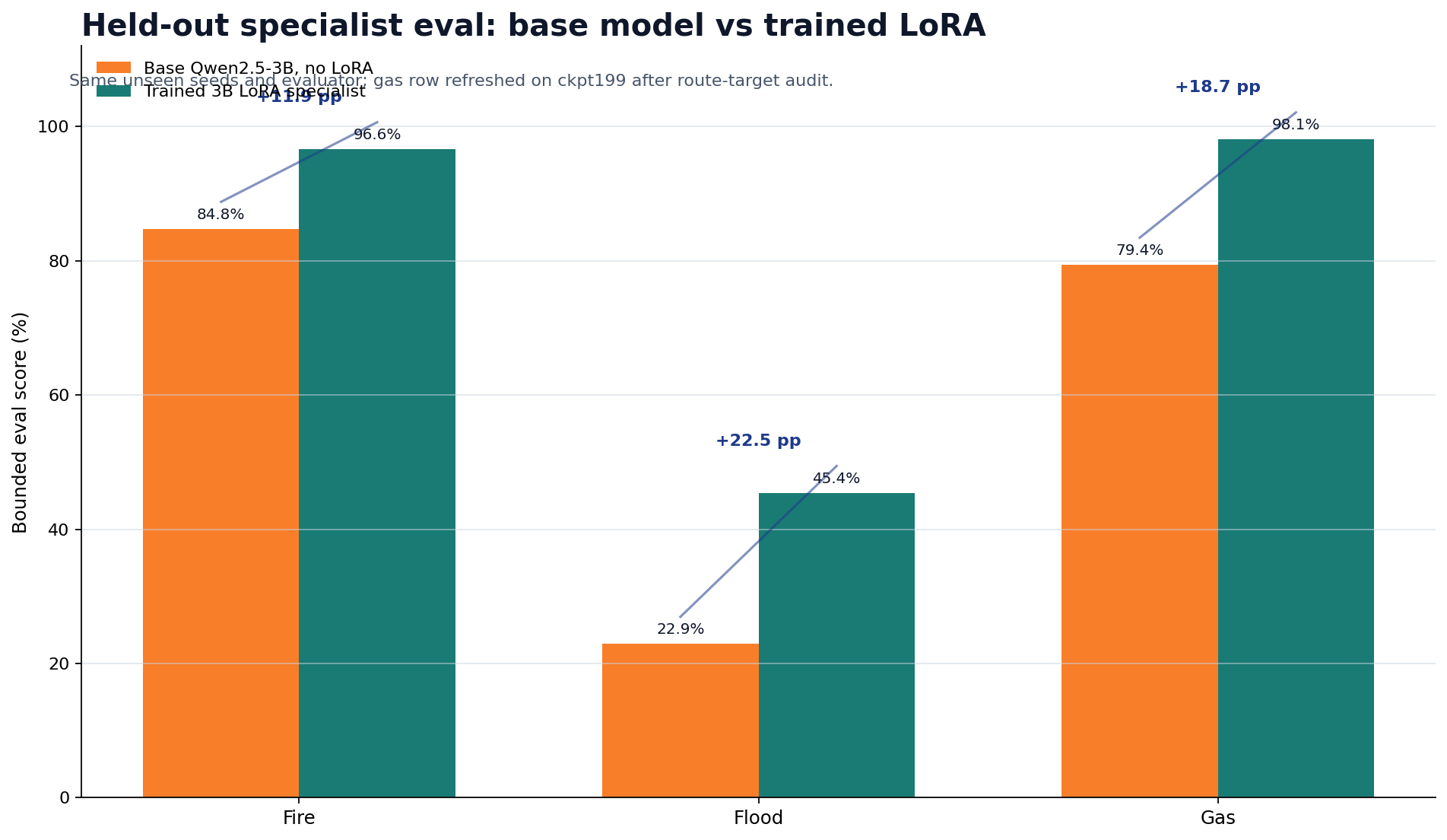
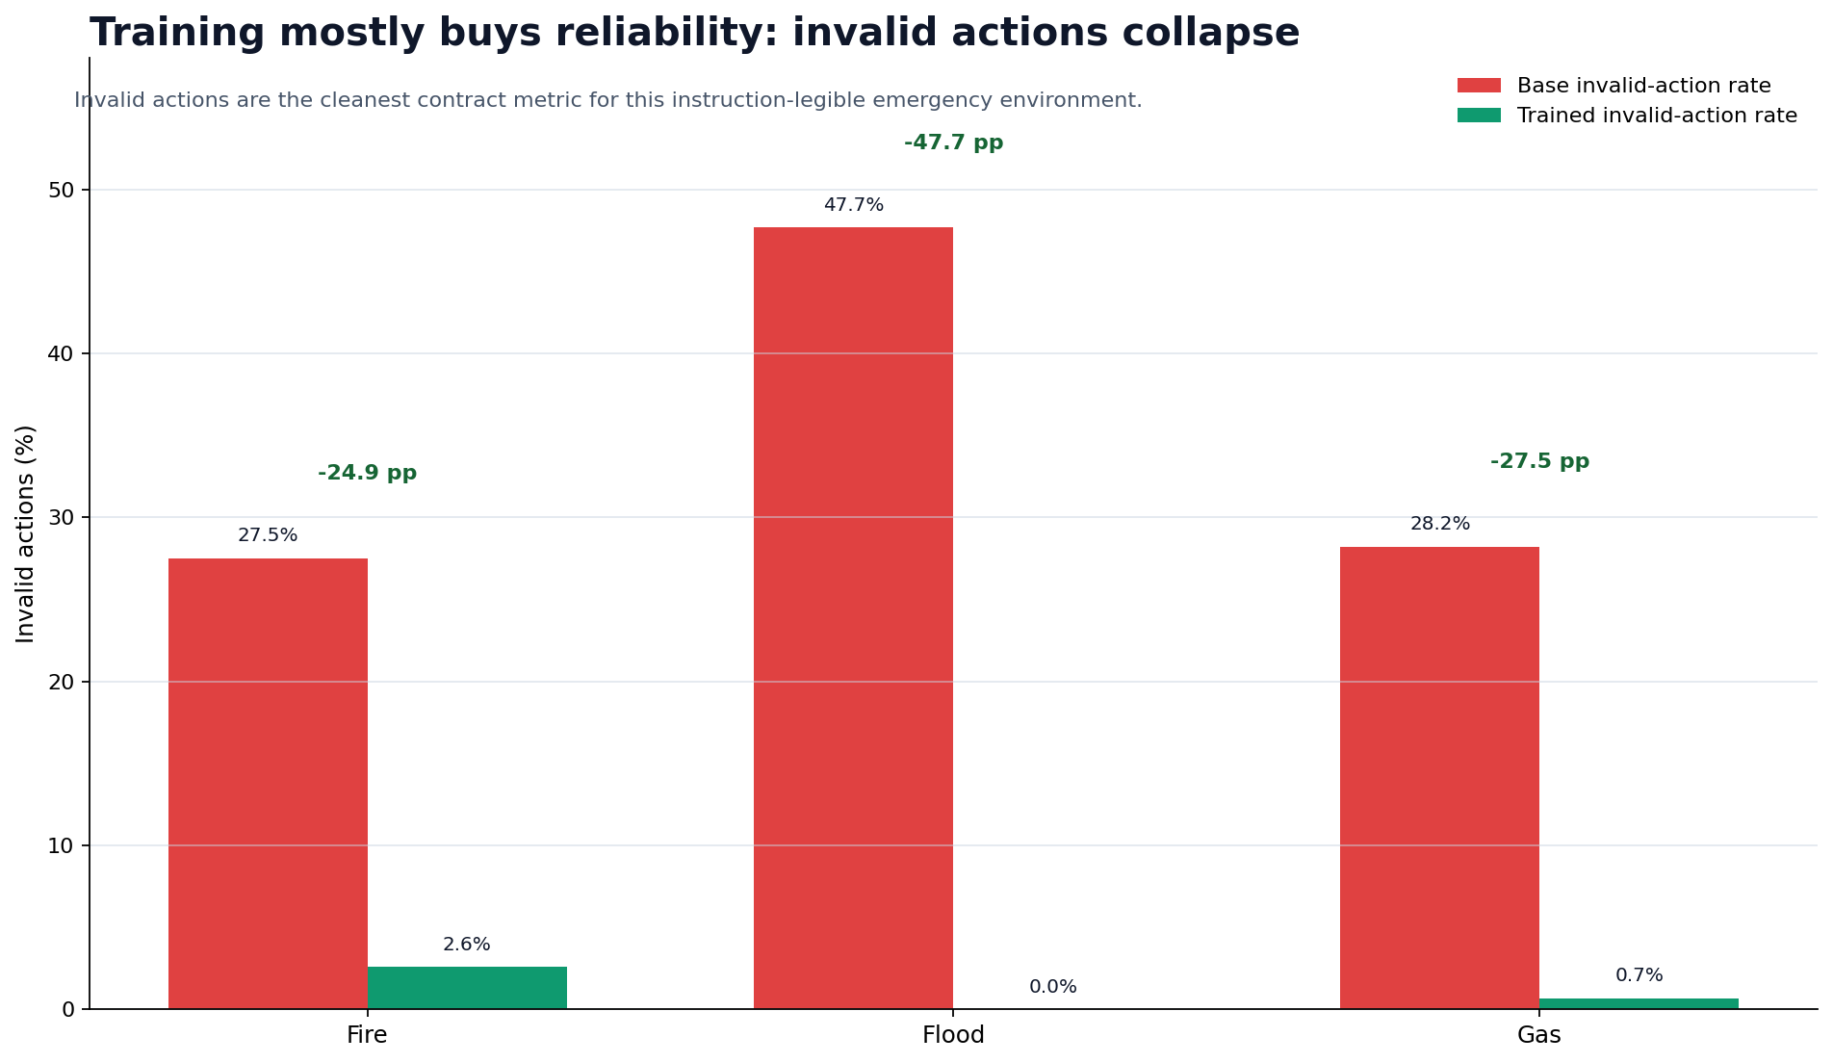
HELD-OUT RESULT
The clean headline: trained 3B specialists improve reliability
62.38%
80.05%
+17.67 pp
34.47% to 1.10%
base bounded score
trained bounded score
same held-out slice
invalid actions
EvacOS2 | 06

Slide 7
FAMILY BREAKDOWN
Fire, flood, and gas each tell a different story
Lane
Base
Trained
Delta
Invalid after
Fire
84.77%
96.64%
+11.87 pp
2.60%
Flood
22.95%
45.42%
+22.47 pp
0.00%
Gas
79.43%
98.09%
+18.67 pp
0.69%
The point is not that the base model was helpless. The point is that training made the same model more reliable under the same contract.
EvacOS2 | 07

Slide 8
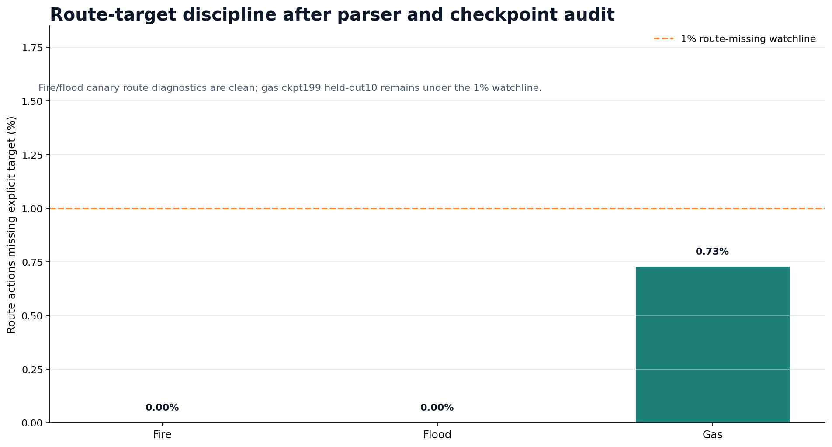
ROUTE-TARGET DISCIPLINE
Reliability means following the route contract
Why this matters
A route action without a target is not a plan. It is a fluent failure.
Current state
Fire and flood are clean. Gas remains below the 1% watchline after audit.
Judge-facing read
The model improved contract discipline, not just surface reward.
EvacOS2 | 08

Slide 9
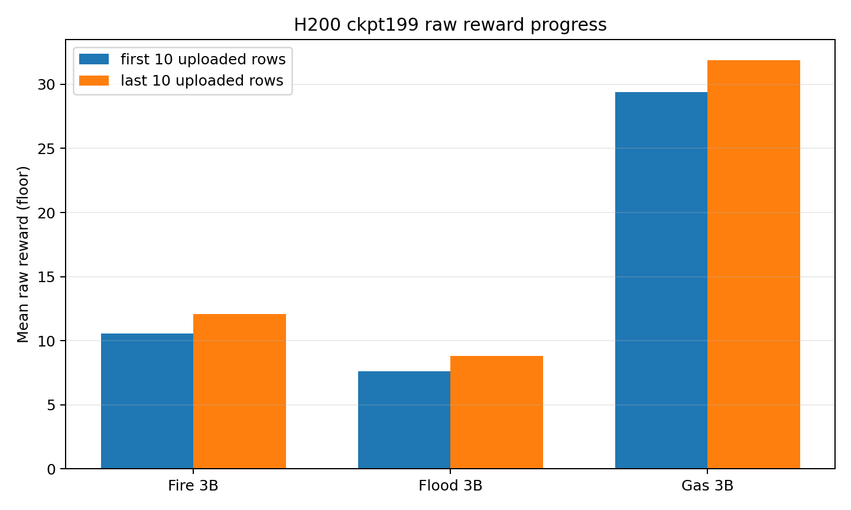
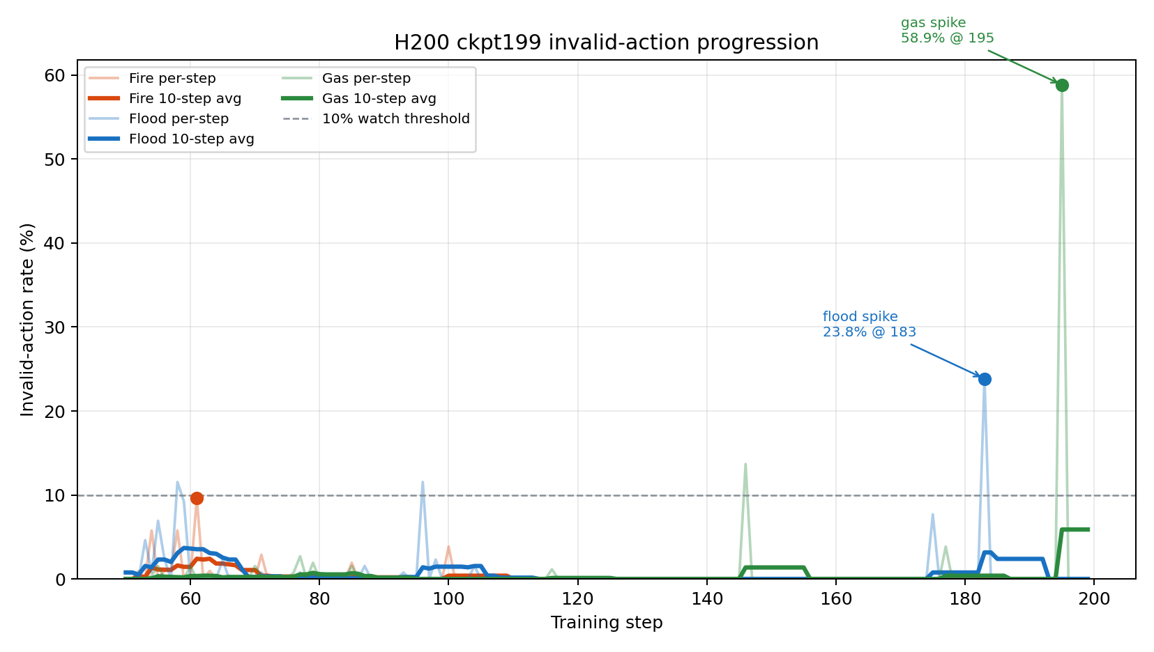
TRAINING TRAIL
Training was not just a table at the end
The larger trail includes 50-step canaries, H200 continuations to ckpt199, refreshed gas audit, and public adapter artifacts.
EvacOS2 | 09

Slide 10
ORCHESTRATOR EVIDENCE
What the 7B proves today
The 7B is not claimed as converged. It is validated as a real coordination lane.
350 to 359
0.00%
0.00%
86.45%
resumed canary steps
invalid actions
orchestrator parse errors
priority-rank fraction
Resume path works from public checkpoint ckpt349
Frozen fire, flood, and gas 3B specialists are wired in
Role metrics are emitted separately for orchestrator behavior
Final held-out 7B convergence remains future work
EvacOS2 | 10

Slide 11
REPRODUCIBILITY
Everything important is public and rerunnable
Live Space
huggingface.co/spaces/shashankN777/evacos2-openenv
GitHub
github.com/sai-shashankN/EvacOS2
Notebook
notebooks/train_evacos_ma.ipynb
Artifacts
shashankN777/evacos2-7b-orchestrator-artifacts
Paper
RESEARCH_PAPER.md and RESEARCH_PAPER.pdf
EvacOS2 | 11

Slide 12
The claim is simple:
EvacOS2 makes agent-team failure measurable.
It does not ask whether a model can sound helpful. It asks whether the right agent acts at the right time, with a valid action, inside a changing world.
Next step: larger held-out suites and a final 7B orchestrator scorecard.
Thank you

Slide 13
TECH STACK
What the system is actually built on
OpenEnv API
Qwen2.5
Unsloth
LoRA adapters
HF Spaces
Environment layer
Training layer
Evidence layer
Deterministic evacuation simulator with fire, flood, and gas lanes exposed through /openenv health, metadata, reset, step, and state endpoints.
Unsloth backend, 4-bit base-model loading, PEFT LoRA adapters, GRPO-family reward optimization, checkpointed metrics and artifacts.
Held-out base/no-LoRA versus trained-LoRA scorecards, plots, public HF artifact repos, notebook, and a runnable Space.
Design principle
This is why the project reads as a benchmark, not just a demo script.
Keep the simulator legible, keep the model weights lightweight, and keep the evidence reproducible enough for a judge to rerun or inspect.

Slide 14
WHY UNSLOTH?
The training constraint was not glamour, it was throughput
Lower memory pressure
Fast adapter iteration
Qwen-friendly path
The base model is loaded in 4-bit mode, which made 3B specialists and 7B orchestration experiments practical on rented GPUs.
We needed frequent short runs, parser fixes, resume tests, and canaries. Adapter-only training kept iteration speed sane.
The stack supports the Qwen2.5 Instruct family used for the 3B floor specialists and the 7B orchestrator lane.
Checkpoint economics
Failure recovery
Uploading full model copies for every specialist would be wasteful. LoRA adapter folders are smaller, clearer, and easier to compare.
When CUDA, parser, or reward issues appeared, we could resume from checkpoints instead of restarting every experiment from zero.
In short: Unsloth let us spend compute on environment interaction instead of on moving huge model copies around.

Slide 15
LORA VS QLORA
What we used, and why the wording matters
LoRA
QLoRA-style setup
Not full fine-tuning
Freeze the pretrained model and train small low-rank adapter matrices. This is the adapter we save, upload, resume, and evaluate.
Load the base model in 4-bit precision while training LoRA adapters. In our configs this is the load_in_4bit: true path.
We did not claim full-model weight updates. The public artifacts are PEFT-compatible LoRA adapters plus metrics, logs, and configs.
Concrete EvacOS2 settings
Judge-facing wording: trained LoRA adapters on a 4-bit loaded base model, not full model retraining.
rank 16, alpha 32, dropout 0.05, target modules q_proj, k_proj, v_proj, o_proj; base models Qwen2.5-3B-Instruct for specialists and Qwen2.5-7B-Instruct for the orchestrator lane.

Slide 16
TRAINING LOOP
How a step becomes evidence
1. Sample episodes
Fire, flood, and gas resets produce structured multi-agent observations.
2. Generate actions
Floor agents and the orchestrator emit schema-bound actions, not free-form plans.
3. Validate and reward
Parser, route-target checks, invalid-action penalties, and disaster rewards create the signal.
4. GRPO-family update
Grouped rewards train LoRA adapters while KL keeps the policy from drifting too far.
5. Save evidence
Checkpoints, CSV metrics, JSONL traces, plots, and held-out scorecards are published separately from the base model.
The important split: training reward can be messy and diagnostic, while held-out evaluation stays bounded, readable, and judge-facing.

