Slide 1

Data Science Internship Assessment Submission
B. Datta Sai Srinivas,
8919009721,
Dssrinivasbaswa@gmail.com

Slide 2
Data Preparation
There exist a multitude of anomalies (1320) within the dataset, including 'I/O Timeout', 'Not Connect', 'Scan Timeout', 'Configure', 'Comm Fail', and 'Unit Down'.
Dealing with Abnormalities:
Handling anomalies in time series data, i.e, Cyclone Separator dataset, requires careful consideration as replacing them with measures of central tendency or simply removing them can disrupt the flow and insights derived from the data.
Therefore implemented the 'Interpolation' method replace the anomalies.

Slide 3
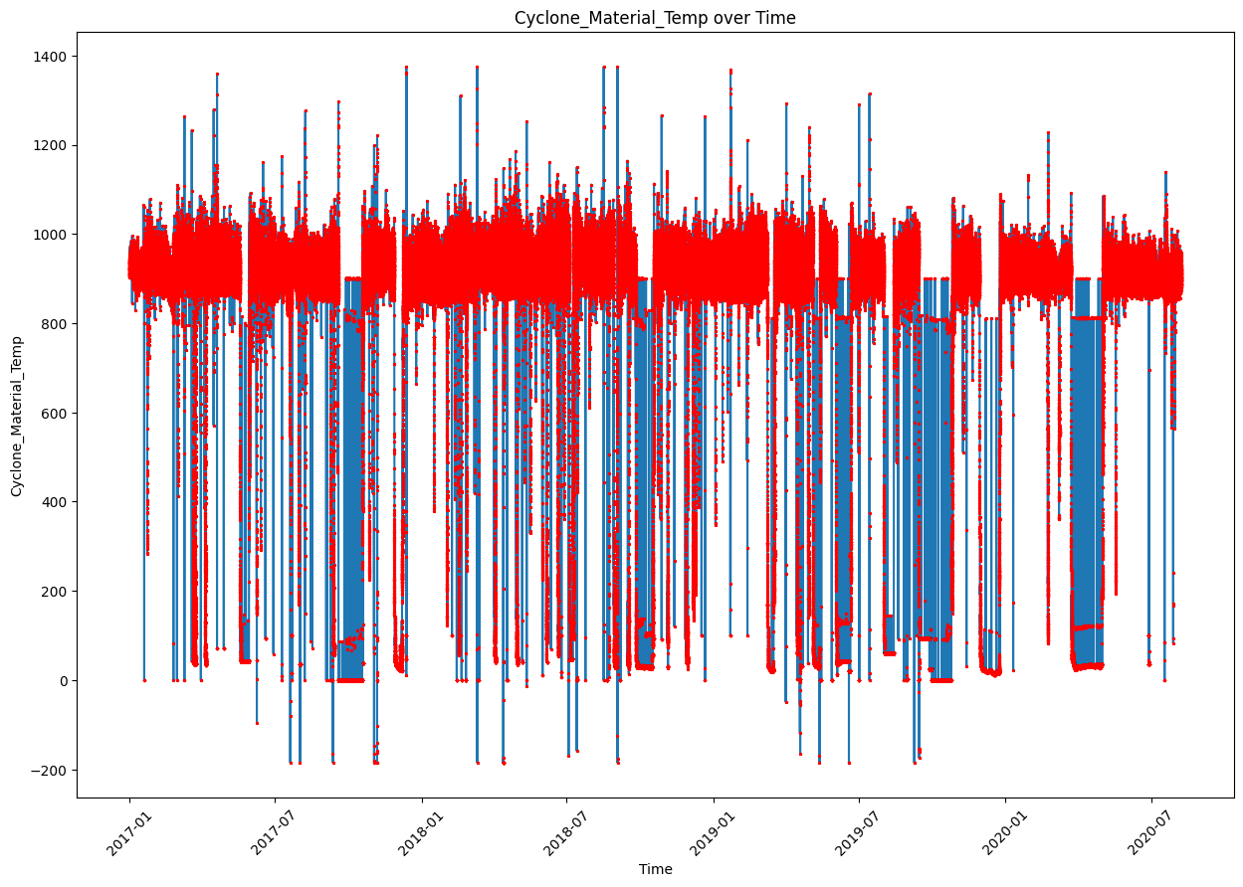
Reason for Implementing Interpolation:
Interpolation helps in filling gaps or missing values, ensuring that the dataset is more complete.
Interpolation helps in maintain continuity and integrity of the data.
It estimates values based on the available data, allowing for the preservation of patterns, trends, and relationships that exist within the dataset.
In the case of time series data, interpolation helps in maintaining the temporal aspect and ensuring that the time-dependent patterns and relationships are preserved.
Visualization of Gaps(Anamolies) of Material Temperature

Slide 4
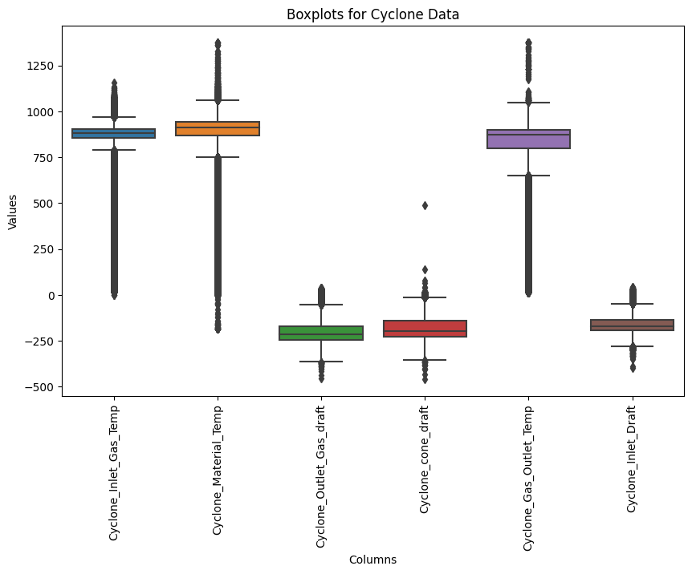
Analysis Strategy-1
Data Preprocessing: Handled the Anomalies by implementing Interpolation. Removed two rows which cant affect the dataset while insights.
Exploratory Data Analysis(EDA): Visualized the Parameters in order to find the gaps of anomalies and outliers of all the parameters i.e. 'Gas_Temperature', 'Material_Temperature', Outlet_Gas_draft', 'Cone_draft', 'Gas_Outlet_Temp', 'Inlet_Draft' and also analyzed the mean, std, min, max and percentiles of the each parameter. Counted the number of values above and below maxima and minima for each feature.

Slide 5
Analysis Strategy-2
Feature Engineering: Feature engineering was performed on the 'time' feature, which originally had a datetime data type, resulting in the derivation of additional features including 'day', 'month', 'year', 'season', 'weekday', 'hour_of_day', 'day_of_year', 'date', and 'time_category'. These derived features were meticulously crafted to facilitate further data analysis and enable deeper insights into the dataset.
Time Series Decomposition: Data was decomposed into components, such as trend, seasonality and residual. This decomposition helped in understanding the underlying patterns and extracting meaningful information from the data.
Interpretation and Insights: Data visualization and analysis of patterns and abnormalities were performed using Power BI. The tool allowed for clear visual representations of the dataset, aiding in the identification of insights and anomalies.

Slide 6
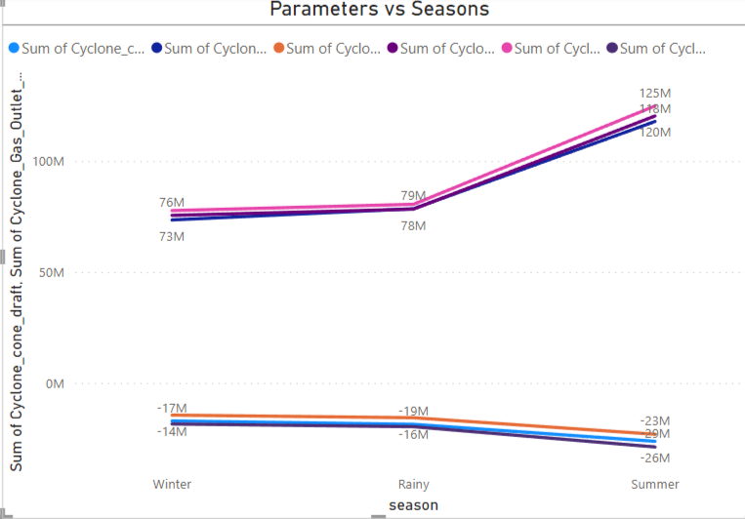
Insights-1
Parameters vs Environment:
Seasons: Parameters like Gas Outlet Temperature, Inlet Gas Temperature, and Material Temperature, exhibit correlations with each other. Specifically, these correlations demonstrate a linear relationship during the winter season, while indicating a rapid increase during the transition from rainy to summer seasons.
In Winter season, these temperature parameters maintain a consistent linear relationship. As one temperature increases or decreases, the other temperatures tend to change in a proportional and predictable manner.
Seasons transition from rainy to summer, there is a notable deviation from the linear relationship.

Slide 7
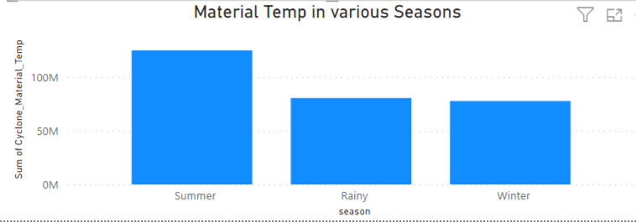
Insights-2
As well as features like Cyclone cone draft, Inlet Draft, Outlet Gas Draft as correlated to each other. They exhibit a consistent linear relationship with each other during the winter season. This linear relationship suggests that changes in one draft variable are accompanied by proportional changes in the other draft variables.
A noteworthy observation is the pronounced and swift decline in the graph when transitioning from the rainy to summer seasons.
By recognizing this deviation in the graph, it becomes evident that external factors related to weather patterns have a significant impact on the cyclone draft, material, inlet and outlet components.
The material temperature exhibits variations with the changing of seasons

Slide 8
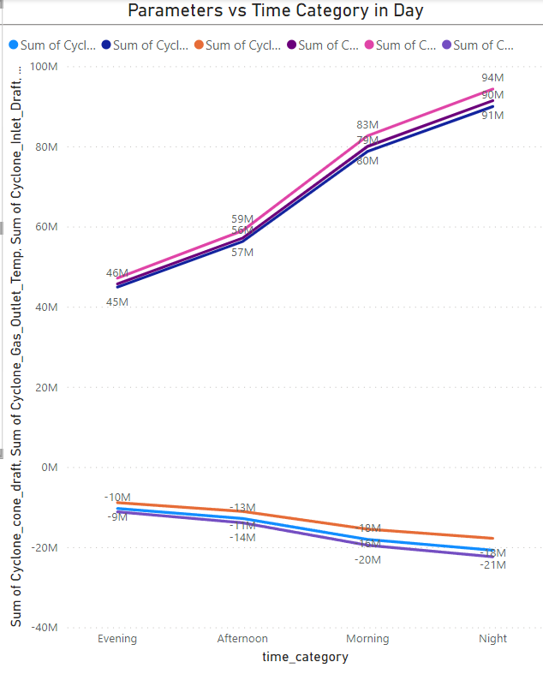
Insights-3
Parameters vs Time Category in Day:
The highest values of Cyclone Cone Draft, Inlet Draft, and Outlet Gas Draft in the evening can be attributed to increased air movement and ventilation requirements during that time.
Conversely, the rapid decrease in draft values during the afternoon, morning, and night can be explained by reduced air flow, changes in operational processes or decreased ventilation needs during those periods and vice versa for Gas Outlet Temperature, Inlet Gas Temperature, and Material Temperature.

Slide 9
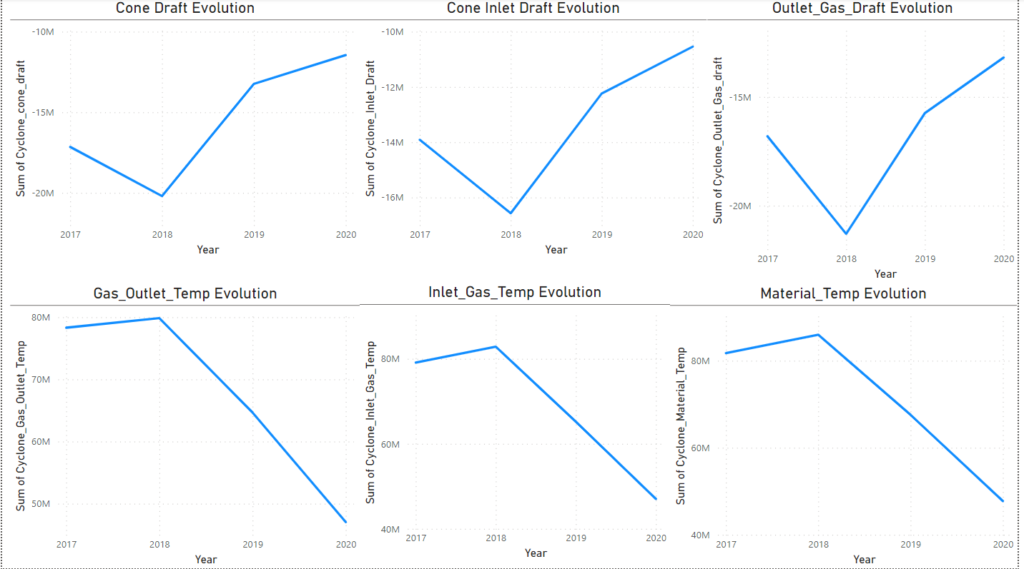
Insights-4
From 2017 to 2018, there was a consistent linear decrease in the values of Cone Draft, Inlet Draft, and Outlet Gas Draft. However, a sudden change occurred in 2018, leading to an increase in these variables. Subsequently, from 2019 to 2020, there was a further slight change is observed.
The evolution of Gas Outlet Temperature, Inlet Gas Temperature and Material Temperature followed a similar pattern. Initially, from 2017 to 2018, there was an increase in linearity. However, starting from 2018, these temperatures showed a decrease that continued until 2020.

Slide 10
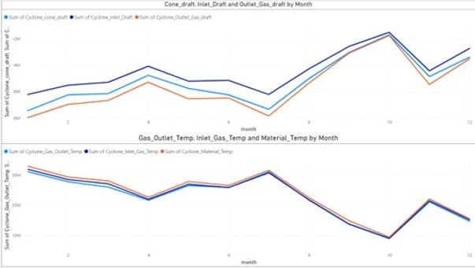
Insights-5
Monthly Insights:
The parameters of the cyclone separator exhibit monthly fluctuations, with occasional increases and decreases.
The Cone Draft, Inlet Draft and Outlet Gas Draft demonstrated a consistent pattern of fluctuations throughout the year. The parameters showed an increase from January to April, followed by a decrease until July. Then, there was a rapid rise until October, followed by a decline in November. However, in December, there was a sudden and significant increase in these measurements and vice versa were Gas Outlet Temperature, Inlet Gas Temperature and Material Temperature.

Slide 11
Conclusions
Most of the times, Cyclone Separator parameters were highly influencing by the Environmental issues i.e. Temperature, Humidity etc.
Material Temperature in Summer Season is higher compared to Rainy and Winter. The reason is due to Insufficient insulation, Ambient Temperature and Heat Transfer.
Inlet Gas and Outlet Gas, Inlet and Outlet Draft are maximum depending on one another in most of the times.
Cone Draft and Gas Outlet Temperature behaving like inversely.
Cone Draft, Inlet Draft and Outlet Gas Draft attaining their highest value at 12:00PM and Inlet Gas Temperature, Gas Outlet Temperature, Material Temperature at 22:00(10:00PM).

Slide 12

Thank You.
I have thoroughly explored various methods to extract insights from the provided dataset. I would appreciate your input to ensure that I have not overlooked any valuable insights or if there are alternative approaches that could be implemented more effectively.
B. Datta Sai Srinivas,
8919009721,
dssrinivasbaswa@gmail.com.

