Slide 1
Biofilms
United they stand
Divided they colonize

Slide 2
What are biofilms?
Biofilms are communities of very small organisms that adhere to a substratum(surface) because their chances of survival improve when they reside in colonies.
In this project, we have tried to simulate simple biofilms reflecting their formation and sustenance.
Each bacterium has a growth rate with which they divide and a nutrient consumption rate as well.

Slide 3
Assumptions
The biofilm gets infinite supply of nutrients from the surface that it is attached to and no nutrient is supplied from the other end.
Nutrients diffuse according to Newton’s law of Heating and Cooling.
They die only due to starvation and no other factors.
A bacterium divides at random into a neighbouring cell with a certain probability depending on the presence of nutrient and the growth rate. If two bacteria choose the same empty cell to divide in, only one bacterium is placed in the cell.

Slide 4
Why Cellular Automata?
The simulation of growth of a biofilm involves a cellular automation of two
m x n grids, one representing the nutrients and the other representing the bacteria.
Bacteria Grid:The state of a bacterium in a cell depends on the state of its four neighbours.
Nutrient Grid: For diffusion of a nutrient throughout the grid, we consider the nutrient value in eight neighboring cells.

Slide 5
How to model it?
At each time step, the following activities are observed in the simulation:
Diffusion of nutrients (occurring in the nutrient grid)
Growth and death of bacteria (occurring in the bacteria grid)
Consumption of nutrients by the bacteria (interaction between the two grids)

Slide 6
Initialization of the nutrient grid
The nutrient grid is an m x n matrix with all the cells initialized to value of MAXNUTRIENT. The condition 0 < MAXNUTRIENT < 1 is followed during the initialization. We have considered it to be 0.999.

Slide 7
Biofilm Initialization
Each cell in the bacteria grid can belong to the following three states:
A fourth state of BORDER is available in the extended bacteria grid
Initially, the matrix is initialized with EMPTY cells except for the first column where a bacterium is present with probability equal to probInitBacteria, generated using a uniform random variable.
EMPTY (available for growth of a new bacterium)
BACTERIUM (contains a live bacterium)
DEAD (contains a dead bacterium)

Slide 8
Biofilm Boundary Conditions
The bacteria grid also adheres to the periodic boundary conditions in the north-south directions, i.e the first row in the extended grid is the last row in the original bacteria grid and the last row in the extended bacteria grid is the first row in the original bacteria.
The east-west direction has fixed boundary conditions , thus the leftmost and the rightmost columns are filled with BORDER cells in the extended grid, thereby making the dimensions of the extended grid to be (m+2) x (n+2).

Slide 9
Boundary Condition for Grids

Slide 10
Biofilm Growth over time
Diffusion
Grow
Consumption

Slide 11

Diffusion of Nutrients
The model of diffusion follows Newton’s Law of Heating and Cooling which states that the rate of change of temperature of an object with respect to time is proportional to the difference in the temperature of the object and that of the surroundings, so similarly the nutrient value of a cell at time t + Δt is given by the formula:
where 0 < r < 0.125 and Δsite = the change in a cell’s nutrient value. Through the formula we only consider diffusion through the system in time.

Slide 12
Growing of bacteria: Where the interaction between the two grids occurs
If a site with live bacterium contains
  no nutrient, it dies due to starvation. So, we change the state of the bacterium in the original grid: BACTERIUM DEAD
  In the presence of nutrients,
    it may reproduce with a probability which is ‘p’ times the cell’s nutrient value.
    the daughter bacteria survives in a neighboring empty cell (chosen by pickNeighbor) whose state changes from EMPTY BACTERIUM

Slide 13
Pick Neighbor: Selects a random empty neighbor.
If there is an empty neighbour, indices of a neighbouring empty cell picked at random from the list of empty neighbor positions (N,E,S,W) from the extended bacteria grid.
Else returns the indices of the current cell in the unextended bacteria grid.
Note:
  Whenever a north or a south neighbor is chosen, we check for the periodic boundary conditions and wrap around when required.
  A cell with indices (i,j) in the original grid translates to a cell with indices (i+1,j+1) in the extended grid.

Slide 14
Consumption of nutrients: maintains the amount of nutrients in the nutrient grid
When the bacteria is surviving, it consumes nutrients.
This function takes the bacteria grid and the nutrient grid at each time step.
Checks whether the cell in the bacterium grid is alive, (i.e. the state of the cell is BACTERIUM ) and
  if it is alive, reduces the amount of nutrients by the amount ‘CONSUMED’.
  else the nutrient value remains unchanged.

Slide 15
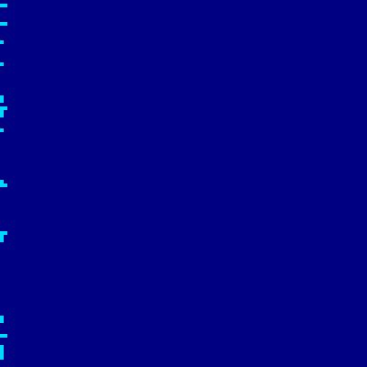
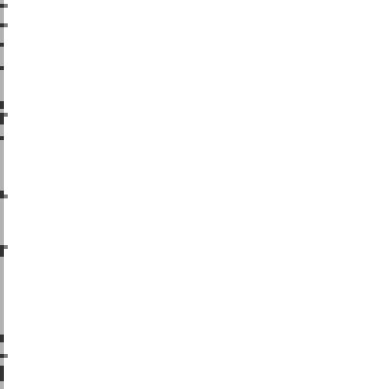
Bacteria Grid at t = 1
Nutrient Grid at t = 1

Slide 16
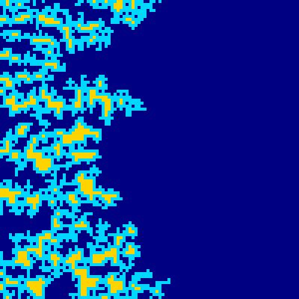

Bacteria Grid at t = 300
Nutrient Grid at t = 300

Slide 17
Observations
We started with a model in which the end state of the bacteria was ‘DEAD’. This leads to the population of bacteria dropping to a very small value quickly, in spite of nutrients still being present in the nutrients grid. (when the consumption value is not too high or low.)
This does not model the real-life situation correctly. Actually, the population of bacteria stagnates at some value( if nutrient supply is infinite).
That is what happens in the other model we analyzed, one where the ‘DEAD’ bacteria decays into nutrients after a series of steps. (when consumption << max_nutrients and the growth rate is high)

Slide 18
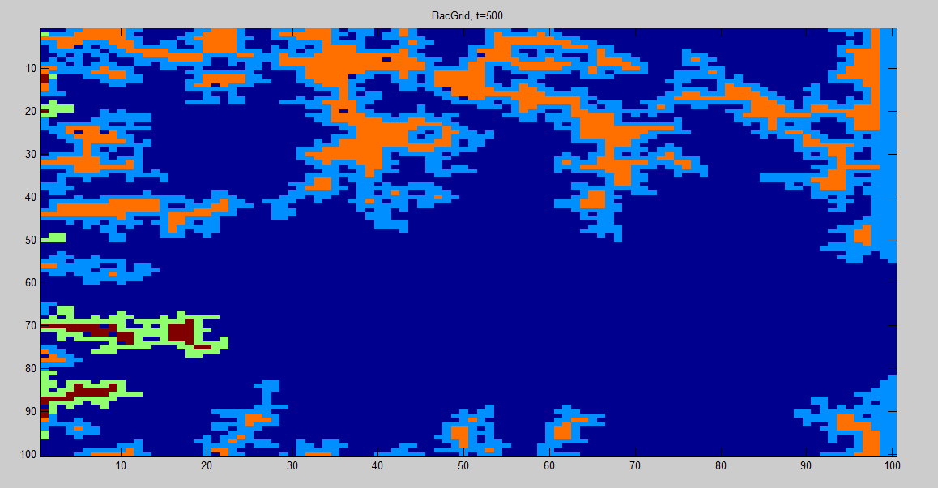
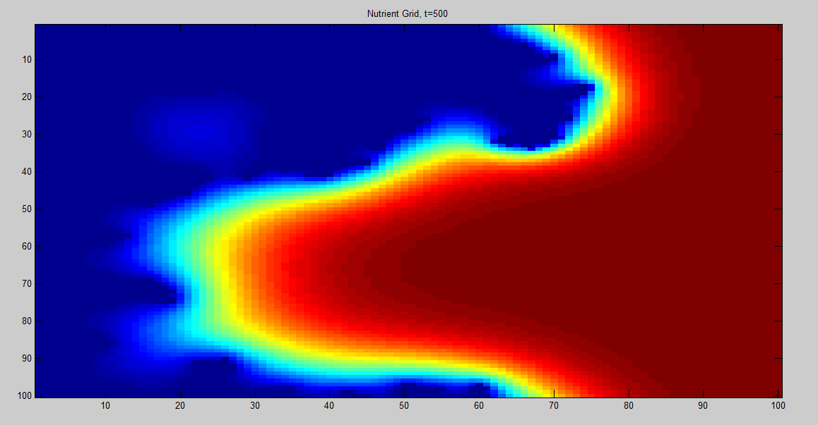
Two types of bacteria
Two types of bacteria with different probInit, consumption value, and growth rates.

Slide 19
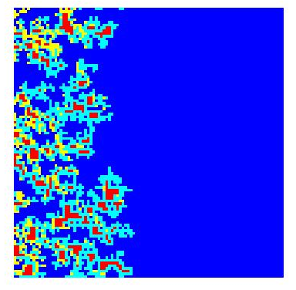
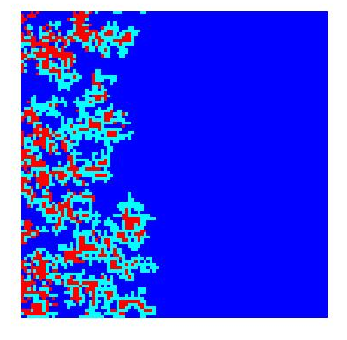
Simulating the reaper model
The Bacteria along with 2 reapers to model colonization.

Slide 20
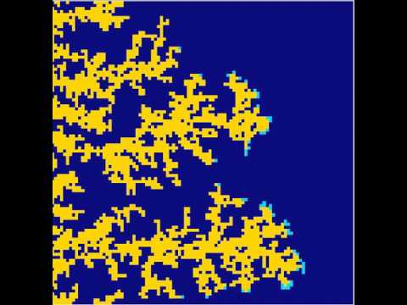
Smart Hungry Neighbour
Consumption from neighbouring cells.

Slide 21
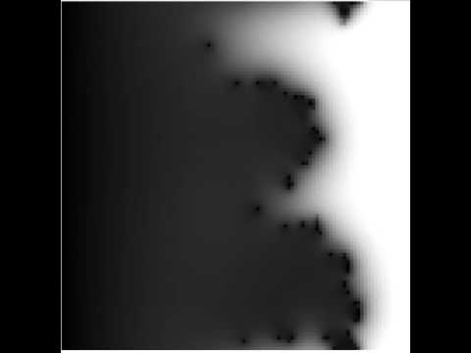

Slide 22
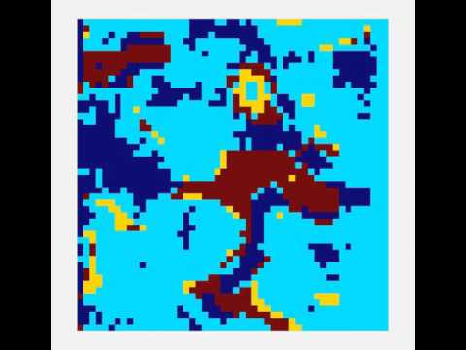
Death Cycle
Modelling of various stages of death.Bacteria dead,decay into nutrients.

Slide 23
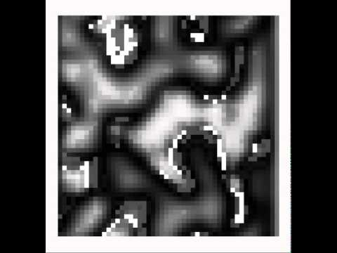
Nutrient Grid for Death Cycle

