Slide 1
Multilabel Questions Classification
Submitted By : Submitted To :
Sarvat Ali (2018201009) Dr. Radhika Mamidi
Prabha Pandey (2018201053)
C. Sai Sukrutha (2018201054)
Shafiya Naaz (2018201062)

Slide 2
Problem Statement
Multilabel classification of questions from coding platforms like codechef, codeforces etc and labelling them based on their respective paradigms.

Slide 3
Motivation
To facilitate the user to be able to access multiple websites at once and get all the questions related to the programming paradigm he is interested in.
For helping the user to identify the category of question he/she is trying to solve.

Slide 4
Data Scraping
Previously, we scraped out data from leetcode, but the data extracted did not have labels.
Therefore we did data scraping from codechef and codeforces where the labels are provided.
We have used the following libraries for scraping data :
requests==2.22.0
beautifulsoup4==4.8.0

Slide 5
Sample Dataset Structure
Codechef:

Slide 6
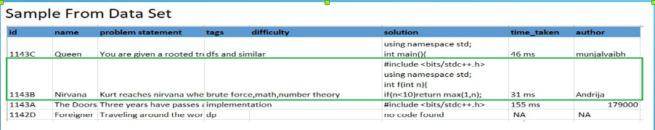
Sample Dataset Structure
Codeforces:

Slide 7
Data Preprocessing
The scraped data is stored in a csv file, which is further used in data preprocessing to make it usable.
Following are the steps performed for cleaning up of data set :
Removing Stop Words
Removing Special Characters
Applying Stemming ( as per English Dictionary )
The above approaches are not applied on solution.

Slide 8
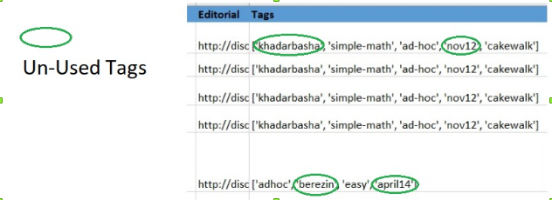
Data Preprocessing continued..
The data scraped had some unused tags, so we removed the data items labeled by any of those tags.

Slide 9
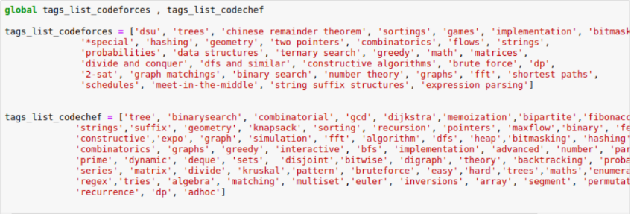
Tag List Used

Slide 10
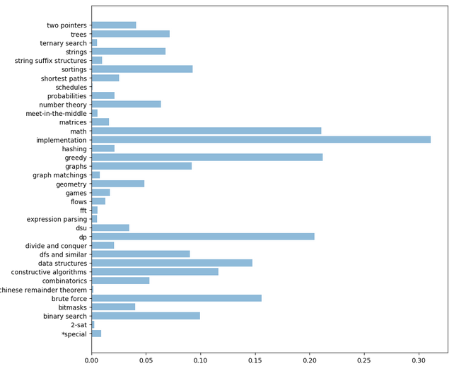

Slide 11
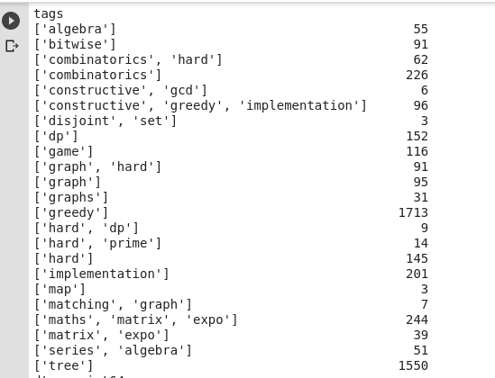
How labels look like

Slide 12
Proposed models
Baseline models:
SVM
Logistic regression
LSTM
CNN
BERT
RoBERTa
XLNET

Slide 13
Baseline models
For Multilabel classification, we use One-vs-Rest scheme and use a Pipeline.
Advantages:
Provides probabilities for each label.
It is more robust: the independent variables don’t have to be normally distributed
Disadvantages:
Linear model

Slide 14
Baseline models
Model | Precision | Recall
Logistic Regression | 0.72 | 0.87
Linear SVM | 0.76 | 0.82

Slide 15
Advanced models
As mentioned in the last evaluation we tried to implement BERT and Roberta this time as our model. Bert is transformer based model that has achieved state-of-the-art results on various NLP tasks. BERT is a bidirectional model , it uses much faster Attention-based approach. The model is also pre-trained on text corpus from wikipedia. This allows us to use a pre-trained BERT model by fine-tuning it for our multilabel classification task.

Slide 16
LRAP and Loss evaluations
Label ranking average precision (LRAP) averages over the samples, answers to the question: for each ground truth label, what fraction of higher-ranked labels were true labels? This performance measure will be higher if you are able to give better rank to labels associated with each sample.
This metric is used in multilabel ranking problem, where the goal is to give better rank to labels associated to each sample.
The obtained score is always strictly greater than 0 and the best value is 1.
The label_ranking_loss function computes ranking loss which averages over the samples the number of label pairs that are incorrectly ordered, i.e. true labels have a lower score than false labels

Slide 17
BERT
After preprocessing the data we fed the problem statement and its solutions to model along with labels after tuning the learning rate, epochs, optimiser we predicted probabilities for each label. We obtained LRAP as 0.91 and eval_loss as 0.06.

Slide 18
Roberta
RoBERTa builds on BERT’s language masking strategy and modifies key hyperparameters in BERT, including removing BERT’s next-sentence pretraining objective, and training with much larger mini-batches and learning rates. RoBERTa was also trained on an order of magnitude more data than BERT, for a longer amount of time. This allows RoBERTa representations to generalize even better to downstream tasks compared to BERT.
LRAP =0.92 eval_loss =0.04

Slide 19
Future Tasks
Fine tune advanced models to predict the test data.
Adjust parameters in all models so as to handle the unbalanced dataset.
Implementation of more basic as well as advanced models to check the best optimal one for this task.
Web app for user to fetch the questions and their respective solutions on input of corresponding label.

Slide 20
Managing Imbalanced Classes
As it is evident, the problem is of Multilabel classification.
The data we extracted had imbalance of classes, i.e. number of occurance of some classes were more than the others.
Imbalanced classes put “accuracy” out of business. Standard accuracy no longer reliably measures performance.
Methods to deal with it:
Up-sample Minority Class
Down-sample Majority Class

Slide 21
Managing Imbalanced Classes
Cont...
Up-sampling is the process of randomly duplicating observations from the minority class in order to reinforce its signal.
Down-sampling involves randomly removing observations from the majority class to prevent its signal from dominating the learning algorithm.
As we didn’t have ton of data to work with, our best bet was up-sampling, which we used to remove class imbalance from the data.

Slide 22
LSTM
An artificial recurrent neural network (RNN) architecture used in the field of deep learning.
It has a “memory” which captures information about what has been calculated so far.
Advantages :
It can process inputs of any length.
Even if the input size is larger, the model size does not increase.
Disadvantages :
Due to its recurrent nature, the computation is slow.
Training of LSTM models can be difficult.

Slide 23
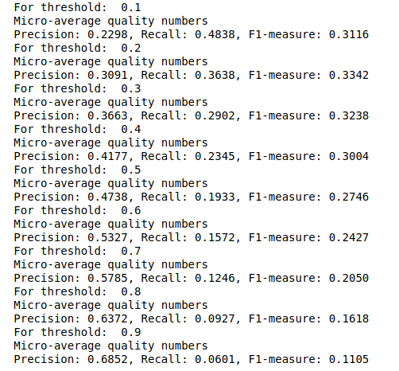
LSTM
A threshold matrix has been defined, with values in range 0.1 to 0.9. Then, we run a loop over the predicted output and compare it with the threshold value and choose tags only if the corresponding value of a tag is more than the threshold value.
Precision : 0.3091
Recall : 0.3638
F1 - score : 0.3342

Slide 24
CNN
CNN or ConvNet is a class of deep neural networks.
Advantages :
CNNs eliminate the need for manual feature extraction.
CNNs can be retrained for new recognition tasks, enabling us to build on pre-existing networks.
Disadvantages :
They need a lot of training data.
If GPU is not good, they are quite slow to train (for complex tasks).

Slide 25
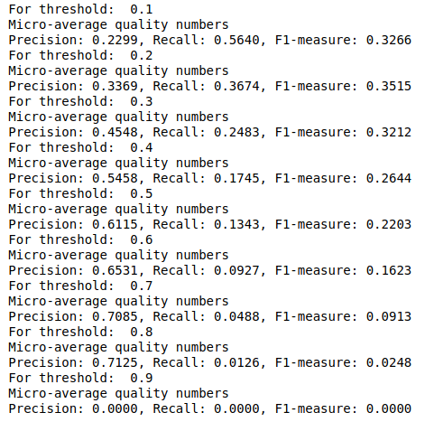
CNN
A threshold matrix has been defined, with values in range 0.1 to 0.9. Then, we run a loop over the predicted output and compare it with the threshold value and choose tags only if the corresponding value of a tag is more than the threshold value.
Precision : 0.3369
Recall : 0.3674
F1 - score : 0.3515

Slide 26
XLNET
It is a large bidirectional transformer that uses improved training methodology, larger data and more computational power to achieve better than BERT prediction.
It uses permutation language modeling, where all tokens are predicted but in random order. This is in contrast to BERT’s masked language model where only the masked (15%) tokens are predicted.. This helps the model to learn bidirectional relationships and therefore better handles dependencies and relations between words.
XLNet was trained with over 130 GB of textual data and 512 TPU chips running for 2.5 days, both of which are much larger than BERT hence it takes larger training time but outperforms BERT in many tasks.

Slide 27
Experimentation with models in their learning rate, epochs, max sequence length etc we came to following conclusion in advance models.As it takes lot of time to train these advanced models we trained only on segment of data taking only 5000 examples with balanced tags.The best results obtained so far are.
BERT
Learning rate= 5e-5
Training epochs = 3
LRAP = 0.98
Eval-Loss= 0.013

Slide 28
ROBERTA
Learning rate= 5e-5
Training epochs = 3
LRAP = 0.99
Eval-Loss= 0.008

Slide 29
XLNET
Learning rate= 5e-5
Training epochs = 1
LRAP = 0.99
Eval-Loss= 0.018

Slide 30
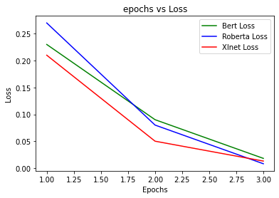
We can see difference between three models as xlnet is more resource intensive and takes longer time to train as compared to the other two.
There is not much difference in performance however Roberta performs best.

Slide 31
Web Application
Web application provides the following functionalities:
To obtain tags for the question of interest.
To provide questions belonging to a paradigm from different platforms at one place.
Login
Register

Slide 32
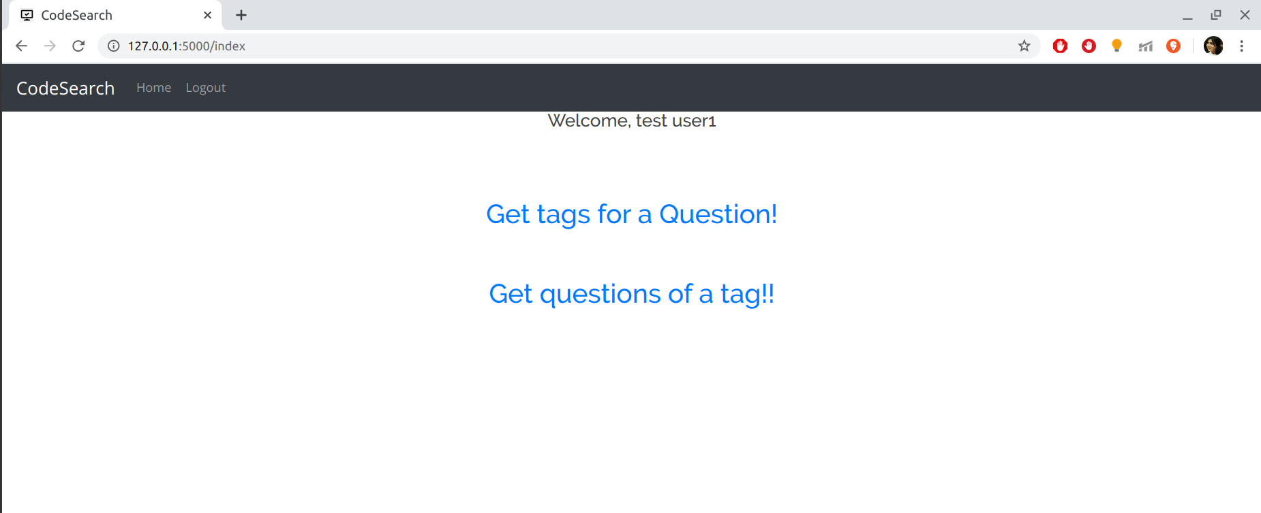
Web Application - Home

Slide 33
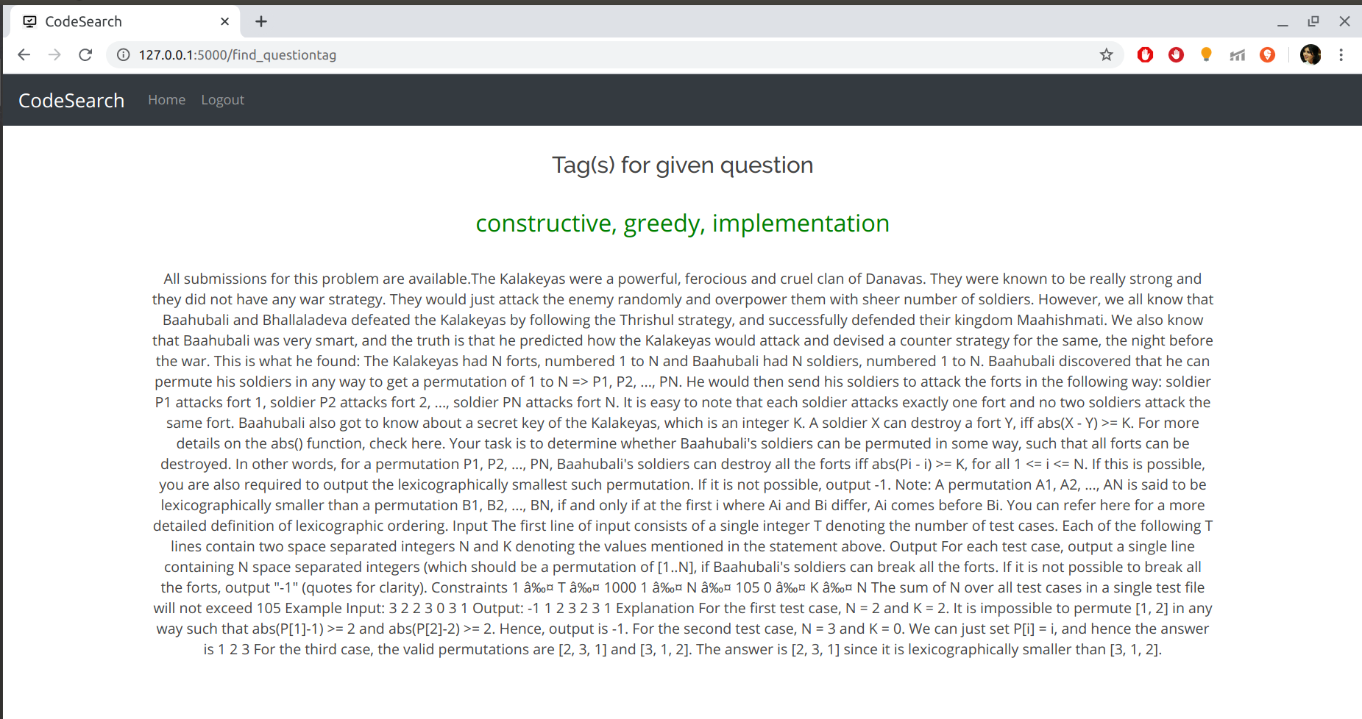
Web Application

Slide 34
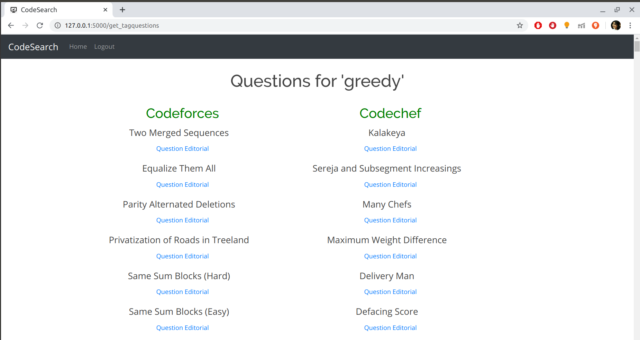
Web Application

Slide 35
Github Link
https://github.com/sai-sukrutha/Coding-Questions-Classifier

Slide 36
Thank You

