Slide 1
MULTITHREADED SERVER
Submitted By:
Prabha Pandey (2018201053)
Sai Sukrutha (2018201054)
Priya Upadhyay (2018202012)
Himani Gupta (2018202014)

Slide 2

Introduction
In a single threaded server:
  Server waits until a new request arrives
  reads the request
  processes the request
  then writes a response back to the originating client.
If another request arrives while the server is processing the first, that other request is ignored until the first has been dealt with fully.

Slide 3
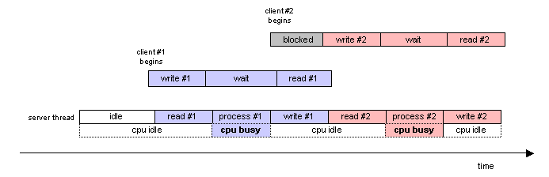

Slide 4
In multithreaded server:
  When a task arrives at the server, a thread is dispatched to handle it.
  If multiple tasks arrive concurrently, then multiple server threads will execute concurrently.
  Each dispatched thread does exactly what the single-threaded server did previously.

Slide 5
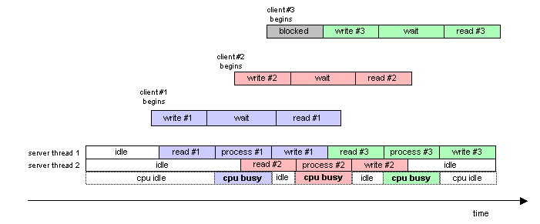

Slide 6
Threadpool
To implement multithreaded server,
we first created our own threadpool library that includes the following functions:
  create_threapool
  Dispatch
  destroy_threadpool

Slide 7
Threadpool structure
Threadpool structure contains the following members:
  min_threads,max_threads – to resize the size of threadpool based on usage dynamically.
  thread_count – number of threads created.
  ending_task – number of tasks (pending) in queue.
  request_queue – queue which holds all the requests that are dispatched. This request queue is of type task which is a structure containing members function, argument, priority.
  threads – threads is the array of all threads in threadpool.

Slide 8
Threadpool structure
  pool_mutex – pthread_mutex use for synchronization and locking of thread.
  cond – conditional variable pthread_cond_t used for making threads to wait when the queue is empty.
  working_threads - Number of threads that are working.
  idle_threads - Number of threads currently in threadpool.
  destroy – destroy is a flag that is set when destroy function is called.

Slide 9
Threadpool Functions
create_threadpool()
  create_threadpool() receives num_threads_in_pool as argument , creates threadpool and returns threadpool
  It creates threads in the pool and each thread executes a thread_function that processes the request in the request queue.
Dispatch()
- dispatch() function takes pool,function,argument,priority as parameters.
  function ,argument and priority passed to a task structure and it is added at the end of request_queue according to task priority.
  Threadpool is resized when number of working threads is 0.75 of the total threads.

Slide 10
Threadpool functions
destroy_threadpool():
  destroy_threadpool accepts pool as argument and sets the destroy member of struct as 1.
  it waits until all the threads complete the remaining tasks and exit.
  Finally,we free the allocated memory.
thread_function():
  The main functionality of this function is that the threads have to pick up funtions from queue and execute them or wait if there is no task.
  Thread fetches the first element of request_queue , the function and argument and places them in task structure , removes the function from queue and executes them.
  After the execution of function the thread returns back to pool.
  If number of working threads are less than half of total threads,then we destroy the thread calling the function.
  We use mutex and conditional variable for synchronisation.

Slide 11
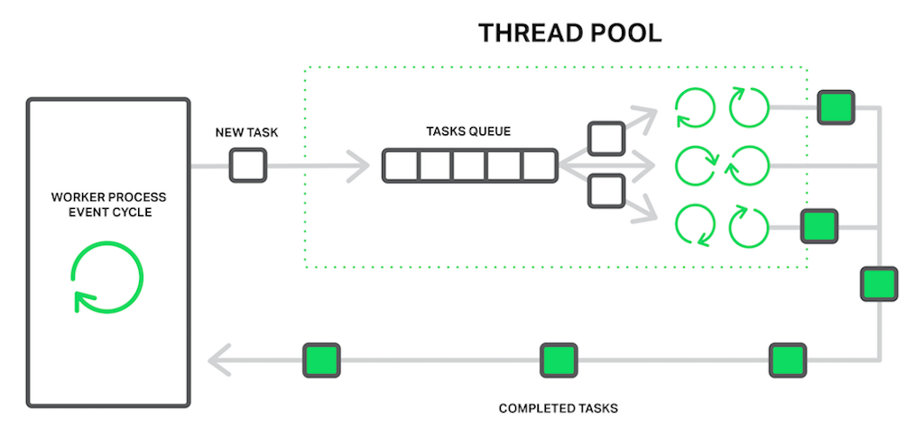

Slide 12
HTTPServer
When the server is ready and listening we assign a threadpool to it using create_threadpool.
When a connection is accepted on the listening port of server, the client request is dispatched to a thread from threadpool.
If all the threads from the threadpool are busy, the service request is appended to the request_queue of the threadpool.

Slide 13
How does it work..
Web Browser sends a request to the server.
Server dispatches a thread from threadpool and the thread executes the function serve_request.
In serve_request,the request header is received and the requested file’s extension is extracted and mapped to its mime type using a map data structure.
A response header is created and sent to the client i.e., web browser.

Slide 14
After sending the response to the browser, the thread goes back to the threadpool where it serves another request or goes to sleep.
Web browser can send multiple requests to the server and the server serves them simultaneously.

Slide 15
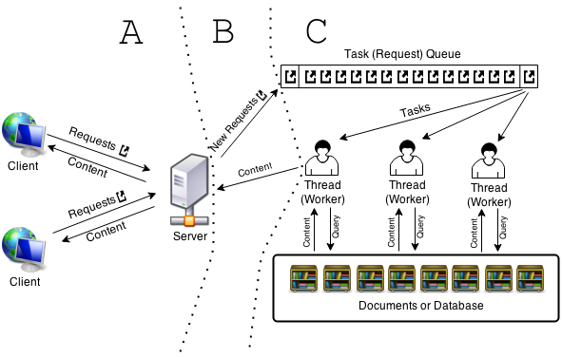

Slide 16


