Slide 1
CFD ENGINEERING
SAI VEERESH BANDI
CFD ENGINEER — COMPRESSIBLE & HYPERSONIC FLOWS
Mach 2–20 · ANSYS Fluent · OpenFOAM · Shock & Expansion Analysis
linkedin.com/in/veeresh-bandi-43b555211
github.com/sai-veeresh
Delhi, India

Slide 2
ABOUT
Engineering at the edge of high-speed flow
I specialize in compressible and hypersonic flows (Mach 2–20), where shock waves, expansions and thermal effects dominate. Trained through Flow ThermoLabs' advanced CFD program, I build stable, physically accurate simulations in ANSYS Fluent and OpenFOAM — with an emphasis on solver strategy, high-quality meshing, turbulence modeling and rigorous validation against published data.
Mach 2–20
Compressible → hypersonic regimes simulated
6+
Driven by propulsion and ambitious aerospace systems — from deep-space exploration to fast-iterating launch startups — I thrive on curiosity in the details, and always validating.
Independent CFD case studies, mesh-to-validation
<0.1%
Mass-imbalance achieved on converged solutions
02

Slide 3
EXPERTISE
Skills & Tools
CFD & Physics
Numerical Methods
Tools
Compressible & hypersonic flows (Mach 2–20)
Shock wave & expansion analysis
Boundary layer behavior, high-speed regimes
Turbulence modeling (k-ω SST)
Species transport & reacting flows
Density-based & pressure-based solvers
AUSM schemes
Mesh & domain independence studies
Convergence & residual analysis
ANSYS Fluent · OpenFOAM
MATLAB · Python (post-processing)
SolidWorks · CATIA · HyperMesh
03

Slide 4
EXPERIENCE
Professional Experience
Design Engineer
HRBL Group · Nov 2024 – Present · Delhi, India
Designed & analyzed EV chassis, battery housings, cooling systems and structural mounts (SolidWorks, CATIA)
Led structural, modal, thermal & CFD-driven analyses in ANSYS to optimize durability and cooling efficiency
Ran CFD thermal simulations for battery/motor cooling; reverse-engineered legacy designs to cut cost
Performed multiphysics (structural + thermal + fluid) validation against performance & safety standards
Product Development Intern
Simulation Lab · Sep – Oct 2024
Conducted aerodynamic CFD analysis on subsonic aircraft wing geometries in ANSYS Fluent
Computed lift/drag coefficients; refined meshes and boundary conditions for accurate force prediction
04

Slide 5
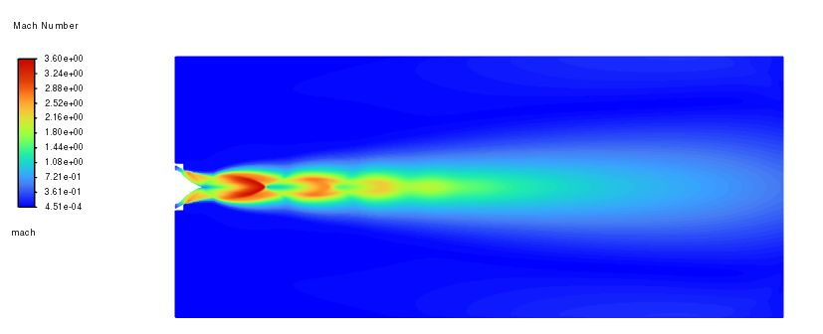
PROJECT 01
Aerospike Nozzle — Expansion Behavior
2D axisymmetric · Density-based solver · k-ω SST
Modeled a modified 2D axisymmetric aerospike to study exit-plume expansion under compressible flow
Nozzle relations sized the geometry before mesh generation and CFD analysis
Mesh-convergence study across coarse / medium / fine grids (25k → 486k elements) to confirm solution independence
Inlet: 15.2 bar, 1180 K · Outlet: 101,325 Pa · Ideal-gas air, Sutherland viscosity · Fine mesh: 486k elements
Results show clear shock-diamond formation from the exit pressure imbalance, with Mach number converging from 2.67 (coarse) to 3.90 (fine mesh) — confirming grid-independent capture of the periodic expansion/recompression structure.
05

Slide 6
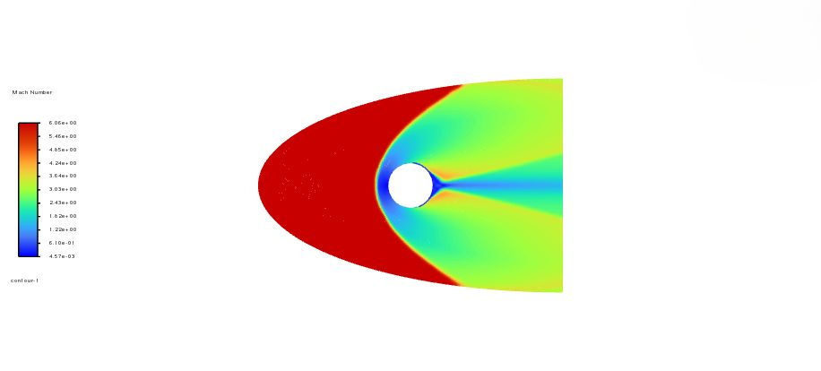
PROJECT 02
Rotating Cylinder in Mach 6 Flow
Transient · Density-based, explicit AUSM · k-ω SST
75 mm cylinder spinning at 1,074 rad/s in Mach 6 freestream, to study rotation–shock coupling
Quad-dominant mesh with 20 inflation layers (0.05 mm first cell) to resolve the boundary layer
Transient, first-order implicit formulation to capture the evolving wake
Freestream: 1,951 Pa, 58.25 K, Mach 6.06 · 34,079 elements · Growth rate 1.2
A detached bow shock forms ahead of the cylinder, and the high spin rate (1,074 rad/s) breaks flow symmetry — visibly skewing the pressure and velocity distribution around the surface.
06

Slide 7
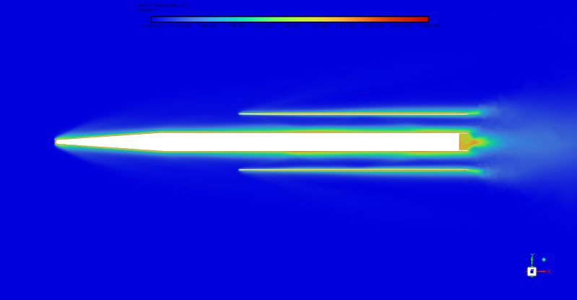
PROJECT 03
NASA X-43 Hypersonic Flow Analysis
Mach 7 · Frozen chemistry vs. species transport
Geometry sourced from GrabCAD and rebuilt for CFD: mesh prep, domain sizing, symmetry model
Compared frozen-chemistry against multi-species air (N₂, O₂) to capture high-temperature gas effects
NASA 9-piecewise polynomial Cp with Sutherland viscosity for accurate thermodynamics at Mach 7
Freestream: 1,400 Pa, 226 K, Mach 7 · ~1.45M cells (polyhedral core + 15-layer prism boundary layer)
Parameter | CFD (this work) | Published
Drag coefficient (Cd) | 0.0166 | 0.015 – 0.018 [1,2]
Pressure / viscous drag | ~93% / ~7% | 85–95% / 5–15%
07

Slide 8
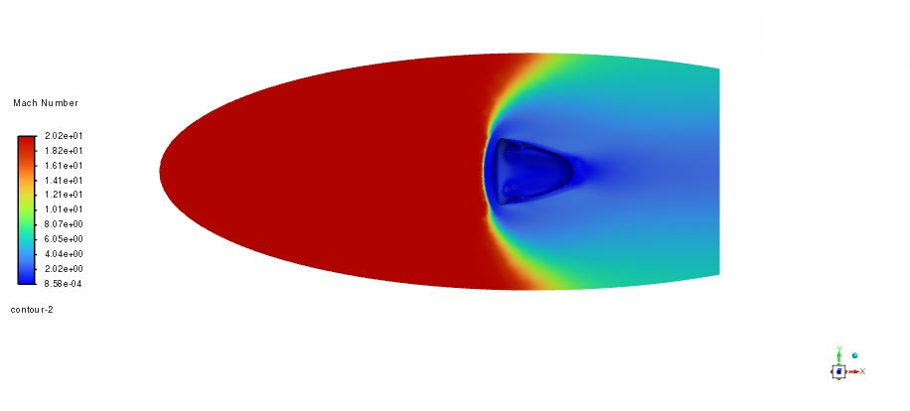
PROJECT 04
SpaceX Dragon Capsule Re-Entry
Mach 20 · Blunt-body hypersonic re-entry
Blunt-body re-entry geometry (GrabCAD, refined) to study bow-shock standoff and stagnation heating
Laminar, density-based solve with NASA 9-piecewise Cp for high-temperature air
Wall held at 1,000 K to examine the thermal protection boundary condition
Freestream: 50 Pa, 216 K, Mach 20 · ~1.6M cells, 15-layer inflation
Parameter | CFD (this work) | Published
Drag coefficient (Cd) | 1.26 | 1.23 [3]
Flow physics | Shock-driven | Shock-driven
08

Slide 9
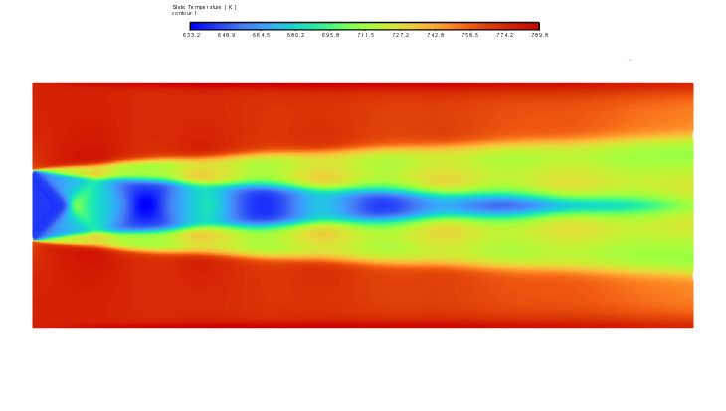
PROJECT 05
LOX / LH₂ Rocket Combustion
Reacting flow · Pressure-based solver · H₂–O₂ species
Simulated LOX/LH₂ mixing and combustion — the propellant pair used in NASA's high-performance engines
Studied species mixing, reaction-zone formation and temperature rise downstream of the injector
Radial-velocity contours reveal alternating vortical structures that enhance turbulent mixing
H₂: 0.0126 kg/s @ 858 K · O₂: 0.1 kg/s @ 1e6 Pa, 858 K · 17,160-element quad mesh
Efficient H₂–O₂ mixing proved to be the key driver of combustion intensity and temperature rise — underscoring how injector design and flow dynamics govern performance in cryogenic rocket engines.
09

Slide 10
LET’S BUILD SOMETHING FAST
EDUCATION
B.Tech in Mechanical Engineering
University College of Engineering, Narasaraopet — JNTUK
2016 – 2020 · CGPA 7.69
CONTACT
LinkedIn — linkedin.com/in/veeresh-bandi-43b555211
GitHub — github.com/sai-veeresh
Based in Delhi, India
[1] Navó & Bergadà, “Aerodynamic Study of the NASA X-43A Hypersonic Aircraft,” Appl. Sci., 10(22), 2020. [2] Davis & White, J. Spacecr. Rockets, 45(3), 2008. [3] Gonzales et al., IEEE Aerospace Conf., 2014.

