Slide 1
HTML DOM Events
15th September 2022

Slide 2
Introduction
An event is a signal that indicates something has happened.
Fire by browser.
Events are part of DOM through which HTML interacts with Javascript and vice-versa.
Some classes of events are MouseEvent, InputEvent, DragEvent, FocusEvent, etc.

Slide 3
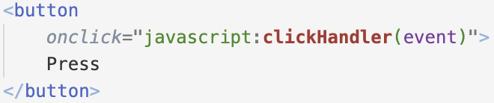
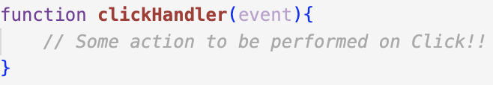
Syntax
index.html
onclick: this event occurs when someone click the button.
main.js
clickHandler: This JS function will get triggered when the onclick event occurs.
Note: event.target contains the element that is being clicked and triggers clickHandler function.

Slide 4
Mouse Events
onclick
The event occurs when the user clicks on an element.
ondblclick
The event occurs when the user double-clicks on an element.
onmouseenter
The event occurs when the pointer is moved onto an element or hover onto an element.
onmouseout
The event occurs when a user moves the mouse pointer out of an element, or out of one of its children.
onmouseleave
The event occurs when the pointer is moved out of an element.

Slide 5
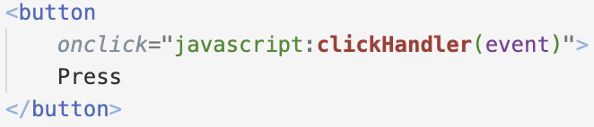
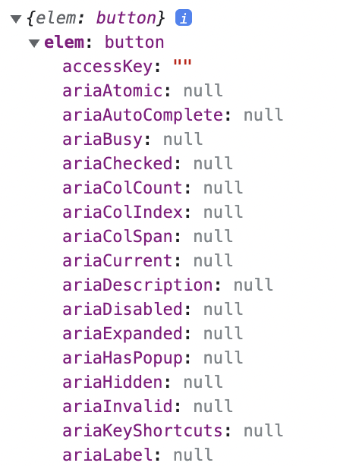
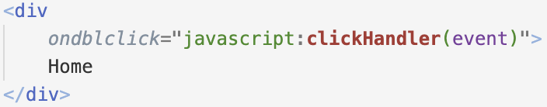
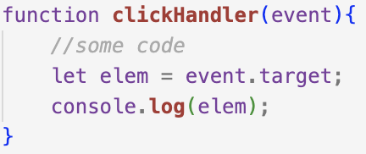
Example on Mouse Events
index.html
Browser Console
main.js

Slide 6
Keyboard Events and Input Events
Keyboard events
onkeydown
The event occurs when the user is pressing a key
onkeypress
The event occurs when the user presses a key
onkeyup
The event occurs when the user releases a key
Input events
oninput
The event occurs when an element gets user input

Slide 7
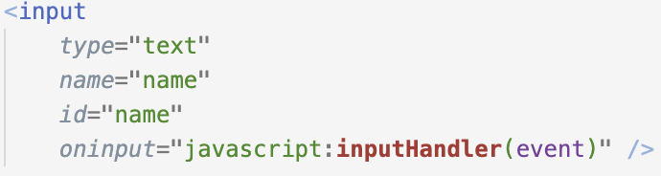
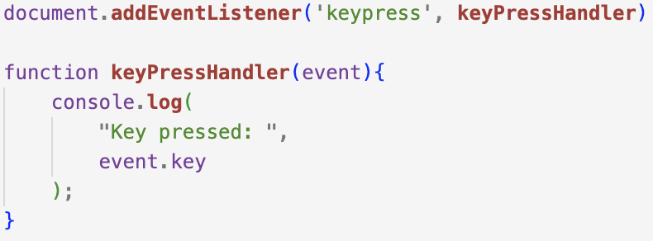
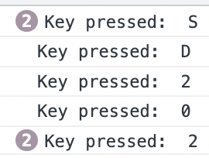
Examples on Keyboard Events
Note: addEventListenser will be covered in later section of slides.

Slide 8
Drag Events
ondrag | The event occurs when an element is being dragged
ondragend | The event occurs when the user has finished dragging an element
ondragenter | The event occurs when the dragged element enters the drop target
ondragleave | The event occurs when the dragged element leaves the drop target
ondragover | The event occurs when the dragged element is over the drop target
ondragstart | The event occurs when the user starts to drag an element
ondrop | The event occurs when the dragged element is dropped on the drop target

Slide 9
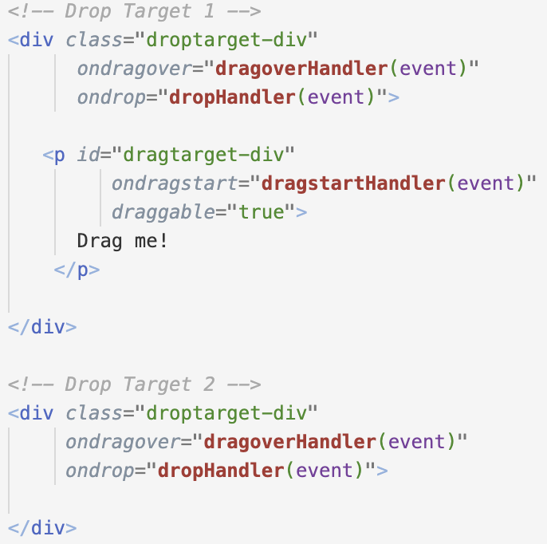
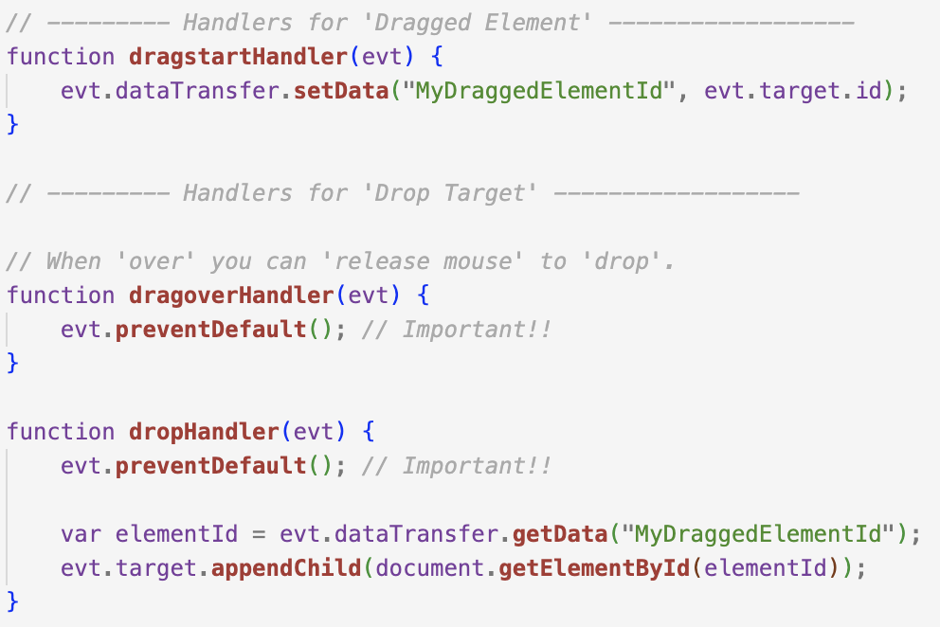
Example on Drag/Drop Events

Slide 10
Focus Events
onblur
The event occurs when an element loses focus
onfocus
The event occurs when an element gets focus
onfocusin
The event occurs when an element is about to get focus
onfocusout
The event occurs when an element is about to lose focus

Slide 11
DOM EventListener
The addEventListener() method attaches an event handler to the specified element.
In bubbling (useCapture=false) the inner most element's event is handled first and then the outer.
In capturing (useCapture=true) the outer most element's event is handled first and then the inner.
Syntax:
element.addEventListener(event, function, useCapture);
The removeEventListener() method removes event handlers that have been attached with the addEventListener() method.
Syntax:
element.removeEventListener(event, function);

Slide 12
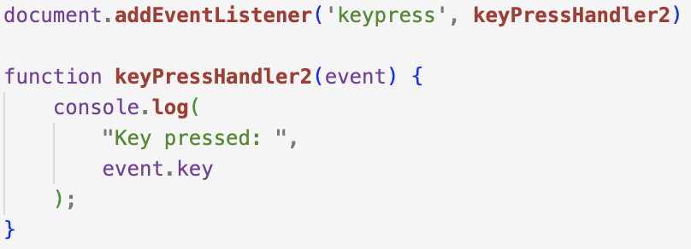
Example on DOM EventListener
Registering an eventlistener to document.
Browser Console
De-registering the existing event listener from document

