Slide 1

Lab 2
More bash commands!

Slide 2

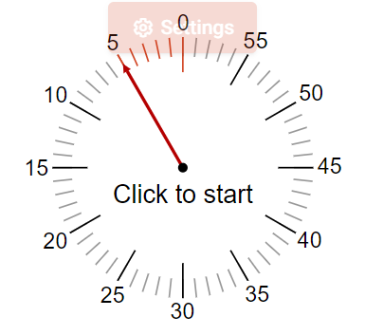
A fun activity!
Using just grep and one out of (cd, ls, cp, mv), find all the files in the current directory that have .txt in the name.
https://linktr.ee/anshium
> Introduction

Slide 3
See, you already know how to find something somewhere!

Slide 4
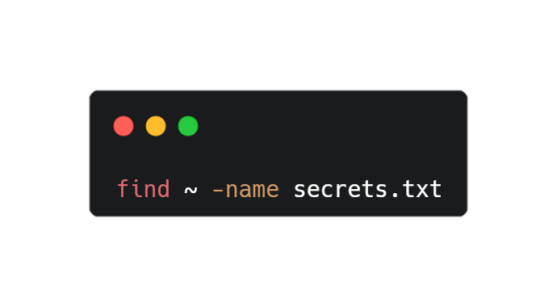
But there is more that you can do!
The find command!
Notes:
Give an introduction by switching to the terminal. Then come back

Slide 5
Ways to search using the find command
Have a look in the terminal.
Notes:
Switch to terminal after showing this slide.

Slide 6

Find is slow, isn’t it?
Please welcome the locate command.

Slide 7
The locate command searches the File System Database (FSDB) and is hence faster
‘
’

Slide 8
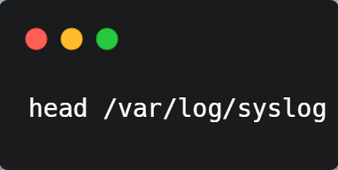
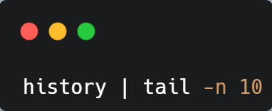
Head and Tail commands
Notes:
Switch to terminal

Slide 9
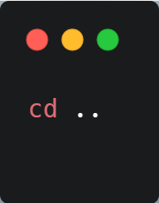
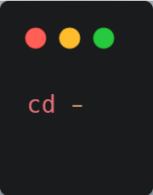
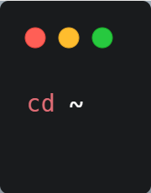
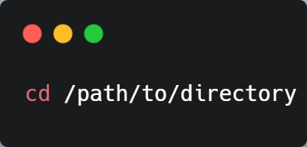
File management using bash (cd)
Absolute path
Relative path
Previous Path
Home dir

Slide 10
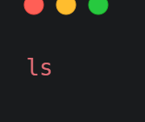
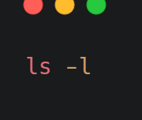
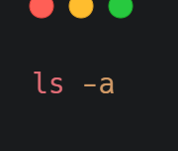
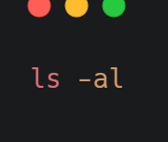
File management using bash (ls)
List files
List with more information
List all files (including hidden)
Combination of all files and verbose.

Slide 11
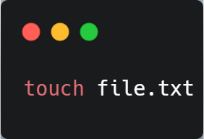
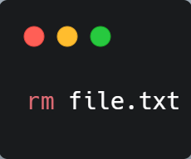
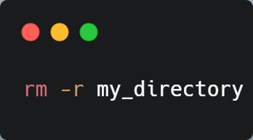
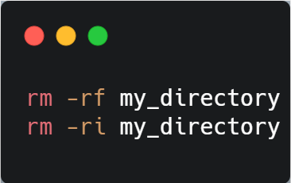
File management using bash
Create new file / change date
Remove file
Recursively remove all files and dir
Force/ prompting

Slide 12
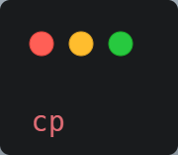
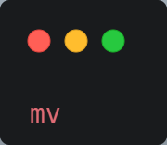
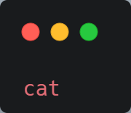
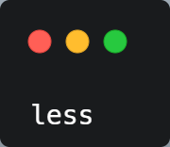

File management using bash
Copy
Move / Rename
File Viewing
Notes:
Cat = concatenate, do recursive options too

Slide 13
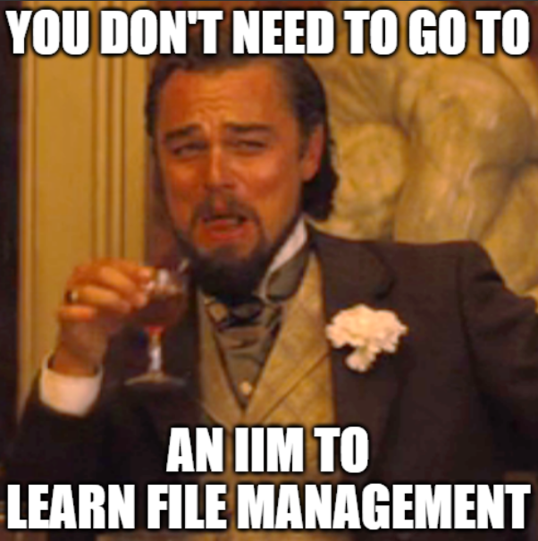

Slide 14
Arrays

Slide 15
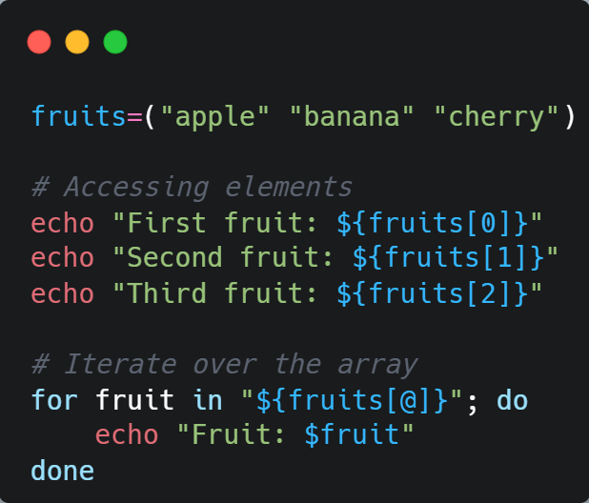

Slide 16
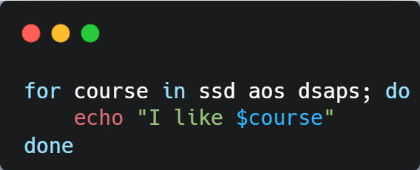
Loops

Slide 17
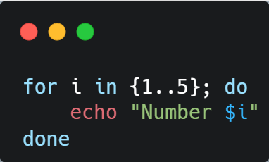
Iterating over Numbers

Slide 18
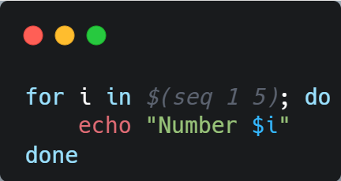
Using seq for range

Slide 19
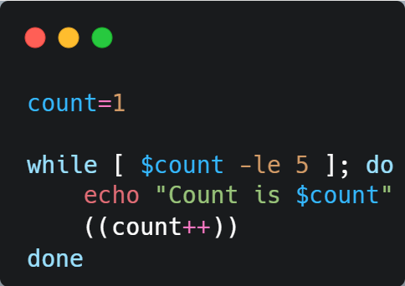
The while loop

Slide 20
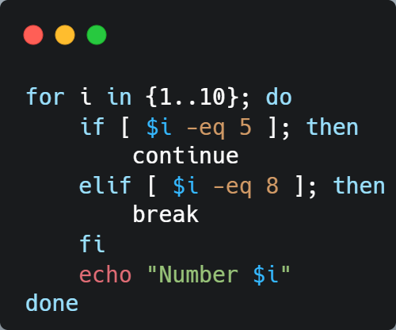
Using break and continue
What would be the output of this code?
(Open the linktree and attempt the quiz)

Slide 21
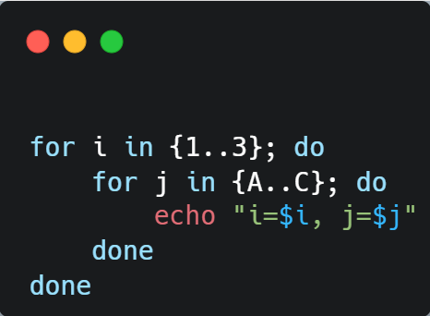
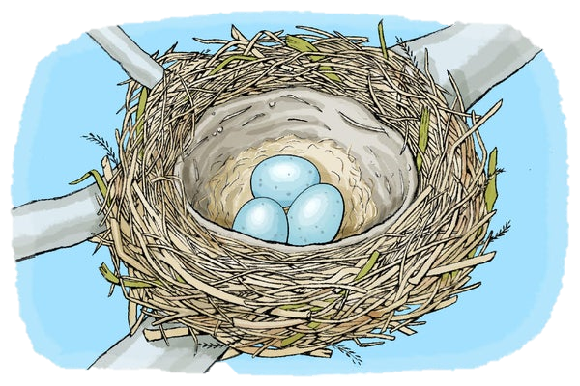
Nested Loops

Slide 22
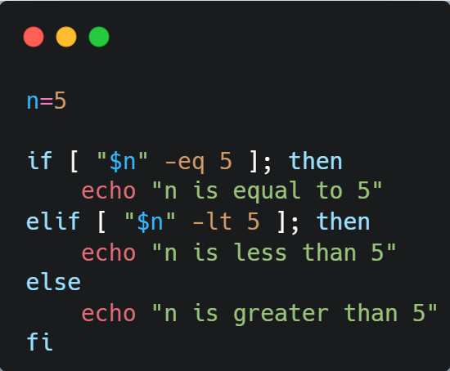
Conditionals

Slide 23
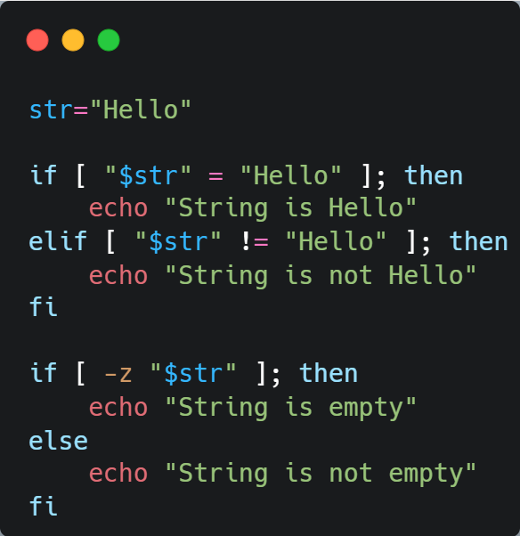
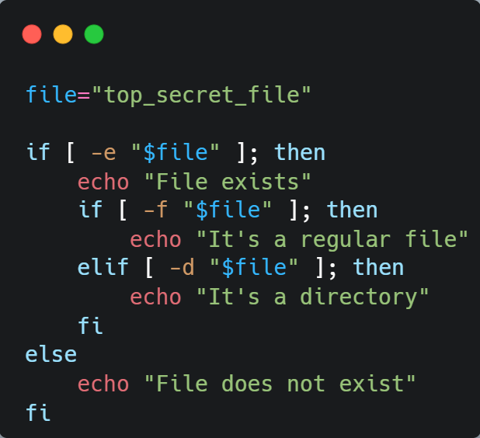
Strings
Files

Slide 24
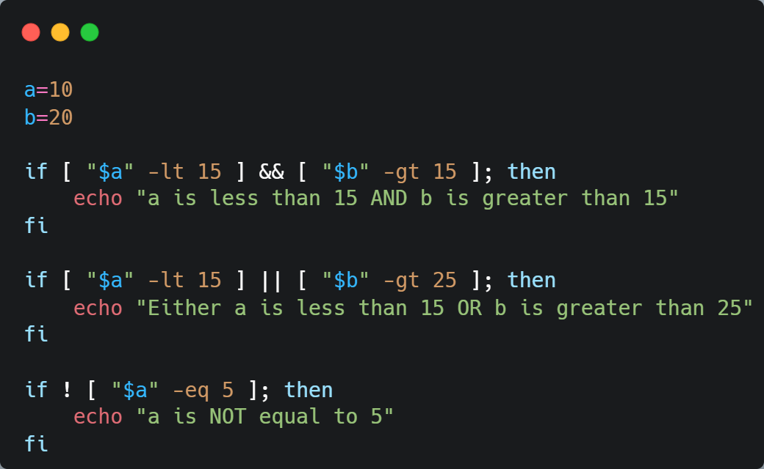
Logical Operators

Slide 25
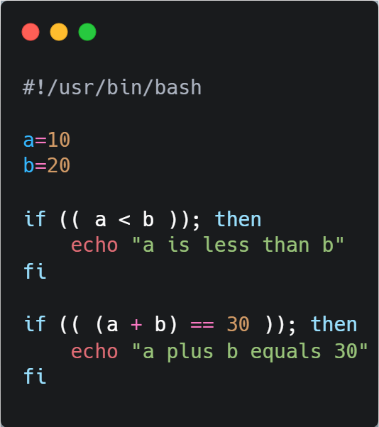
Arithmetic Operators

Slide 26
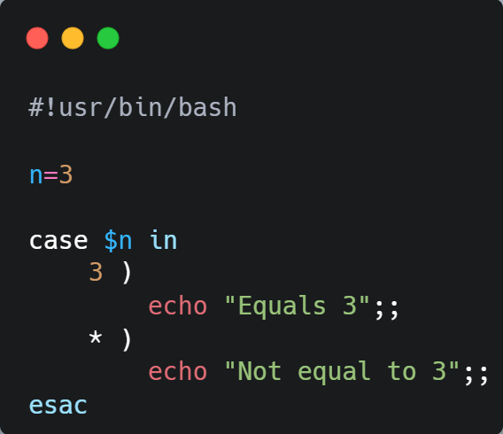
Cases

Slide 27
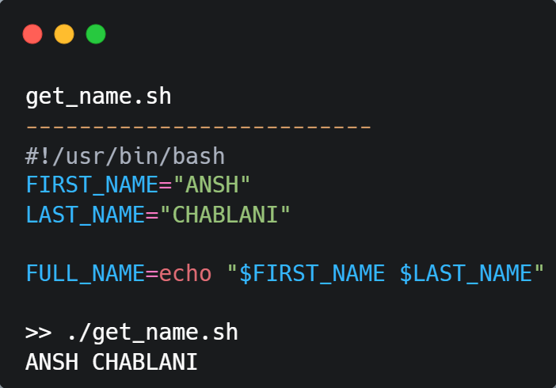
Variables

Slide 28
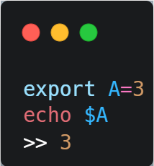
Export
Used to set variables

Slide 29
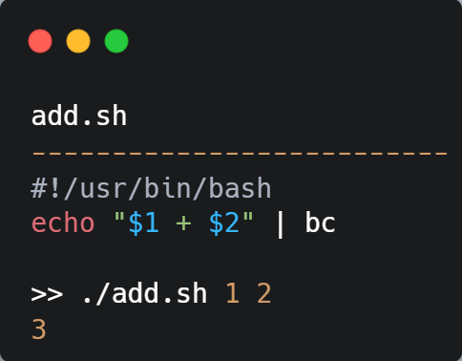
Command Line Arguments

Slide 30
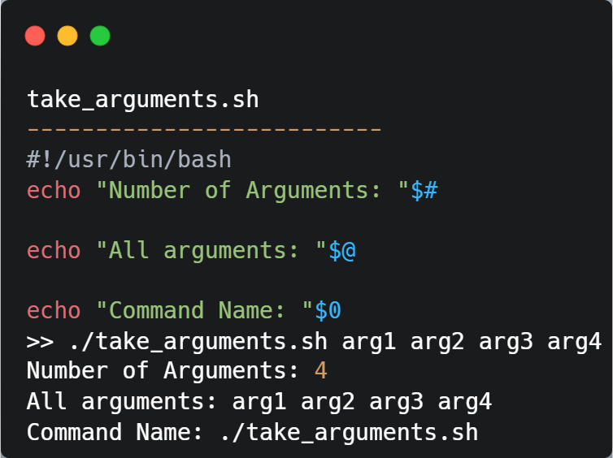

Slide 31
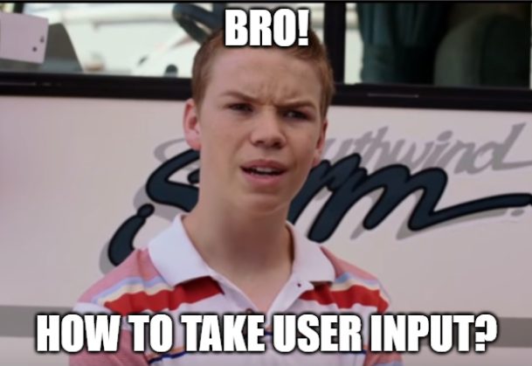
read
How do you take input?
Notes:
Give examples and give link to regex tutorials.

Slide 32
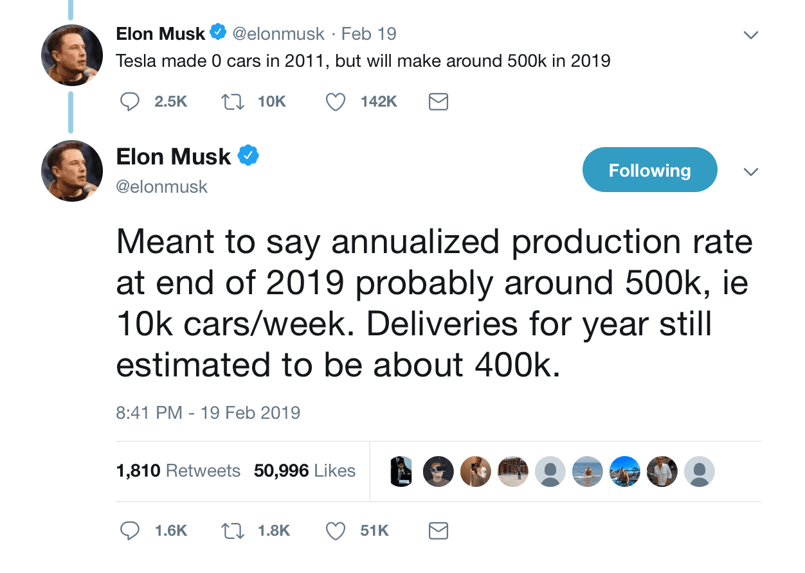
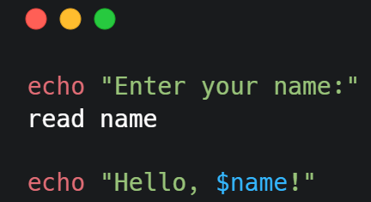
II finally found how to take user input in bash
Notes:
Go to terminal to show various ways to read in bash.

Slide 33
Regular Expressions
Let’s see this live in the terminal.
Notes:
Give examples in terminal and give link to regex tutorials.

Slide 34
bc
Notes:
Basic Calculator, switch to terminal to show

Slide 35
wc
Notes:
Word count, switch to terminal to show

Slide 36

Thank you

