Slide 1
Final project
B Venkata Sai Krishna Mail : 2200032230cser@gmail.com

Slide 2
Title: keyloggers in security
◆ Keyloggers, short for keystroke loggers, are tools or software designed to record the keys struck on a keyboard, typically in a covert manner so that the person using the keyboard is unaware of their activity being monitored.
Keyloggers can be used for various purposes, ranging from legitimate uses in IT troubleshooting and employee monitoring to malicious uses in cyber espionage and identity theft.

Slide 3
AGENDA
Problem Statement
Project Overview
Target Users
Solution and Value Proposition
Unique Features
Implementation Details
Results

Slide 4
Problem Statement
◆ Keyloggers, while potentially useful for legitimate purposes, pose a significant security threat when used maliciously. They can steal sensitive information, leading to identity theft, financial loss, and unauthorized access to private data. Organizations and individuals need effective solutions to detect, prevent, and mitigate the risks posed by keyloggers.

Slide 5
Project Overview
◆ This project aims to develop a comprehensive security solution that can detect and prevent keylogger attacks. It will include both software tools and best practices for individuals and organizations to safeguard against keylogging threats. The project will also provide educational resources to raise awareness about the risks and countermeasures associated with keyloggers.

Slide 6
WHO ARE THE END USERS?
Cybercriminals: These individuals or groups deploy keyloggers to steal sensitive information
◆ such as usernames, passwords, credit card numbers, and other personal data for financial gain.
Spyware Developers: Some companies or individuals create and distribute keyloggers
as a form of spyware
to monitor users' activities on their devices without their consent. This can include employers monitoring employees, parents monitoring children, or abusive partners spying on their significant others.
Nation-State Actors: Government agencies may employ keyloggers for espionage
purposes, monitoring the activities of individuals or organizations for intelligence gathering.
Law Enforcement: In certain cases, law enforcement agencies may use keyloggers as
part of criminal investigations, with appropriate legal authorization.
Ethical Hackers and Penetration Testers: Some security professionals use keyloggers as part of their job to test the security of systems and networks, identifying vulnerabilities and weaknesses that could be exploited by malicious actors.

Slide 7
Threats of Keyloggers from Hackers
Data Theft:
Description: Hackers use keyloggers to steal sensitive information such as passwords, credit card numbers, and personal identification details.
Impact: This can lead to identity theft, financial loss, and unauthorized access to personal
and corporate accounts.
Corporate Espionage:
Description: Keyloggers can be used to capture confidential business information, trade secrets, and intellectual property.
Impact: This can result in significant financial losses, damage to a company’s reputation, and a competitive disadvantage.
System Compromise:
Description: By capturing login credentials and other security information, hackers can gain unauthorized access to systems.
Impact: This can lead to further exploitation of network vulnerabilities, deployment of
additional malware, and loss of control over IT infrastructure.
Surveillance and Privacy Invasion:
Description: Keyloggers can monitor and record a user's activities, violating their privacy.
Impact: This leads to a significant breach of personal privacy and can be used for blackmail or harassment.

Slide 8
Prevention Measures for keyloggers from hackers
Antivirus and Anti-Malware: Regular scans and real-time protection.
Firewalls: Network and personal firewalls.
Behavioral Analysis & IDS: Detect unusual activities and monitor network traffic.
Software Updates: Regular and automatic updates for OS and applications.
Anti-Keylogging Software: Specialized tools for keystroke protection.
Secure Authentication: Implement 2FA and biometric authentication.
Virtual Keyboards: Use on-screen keyboards for sensitive entries.

Slide 9
YOUR SOLUTION AND ITS VALUE PROPOSITION
Advanced Detection Algorithms:
Utilize machine learning and behavioral analysis to identify and block keyloggers.
Real-Time Monitoring:
Continuous surveillance of system activities to detect suspicious behaviors.
Comprehensive Protection Suite:
Integrate antivirus, anti-malware, firewall, and anti-keylogging software.
User-Friendly Dashboard:
Centralized interface for monitoring and managing security status.
Regular Updates and Patches:
Ensure the latest protection against new threats with automatic updates.
User Education and Training:
Provide resources to help users recognize and avoid keylogging threats.
Cloud Integration:
Offer cloud-based threat intelligence and monitoring.

Slide 10
THE WOW IN YOUR SOLUTION
Cutting-Edge Detection:
Utilizes advanced machine learning and behavioral analysis for unparalleled threat detection.
Real-Time Insights:
Offers continuous, real-time monitoring and instant alerts for suspicious activities.
All-In-One Protection:
Combines antivirus, anti-malware, firewall, and anti-keylogging tools into a seamless suite.
User-Friendly Experience:
Features an intuitive, centralized dashboard for easy management and monitoring.
Automatic Updates:
Ensures the latest protection with seamless, automatic updates and patches.
Educational Resources:
Empowers users with comprehensive training and awareness programs.

Slide 11
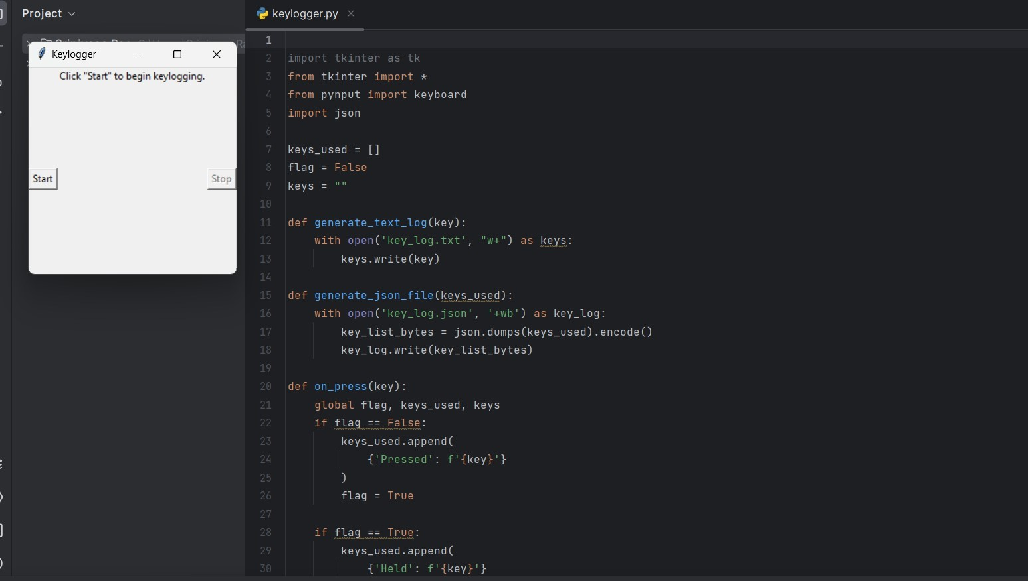
outputs

Slide 12
RESULTS
Increased Security:
Significant reduction in keylogger infections and data breaches.
Enhanced User Awareness:
Improved knowledge and vigilance against keylogging threats among users.
Compliance Achievement:
Businesses meet data protection regulations, avoiding legal issues and penalties.
Operational Efficiency:
Simplified security management, reducing time and resources spent on threat detection.
Financial Protection:
Prevention of financial losses due to identity theft and unauthorized transactions.
Data Integrity:
Ensured the confidentiality and integrity of sensitive information.

Slide 13
GIT LINK:
https://github.com/sai123krishna/APSSDC1

