Slide 2
Problem Statement
The dataset contains information about movies from different years, genres, budgets, revenues, ratings, and creators.
The goal is to understand patterns that influence a movie’s performance and identify the key factors that drive box-office success.
Objectives
Analyze the distribution of movie ratings, genres, budgets, and earnings.
Identify trends in gross revenue over the years.
Measure the relationship between budget, gross earnings, votes, and scores.
Highlight top-performing directors and countries with the most movie output.
Detect data quality issues such as missing or inconsistent entries.

Slide 3
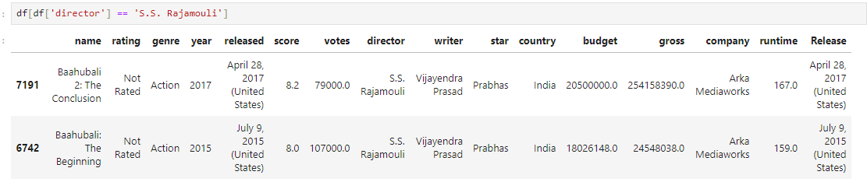
Highest-Grossing Telugu Films in India

Slide 4
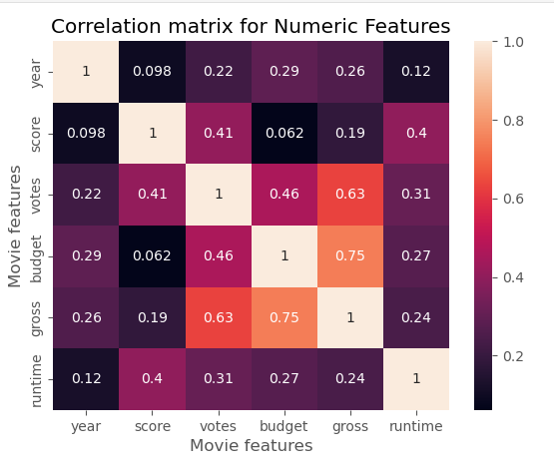
High Correlation Between Budget and gross (Heat Map)
Key Insights
Budget and gross have a strong positive correlation (0.75).
Votes also correlate well with gross (0.63), meaning audience interest impacts earnings.
Score shows moderate correlation with votes but weak with gross.
Year and runtime have minimal influence.

Slide 5
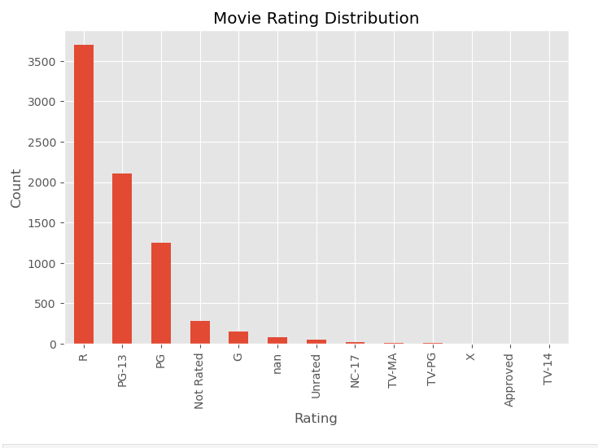
Movies Rating Distribution( Bar Chart)
Key Insights
R-rated movies dominate the dataset with the highest count.
PG-13 and PG follow, showing strong representation of family and teen-friendly films.
Very few movies fall under G, NC-17, TV ratings, or “Approved.”
A noticeable number of movies are marked as “Not Rated” or missing, indicating inconsistent rating data.

Slide 6
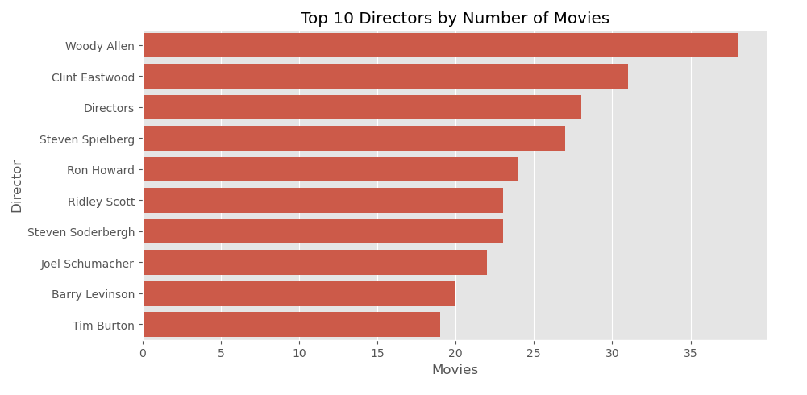
Top 10 Directors by No. of Movies
Key Insights
Woody Allen appears most frequently in the dataset with the highest movie count.
Clint Eastwood and Steven Spielberg follow with strong representation.
Some entries like “Directors” indicate inconsistent or incorrect labeling in the data.
The distribution shows only a small group of directors with very high output, while most others appear far less often.

Slide 7
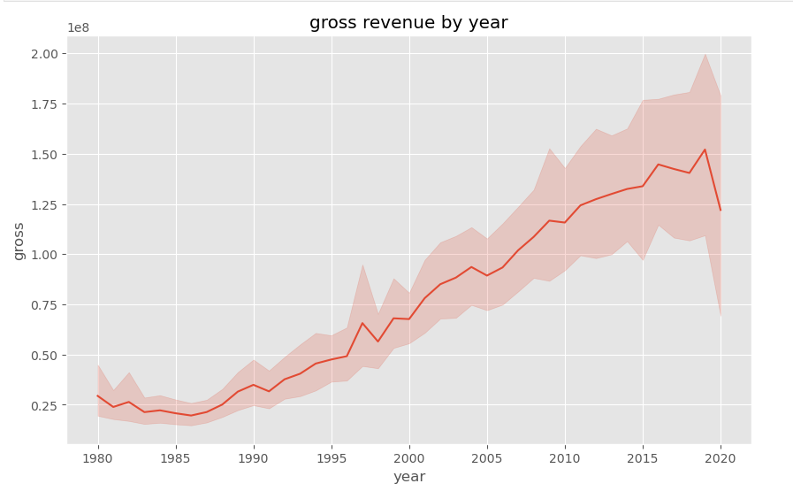
Gross Revenue by year(line chart)
Key Insights
Gross revenue shows a steady rise from the early 1980s to around 2018.
Growth accelerates sharply after the mid-2000s, indicating stronger box-office performance in recent years.
Revenue drops in 2020, likely linked to industry disruption and fewer theatrical releases.
The overall trend confirms long-term improvement in movie earnings over the decades.

Slide 8
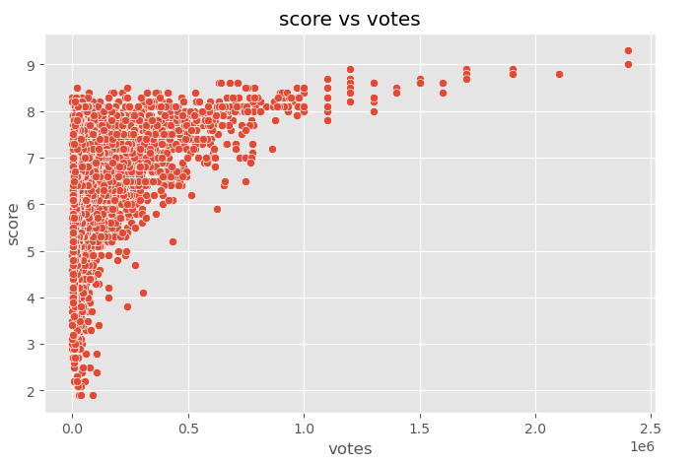
Score vs Votes( Scatter Plot)
Key Insights
Movies with higher vote counts usually have higher scores, showing a positive relationship.
Low-vote movies show wide score variation, indicating unstable or unreliable ratings.
High-score movies typically attract large audiences, leading to more votes.
Outliers exist: a few movies received many votes despite only average scores.

Slide 9
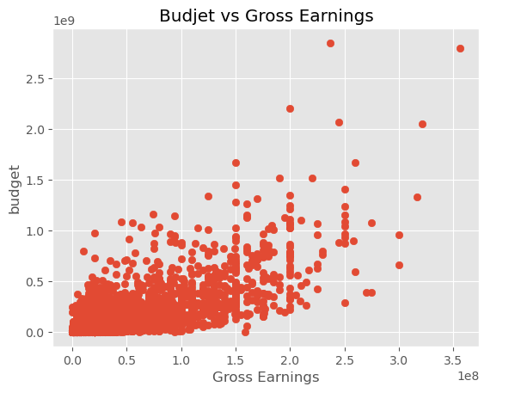
Budget vs Gross Earnings
Higher budgets generally lead to higher gross earnings, showing a clear positive relationship.
Low-budget films show wide variability in earnings, meaning some small productions perform unexpectedly well.
High-budget films cluster toward higher gross ranges, indicating stronger box-office reliability.
A few outliers exist where large budgets did not translate into strong earnings.

Slide 10
Conclusion
The analysis highlights clear patterns in how movies perform.
Higher budgets generally lead to higher gross earnings, while audience engagement—measured through votes—aligns with stronger scores.
Revenue has grown steadily over the decades, with noticeable drops during industry disruptions.
Rating and genre distributions show that a few categories dominate production, and only a small group of directors appear consistently in the dataset.
Overall, the trends point to predictable relationships between budget, reception, and box-office performance, while also revealing data-quality gaps that need cleaning before deeper modeling.

