Slide 1
FIRST-ROUND HACKATHON PITCH
AEGISGRID
City infrastructure coordination
One shared scenario across traffic, power, metro and emergency response
HYDERABAD PROTOTYPE
AEGISGRID
01
Notes:
Opening, 20 seconds. AegisGrid is a prototype for coordinating city infrastructure during disruption. Our Hyderabad demonstration connects traffic, electricity, metro and ambulance workflows through shared scenario state. We are asking to advance to a focused validation pilot. Do not describe this as a deployed city control system.

Slide 2
THE PROBLEM
One storm affects several control rooms
RAIN
Traffic and ambulance
Waterlogged roads change access and corridor choices.
A shared cause
Metro
Separate decisions
Disruption can shift passenger demand to stations.
Electricity
Pumping and demand changes can alter equipment loading.
AEGISGRID
02
Notes:
Problem, 30 seconds. Consider a heavy-rain scenario. Water accumulates on roads, journeys slow and an ambulance may need an alternative corridor. Our model also estimates changes in metro arrivals and electrical demand. Operators need a common account of the event and its consequences. These are scenario relationships, not measured claims about a particular Hyderabad storm.

Slide 3
THE SOLUTION
A common state for every department
01
02
03
Set the event
Calculate effects
Review the response
Select an area, intensity and simulation time.
Update water, road conditions, demand and queues.
Show causes, recommendations and approval outcomes.
AEGISGRID
03
Notes:
Solution, 30 seconds. AegisGrid stores one shared simulation state in the database. Operators create a scenario once in the main command center. Each department reads the same time and event context. Rules calculate consequences. For supported workflows, an operator reviews a recommendation before an action changes the scenario. This prevents each portal from inventing its own version of conditions.

Slide 4
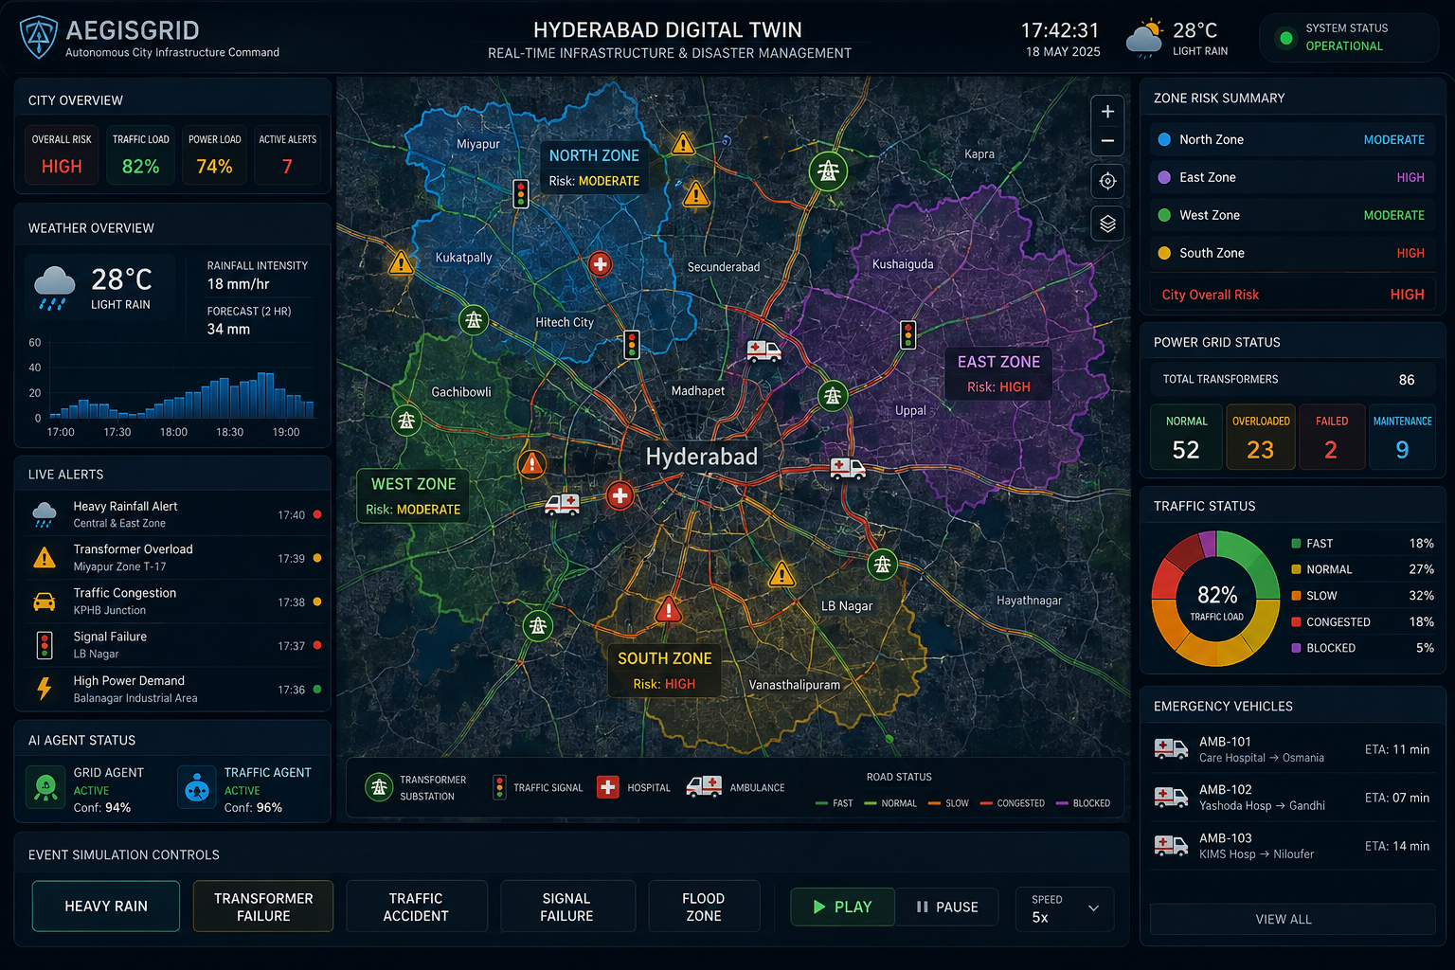
PRODUCT EXPERIENCE
The command center is the coordination point
Shared city context
Department portals retain their own operational tasks.
Visual reference only
Illustrative values in image
AEGISGRID
04
Notes:
Interface vision, 20 seconds. This image is the user's visual reference, not a screenshot of the finished product. It illustrates the intended city overview with department context. The implemented prototype already has department portals and central scenario controls, while visual refinement continues. All numbers inside the reference image are illustrative and are not evidence of measured system performance. Source: user-provided D:/download chrome/AegisGrid Hyderabad Command Center.png.

Slide 5
DEMO WALKTHROUGH
A rainfall scenario produces linked effects
1
Rainfall input
Operator selects a polygon and intensity.
2
Accumulation
Water rises according to rainfall and drainage.
3
Cross-domain effects
Road costs, metro demand and power load respond.
4
Approved action
A drainage action changes subsequent water levels.
AEGISGRID
05
Notes:
Demo story, 40 seconds. First draw a polygon and choose rainfall intensity. Advance the shared clock. Water accumulates according to the drainage assumptions and affects intersecting roads. Show the same rainfall context alongside metro queues and modeled power demand. Review a drainage recommendation, approve it and observe the changed drainage rate. The model is intentionally inspectable. Thresholds and cross-domain parameters still require calibration.

Slide 6
DATA FOUNDATION
Real geography anchors the simulation
374,988
57
5,220
Imported road segments
Parent metro stations
Electrical equipment assets
OSM reference geometry
GTFS locations and schedules
Generated database inventory
Reference data and generated operating data carry separate provenance.
AEGISGRID
06
Notes:
Data foundation, 30 seconds. The repository handoff records 374,988 imported road segments and 57 parent metro stations from the source timetable. The electrical inventory contains 5,220 generated equipment assets: 60 substations, 120 power transformers, 240 feeders and 4,800 distribution transformers. These are prototype dataset sizes, not claims of surveyed city coverage. OSM and GTFS provide reference geometry and schedules. Generated profiles fill missing operating measurements with explicit provenance. Source: D:/aegisgrid/SHARED_SIMULATION_HANDOFF.md, dataset snapshot documented on 4 September 2026.

Slide 7
TECHNICAL ARCHITECTURE
The backend owns the operating state
Inputs
Shared runtime
OSM and GTFS references
Stored profiles and operator scenarios
FastAPI model updates and routing
Supabase versioned run state
Operator portals
Optional adapters
Next.js command center
Traffic, ambulance, electricity and metro
Google data services and AI explanations
Hardware telemetry for a future pilot
AEGISGRID
07
Notes:
Architecture, 35 seconds. Next.js provides the operator portals. FastAPI coordinates model updates and routing. Supabase stores reference and generated data in separate projects, and a version-checked run record is the shared scenario authority. NetworkX routing uses source roads and scenario costs. Google services and language-model APIs are optional adapters, not the state authority. Rules currently drive the demonstrated drainage recommendation. API-key availability does not mean every integration is live. Source: repository handoff and prior implementation record.

Slide 8
WHY IT MATTERS
Every response has a traceable cause
Event context
All portals use the same scenario and clock.
Causal consequences
Operators can inspect why conditions changed.
Accountable actions
Supported approvals leave an event trail.
AEGISGRID
08
Notes:
Differentiation, 25 seconds. Our contribution is the coordination workflow: one event, shared consequences and a traceable action. A schedule-only transit map cannot by itself explain a rainfall-driven queue change, and a map alone does not record why a response was approved. AegisGrid brings these elements together in a prototype. We do not claim a competitive benchmark or fully autonomous city control.

Slide 9
PILOT AND IMPACT
A focused pilot can test the value
Pilot scope
Success measures
One area
One rainfall scenario
One authorized meter feed
Time to approved response
Routes through blocked roads
Queue growth and recovery
Agreement across portals
Impact targets require pilot measurement. No field savings claimed.
AEGISGRID
09
Notes:
Validation and adoption, 35 seconds. Begin with one area and one scenario family. Compare an uncoordinated baseline with the shared workflow using identical inputs. Measure decision time, blocked-route violations and queue recovery, rather than claiming an unmeasured percentage improvement. Potential pilot partners are traffic operators, metro operations and a utility or campus team. The first sensor connection can use an existing compatible meter. Commercial procurement and revenue are hypotheses, not traction.

Slide 10
THE ASK
Next stage: a validated coordination pilot
One area.
One shared scenario.
A measurable response.
Seeking next-round support and an operations partner
AEGISGRID
10
Notes:
Closing, 20 seconds. We have a working foundation for shared scenarios, source geography and department workflows. The next stage is to stabilize the interface, calibrate the model and validate one operational scenario with a partner. We seek advancement and domain feedback to make that pilot possible. Close with: AegisGrid helps departments reason about the same event before they act.

Slide 11
APPENDIX
Prototype status and integration boundaries
Prototype foundation
Work still required
Shared scenario clock and state
Rainfall and drainage rules
Road closure effects
GTFS-based train positions
Modeled demand and passenger queues
Map and movement refinement
Verified live weather / telemetry
Electrical protection and load-flow
Dynamic metro dispatch
Field calibration and pilot validation
AEGISGRID
11
Notes:
Appendix, use during questions. Implemented items reflect repository documentation, not a fresh full-system acceptance test. Current limitations include visual regressions under repair, process-local legacy corridor state, uncalibrated rain-to-demand relationships, no full electrical load-flow or protection model, and no live metro GPS or dynamic train dispatch. Google weather and LLM orchestration should be described as integrations to verify and complete, not deployed capabilities. Source: D:/aegisgrid/SHARED_SIMULATION_HANDOFF.md and this task's implementation history.

Slide 12
APPENDIX
Questions judges may ask
Is the data live?
Where does AI fit?
Source geography and timetables are real. Missing operating data is modeled.
Rules drive the current demo. AI explanation and advisory integration remain limited.
How does cost stay controlled?
Does it control city equipment?
Reuse meters, cap API calls and summarize stored readings.
No physical actuation in this prototype. Operators review simulated actions.
AEGISGRID
12
Notes:
Appendix answers. Are the measurements real? Reference road geometry and transit schedules come from source datasets. Missing electrical topology and operating measurements are explicitly modeled and stored in the database. Where is AI? Current demonstrated decisions use rules. An LLM can explain or summarize shared state, but proposed actions should pass deterministic checks and operator approval. What does it cost? Reuse existing meters, make bounded API calls, and retain summaries rather than all raw readings forever. Exact production cost needs a scoped pilot and vendor quotes. What stops unsafe action? This prototype does not control real utility protection, signal cabinets or trains. Only authorized integrations should ever enable operational writes.

