Slide 1
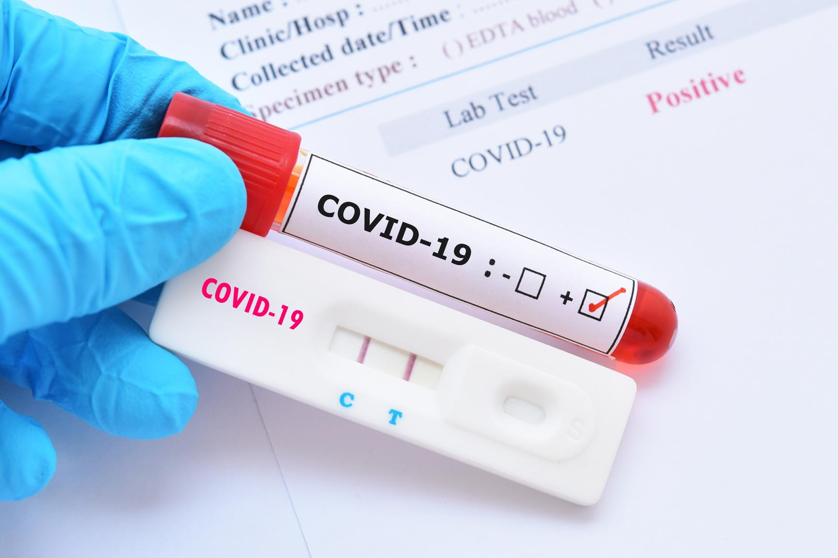
COVID-19 Testing
Management System
Team members:

Slide 2
Introduction
As the COVID-19 crisis endures and the virus continues to spread globally, the need for collecting epidemiological data and patient information also grows exponentially.
This COVID-19 testing management system is designed to overcome all types of challenges related to the management of diagnostic which were generally used to be handled locally and manually.
This system is an online COVID-19 lab manager application that brings up various COVID-19 test working online.
It will help us to maintain records of all transactions made at the daily tests and help to recognize all customers, employees etc.

Slide 3
Innovation
COVID-19 Testing Management System is web based technology which brings up various diagnosis works online.
Here patients are first allowed to register on the website and provide personal, test information. Once registered with their address and contact details etc., the patients may now see a variety of tests conducted by the lab.
The patient will select the required test and book appointment after that lab center send a lab boy at registered address to collect a sample.
After successful sample collection patient can track their test history using the name, order and registered mobile number.
The system allows admin to attach a copy of the report into the system and automatically shown on user side so user can downloads report.

Slide 4
Use cases
Incase if we have covid symptoms or become unwell for any reason, we have to go to a COVID-19 test lab center.
As covid cases are increasing there will be many patients who came for a checkup, so we have to wait in a queue. This increases the threat of covid cases increment a lot.
As Technology is growing rapidly we are also moving into a technical world where everything is online.
So with the help of this project we are bringing the use of technology in the field of medical diagnosis where patients can avail all the diagnosis facilities at their door steps without contact to others.
This project makes the diagnosis process easy and reduces the burden of patients. At a same time it helps the diagnostic center to track all their patient details with their respective test rep

Slide 5

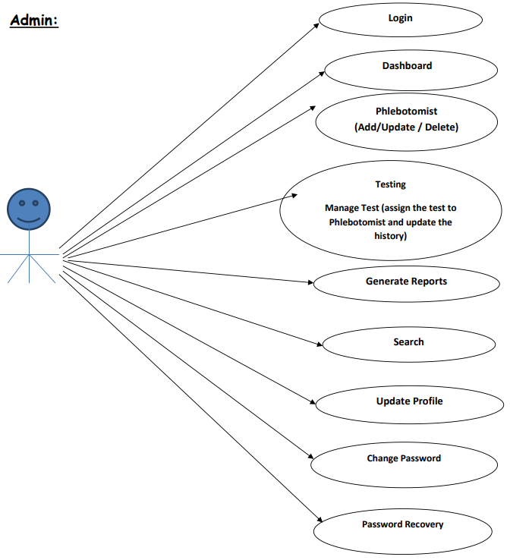
Admin

Slide 6
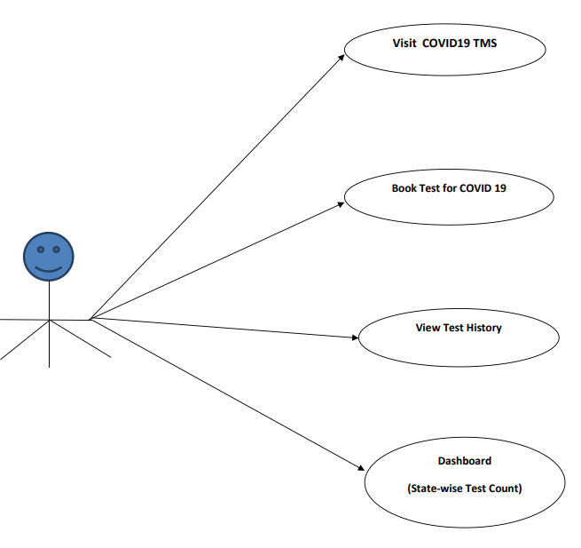
User(Patient)

Slide 7
Languages
CSS
JavaScript
Bootstrap
PHP
MySQL

Slide 8
AWS Services
AWS EC2 Instance:
An Amazon EC2 instance is a virtual server in Amazon's Elastic Compute Cloud (EC2) for running applications on the Amazon Web Services (AWS) infrastructure. You can use Amazon EC2 to launch as many or as few virtual servers as you need, configure security and networking, and manage storage. Amazon EC2 enables you to scale up or down to handle changes in requirements or spikes in popularity, reducing your need to forecast traffic.
AMAZON RDS:
Amazon RDS (Relational Database Service) is a fully-managed SQL database cloud service that allows to create and operate relational databases. Using RDS you can access your files and database anywhere in a cost-effective and highly scalable way.

Slide 9
Architecture Diagram

Slide 10
Outcome
COVID-19 Testing Management System is very much graceful and lively. This system can be implemented in diagnostic labs and clinics.
It provides a friendly graphical user interface which proves to be better when compared to the existing system.
It will minimize the risk of losing any sort of data because all sort of patient details and transactions are recorded on the system.
It gives appropriate access to the authorized users depending on their permissions.
It effectively overcomes the delay in communications.
Updating and storage of information becomes so easier.
The System has adequate scope for modification in future.

