Slide 1
SYSTEM USING AIML PRESENTED BY : M.SAI KIRAN 322129512067
AIR QUALITY PREDICTION

Slide 2
> WHAT IS AIR POLLUTION > WHAT IS AIR QUALITY INDEX > WHAT IS AIR QUALITY PREDICTION SYSTEM > THE PROBLEM STATEMENT > HOW MACHINE LEARNING CAN BE USED IN THIS PROJECT > WHAT ARE THE STEPS INVOLVED > CODE FOR PROGRAM > OUTPUT FOR PROGRAM > CONCLUSION
CONTENTS :

Slide 3
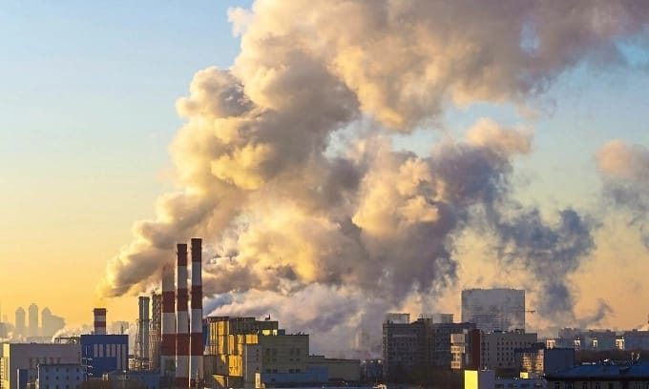
AIR POLLUTION :
AIR POLLUTION IS THE COMBINATION OF THE AIR BY HARMFUL SUBSTANCES INCLUDING GASES , PARTICLES , AND BIOLOGICAL MOLECULES , THAT CAN NEGATIVELY IMPACT HUMAN HEALTH AND THE ENVIRONMENT .
THESE POLUTANTS CAN BE FOUND BOTH OUTDOORS AND INDOORS , AND CAN STEM FROM NATURAL SOURCES LIKE WILDFIRES OR HUMAN ACTIVITIES LIKE BURNING FOSSIL FUELS .

Slide 4
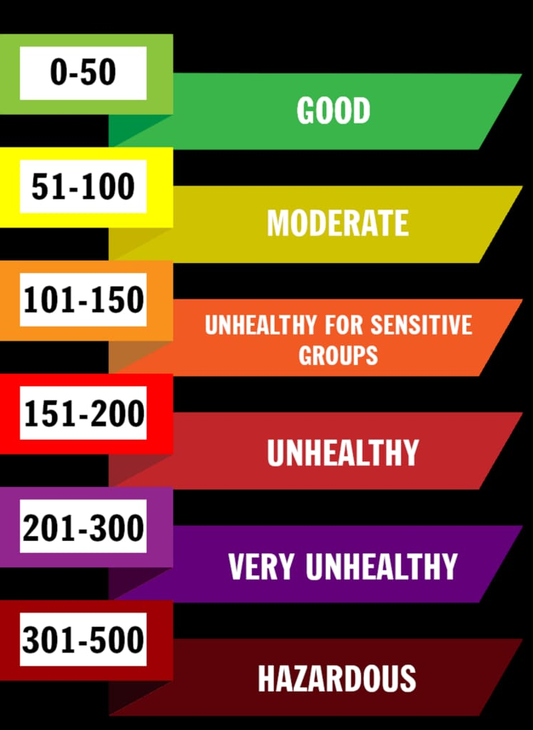
AIR QUALITY INDEX :
THE AIR QUALITY INDEX (AQI) IS A NUMERICAL SCALE USED TO COMMUNICATE THE DAILY AIR QUALITY STATUS TO THE PUBLIC .
AQI INCLUDES SIX COLORED – CODED CATEGORIES .
IT TRANSLATE THE LEVELS OF VARIOUS AIR POLLUTANTS INTO A SINGLE , EASY TO UNDERSTAND NUMBER AND CORRESPONDING COLOR CODE , ALONG WITH HEALTH ADVISORY INFORMATION .
THE HIGHER THE AQI VALUE THE GREATER THE LEVEL OF AIR POLLUTION AND THE GREATER THE HEALTH CONCERN

Slide 5
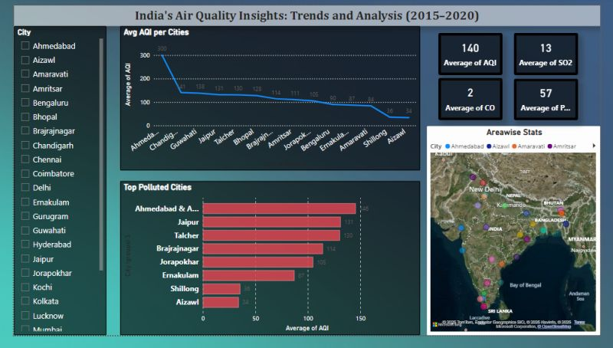
AIR QUALITY PREDICTION SYSTEM :
AN AIR QUALITY PREDICTION SYSTEM USES DATA ANALYSIS , MODELING AND FORECASTING TECHNIQUES TO ESTIMATE FUTURE AIR QUALITY CONDITIONS .
THESE SYSTEMS HELPS IN UNDERSTANDING THE SOURCES AND TRENDS OF AIR POLLUTION , ENABLING TIMELY INVENTIONS AND PUBLIC AWARENESS .
THEY UTILIZE DATA FROM MONITORING STATIONS , METEROLOGICAL MODELS , AND OTHER SOURCES TO PREDICT AIR QUALITY METRICS LIKE THE AIR QUALITY INDEX (AQI)

Slide 6
PROBLEM STATEMENT :
PREDICTION OR FORECAST OF AIR QUALITY OR THE CONCENTRATION LEVEL OFDAY BY DAY THE AIR POLLUTION BECOMES SERIOUS CONCERN IN INDIA AS WELL AS IN OVERALL WORLD.
PROPER OR ACCURATE OTHER AMBIENT AIR POLLUTANTS SUCH AS SULPHUR DIOXIDE , NITROGEN DIOXIDE , CARBON MONOXIDE , PARTICULAR MATTER HAVING DIAMETER LESS THAN 10MICRO , PARTICULATE MATTER HAVING DIAMETER LESS THAN 2.5MICRO , OZONE ETC…IS VERY IMPORTANT BECAUSE IMPACT OF THESE FACTORS ON HUMAN HEALTH BEComes severe .
This literature review focuses on the various techniques used for prediction or modelling of air quality index(aqi) and forecasting of future concentration levels of pollutants that may cause the air pollution so that governing bodies can take the actions to reduce the pollution .

Slide 7
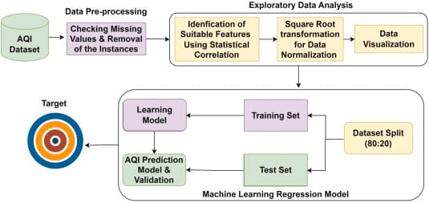
HOW AIML CAN BE USED IN THIS PROJECT :
ARTIFICIAL INTELLIGENCE AND Machine learning (ai&ml) are being increasingly used in air quality monitoring and prediction systems to improve accuracy and efficiency .
It includes 3 processes :
data preprocessing
Exploratory data analysis
Machine learning regression model

Slide 8
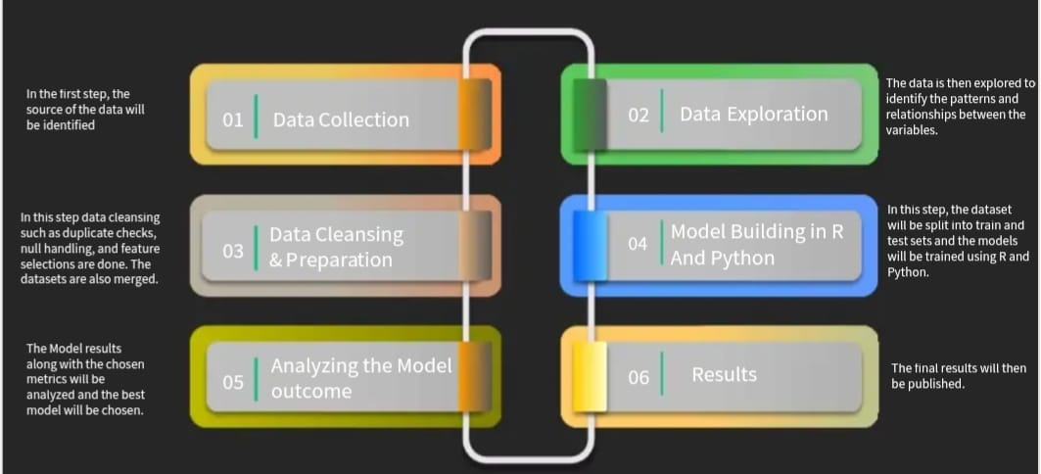
STEPS INVOLVED :

Slide 9
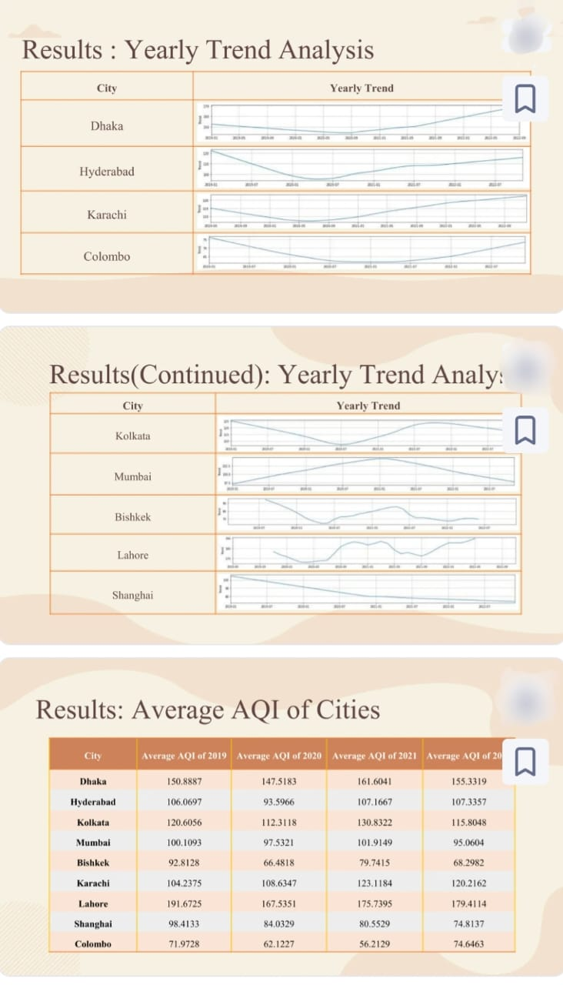
OUTPUT :

Slide 10
CONCLUSION :
THE MODEL RESULTS FROM R AND PYTHON SUGGEST THAT NO2 AND CO ARE BETTER PREDICTORS FOR AQI IN COMPARISION WITH OTHER POLLUTANTS .
THOUGH OZONE WAS NOT A STRONG PREDICTOR FOR AQI AS PER THE MODEL , THE EFFECTS OF OZONE CANNOT BE UNDERMINED AS IT CAN HAVE DETRIMENTAL EFFECTS ON AIR QUALITY , SO IT WAS INCLUDED DURING THE MODEL BUILDING .
ADDITIONAL MODELS SUCH AS CLUSTERING CAN BE BUILT TO IDENTIFY THE CLUSTERS OF REGIONS WITH HIGHER AQI .
ALSO CLUSTERING BASED ON THE PERIOD OF THE YEAR CAN BE BUILT TO IDENTIFY PATTERNS IN THE PERIOD OF THE YEAR WHEN THE AIR IN THOSE REGIONS IS MOST POLLUTED .

Slide 11


