Slide 1
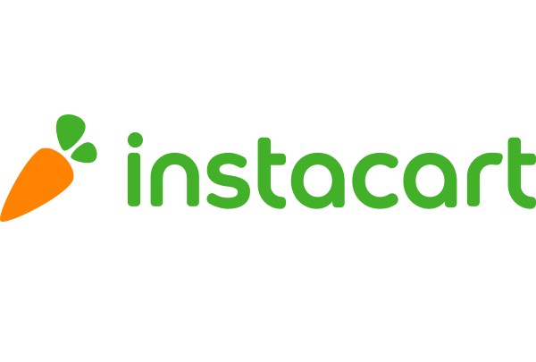
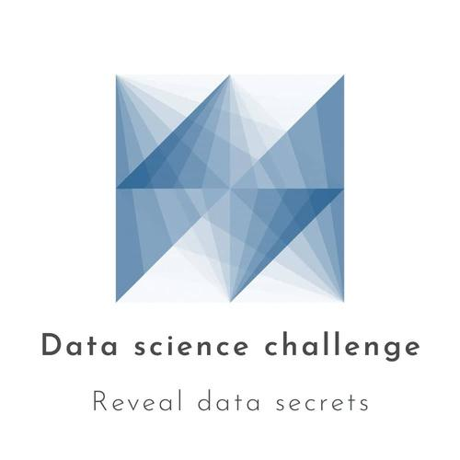

Recommendation using Customer Segmentation and Market Basket Analysis

Slide 2
Problem Definition
To develop a system that efficiently identifies associations and patterns in purchase data to generate personalized product recommendations for users on the Instacart platform.

Slide 3
Analysis Model
Problem formulation
What do we want? We want to predict the products that will be in user's next future order.
Forming the data: We take each user with his/her previously ordered products, and form each record to be a user-product pair.
Then using cluster and relation rules, we can see whether this user will order or not this product in his/her future order.
Let's extract features that relate to this user-product pair.

Slide 4
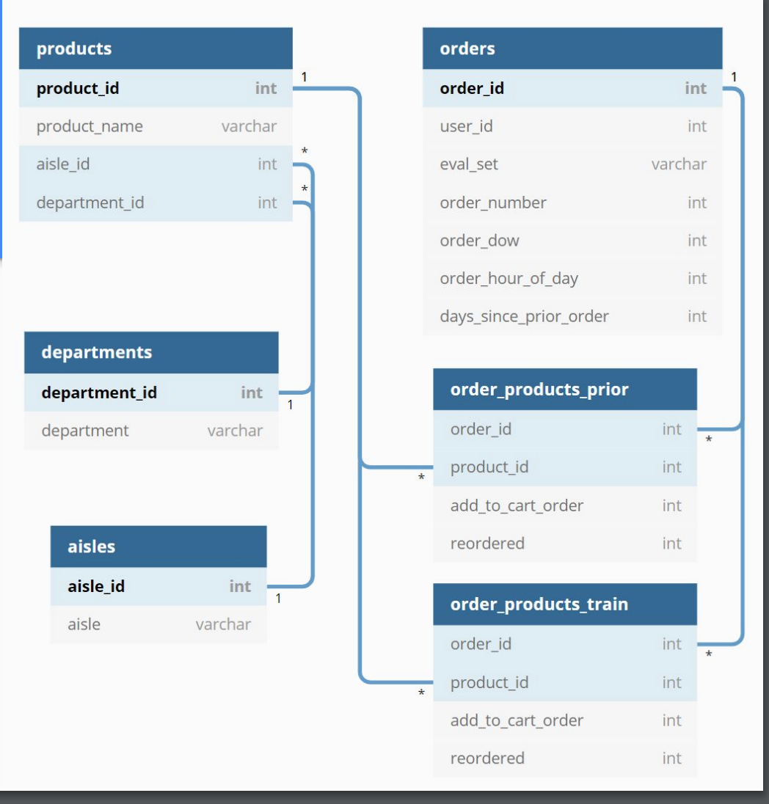
Data Description
Aisles [~134 sub-department]
21 Departments
134 Aisles
49,688 Products
206,209 Users
3,421,083 Orders...

Slide 5
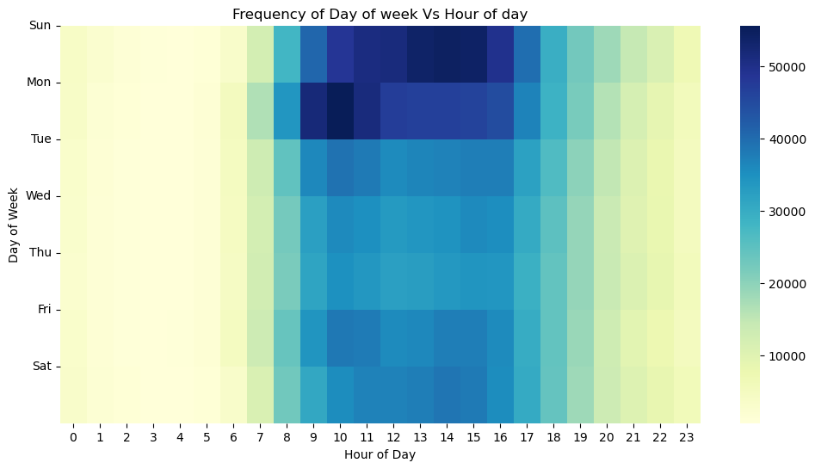
EDA
Peak ordering times are midday across all days, with evenings being the next busiest.
The least active hours are early morning (1-5 AM).
Sundays and Mondays show the highest overall ordering activity, indicating the start of the week as prime grocery shopping time.

Slide 6
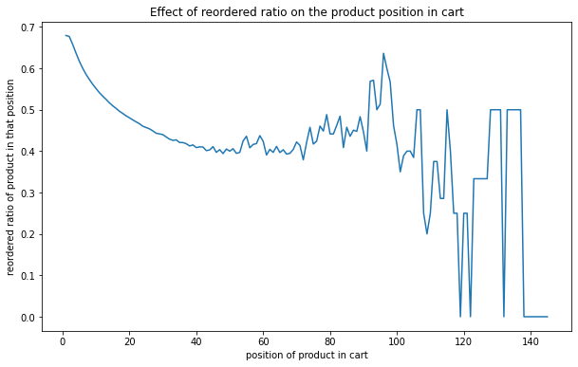
EDA
Intuitively, products placed first in cart are the products mostly reordered.
People tend to put first the products they already know.

Slide 7
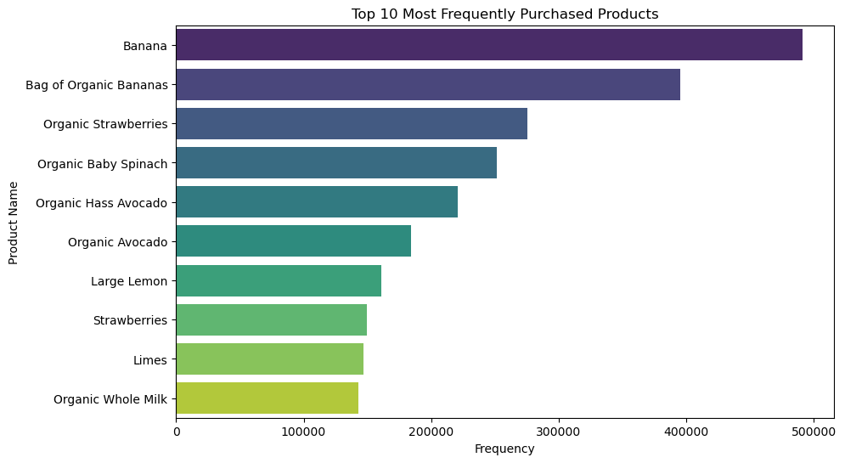
EDA
Analyzing products
5 Most Ordered Products
Banana
Bag of Organic Bananas
Organic Strawberries
Organic Baby Spinach
Organic Hass Avocado
14% of all purchases are bananas.
Organic products are frequently ordered.

Slide 8
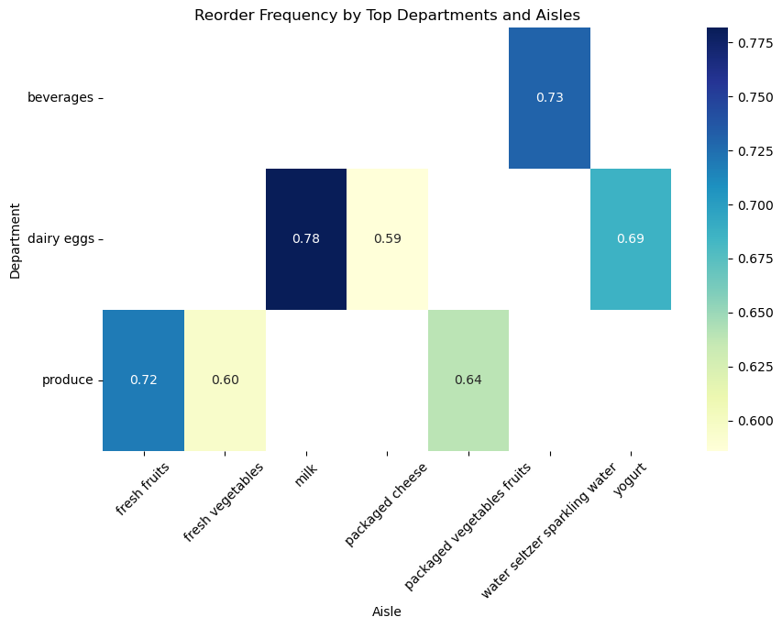
EDA
Reorder Frequency Heatmap
Beverages and dairy products, particularly yogurt, show strong customer repurchase patterns.
Produce items like fresh fruits and vegetables have varied reorder frequencies, indicating a mix of staple and occasional purchases.
Prioritize stock replenishment for high-frequency items to maintain supply with demand.

Slide 9
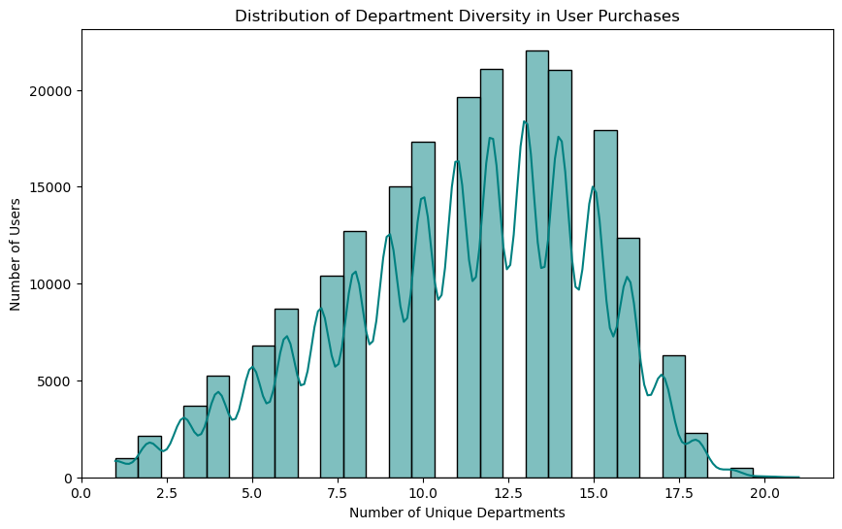
EDA
Analyzing Customer Purchase Diversity Across Departments
Most users purchase from a range of 10 to 15 unique departments, indicate a moderate to high level of diversity.
Fewer users shop at either a very low (0-5) or very high (15-20) number of unique departments.
Targeting users who shop from fewer departments could be a strategy to increase the breadth of their purchases by introducing them to a wider array of products.

Slide 10
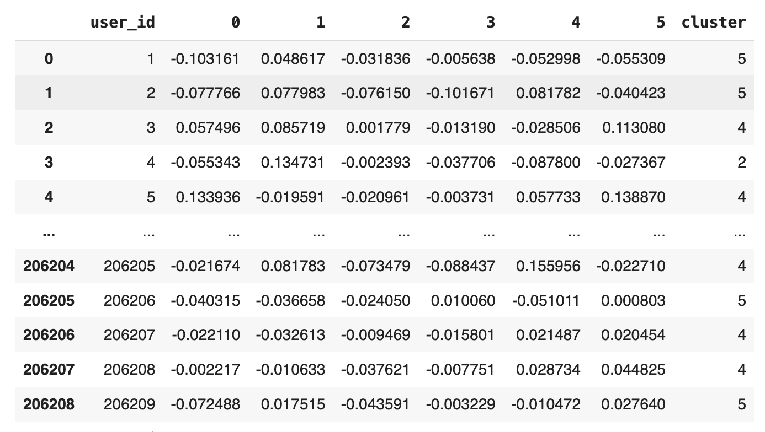
K-means Clustering
Clustering users based on purchase behavior using K-means.
Each user is assigned a cluster number reflecting their purchasing pattern.

Slide 11
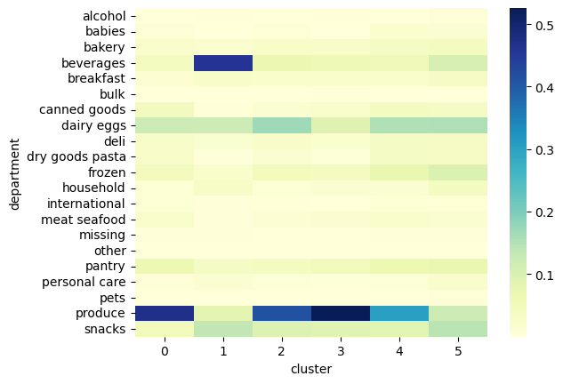
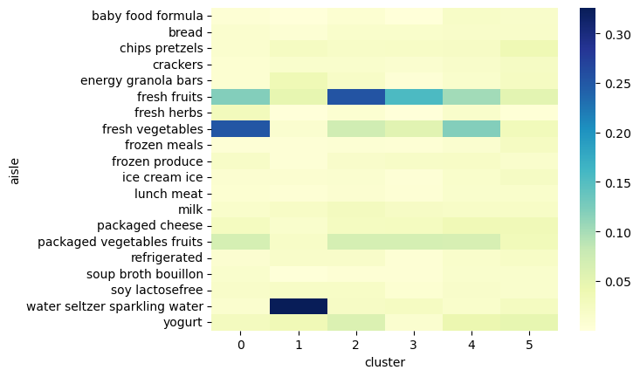
K-means Clustering
Department Preferences by Customer Cluster
Aisle Preferences by Customer Cluster

Slide 12
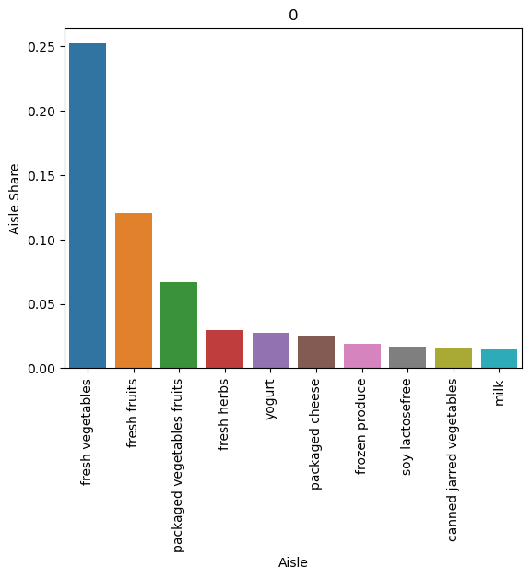
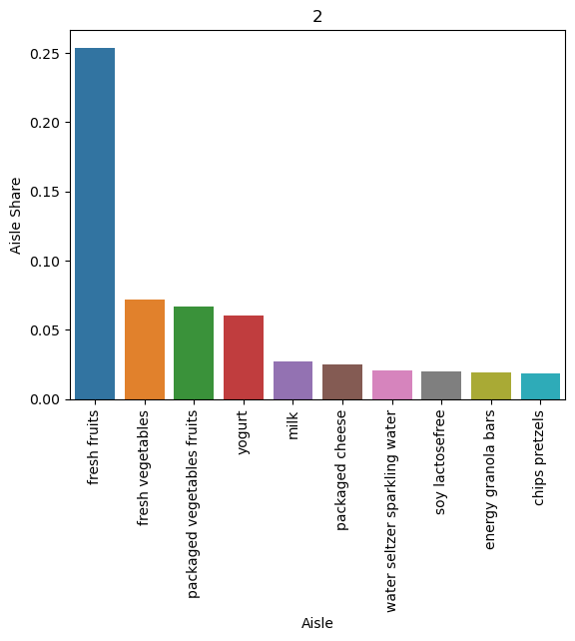
K-means Clustering
Top aisle purchases visualized for individual clusters.
Identifies cluster-specific product affinities.
Helps tailor recommendations to cluster-specific popular products.
Bar Chart of Aisle Shares per Cluster 0
Bar Chart of Aisle Shares per Cluster 2

Slide 13
Association Rules
Association rule finds interesting association or correlation relationships among set of data items ( products )
which is used for decision-making processes.

Slide 14
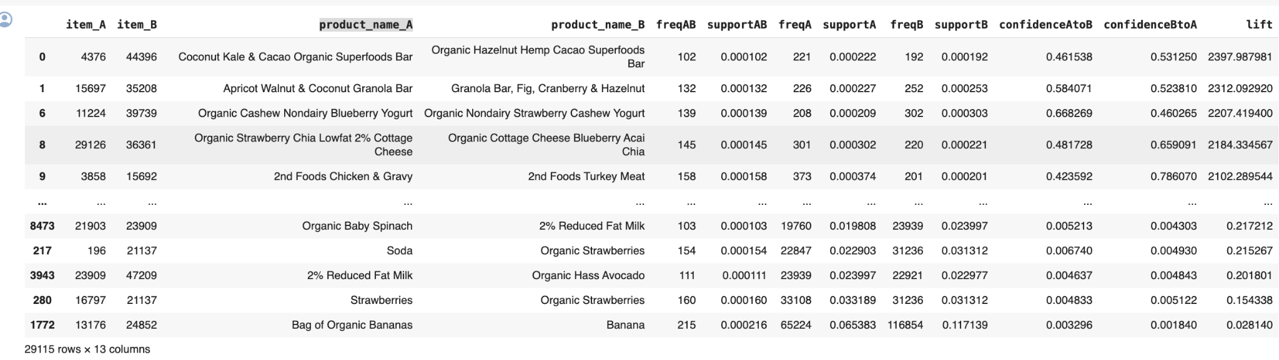
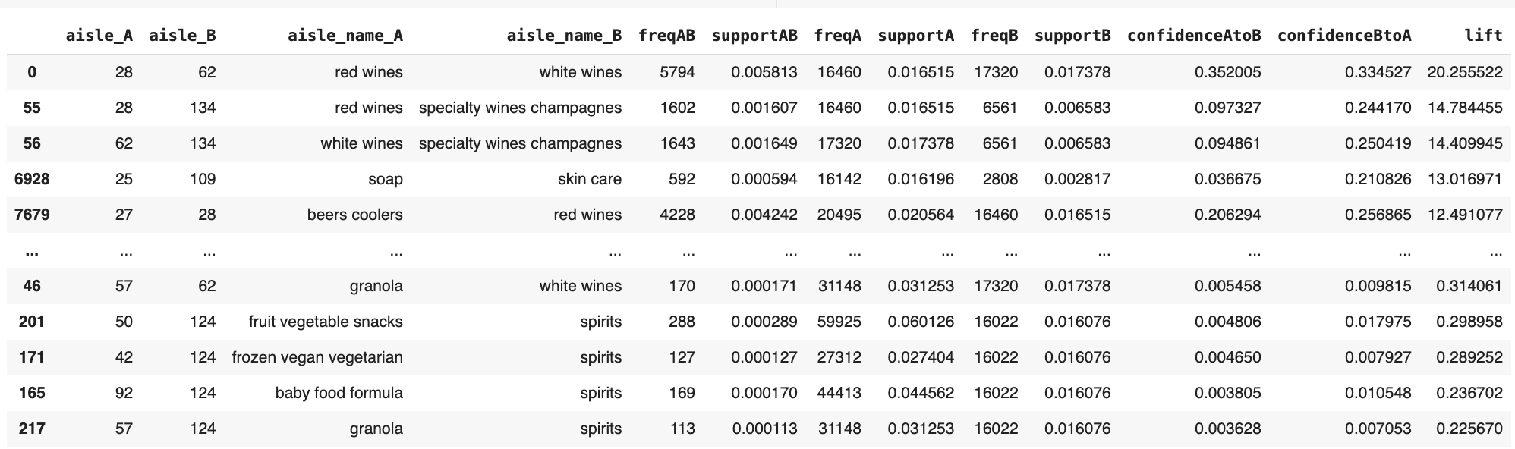
Association Rules
Cluster-Specific Product Pairing
Cluster-Specific Aisle Pairing

Slide 15
Recommendation
Clustering Users: Segment users into clusters based on purchase behavior using K-means on PCA-reduced features.
Mining Association Rules: Identify frequent itemsets and calculate support, confidence, and lift for each cluster.
Building Rule Sets: Construct actionable rules from itemsets, filtering by confidence and lift thresholds.
Developing Recommendation Engine: Create functions to match users to clusters and retrieve cluster-specific rules.
Generating Recommendations: Recommend items with strong association rules to the input product for the user's cluster.
Delivering Recommendations: Present a sorted list of recommended products, excluding the input item.

Slide 16
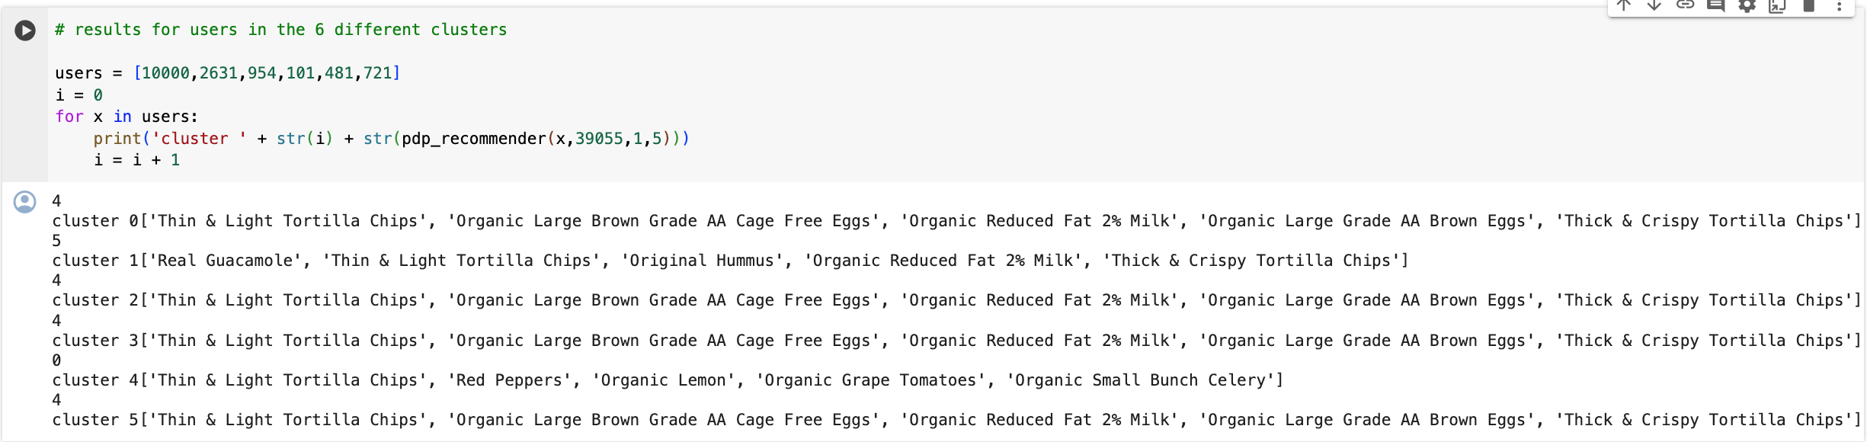
Recommendation

Slide 17
Conclusion
User shopping experience can be much enhanced if considered applying user-centric recommenders and associations.
From analysis, recommendation can differ according to time.

