Slide 1
Sales & Financial Dashboard - Tableau Dashboard Analysis
Insights from Sales Data & Financial Performance
Presenter : [PARAPATLA SAI KUMAR]
Date : [25 September 2025]

Slide 2
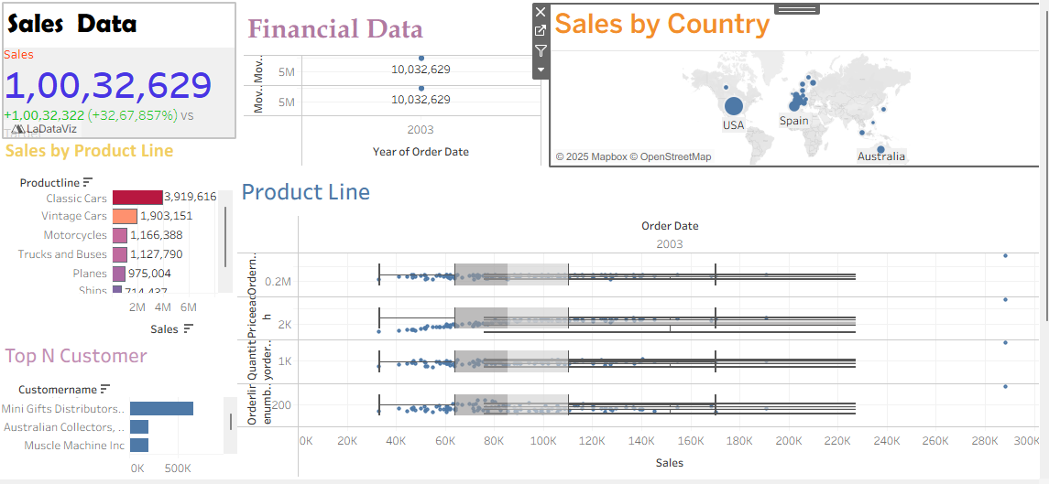
Introduction & Dashboard Purpose
Objective: Provide stakeholders with a clear view of sales and financial performance.
Key Questions: - What are the overall sales trends?
- Which product lines and countries drive performance?
- Who are the top customers?
Data Source: Sales Data Sample (Excel).

Slide 3
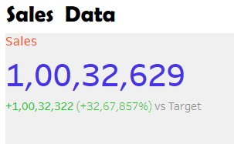
Key Sales Metrics
Total Sales: Example 1,00,32,629
YoY Growth: Example +32,67,857%

Slide 4
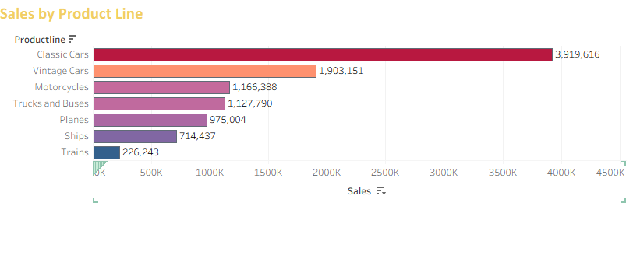
Sales Performance by Product Line
Detailed view of sales distribution across product lines.
Identify top performing lines (e.g., Classic Cars, Vintage Cars).
Highlight areas with potential improvement.

Slide 5
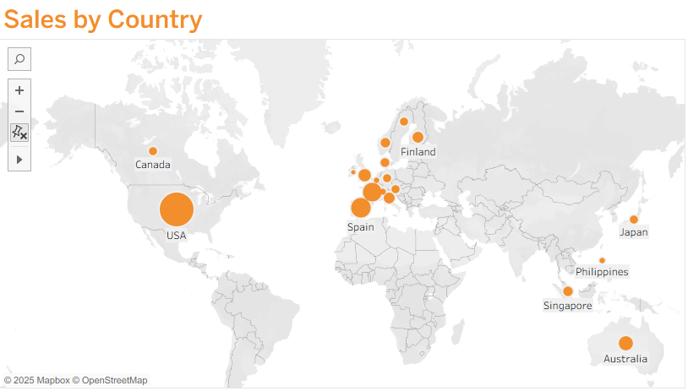
Global Sales by Country
Analysis of sales by region and country.
Identify strongest markets (e.g., USA, Spain, Australia).
Spot underperforming regions for strategic action.

Slide 6
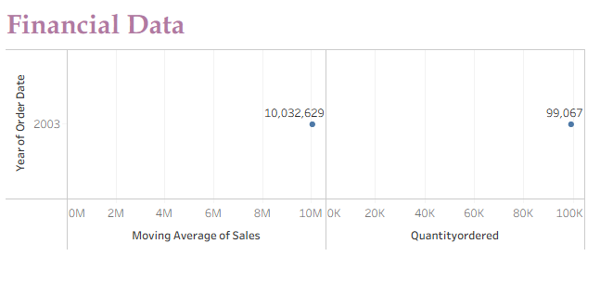
Sales Trend Analysis
Sales performance visualized across time.
Identify seasonality and trend patterns.
Spot sudden changes or growth opportunities.

Slide 7
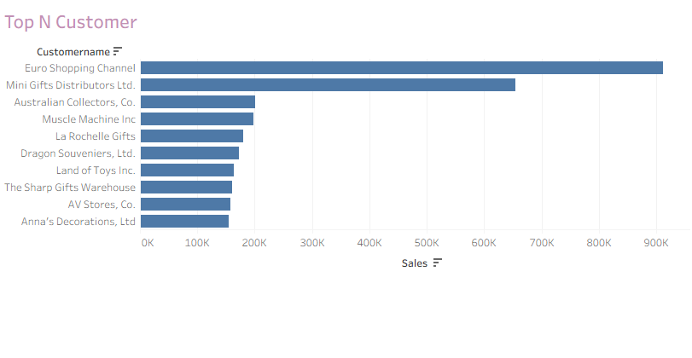
Identifying Top Customers
Highlight most valuable customers by sales contribution.
Support account management and retention strategies.

Slide 8
Summary & Next Steps
Key Takeaways:
- Sales growth observed across multiple product lines.
- Strongest markets identified geographically.
- Top customers driving revenue highlighted.
Recommendations:
- Focus on underperforming product lines.
- Strengthen presence in low-performing regions.
- Develop loyalty programs for top customers.
Call to Action: Further explore profitability metrics and customer segmentation.

