Slide 1
Ethereum and Dogecoin closing price forecasting
Jagath Sai Narayana Kakaraparty
Nisarg Negi
Yashesh Pandya
Siddhi Jadhav

Slide 2
Introduction
Ethereum and Dogecoin are an alternative to traditional cryptocurrencies like Bitcoin.
Thousands of computers around the world compete to mine these cryptocurrencies. As their popularity has surged, competition of mining of these cryptocurrencies has increased too.
Just like Bitcoin, Ethereum’s and Dogecoin’s prices are based on global marketplace of supply and demand and hence, their prices can keep fluctuating.
Our aim is to build an accurate forecasting model for the closing price of the Ethereum and Dogecoin cryptocurrencies using the dataset.

Slide 3
Data and description
The dataset consists of history of daily prices of Ethereum and Dogecoin cryptocurrencies from the period 09-Aug-2015 to 07-Jul-2021. We will be using two datasets one for the forecasting the value of Ethereum cryptocurrency while the other one for forecasting the value of Dogecoin cryptocurrency. The data has been referred from Kaggle. The features present in this dataset and it’s description are as follows:
SNo (integer)- Serial Number: Unique identifier of the Ethereum/Dogecoin dataset.
Name (string) : Name of the coin
Symbol (string) - Symbol or Acronym associated with Ethereum/Dogecoin
Date (Date time in form of string): Time and Date of when the instance was created
High (float) - The greatest value of the coin at that time
Low (float)- The lowest value of the coin at that time
Open (float)- Opening price on the given day
Close (float)- Closing price on the given day
Volume (float)- Volume of transactions on the given day
Marketcap (float)- Market capitalization in USD or the total value of all the coins that have been mined in USD.

Slide 4
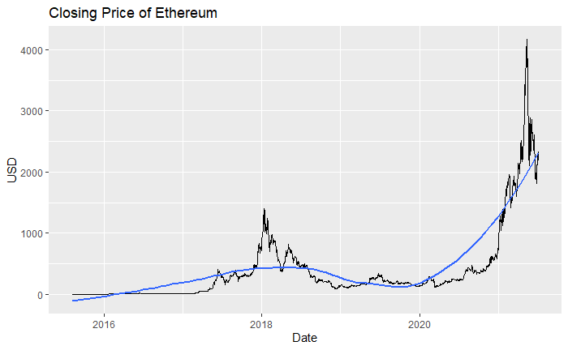
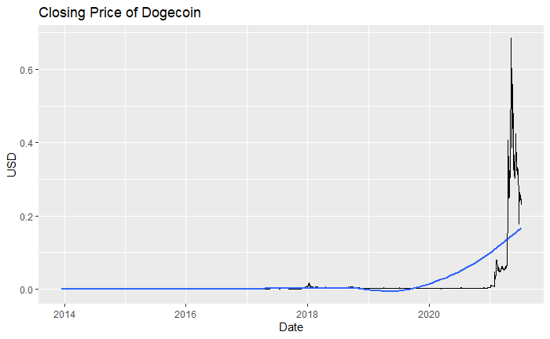
Time series plot

Slide 5
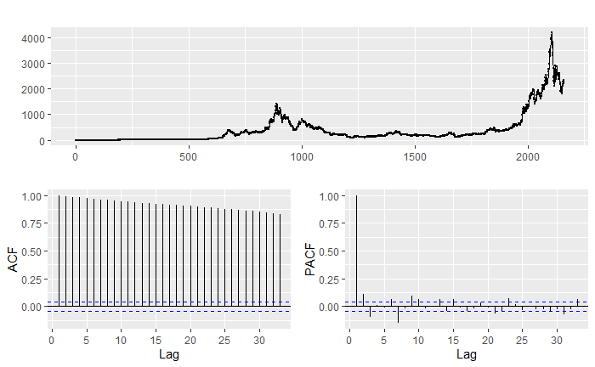
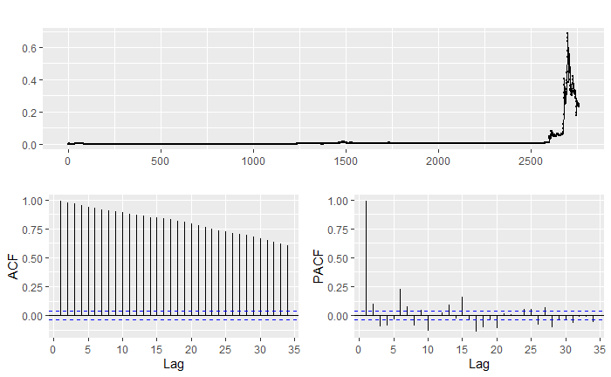
ACF and PACF plots
Ethereum ACF and PACF plots
Dogecoin ACF and PACF plots

Slide 6
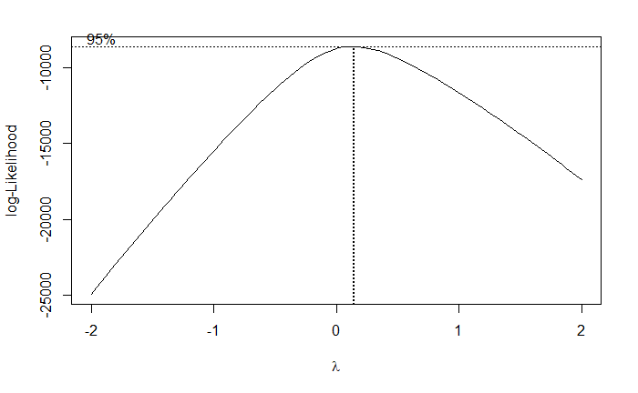
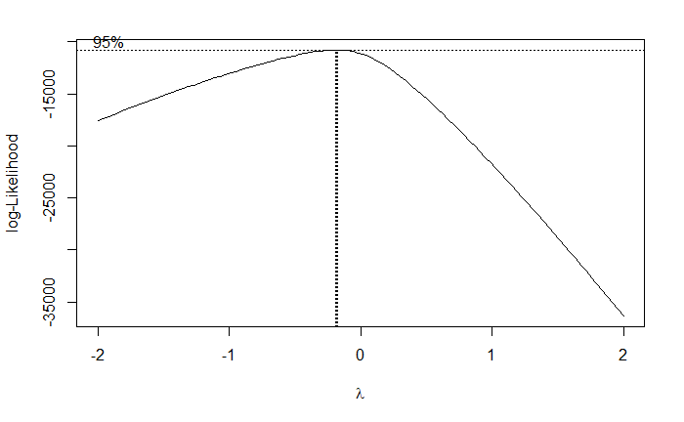
BoxCox Transformation – Estimating the value of λ
Ethereum Log-likelihood plot
Dogecoin Log-likelihood plot
λ = 0.1414141
λ = -0.1818182

Slide 7
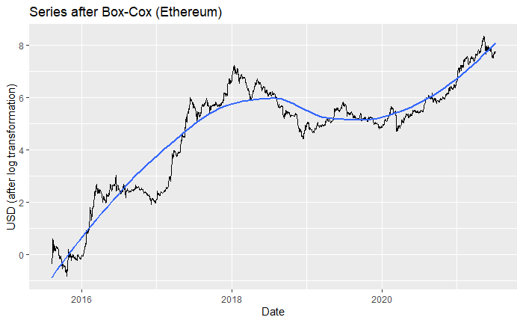
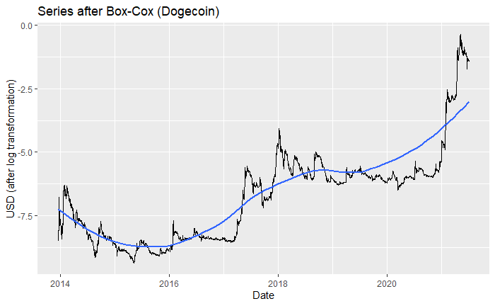
BoxCox Transformation – Transformed Time series plot

Slide 8
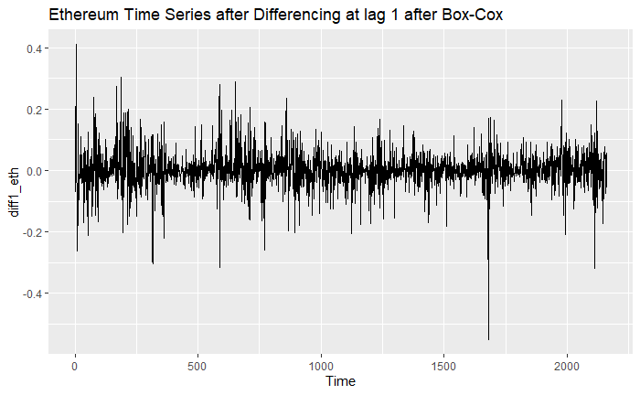
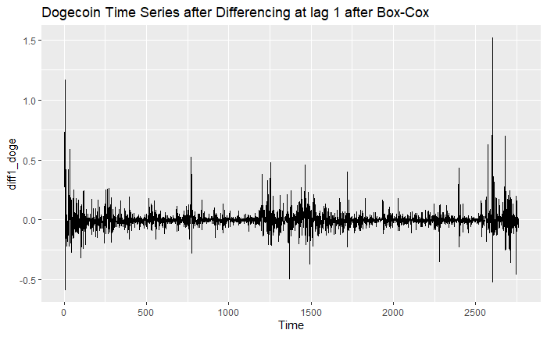
Differencing at Lag 1

Slide 9


Dickey-Fuller test
Dickey-Fuller test to determine if the Ethereum data is stationary:
Dickey-Fuller test to determine if the Dogecoin data is stationary:

Slide 10
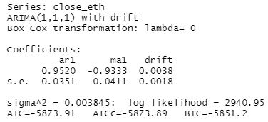
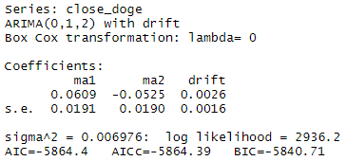
ARIMA model fit and accuracy
Ethereum
Dogecoin

Slide 11
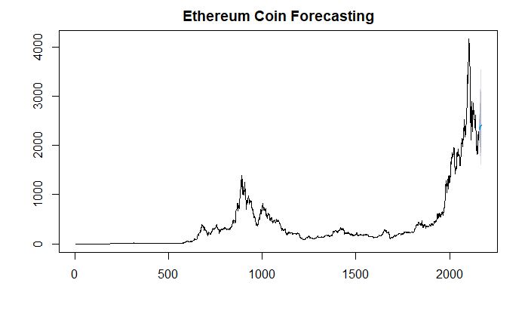
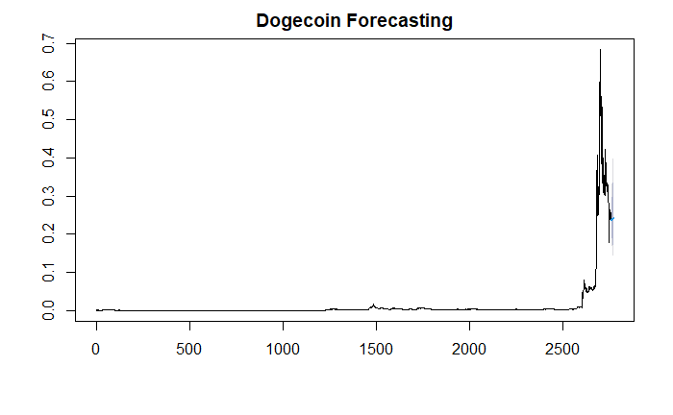


Forecast

Slide 12
Thank You!

