Slide 1
Faithful Benchmark for Information-Seeking Dialogue
Jagath Sai Narayana Kakaraparty
Siddhi Jadhav
Briyana Rana

Slide 2
Problem Statement
With the increasing use of information-seeking dialogue systems, it is necessary that the response utterances to the queries from seekers be supported by the ground truth.
Although there are several models that generate natural language (human-like) responses, many encounter the problem of generating factually incorrect responses termed as “Hallucination” which need to be addressed.
We build a model that trains on the conversation history and underlying knowledge to generate hallucination-free’ responses to seeker queries using targeted responses as the human annotated data (golden responses) taken from FaithDial.

Slide 3
Approach
We aim to approach the problem by performing three main tasks which are as given below:
Using the conversation history and underlying knowledge, we determine if the original responses were hallucinated or not.
Using the conversation history and underlying knowledge, we determine different labels of VRM taxonomies.
Using the conversation history and underlying knowledge, we generate hallucination-free responses to conversation history/seeker queries.

Slide 4
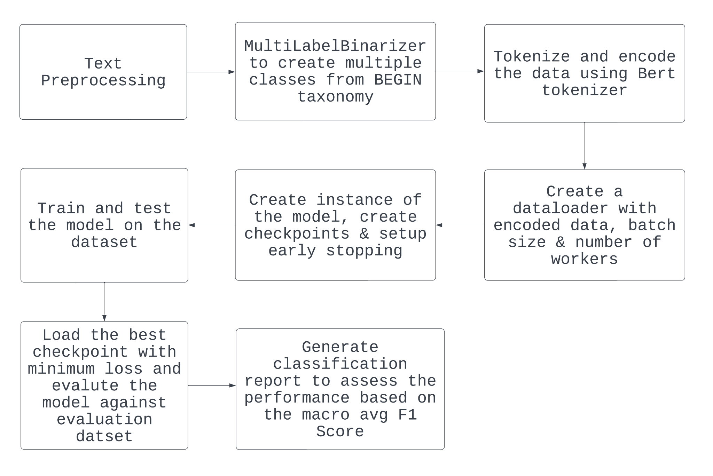
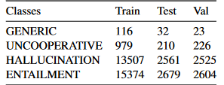
Multi Class Classification of BEGIN taxonomy

Slide 5
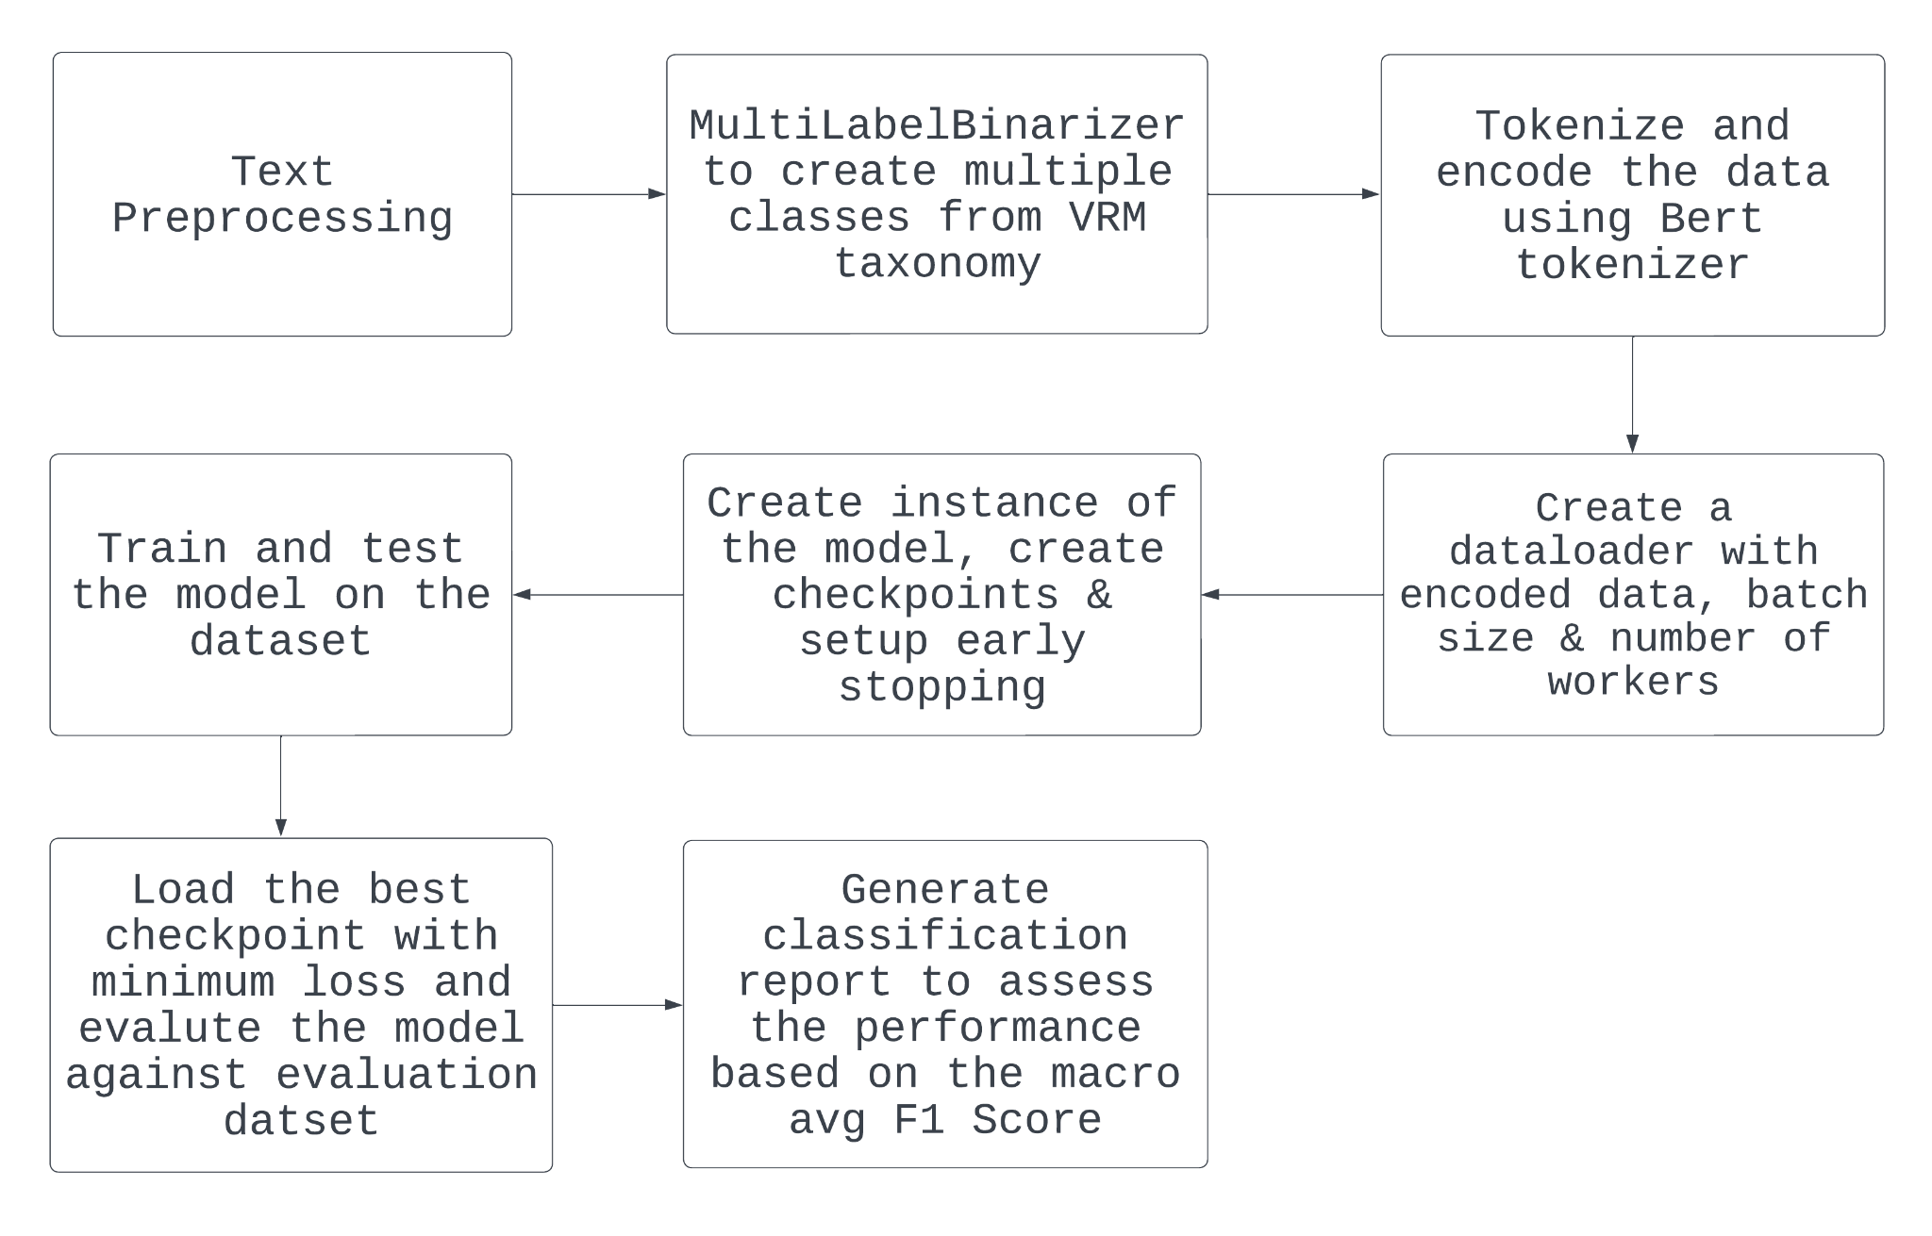
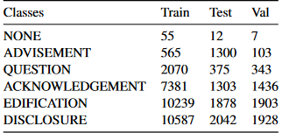
Multi Label Classification of VRM taxonomy

Slide 6
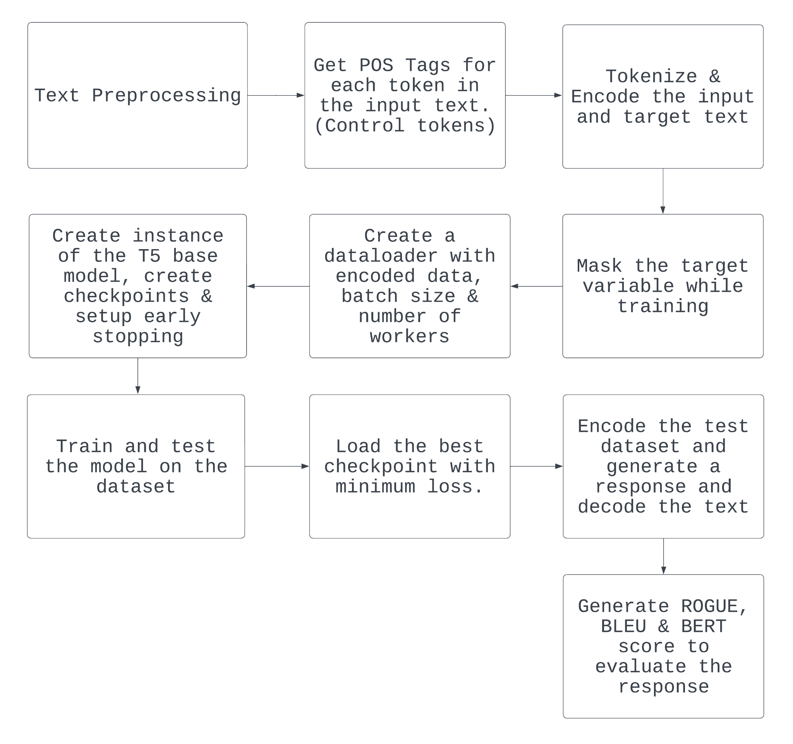
Text generation using T5-base

Slide 7
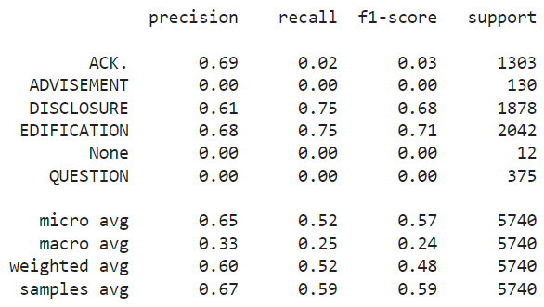
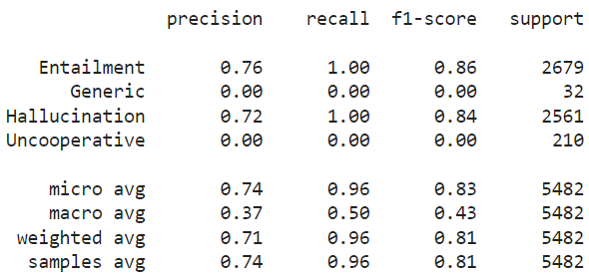
Results of Classification using BERT
Classification report of BEGIN
Classification report of VRM

Slide 8
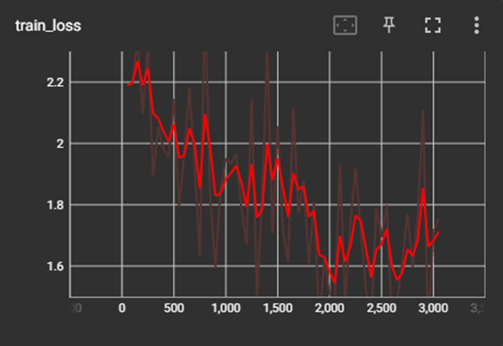
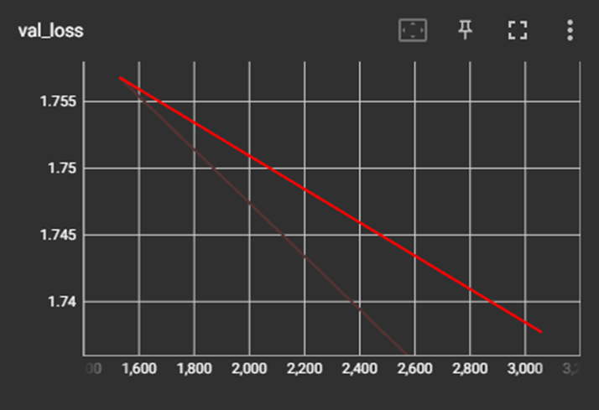
Text generation using T5 (Loss Logs)

Slide 9
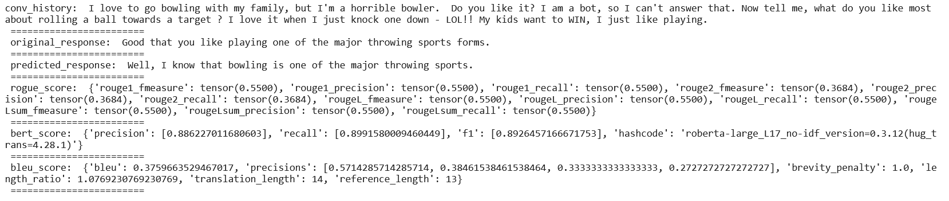
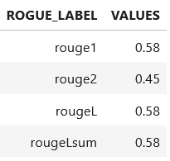
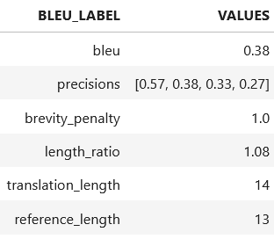
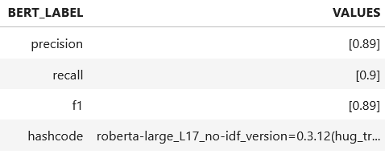
Results for Text generation using T5

Slide 10
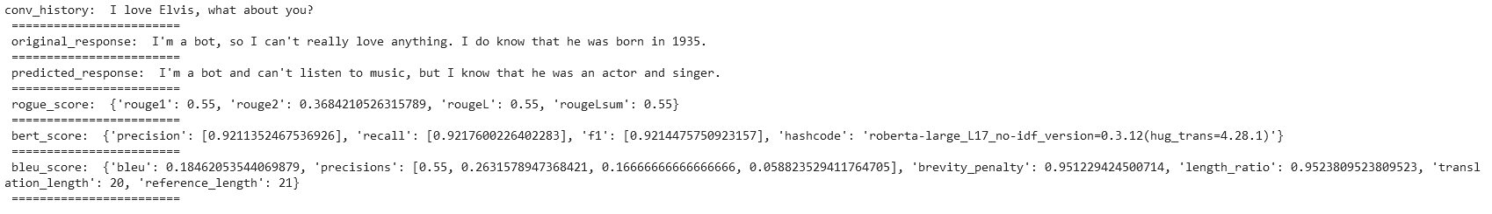
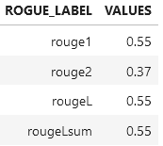
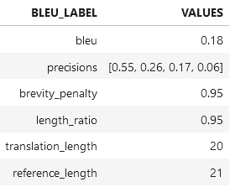
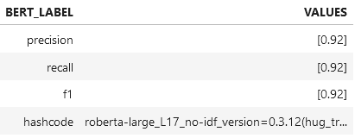
Results for Text generation using T5

Slide 11
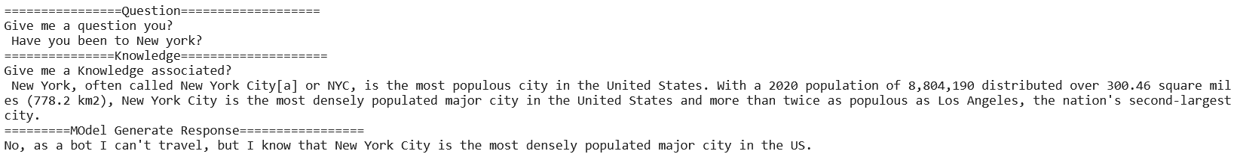
Text Generation of the model on Manual input

Slide 12
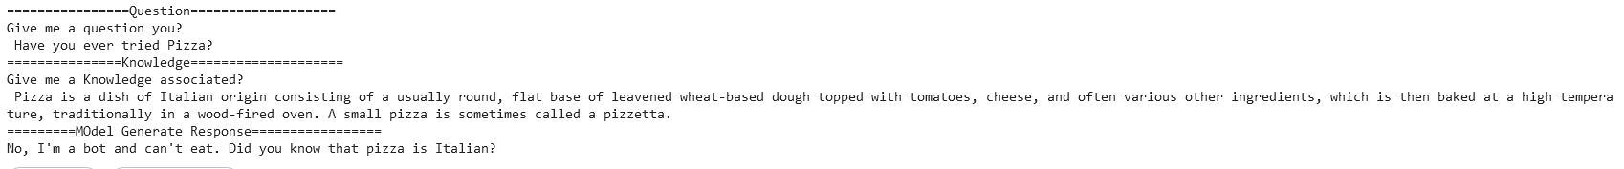
Text Generation of the model on Manual input

Slide 13
Future Improvement
As the current model is heavily relying on the knowledge present in the dataset. For future, we can improve the model by crawling through the wikipedia to gather the information
Utilizing active learning techniques to improve the efficiency of dataset annotation and model training.
Deploying the model as a conversational agent and collecting user feedback to further improve the quality and naturalness of generated responses.

Slide 14
THANK YOU!
Q/A

